Slide 1
Presenter
DeviNanjappan
Principal
[FACULTY OF NURSING]

Slide 2
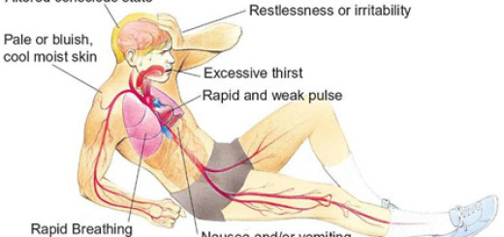
Definition
Shock is the state of insufficient blood flow to the tissues of the body as a result of problems with the circulatory system.
Shock is defined as a state of cellular and tissue hypoxia due to either reduced oxygen delivery, increased oxygen consumption, inadequate oxygen utilization, or a combination of these processes

Slide 3
Incidence
This most commonly occurs when there is circulatory failure manifested as hypotension (ie, reduced tissue perfusion);
It is crucial to recognize that a patient in shock can present hypertensive, normotensive, or hypotensive. Shock is initially reversible,
It must be recognized and treated immediately to prevent progression to irreversible organ dysfunction.

Slide 4
Causes
Shock is a common end point of many medical conditions.
Shock itself is a life-threatening condition as a result of compromised body circulation
Type | Cause
Low volume | Fluid loss such as bleeding or diarrhea
Heart | Ineffective pumping due to heart damage
Obstructive | Blood flow to or from the heart is blocked
Distributive | Due to abnormal flow within the small blood vessels

Slide 5
Risk factors
Advancing age
Have a history of heart failure or heart attack.
Have blockages (coronary artery disease) in several of your heart's main arteries.
Have diabetes or high blood pressure.
female.

Slide 6
Prevention
Shock can be prevented by reducing the incidence of the causes, such as heart failure, injuries, dehydration

Slide 7
Types of shock
Septic shock results from bacteria multiplying in the blood and releasing toxins. Common causes of this are pneumonia, urinary tract infections, skin infections (cellulitis), intra-abdominal infections (ruptured appendix), and meningitis.
Anaphylactic shock is a type of severe hypersensitivity or allergic reaction. Causes include allergy to insect stings, medicines, or foods (nuts, berries, seafood).
Cardiogenic shock happens when the heart is damaged and unable to supply sufficient blood to the body. This can be the end result of a heart attack or congestive heart failure.
Hypovolemic shock is caused by severe blood and fluid loss, such as from traumatic bodily injury, which makes the heart unable to pump enough blood to the body, or severe anemia where there is not enough blood to carry oxygen through the body.
Neurogenic shock is caused by spinal cord injury, usually as a result of a traumatic accident or injury.

Slide 8
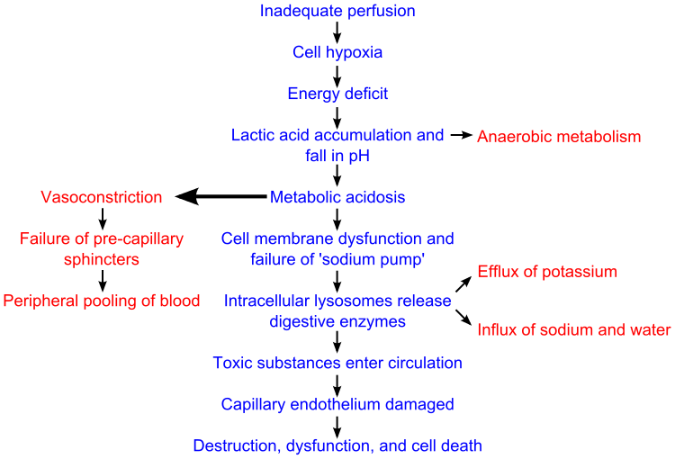
Pathophysiology

Slide 9
Clinical S/S
Signs common to most forms of shock
Pallor, mottled skin, cold extremities, sweating and thirst.
Rapid and weak pulse often only detected on major arteries (femoral or carotid).
Low blood pressure (BP), narrow pulse pressure, BP sometimes undetectable.
Capillary refill time (CRT) > 3 seconds.
Cyanosis, dyspnoea, tachypnoea are often present in varying degrees depending on the mechanism.
Consciousness usually maintained, but anxiety, confusion, agitation or apathy are common.
Oliguria or anuria.

Slide 10
Clinical S/S
Anaphylactic shock
Significant and sudden drop in BP
Tachycardia
Frequent cutaneous signs: rash, urticaria, angioedema
Respiratory signs: dyspnoea, bronchospasm
Septic shock
High fever or hypothermia (< 36 °C), rigors, confusion
BP may be initially maintained, but rapidly

Slide 11
Clinical S/S
Cardiogenic shock
Respiratory signs of left ventricular failure (acute pulmonary edema) are dominant:
tachypnoea, crepitations on auscultation.
Signs of right ventricular failure: raised jugular venous pressure, hepatojugular reflux,

Slide 12
Diagnosis
The aetiological diagnosis is oriented by: – The context: trauma, insect bite, ongoing medical treatment, etc. – The clinical examination: • fever • skin pinch consistent with dehydration • thoracic pain from a myocardial infarction or pulmonary embolus • abdominal pain or rigidity of the abdominal wall from peritonitis, abdominal distension from intestinal obstruction • blood in stools, vomiting blood in intestinal haemorrhage • subcutaneous crepitations, likely anaerobic infection

Slide 13
In case of Sepsis

Slide 14
Treatment
In all cases
Emergency: immediate attention to the patient.
Warm the patient, lay him flat, elevate legs (except in respiratory distress, acute pulmonary edema).
Insert a peripheral IV line using a large caliber catheter (16G in adults). If no IV access, use intraosseous route.
Oxygen therapy, assisted ventilation in the event of respiratory distress.
Assisted ventilation and external cardiac compression in the event of cardiac arrest.
Intensive monitoring: consciousness, heart rate, BP, CRT, respiratory rate, hourly urinary output (insert a urinary catheter) and skin mottling.

Slide 15
Treatment
Management according to the cause
Haemorrhage
Control bleeding (compression, tourniquet, surgical haemostasis)
Determine blood group.
Priority: restore vascular volume as quickly as possible:
Insert 2 peripheral IV lines (2 catheters 16G in adults).
Ringer lactate or 0.9% sodium chloride: replace 3 times the estimated losses and/or plasma substitute: replace 1.5 times the estimated losses
Transfuse: classically once estimated blood loss represents approximately 30 to 40% of blood volume (25% in children). The blood must be tested (HIV, hepatitis B and C, syphilis, malaria in endemic areas, etc.)

Slide 16
Treatment
Severe acute dehydration due to bacterial/viral gastroenteritis
Urgently restore circulating volume using IV therapy with Ringer lactate:
As soon as the patient is able to drink (often within 2 hours), provide oral rehydration solution (ORS) as the patient tolerates.
Closely monitor the patient;

Slide 17
Treatment
Severe anaphylactic reaction
Administer epinephrine (adrenaline) IM, into the anterolateral part of the thigh, in the event of hypotension, pharyngolaryngeal oedema, or breathing difficulties:
At the same time, administer rapidly Ringer lactate or 0.9% sodium chloride: 1 litre in adults (maximum rate); 20 ml/kg in children, to be repeated if necessary.
repeat IM epinephrine every 5 to 15 minutes.
In patients with bronchospasm, epinephrine is usually effective. If the spasm persists give 10 puffs of inhaled salbutamol.

Slide 18
Treatment
Septic shock
Vascular fluid replacement with Ringer lactate or 0.9% sodium chloride or plasma substitute.
Use of vasoconstrictors:
dopamine IV at a constant rate by syringe pump: 10 to 20 micrograms/kg/minute or, if not available epinephrine IV at a constant rate by syringe pump: Use a diluted solution, i.e. add 1 mg epinephrine (1:1000) to 9 ml of 0.9% sodium chloride to obtain a 0.1 mg/ml solution (1:10 000). Start with 0.1 microgram/kg/minute. Increase the dose progressively until a clinical improvement is seen.

Slide 19
Treatment
The objective is to restore efficient cardiac output.
The treatment of cardiogenic shock depends on its mechanism.
In the event of worsening signs with vascular collapse, use a strong cardiotonic: dopamine IV at a constant rate by syringe pump : 3 to 10 micrograms/kg/minute
Once the hemodynamic situation allows (normal BP, reduction in the signs of peripheral circulatory failure), nitrates or morphine may be cautiously introduced.
Digoxin should no longer be used for cardiogenic shock, except in the rare cases when a supraventricular tachycardia has been diagnosed by ECG. Correct hypoxia before using digoxin. digoxin slow IV: Adults: one injection of 0.25 to 0.5 mg, then 0.25 mg 3 or 4 times per 24 hours if necessary
Cardiac tamponade: restricted cardiac filling as a result of haemopericardium or pericarditis. Requires immediate pericardial tap after restoration of circulating volume.
Tension pneumothorax: drainage of the pneumothorax.
Symptomatic pulmonary embolism: treat with an anticoagulant in a hospital setting.

Slide 20
Know the differences
heart attack
Blood supply to the heart muscle is reduced or blocked, but the heart keeps beating; however, there may be damage to the heart muscle.
Usually, the person knows something is happening, and can talk about his or her symptoms
sudden cardiac arrest The electrical system of the heart goes wrong (think of the way the lights flash before the power goes out), and the heart stops pumping blood.
Usually, the person is unconscious, and a pulse may not be found.

