Slide 1
Coronary artery disease (CAD) Presenter: DeviNanjappan

Slide 2
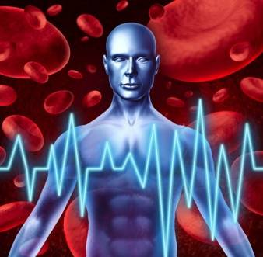
Hi Neelam.,
Coronary Artery Disease
Overview
Definition
Incidence
Risk factor and its prevention
Pathophysiological clinical features
Diagnosis
Management
EBP

Slide 3
Overview: heart disease
Most men and women do not know that heart disease is their own greatest health risk
Heart disease is largely preventable
It can take action to protect their hearts
Heart disease is a “now” problem
“Later” may be too late
There are many forms of heart disease
Coronary artery disease, or coronary heart disease, is most common
Heart disease develops over years and progresses when the heart doesn’t get enough nutrient-rich blood

Slide 4
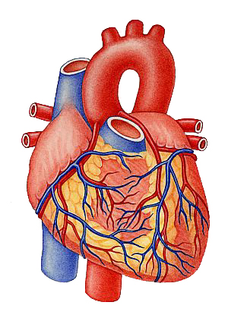
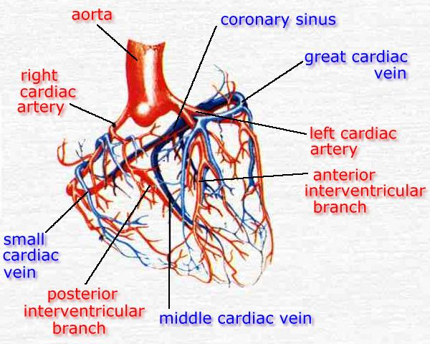
Review: Coronary blood supply

Slide 5
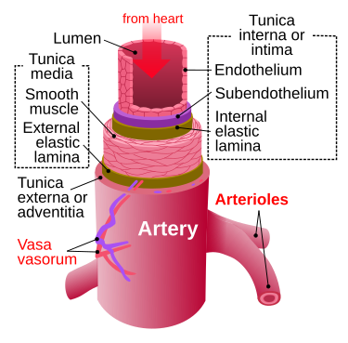
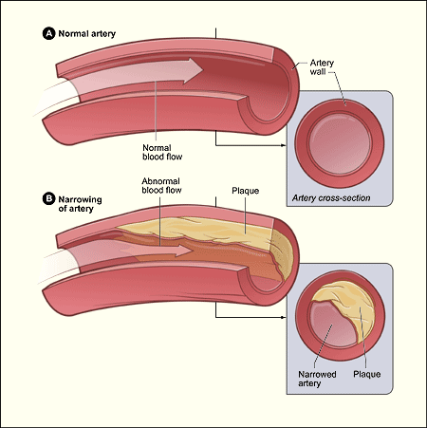
DEFINITION: Coronary artery Disease (CAD/CHD/HD)
It involves the reduction of blood flow to the heart muscle due to build-up of plaque (atherosclerosis) in the arteries of the heart. It is the most common of the cardiovascular diseases
Atherosclerosis is a disease in which the inside of an artery narrows due to the buildup of plaque

Slide 6
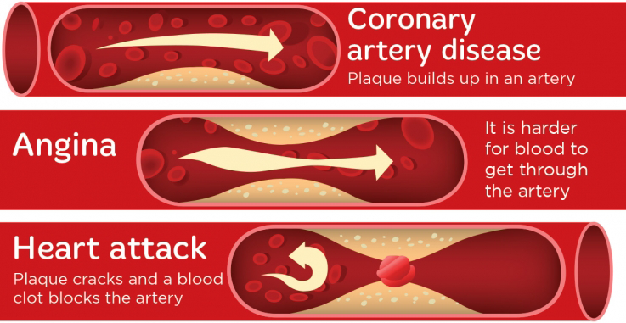
CAD ……
Coronary artery disease is the narrowing or blockage of the coronary arteries, usually caused by atherosclerosis. Atherosclerosis (sometimes called "hardening" or "clogging" of the arteries) is the buildup of cholesterol and fatty deposits (called plaques) on the inner walls of the arteries.

Slide 7
Incidence
CAD affected 110 million people and resulted in 8.9 million deaths
The risk of death from CAD for a given age decreased between 1980 and 2010, especially in developed countries
Globally CVD deaths represent about 30% of all death
Coronary artery disease (CAD) is the leading cause of cardiovascular mortality worldwide, with >4.5 million deaths occurring in the developing world. both CAD mortality and the prevalence of CAD risk factors continue to rise rapidly in developing countries.
58 million disability adjusted life years (DALYs) lost due to CHD worldwide

Slide 8
The Epidemiologic Transition
Stages :
Pestilence and Famine,
Receding Pandemics,
Degenerative and Man-made Diseases,
Delayed Degenerative Diseases.
Movement through these stages has resulted in a dramatic shift to CVD and cancer in most high-income countries over the last two centuries.
Between 1990 and 2020, coronary heart disease alone is anticipated to increase by 120% for women and 137% for men in developing countries

Slide 9
Risk factor
These include high blood pressure, smoking, diabetes, lack of exercise, obesity, high blood cholesterol, poor diet, depression, family history, and excessive alcohol
Smoking and obesity are associated with about 36% and 20% of cases
Lack of exercise has been linked to 7–12% of cases.
Job stress appears for about 3% of cases
heritability of coronary artery disease has been estimated between 40% and 60%
Blood fat,Endometriosis in women under the age of 40
In the Asian population, the b fibrinogen gene G-455A polymorphism was associated with the risk of CAD

Slide 10
heart disease Risk factors
The Multiplier Effect
1 risk factor doubles your risk
2 risk factors quadruple your risk
3 or more risk factors can increase your risk more than tenfold
Primary Prevention
By doing just 4 things – eating right, being physically active, not smoking, and keeping a healthy weight – you can lower your risk of heart disease by as much as 82 percent

Slide 11
Prevention(90 % )
eating a healthy diet, regularly exercising, maintaining a healthy weight, and not smoking (Evidence also suggests that the Mediterranean diet⁾
Medications for diabetes, high cholesterol, or high blood pressure are sometimes used.
. Effective lifestyle changes include:
Weight control
Smoking cessation
Avoiding the consumption of trans fats (in partially hydrogenated oils)
Decreasing psychosocial stress
Exercise:Aerobic exercise, like walking, jogging, or swimming

Slide 12
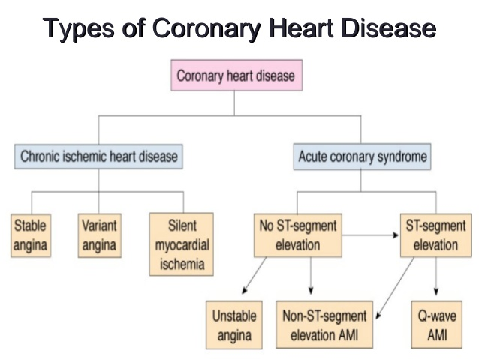

Slide 13
Pathophysiology
Limitation of blood flow to the heart causes ischemia (cell starvation secondary to a lack of oxygen) of the heart's muscle cells.
The heart's muscle cells may die from lack of oxygen and this is called a myocardial infarction (commonly referred to as a heart attack).
It leads to damage, death, and eventual scarring of the heart muscle without regrowth of heart muscle cells.
Chronic high-grade narrowing of the coronary arteries can induce transient ischemia
which leads to the induction of a ventricular arrhythmia,
which may terminate into a dangerous heart rhythm known as ventricular fibrillation,
leads to sudden death

Slide 14
Clinical Features
chest pain or discomfort that occurs regularly with activity, after eating, or at other predictable times; this phenomenon is termed stable angina and is associated with narrowing of the arteries of the heart. Angina also includes chest tightness, heaviness, pressure, numbness, fullness, or squeezing
Angina that changes in intensity, character or frequency is termed unstable. Unstable angina may precede myocardial infarction
Angina, shortness of breath, sweating, nausea or vomiting, and lightheadedness are signs of a heart attack, or myocardial infarction
For women of all races is shortness of breath: extreme fatigue, sleep disturbances, shortness of breath, indigestion, and anxiety
On average, women experience symptoms 10 years later than men. Women are less likely to recognize symptoms and seek treatment.

Slide 15
Diagnosis
Baseline electrocardiography (ECG)
Exercise ECG – Stress test
Exercise radioisotope test (nuclear stress test, myocardial scintigraphy)
Echocardiography (including stress echocardiography)
Coronary angiography
Intravascular ultrasound
Magnetic resonance imaging (MRI)
Risk assessment
age, gender, diabetes, total cholesterol, HDL cholesterol, tobacco smoking and systolic blood pressure

Slide 16
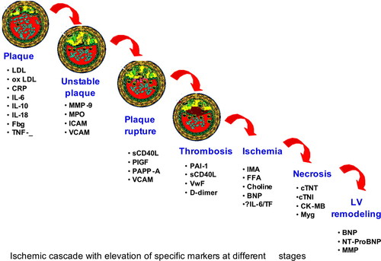

Slide 17
Treatment
There are a number of treatment options for coronary artery disease:
Lifestyle changes
Medical treatment – drugs (e.g., cholesterol lowering medications, beta-blockers, nitroglycerin, calcium channel blockers, etc.);
Coronary interventions as angioplasty and coronary stent;
Coronary artery bypass grafting (CABG)
Medications
Statins, which reduce cholesterol, reduce the risk of coronary artery disease
Nitroglycerin
Calcium channel blockers and/or beta-blockers
Antiplatelet drugs such as aspirin , Clopidogrel plus aspirin
Surgery
Angioplasty
Bypass graft
PCI

Slide 20
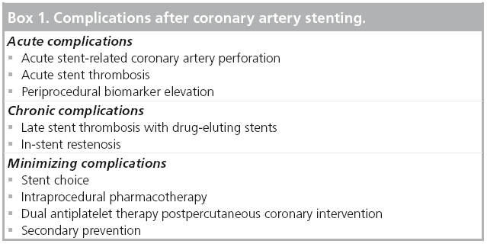

Slide 21
Evidence
Dietary changes can decrease coronary artery disease. For example, data supports benefit from a plant-based diet and aggressive lipid lowering to improve heart disease
Stem cell therapy

Slide 22
Myocardial Infarction(MI)/heart attack Presenter: DeviNanjappan

Slide 23
Hi Neelam.,
Myocardial Infarction
Overview
Definition
Incidence (same as CAD )
Risk factor and its prevention
Pathophysiological :types
clinical features
Diagnosis ,complication
Management
EBP

Slide 24
MI defined……
Myocardial ischemia that results from a perfusion-dependent imbalance between supply and demand leads to myocyte necrosis which develops progressively depending on different factors (organ, species, cardiac work, duration of ischemia, collateral blood flow, etc
Myocardial infarction is an ischemic necrosis of the myocardium, caused by occlusion of coronary artery and prolonged myocardial ischemia. Infarction produces necrosis characterized by loss of myocardial structure and cell death; this is followed by tissue repair including formation of scar.
MI is an extreme consequence of acute coronary syndromes – the spectrum of clinical states caused by instability of coronary artery lumen due to plaque instability and (athero)thrombosis

Slide 25
Incidence
An estimated 35 lives per 1000 patients treated are saved when thrombolysis is used within the first hour of symptom onset, compared with 16 lives saved per 1000 treated when given 7 to 12 hours after symptom onset. The most common cause of death and disability in the western world and worldwide is coronary artery disease
There are 32.4 million myocardial infarctions and strokes worldwide every year.
Patients with previous myocardial infarction (MI) are the highest risk group for further coronary events.
Survivors of MI are at increased risk of recurrent infarctions and have an annual death rate of 5% - six times that in people of the same age who do not have coronary heart disease.

Slide 26
Etiology
Myocardial infarction is closely associated with coronary artery disease:
Smoking
Abnormal lipid profile/blood apolipoprotein (raised ApoB/ApoA1)
Hypertension
Diabetes mellitus
Abdominal obesity (waist/hip ratio) (greater than 0.90 for males and greater than 0.85 for females)
Psychosocial factors such as depression, loss of the locus of control, global stress, financial stress, and life events including marital separation, job loss, and family conflicts
Lack of daily consumption of fruits or vegetables
Lack of physical activity

Slide 27
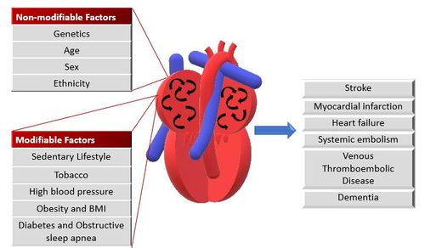

Slide 28
Prevention
Evidence based interventions for secondary prevention include the use of aspirin, beta-blockers, angiotensin converting enzyme inhibitors;
lipid lowering drugs and other anti- hypertensives, as well as modifying lifestyle related risk behaviours

Slide 29
Categories of necrosis
Coagulation necrosis, the most common form, is principally but not exclusively caused by marked reductions in coronary perfusion and is characterized by loss of myocardial contractile properties (due to intracellular acidosis)
Colliquative myocytolysis (i.e. liquefaction necrosis) is portrayed by lysis of myocardial fibers ensuing from release of hydrolytic enzymes by inflammatory cells (i.e. leukocytes, neutrophils, etc. . Lesions comprise loss of contractile proteins, vacuolization, edema and nuclear changes including fragmentation.
Coagulative myocytolysis results from the action of toxins such as nicotine and carbon monoxide; histopathological features resemble those produced by sympathetic nervous system stimulation and catecholamine release

Slide 30
types of infarction
Type 1 :infarction occurs because of plaque rupture, ulceration or dissection, etc. in the presence of unstable atherosclerotic coronary artery disease (CAD) that comprises blood flow with resultant myocardial necrosis
Type 2: infarction is caused by a disequilibrium between oxygen supply and demand produced by factors other than unstable CAD (i.e. toxic effects of endogenous circulating compounds—catecholamines, endothelial dysfunction, etc.).
Type 3: infarction involves patients with cardiac death resulting from symptoms associated with myocardial ischemia but for whom cardiac biomarker results are lacking.

Slide 31
types of infarction contd.
Type 4:infarction is linked to percutaneous coronary intervention and stent thrombosis, respectively while Type 5 infarction is related to coronary artery bypass grafting
Type 5: infarction is related to coronary artery bypass grafting
Infarcts are generally classified on the basis of size—microscopic (focal necrosis), small (30% of LV); however, they are also classified on the basis of location (anterior, lateral, inferior, etc.)
In addition, within the pathologic context, “acute, healing or healed” infarction should be used; in acute infarction inflammatory cells are present. In healed infarcts (i.e. 5 - 6 weeks post-infarction), scar tissue is manifest while inflammatory cell infiltration is absent and electrocardiographic morphology remains in flux. Acute ischemic injury

Slide 32
types of MI
ST-segment elevation myocardial infarction (STEMI; ≥2 mm ST segment elevation and prominent T waves on the electrocardiogram)
STEMI is a life-threatening and time-sensitive emergency that results from complete thrombotic occlusion of the infarct-related artery
these patients generally present with severe chest pain and large myocardial risk areas. Rapid access to coronary revascularization strategies are recommended and lowering door-to-balloon times remains a priority for these patients
non-ST-segment elevation myocardial infarction (NSTEMI; symptoms of acute coronary syndrome exemplified by ST-segment depression and T wave inversion on the electrocardiogram).
T-wave inversions depended on anatomic distribution of myocardial ischemia and were associated with variations in systolic cardiac function.

Slide 34
patho- point to ponder
During coronary occlusion opening of coronary collateral vessels in conditioned myocardium is associated with a marked reduction of ST segment elevation during repeated coronary occlusions
Acute ischemic injury is classed as being either reversible, where myocytes survive ischemic duration where myocytes survive ischemic durations
irreversible, with no capacity for myocyte recovery
Early restoration of blood flow to reversibly injured myocytes is key to complete recovery of cellular function with no discernable sequelae.
irreversible myocyte injury (i.e. necrosis) produces marked cellular ultrastructural changes such as cell swelling, denaturation of intracellular proteins, membrane disruption, presence of contraction bands and mitochondrial calcification, etc. due to metabolic failure and rapid depletion of high-energy stores

Slide 35
Characteristics/Clinical Presentation
Chest pain, upper extremity pain, mandibular, or epigastric discomfort that occurs during exertion or at rest and is usually not affected by positional changes or active movement of the region. Chest pain (usually retrosternal), sometimes described as the sensation of pressure or heaviness.
Pain radiating to the left shoulder, neck, or arms (with no obvious precipitating factors), and it may be intermittent or persistent.
Dyspnea or fatigue.
Pain lasting more than 20 minutes
Additional symptoms, such as sweating, nausea, abdominal pain, dyspnea, and syncope, may also be present.
Atypical with subtle findings such as palpitations
Dramatic manifestations, such as cardiac arrest. Silent ie with no symptoms.
Signs and symptoms vary based on gender.

Slide 36
Clinical Evaluation
The resting 12 lead ECG is the first-line diagnostic tool for the diagnosis of acute coronary syndrome (ACS). It should be obtained within 10 minutes of the patient’s arrival in the emergency department.
Biomarker Detection of MI
Cardiac troponins (I and T) are components of the contractile apparatus of myocardial cells and expressed almost exclusively in the heart.
A troponin test measures the levels of troponin T or troponin I proteins in the blood. These proteins are released when the heart muscle has been damaged, such as occurs with a heart attack. The more damage there is to the heart, the greater the amount of troponin T and I there will be in the blood
3. Imaging

Slide 37
Prognosis
Acute MI carries a mortality rate of 5-30%; the majority of deaths occur prior to arrival to the hospital.
Within the first year after an MI, there is an additional mortality rate of 5% to 12%.
Overall prognosis depends on the extent of heart muscle damage and ejection fraction. Patients with preserved left ventricular function tend to have good outcomes.

Slide 38
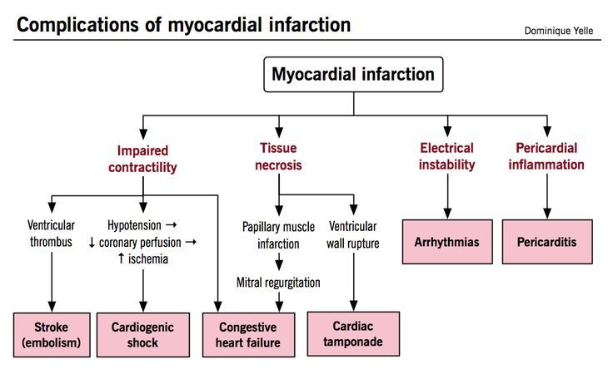

Slide 39
Pre –Hospital Goal
efforts are ongoing to promote rapid identification and treatment of patients with acute MI
patient education about the symptoms of acute MI and appropriate actions to take
prompt initial care of the patient by the community emergency medical system.
In treating the patient with chest pain, emergency medical system personnel must act with a sense of urgency.

Slide 40
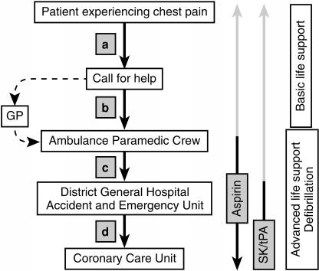
EMERGENCY MANAGEMENT(pre Hospital )

Slide 41
Initial Recognition and Management in the Emergency Department
oxygen by nasal prongs;
sublingual nitroglycerin (unless systolic arterial pressure is less than 90 mm Hg or heart rate is less than 50 or greater than 100 beats per minute [bpm]);
adequate analgesia (with morphine sulfate or meperidine);
aspirin, 160 to 325 mg orally.
A 12-lead electrocardiogram (ECG) should also be performed
A 12-lead electrocardiogram (ECG) should also be performed. ST-segment elevation (equal to or greater than 1 mV) in contiguous leads provides strong evidence of thrombotic coronary arterial occlusion and makes the patient a candidate for immediate reperfusion therapy,
fibrinolysis or primary percutaneous transluminal coronary angioplasty (PTCA)
Prompt access to emergency coronary artery bypass graft (CABG) surgery must also be available if primary PTCA is to be undertaken.

Slide 42
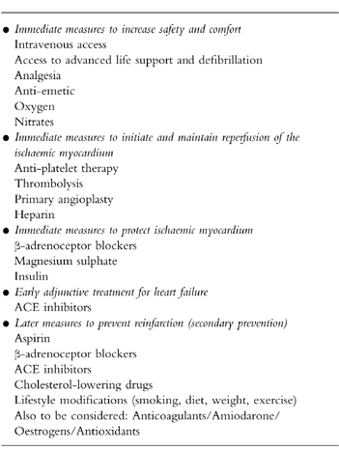
Management

Slide 43
Discharge from hospital
Before hospital discharge or shortly thereafter, the patient with recent acute MI should undergo standard exercise testing (submaximal at 4 to 7 days or symptom limited at 10 to 14 days).
Long-Term Management
For an indefinite period after acute MI, the patient should continue to receive aspirin, a β-adrenoceptor blocker, and a selected dose of an ACE inhibitor
The patient with a low-density lipoprotein (LDL) cholesterol measurement greater than 130 mg/dL despite diet should be given drug therapy with the goal of reducing LDL to less than 100 mg/dL.
Smoking cessation is essential.
Finally, the patient should be encouraged to participate in a formal rehabilitation program and ultimately to plan to engage in 20 minutes of exercise at the level of brisk walking at least three times a week.

Slide 44
Discharge from hospital
Cardiac Rehab is beneficial to patients of all ages who have had a heart attack, CAD, angina, or CHF. Other individuals who may gain benefits from this include post-surgical CABG, percutaneous intervention (PCI), or coronary angioplasty patients

