Slide 1
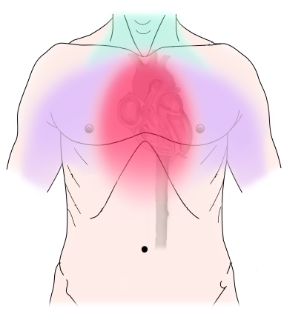
Angina/Angina pectoris (Ischemic chest pain )
Presenter
DeviNanjappan
Principal
[FACULTY OF NURSING]

Slide 2
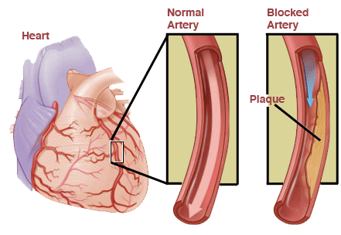
What Is Angina?
Angina is chest pain that happens because there isn't enough blood going to part of your heart. It can feel like a heart attack, with pressure or squeezing in your chest. It’s sometimes called angina pectoris or ischemic chest pain.
It's a symptom of heart disease, and it happens when something blocks your arteries or there's not enough blood flow in the arteries that bring oxygen-rich blood to your heart.

Slide 3
Incidence
Angina raises your risk of having a heart attack. But it’s treatable. Consider it a warning sign and make healthy choices.
In the early 20th century this was a known sign of impending death.
People with an average age of 62 years, who have moderate to severe degrees of angina
the Centers for Disease Control and Prevention (CDC) reports that the risk of CHD (Coronary heart disease), stroke, and PVD (Peripheral vascular disease) is reduced within 1–2 years of smoking cessation.
Disease of affluence shifting

Slide 4
Causes
A fatty substance called plaque builds up in your arteries, blocking blood flow to your heart muscle.
Less common causes of chest pain include:
A blockage in a major artery of your lungs (pulmonary embolism)
An enlarged or thickened heart (hypertrophic cardiomyopathy)
Narrowing of a valve in the main part of your heart (aortic stenosis)
Swelling of the sac around your heart (pericarditis)
Tearing in the wall of your aorta, the largest artery in your body (aortic dissection)

Slide 5
Risk Factors
Older age
Family history of heart disease
High blood pressure
High cholesterol
Diabetes
Obesity
Stress
Using tobacco
Not getting enough exercise

Slide 6
Prevention
Be active, but it's important to listen to your body. If you feel pain, stop what you’re doing and rest. Know what triggers your angina, like stress or intense exercise. Try to avoid things that tend to set it off.
If you smoke, stop. It can damage your blood vessels and increase your heart disease risk.
Eat a heart-healthy diet to lower your blood pressure and cholesterol levels. When those are out of normal range, your chance for heart disease can rise. Eat mainly fruits and vegetables, whole grains, fish, lean meat, and fat-free or low-fat dairy. Limit salt, fat, and sugar.
Use stress-relieving measures like meditation, deep breathing, or yoga to relax.
Exercise most days of the week.
See your doctor regularly

Slide 7
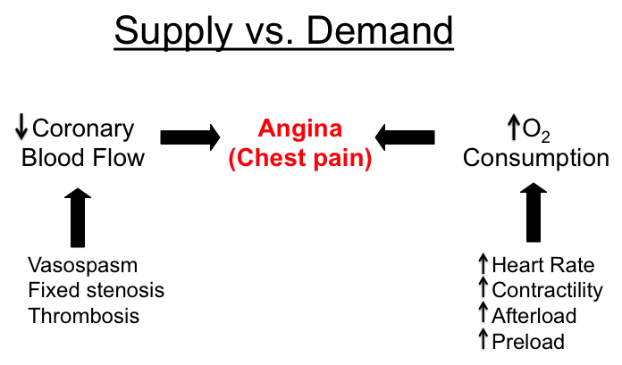
Pathophysiology
Angina results when there is an imbalance between the heart's oxygen demand and supply. This imbalance can result from an increase in demand (e.g., during exercise) without a proportional increase in supply (e.g., due to obstruction or atherosclerosis of the coronary arteries).

Slide 8
Types
Micro vascular angina in women(MVA)
Women with myocardial ischemia often have either no or atypical symptoms, such as palpitations, anxiety, weakness, and fatigue. Additionally, many women with angina are found to have cardiac ischemia, yet no evidence of obstructive coronary artery disease on cardiac catheterization.
The diagnosis of MVA may require catheterization during which there is assessment of the microcirculatory response to adenoside or acetylcholine and measurement of coronary and fractional flow reserve. New techniques include positron emission tomography (PET) scanning, cardiac magnetic resonance imaging (MRI), and transthoracic Doppler echocardiography.

Slide 9
Types contd…
Suspected angina
Hospital admission for people with the following symptoms is recommended, as they may have unstable angina: pain at rest (which may occur at night), pain on minimal exertion, angina that seems to progress rapidly despite increasing medical treatment. All people with suspected angina should be urgently referred to a chest pain evaluation service, for confirmation of the diagnosis and assessment of the severity of coronary heart disease.

Slide 10
Types contd…
Stable Angina
In stable angina, episodes of chest discomfort are usually predictable. They can occur during exertion (such as running to catch a bus) or during mental or emotional stress. Normally, the chest discomfort is relieved with rest, use of nitroglycerin, or both. If you have recurring episodes of chest discomfort, you should see your doctor for a medical evaluation.
Unstable Angina
In unstable angina, chest pain can occur at any time—often while a person is resting. The discomfort may be more severe and last longer than in typical angina. The most common cause is reduced blood flow to the heart muscle because the coronary arteries are narrowed by fatty buildups. If you experience unstable angina you should call your physician immediately as this may be the rise of a more important medical condition.

Slide 11
Types contd…
Variant angina pectoris can happen at any time. Unlike typical angina, it nearly always occurs when a person is resting. Attacks can be very painful and usually happen between midnight and 8AM. Variant angina is caused by spasms in the coronary arteries. About two-thirds of people with variant angina have severe coronary blockages in at least one major vessel. The spasm usually occurs very close to the blockage. If you think you might have variant angina, please call you physician immediately.

Slide 12
Diagnosis
EKG. This test measures your heart’s electrical activity and rhythm.
Stress test. This checks how your heart is working while you exercise.
Blood tests. Your doctor will check for proteins called troponins. Lots of them are released when your heart muscle is damaged, as in a heart attack. Your doctor may also do more general tests like a metabolic panel or complete blood count (CBC).
Imaging tests. Chest X-rays can rule out other things that might be causing your chest pain, like lung conditions. Echocardiograms and CT and MRI scans can create images of your heart to help your doctor spot problems.
Cardiac catheterization. Your doctor inserts a long, thin tube into an artery in your leg and threads it up to your heart to check your blood flow and pressure.
Coronary angiography. Your doctor injects dye into the blood vessels of your heart. The dye shows up on an X-ray, creating an image of your blood vessels. They may do this procedure during cardiac catheterization.

Slide 13
Treatment
Drugs:
Nitrates: nitroglycerin, isosorbide dinitrate
Beta Blockers: propranolol, metoprolol, atenolol
Calcium Channel Blockers: nifedipine, verapamil, diltiazem
Metabolism Modifiers: ranolazine
Related Drugs: glucagon, sildenafil
Unstable Angina Rx: Morphine, Oxygen, Nitroglycerin, Aspirin (MONA)

Slide 14
Cardiomegaly (Enlarged Heart)
Presenter
DeviNanjappan
Principal
[FACULTY OF NURSING]

Slide 15
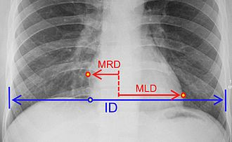
Definition
Cardiomegaly also called as megacardia or megalocardia)
It is a medical condition in which the heart is enlarged. As such, it is more commonly referred to simply as "having an enlarged heart".
It is when the transverse diameter of the cardiac silhouette is greater than or equal to 50% of the transverse diameter of the chest (increased cardiothoracic ratio) on a posterior anterior projection of a chest radiograph or a computed tomography
MRD = greatest perpendicular diameter from midline to right heart border MLD = greatest perpendicular diameter from midline to left heart border ID = internal diameter of chest at level of right hemidiaphragm
A normal measurement is 0.42-0.50.

Slide 16
Cardiothoracic ratio(CTR) 0.42-0.50.
MRD = greatest perpendicular diameter from midline to right heart border MLD = greatest perpendicular diameter from midline to left heart border ID = internal diameter of chest at level of right hemidiaphragm
A measurement <0.42 is usually deemed to be pathologic. A measurement >0.50 is usually taken to be abnormal although some radiologists feel that measurements up to 0.55 are "borderline".

Slide 17
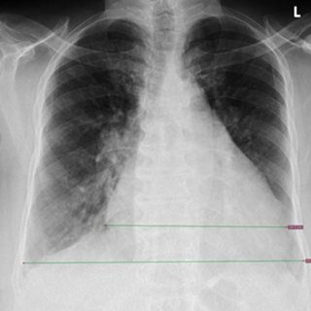
transverse cardiac diameter (TCD)
1.5 to 2cm on two consecutive radiographs,

Slide 18
transverse cardiac diameter (TCD) transverse thoracic diameter (TTD) Cardiothoracic ratio(CTR)

Slide 19
Epidemiology
Recent studies suggest that cardiomegaly is associated with a higher risk of sudden cardiac death.
Heart failures increase with age, more common in males,
Hhalf of people diagnosed with heart failure die within 5 years of being diagnosed.
Cardiomyopathy is also associated with cardiomegaly

Slide 20
Causes and Risk factors and prevention
CCF
Cardiomyopathy
immediate family member who has or had cardiomegaly may indicate that a person is more susceptible to getting this condition (congenital)
Risk factor and Prevention {discussion )

Slide 21
Pathophysiology
congestive heart failure leads to myocardial tissue increase in size
as the heart works harder the actin and myosin filaments experience less overlap which increases the size of the myocardial fiber
If the heart tissue gets too big and stretches too far, then those filaments cannot effectively pull on one another to shorten the muscle fibers, thus impacting the heart's sliding filament mechanism
fibers cannot shorten properly, and the heart cannot contract properly, then blood cannot be effectively pumped to the lungs to be re-oxygenated and to the body to deliver oxygen to the working tissues of the body.
an enlarged heart is more susceptible to forming blood clots in the lining of their heart. These clots can also be formed in other parts of the body.

Slide 22
Clinical Signs
History and PE( specific sign is a displaced point of maximal impulse (PMI)
The precordial examination will reveal a displaced PMI usually below the 5th intercostal space and lateral to the mid clavicular line and palpable across 2 intercostal spaces. Sustained PMI is a sign of severe left ventricular hypertrophy.
holosystolic murmur of mitral and/or tricuspid regurgitation resulting from dilatation of the mitral annulus and displacement of papillary muscles with abnormal myocardial remodeling.

Slide 23
Clinical Signs
Sinus tachycardia resulting from increased sympathetic drive
Diminished pulse pressure reflecting reduced stroke volume
Varying degrees of respiratory distress based on the severity of the disease
Cool, cyanotic extremities secondary to peripheral vasoconstriction
Jugular venous distension and/or positive abdominojugular reflex indicating elevated right-sided filling pressures
Ascites, hepatomegaly and peripheral edema resulting from increased pressure in the hepatic veins
systemic veins Pulmonary crackles resulting from elevated left-sided filling pressure and transudation of fluid into alveoli
S3 gallop in early diastole resulting from volume overload and systolic dysfunction; S4 gallop in late diastole resulting from diastolic dysfunction

Slide 24
Diffential Diagnosis
Pericardial effusion Anterior mediastinal mass Prominent epicardial fat pad Mediastinal widening secondary to pulmonary/aortic pathology

Slide 25
Prognosis
Despite the advent of new therapies, mortality remains high in patients with symptomatic HF. Roughly, 1-year mortality is 30% while 5-year mortality is 50%. The severity of symptoms, advanced age, and HF hospitalization are significant predictors of mortality in HF

Slide 26
Complication
Decompensated heart failure
Sudden cardiac death
malignant ventricular arrhythmias
Thromboembolism secondary to mural thrombi

Slide 27
Clinical diagnosis
A chest X-ray with an enlarged cardiac silhouette and a cardiothoracic ratio of more than 50% is suggestive of cardiomegaly
Electrocardiogram (ECG) can reveal non-specific changes including LV/RV hypertrophy, low voltage QRS in case of fibrosis/dilated cardiomyopathy, conduction abnormality, arrhythmia, PVC’s, ST-T wave changes and Q waves suggestive of prior MI.
echocardiogram can be used to assess LV, RV and atrial size and systolic/diastolic function
Cardiac MRI is an emerging diagnostic modality for the accurate evaluation of LV and RV mass, size, and function.
Serum levels of brain natriuretic peptide (pro-BNP), troponin I and T, renal function, and liver function tests are useful in the setting of heart failure Stress test and/or coronary angiogram to evaluate for coronary artery disease

Slide 28
Treatment
Patients with treating any underlying risk factors such as hypertension, dyslipidemia, and diabetes. Other underlying conditions, including obstructive sleep apnea, arrhythmias, anemia, and thyroid disorders also require treatment.
cardiomyopathy and symptoms of heart failure are managed with diuretics and salt restriction in addition to the above therapies
ACE inhibitors, Beta Blockers
(implantable cardioverter defibrillator)
CRT (cardiac resynchronization) ICD –D OR P

