Slide 1
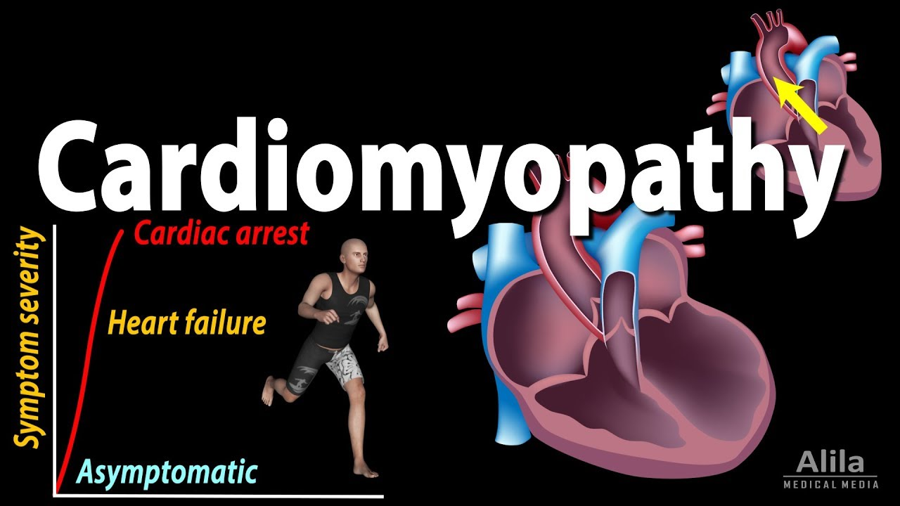
Presenter
DeviNanjappan
Principal
[FACULTY OF NURSING]

Slide 2
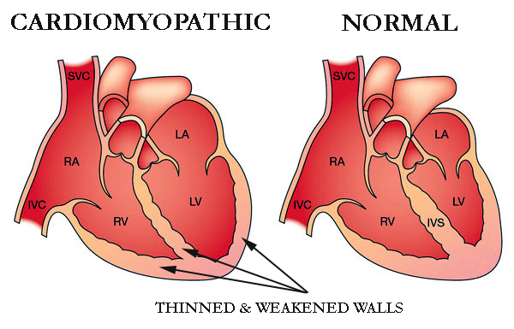
Definition
Cardiomyopathy is a group of diseases that affect the heart muscle]
Cardiomyopathies are a group of diseases in which the function of the myocardium (heart muscle) is impaired for any reason. People with cardiomyopathy are often at risk of arrhythmia and/or sudden cardiac death

Slide 3
Incidence
the incidence of DCM is reported with 5–7 cases per 100 000 persons per year
the prevalence rates were higher for men, with a male/female ratio of 3:1
Epidemiology of DCM is rapidly changing. Furthermore, genetic testing may identify asymptomatic carriers, which lead to redefine prevention strategies, sport recommendations and ICD implantation.

Slide 4
Causes
Cardiomyopathies are either confined to the heart or are part of a generalized systemic disorder, both often leading to cardiovascular death or progressive heart failure-related disability

Slide 5
Risk factors
family history of cardiomyopathy, sudden cardiac arrest, or heart failure
coronary heart disease
diabetes
severe obesity
sarcoidosis
hemochromatosis
amyloidosis
heart attack
long-term high blood pressure
Alcoholism
According to research, HIV, HIV treatments, and dietary and lifestyle factors can also increase your risk of cardiomyopathy.

Slide 6
Prevention
maintaining a healthy weight
eating a modified diet
limiting caffeine intake
getting enough sleep
managing stress
quitting smoking
limiting alcohol intake
getting support from their family, friends, and doctor

Slide 7
Types
Dilated cardiomyopathy (DCM) is the most common form. Patients with this disease usually undergo heart transplantation. In DCM the heart (especially the left ventricle) is enlarged and the pumping function is impaired.
Hypertrophic cardiomyopathy (HCM or HOCM) is a genetic disorder in which the heart muscle is thickened, which can block blood flow and prevent the heart from functioning properly.
Arrhythmogenic right ventricular cardiomyopathy (ARVC) is caused by an electrical disturbance of the heart in which heart muscle is replaced by fibrous scar tissue. The right ventricle is generally most affected.
Restrictive cardiomyopathy (RCM) is the least common cardiomyopathy. The walls of the ventricles are stiff, but may not be thickened, and resist the normal filling of the heart with blood.

Slide 8
Other Types
Peripartum cardiomyopathy occurs during or after pregnancy. This rare type occurs when the heart weakens within five months of delivery or within the final month of pregnancy. When it occurs after delivery, it’s sometimes called postpartum cardiomyopathy. This is a form of dilated cardiomyopathy, and it’s a life-threatening condition. There’s no cause.
Alcoholic cardiomyopathy is due to drinking too much alcohol over a long period of time, which can weaken your heart so it can no longer pump blood efficiently. Your heart then becomes enlarged. This is a form of dilated cardiomyopathy.
Ischemic cardiomyopathy occurs when your heart can no longer pump blood to the rest of your body due to coronary artery disease. Blood vessels to the heart muscle narrow and become blocked. This deprives the heart muscle of oxygen. Ischemic cardiomyopathy is a common cause of heart failure. Alternatively, non ischemic cardiomyopathy is any form that isn’t related to coronary artery disease.
Non compaction cardiomyopathy, also called spongiform cardiomyopathy, is a rare disease present at birth. It results from abnormal development of the heart muscle in the womb. Diagnosis may occur at any stage of life.

Slide 9
Pathophysiology
heart is abnormally enlarged, thickened, and/or stiffened.
As a result, the heart muscle's ability to pump blood is less efficient, often causing heart failure and the backup of blood into the lungs or rest of the body.
The disease can also cause abnormal heart rhythms.
A weakened heart also can cause other complications, such as heart valve problems.
SCA/SCD

Slide 10
Clinical S/S
As the disease worsens, shortness of breath, feeling tired, and swelling of the legs may occur, due to the onset of heart failure.
lightheadedness and dizziness
chest pain
heart palpitations
fainting attacks
high blood pressure
edema, or swelling, of your feet, ankles, and legs

Slide 11
Diagnosis
Physical exam
Family history
Blood test
ECG
Echocardiogram
Stress test
Genetic testing

Slide 12
Treatment
you can’t reverse or cure cardiomyopathy, but you can control it with some of the following options:
heart-healthy lifestyle changes
medications, including those used to treat high blood pressure, prevent water retention, keep the heart beating with a normal rhythm, prevent blood clots, and reduce inflammation
surgically implanted devices, like pacemakers and defibrillators
surgery
heart transplant, which is considered a last resort

Slide 13
Treatment Contd…..
lower your blood pressure. ACE inhibitors, angiotensin II receptor blockers, beta blockers and calcium channel blockers are examples of medicines that lower blood pressure.
Slow your heart rate. Beta blockers, calcium channel blockers, and digoxin are examples of medicines that slow the heart rate. Beta blockers and calcium channel blockers also are used to lower blood pressure.
Keep your heart beating with a normal rhythm. These medicines, called antiarrhythmics, help prevent arrhythmias (irregular heartbeats).
Balance electrolytes in your body. Electrolytes are minerals that help maintain fluid levels and the acid-base balance in your body. Electrolytes also help muscle and nerve tissues work properly. Medicines used to balance electrolytes include aldosterone blockers.
Remove excess fluid and sodium from your body. Diuretics, or “water pills,” are an example of a medicine that helps remove excess fluid and sodium from the body.
Prevent blood clots from forming. Anticoagulants (PDF), or *blood thinners, help to prevents blood clots. Blood thinners often are used to prevent blood clots from forming in people who have dilated cardiomyopathy.
Reduce inflammation. Medications used to reduce inflammation include corticosteroids.

Slide 14
Treatment Contd…..
Septal myectomy – Septal myectomy is open-heart surgery. It's considered for people who have obstructive hypertrophic cardiomyopathy and severe symptoms. This surgery generally is reserved for younger patients and for people whose medications aren’t working well. A surgeon removes part of the thickened septum that’s bulging into the left ventricle. This improves blood flow within the heart and out to the body.
Surgically implanted devices – Surgeons can implant several types of devices in the body to help the heart work better, including:
Pacemaker This small device uses electrical pulses to prompt the heart to beat at a normal rate.
Cardiac resynchronization therapy (CRT) device This device coordinates contractions between the heart’s left and right ventricles.
Left ventricular assist device (LVAD) This implantable device helps the heart pump blood to the body. An LVAD can be used for long-term therapy or as an interim treatment for those awaiting a heart transplant.
Implantable cardioverter defibrillator (ICD) An ICD helps to maintain a normal heartbeat by sending an electric shock to the heart if an arrhythmia, or irregular heartbeat, is detected.
Heart Transplant – In a heart transplant surgery, a person’s diseased heart is replaced with a healthy donor heart. A heart transplant is a last resort for people who have end-stage heart failure. (“End-stage” means that all other treatment options have been explored, without success.)
Alcohol septal ablation (nonsurgical procedure) – In this procedure, ethanol (a type of alcohol) is injected through a tube into the small artery that supplies blood to the area of heart muscle thickened by HCM. The alcohol causes these cells to die. The thickened tissue shrinks to a more normal size. The risks and complications of heart surgery increase with age. For this reason, ablation may be preferred to myectomy in older patients with other medical conditions.

