Slide 1
Infective Endocarditis
Presenter
DeviNanjappan
Principal
[FACULTY OF NURSING]

Slide 2
Definition
Endocarditis is an inflammation of the inner layer of the heart, the endocardium. it usually involves the valves and other structures like the intraventricular and septum.
Infective endocarditis (IE) is a microbial infection of a heart valve (native or prosthetic) or the mural endocardium, leading to tissue destruction and formation of vegetations
It is primarily a disease of the heart, but by virtue of its haematogenic spread, it is also a multisystem disorder

Slide 3
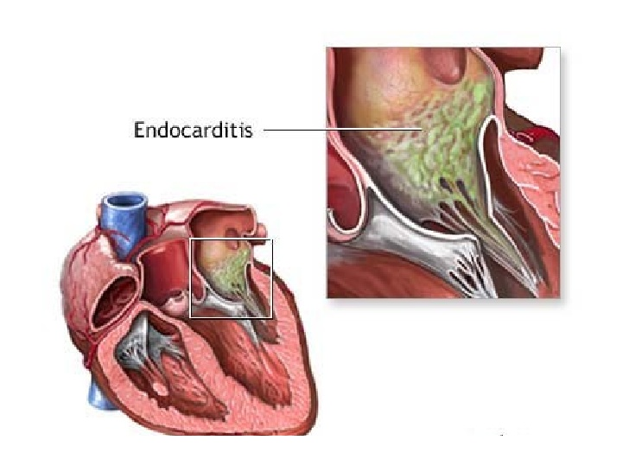

Slide 4
Incidence
The incidence of IE is 1.7–7.2 cases per 100 000 person-years. The female to male ratio has remained stable over the years at 1:2.2
the median age of endocarditis patients has increased from 30–40 to 47–69 yr and rheumatic heart disease is no longer the main risk factor for IE in Western countries.

Slide 5
Causes
Staphylococcus aureus is now more common than oral Streptococci (formerly Streptococcus viridans)
MRSA9 methicillin-sensitive S. aureus is predominantly related to nosocomial infection, wound infection, permanent i.v. catheters, or surgical intervention
Fungus e.g. candida, aspagellus
Gram negative organisms e.g. pseudomonas Bacterias e.g. staphylococci
Acute rheumatic fever which cause enlarged and tender lymph nodes,
damages the valves Congenital heart disease

Slide 6
Risk factors
Previous heart damage
Dental procedures which lead into the introduction of bacterias
Heart surgery
Intubations
Procedures involving gastro intestinal and genitourinaly tracts e.g. barium, enemas, sigmoidoscopy, catheterisation and cytoscopy
Reproductive conditions like delivery of new babies, abortions and pelvic inflammatory disease

Slide 7
Prevention
You can reduce the risk of bacterial endocarditis by practicing good oral hygiene habits every day. Good oral health is generally more effective in reducing your risk of bacterial endocarditis than is taking preventive antibiotics before certain procedures.

Slide 8
Pathophysiology
IE originates at sites where the endothelium is damaged by high blood velocity or mechanical damage and on foreign bodies in the circulation.
Initially, a sterile thrombotic vegetation (non-bacterial thrombotic endocarditis) is formed, which facilitates bacterial adherence during transient bacteraemia.
Platelets and fibrin deposits at the injury site provide an adherent surface for the formation of vegetations.
Finally, the vegetations may produce the secondary effects of endocarditis such as tissue destruction, generalized and difficult to eradicate sepsis, and septic emboli and abscesses

Slide 9
Clinical S/S
Loss of vision
Ischemia
Fever
Shortness of breath
Shock
Finger clubbing
Myocardial infarction
Weight loss
Malaise Chills
Night sweats
Chest and abdominal pain
anorexia

Slide 10
Complication
Chronic heart failure
Shock
Stroke
embolism

Slide 11
Diagnosis
Simplified Duke criteria for the diagnosis of IE Major criteria
Positive blood cultures
Positive echocardiogram for IE defined as
Oscillating Intracardiac mass
Intracardiac abscess
New partial dehiscence of prosthetic valve
Minor criteria Predisposition such as heart condition or i.v. drug use Fever Vascular phenomena or immunological phenomena such as
major arterial emboli,
septic pulmonary infarcts,
mycotic aneurysm,
Intracranial haemorrhage,
Conjunctival haemorrhages, and Janeway lesions
Other microbiological evidence such as PCR, serological tests, or positive blood culture but does not meet a major criterion

Slide 12
Treatment
Medical management
if the patient is having poor intake of oxygen administer oxygen therapy 4-6 l/m in helping the patient get supplemented with enough oxygen
Administer antibiotic treatment like ampicillin + flucloxacilin +gentamicin
Administer pcm 1g tds p.o as analgesic that help in relieving pain
Administer inotropic drugs like digoxin that help in increasing contractility of the heart
The patient can also be administered with morphine which help to decrease anxiety

