Slide 1
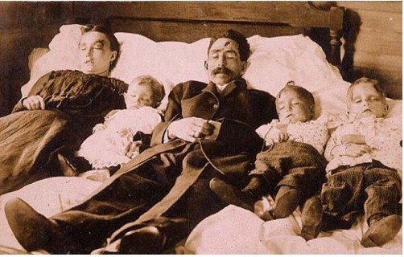
Post Mortem Care
PREPARED BY MR.N.SANDEEP WESLEY ASSISTANT LECTURER
SMT.NAGARATHNAMMA SCHOOL & COLLEGE OF NURSING
BENGALURU

Slide 2
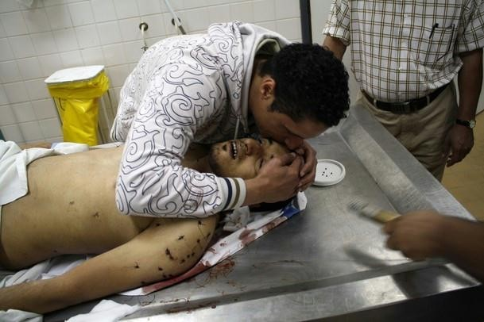

Slide 3
Description
All deceased children are treated w/ respect while being provided end-of-life care
Family members are allowed to participate in the activities to complete end-of-life care needs
Religious practices, cultural rituals, and any other request are taken into consideration.

Slide 4
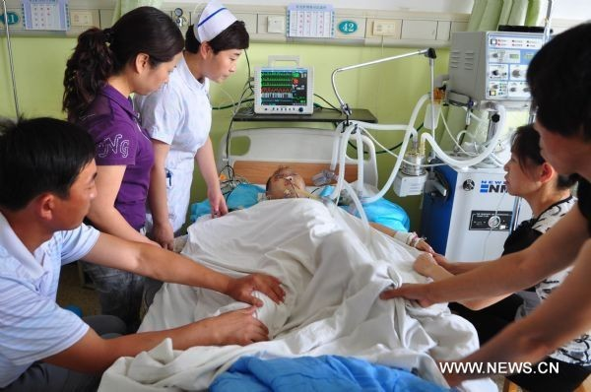

Slide 5
RN/LPN/HCP is responsible for ensuring that all aspects of post mortem care are completed.

Slide 6
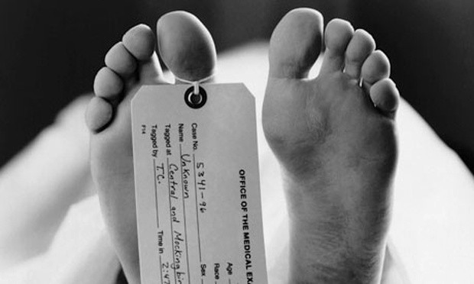

Slide 7
PURPOSE
To clean and prepare the patients body before it is transported to the morgue

Slide 8
ASSESSMENT
Verify that patient has been pronounced dead by the physician.
Identify cadaver, and collect his/her belongings for labeling.

Slide 9
PLANNING
Collect necessary equipment:
  Bathing supplies
  Shroud or morgue bag
  3 identification tag
  Roll of gauze
  Paper/plastic bag for personal belongings
  Morgue cart

Slide 10
If there are visitors in the room, carefully explain the situation and ask them to temporarily leave the room if possible.
Follow the hospital procedure regarding the notification of various dept. and personnel.

Slide 11
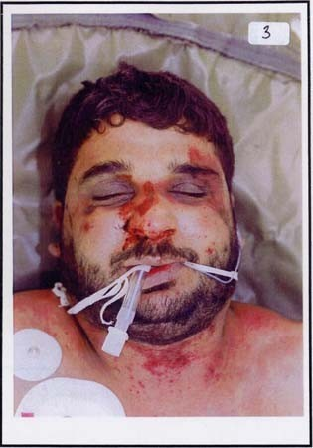

Slide 12
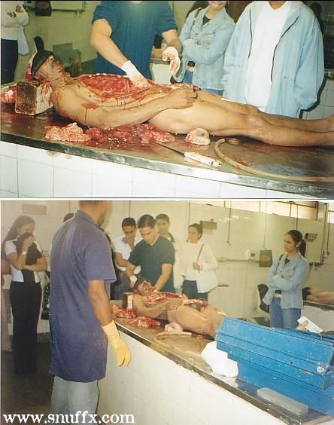

Slide 13
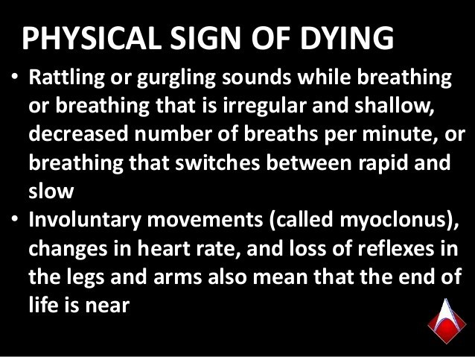

Slide 14


Slide 15
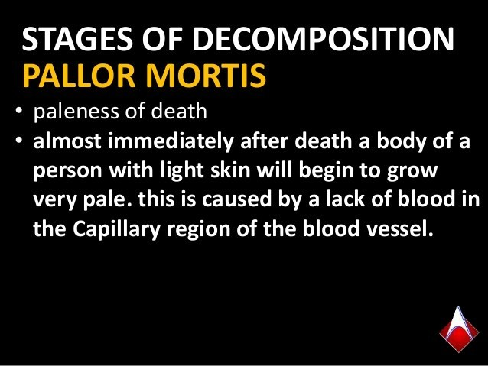

Slide 16
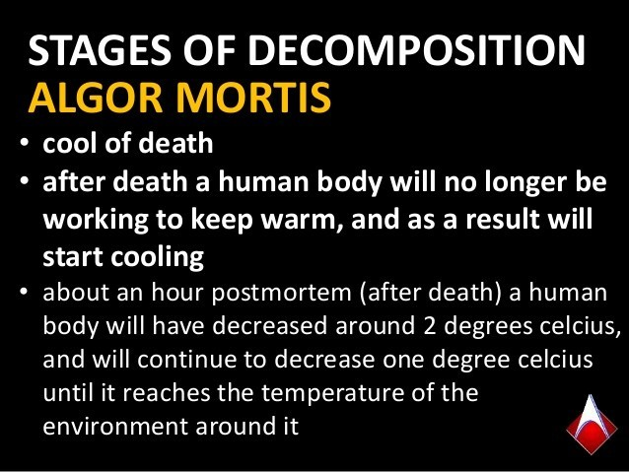

Slide 17
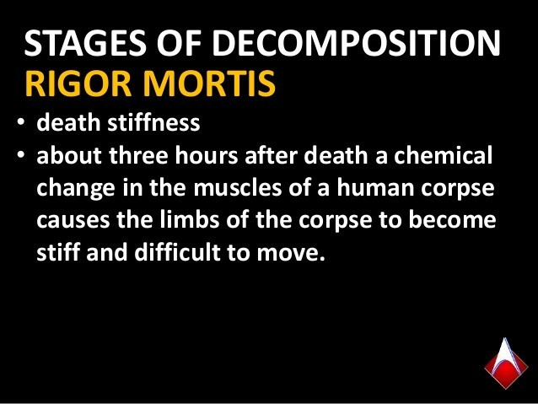

Slide 18
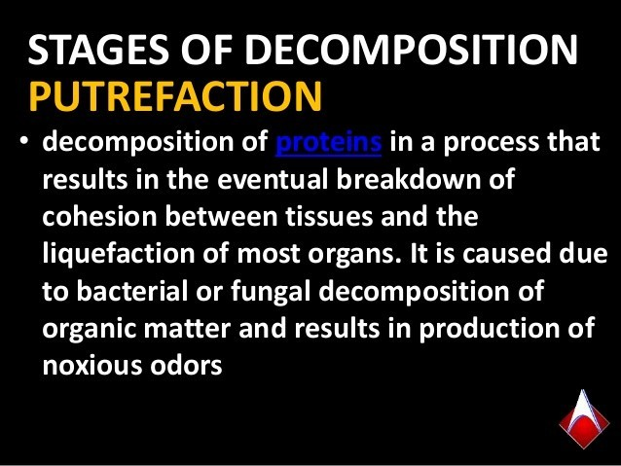

Slide 19
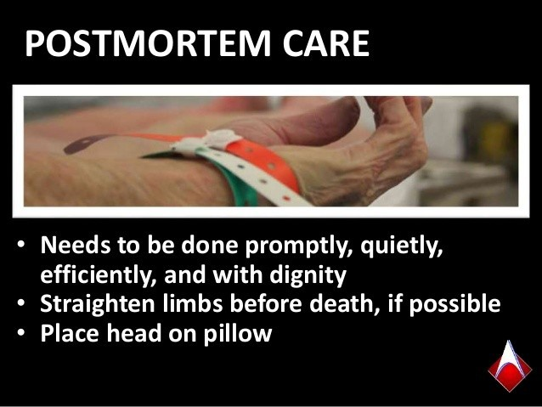

Slide 20
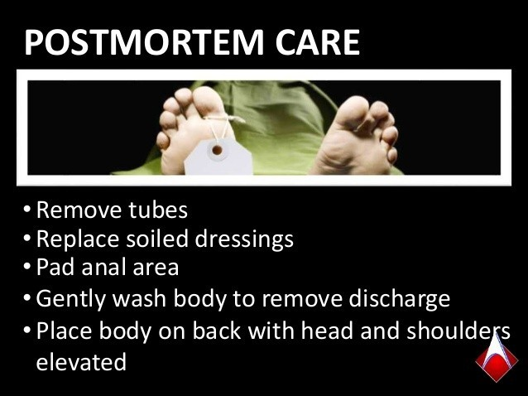

Slide 21
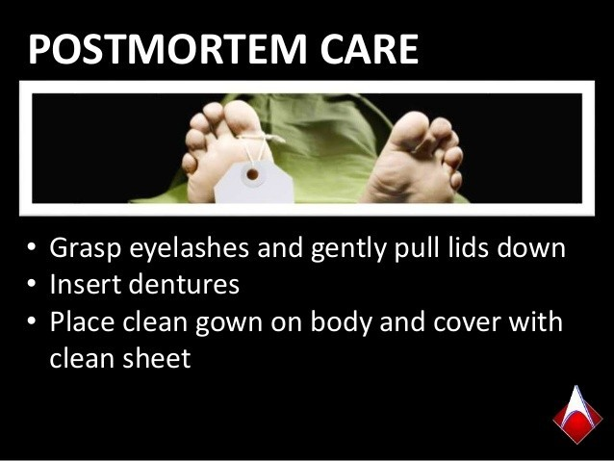

Slide 22
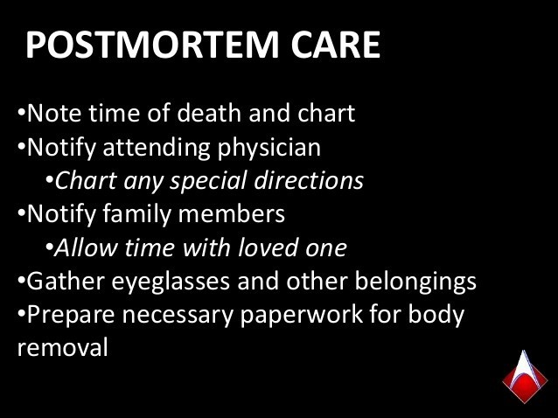

Slide 23
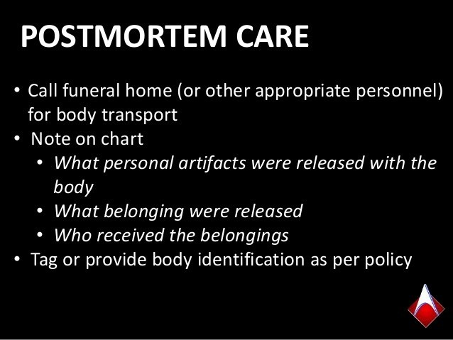

Slide 24
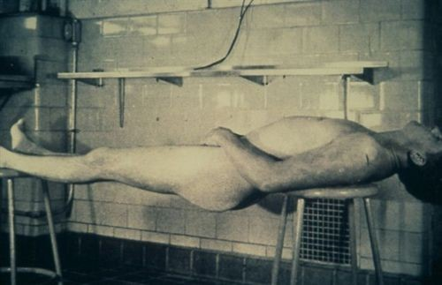
RIGOR MORTIS

Slide 25
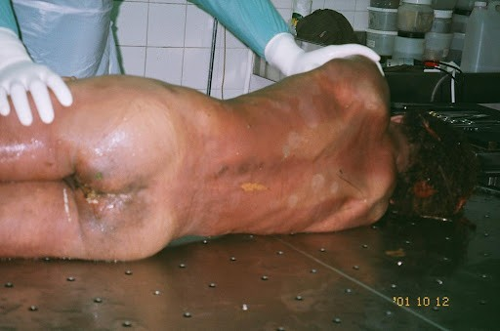
LIVOR MORTIS

Slide 26
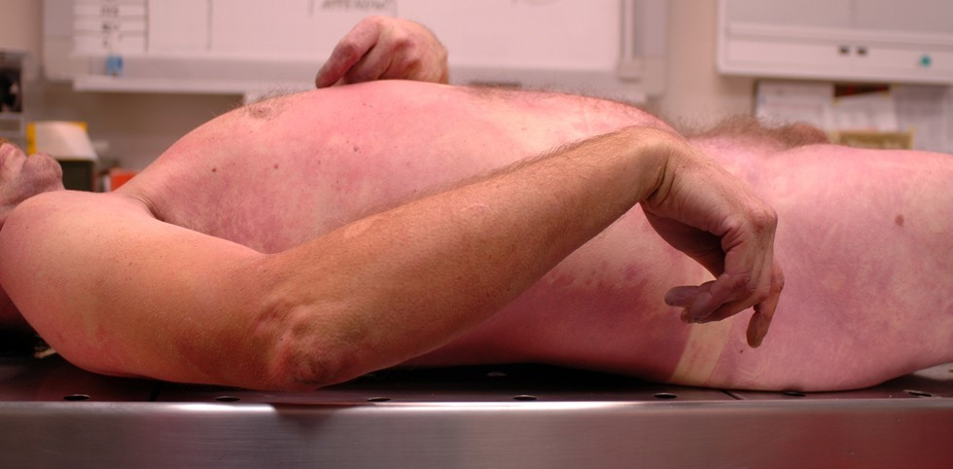
ALGOR MORTIS

Slide 27
IMPLEMENTATION
Maintain proper alignment of body. Raise the head of the bed slightly.
IF possible, place dentures in the mouth
Remove any external obj causing pressure or injury to the skin
Following hospital policy, remove, cut or secure any tubes, drains or monitoring lines

Slide 28
Following hospital policy, secure or replace dressings.
Cleans the body as needed.
Close the eyes
If the family is to visit the deceased, provide clean linen and gown to pt.
Prepare the equipment used for cleansing
ID tags-toe,wrist and morgue bag

