Slide 1
LESIONS AND ABRASIONS
By: Gincy Samuel
Asst. Professor
Department: MSN

Slide 2
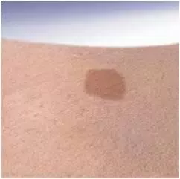
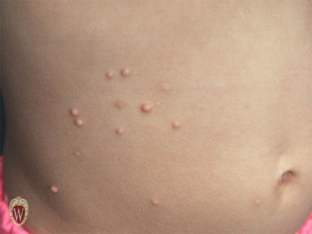
LESIONS AND ABRASIONS
Primary skin lesions
Macule: flat, non-palpable
change in skin color smaller than 1 cm.
Papule: elevated, solid mass with circumscribed border. Diameter less than 1 cm.

Slide 3
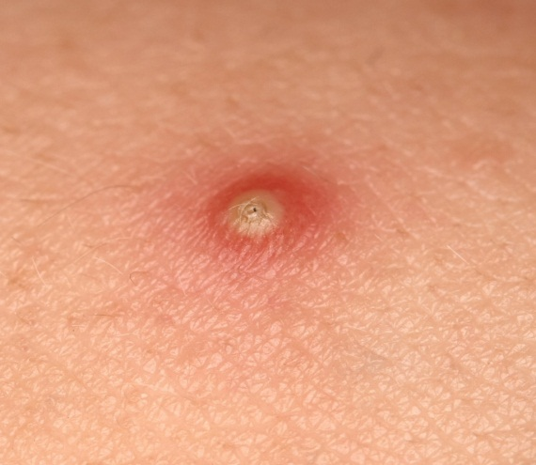
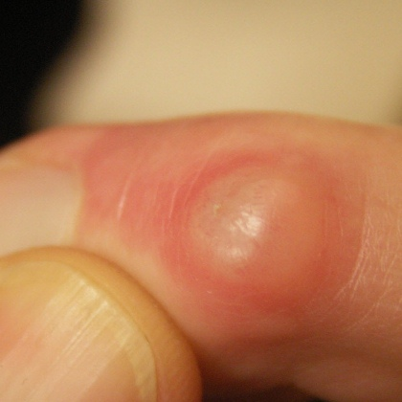
Pustule: elevated, pus filled
vesicle with circumscribed border.
It vary in size
Cyst: elevated, thick walled
lesion containing fluid/semisolid
matter.

Slide 4
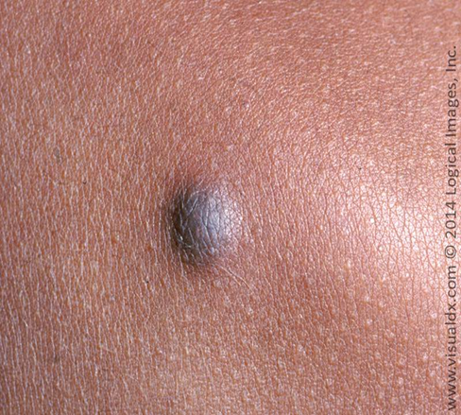
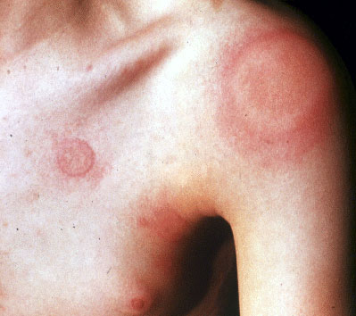
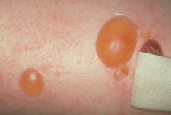
Nodule: larger than papule.
Raised solid lesion extending
deep into dermis.
Wheal: elevated, reddish area
with irregular border
Vesicle bullae: elevated, fluid filled,
round or oval shaped palpable mass
with thin translucent wall.
Smaller than 0.05 cm

Slide 5
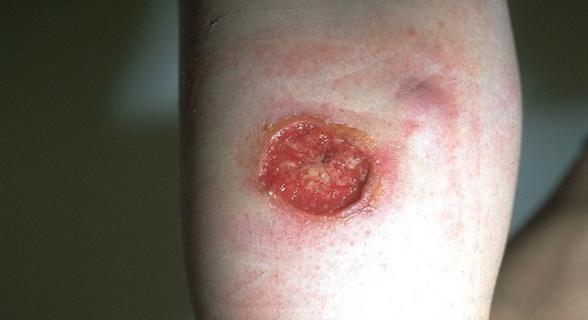
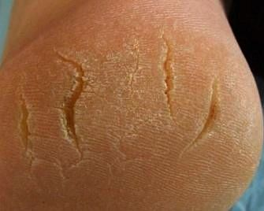
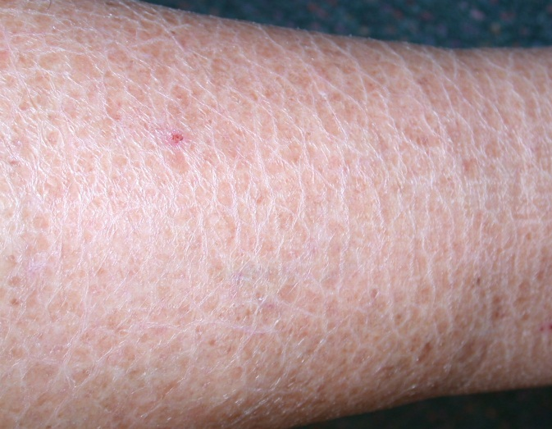
Secondary skin lesions
Ulcer: skin loss extending past
epidermis, tissue loss, bleeding
and scarring.
Fissure: deep linear split
through epidermis into dermis
Scales: shedding flakes of skin
tissue. Color may be white, grey
or silver.

Slide 6
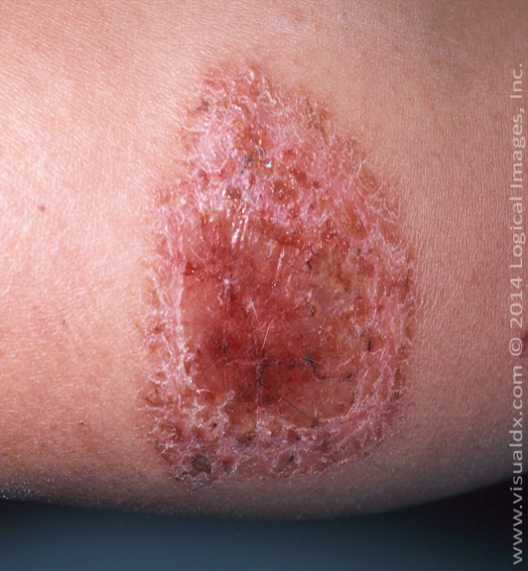
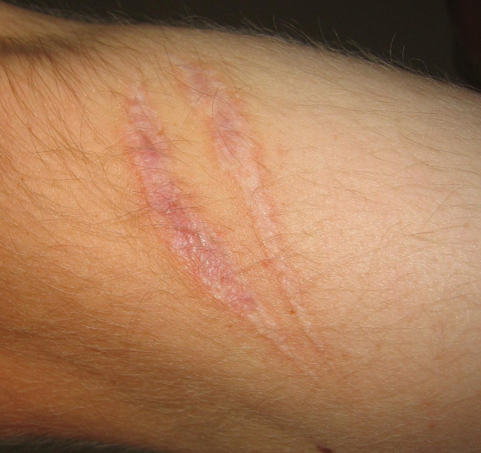
Crust: dry blood, serum or
pus left on the skin surface
can be red brown, orange or yellow.
Scar: flat irregular area of connective tissue left after wound has healed. New scar red or purple, older scar silvery or white.

Slide 7
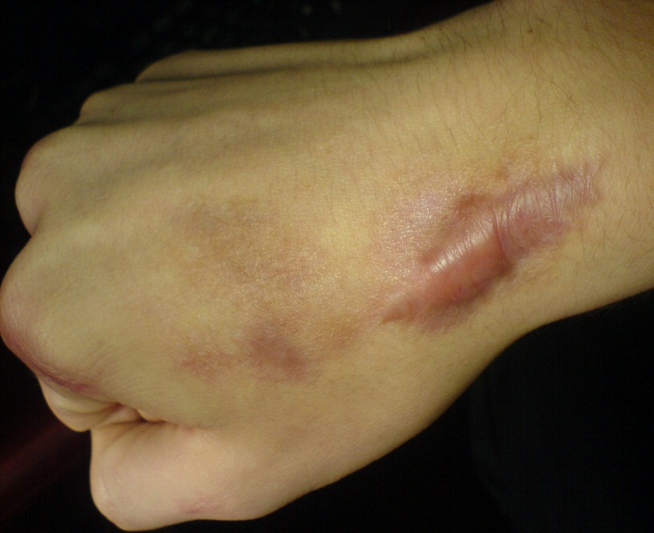
Keloid: elevated irregular darkened area of excess scar tissue caused by excessive collagen formation during healing.

Slide 8
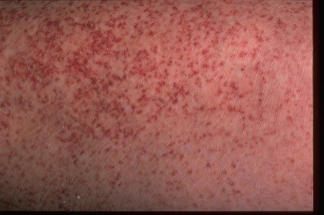
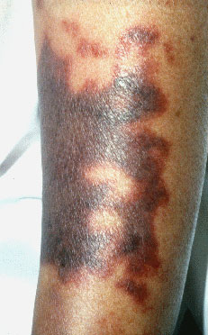
Vascular skin lesions
Petechiae: flat red or purple rounded
approx. 1-3mm in diameter associated
with bleeding tendencies into the skin.
Ecchymosis: round or irregular macular
lesion larger than petechiae.
Color changes from black yellow
and green. Associated with injury or
bleeding underneath.

Slide 9
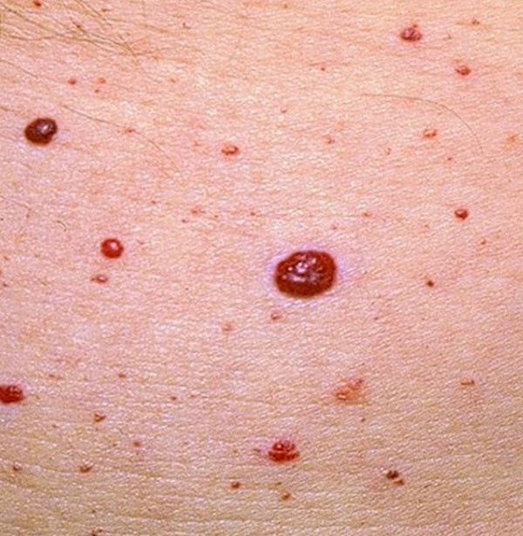
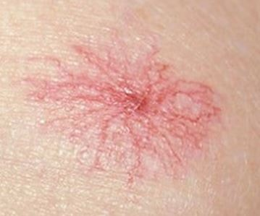
Cheery angioma: papular and round.
Red or purple. Present on trunk,
extremities. Blanched with pressure.
Spider angioma: a flat bright red
dot with tiny radiating blood vessels
Associated with liver disease,
vitamin B deficiency.

