Slide 1
Integumentary system DISORDERS
By: Gincy Samuel
Asst. Professor
Department: MSN

Slide 2
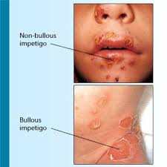
BACTERIAL INFECTIONS IMPETIGO
It is a superficial skin infection caused by staphylococci/ streptococci/ multiple bacteria. It involve exposed areas of body, face, hands, neck and extremities.
BULLOUS IMPETIGO
Caused by Staphylococcus aureus
It is characterized by formation of
bullae from original vesicles.
It ruptures and leave a raw red
area

Slide 3
Pathophysiology
Bacterial infections mostly arise from hair follicle
Bacteria accumulate and grow
Cause localized infection
Bacteria invade deeper tissues
Systematic infections

Slide 4
Causes and types
Primary impetigo: due to poor hygiene and malnutrition.
Secondary impetigo: due to insect bite, lice etc
Clinical Manifestations
Vesiculopustular lesions
Lesions are small, red macules, thin walled vesicles
Honey yellow crust after rupture

Slide 5
Treatment
Antibiotics: oral penicillin, erythromycin
Topical ointment: mupirocin
Antibiotic solution: betadine
Nursing management
Advice to soak the lesions with soap solution to remove crust.
Advice to bath daily at least once with soap.
Advice to use separate towel.
Advice for isolation to prevent spread of disease.

Slide 6
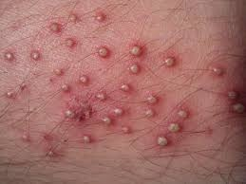
FOLLICULITIS
It is the inflammation of the hair follicles caused by staphylococcus aureus. It begins at opening of follicle and extend down into follicle.

Slide 7
Causes
Due to Friction, Moisture, Rubbing, more oil
Poor hygiene
Poor nutrition
Prolonged skin moisture
Trauma to skin
Tight heavy fabrics on upper legs

Slide 8
Clinical Manifestation
Small pustules at hair follicle, surrounded by erythema
Slight burning
Intense itching and tenderness
Found on extremities, scalp, beard, groin and eye lids.
Treatment
Topical antibiotic (bactroban)
Antibacterial soap
Warm compress of water to heal lesion

Slide 9
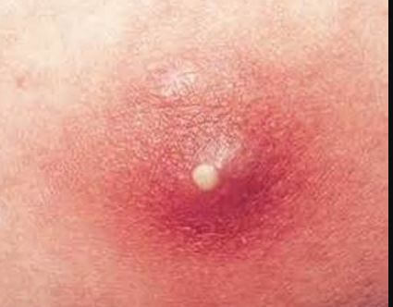
Furuncle (boil)
It is acute inflammation of one or more hair follicles spreading into dermis. Caused by
staphylococcus aureus.
It occur on back of neck, thigh, axillae, perineum or buttocks.

Slide 10
Clinical Manifestation
Deep, red painful nodule 1-5cm in diameter
Nodules develop into painful cyst
Purulent drainage
Treatment
Topical antibiotics
Incision and drainage
Warm compression

Slide 11
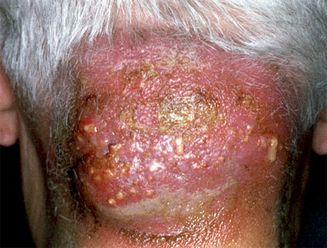
Carbuncles
It is multiple interconnected furuncles. Lesions deep in lower dermis and subcutaneous tissue. Caused by staphylococcal infections.
Found on back of neck, upper arm, buttocks and lateral thighs.
Causes
Hot and humid climate

Slide 12
Clinical Manifestation
Pustules with redness
Chills, fever
Malaise
Treatment
Topical antibiotics
Incision and drainage

Slide 13
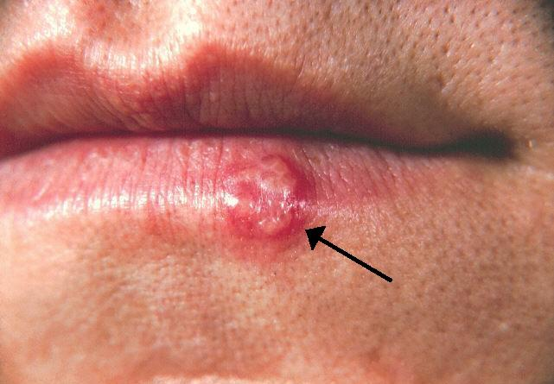
VIRAL INFECTION Herpes Simplex
It is also called fever blister or cold sore. Caused by herpes simplex virus type 1 and type 2.
HSV type 1 causes lip, face and mouth lesions
HSV type 2 causes STD
Causes
Infected body fluid, saliva,
Cervical secretion.

Slide 14
Clinical Manifestation
Burning and tingling sensation
Erythema, vesicle formation and pain
Fever, sore throat
10 to 14 days pustules, ulcers and crusting
Treatment
Acyclovir ointment and oral medicines
Moist compresses

Slide 15
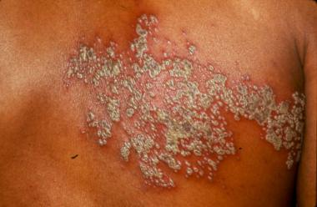
HERPES ZOSTER (SHINGLES)
It is an acute, cutaneous viral infection caused by reactivation of varicella zoster virus. Mainly occur in immunosuppressed patient, after radiotherapy, chemotherapy, organ transplant and HIV patient.

Slide 16
Pathophysiology
Herpes virus reactivate varicella virus
Latent infection in sensory dorsal ganglia near brain and spinal cord
When latent infection reactivated- virus travel by way of peripheral nerves to skin
Virus multiples and create blisters

Slide 17
Clinical Manifestation
red patches
fluid-filled blisters that break easily
rash on the face and ears
itching
fever
chills
headache
fatigue
muscle weakness

Slide 18
Treatment
Antiviral medication (acyclovir) orally
Cold compresses
Analgesics
Nursing management
Keep the room temperature cool
Maintain strict isolation
Apply wet compresses and calamine lotion
Administer medication

Slide 19
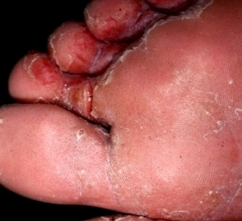
FUNGAL INFECTION Athlete’s Foot (Tinea Pedis)
It is a contagious fungal infection that affects the skin on the feet.
It can also spread to the toenails and the hands.
The fungal infection is called athlete’s foot because it’s commonly seen in athletes.

Slide 20
Causes and Risk Factors
Direct contact with an infected person
Touching surfaces contaminated with the fungus.
The fungus found in showers, on locker room floors, and around swimming pools.
sharing socks, shoes, or towels with an infected person
wearing tight-fitting, closed-toe shoes
Wet feet for long periods of time
sweaty feet
minor skin or nail injury on your foot

Slide 21
Clinical Manifestation
Itching and burning between the toes and soles of the feet
Blisters on the feet
cracking and peeling skin on the feet
dry and raw skin on the soles or sides of the feet
discolored, thick toenails
toenails pulled away from the nail bed

Slide 22
Treatment
Topical antifungal cream, gel, spray or powder.
Feet soaked in burow’s solution, potassium permanganate solution or saline solution to remove crusts and scales.

Slide 23
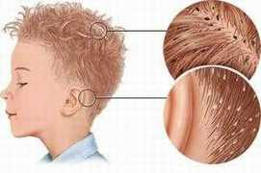
PARASITIC INFESTATION PEDICULOSIS
It is the infestation with lice which lives on the blood of an animal or human host.

Slide 24
Types
Pediculus humanus capitis (head louse): present behind ear and nape of the neck.
Pediculus humanus corporis (body louse, clothes louse): found in people with no bath and wash facility
Pediculus pubis ("crab" louse, pubic louse): found in chest, axilla, beard and eyelashes.

Slide 25
Clinical Manifestation
1. Pediculus capitis
pruritis, erythema of scalp, foul smelling with visible eggs
2. Pediculus corporis
Lice on shoulder, trunk and buttocks
Itching
Hyper pigmentation
3. Pediculus pubis
Reddish brown dust on underclothing
Skin irritation
itching

Slide 26
Medication
Topical medication with gamma benzene hexachloride, melathion to treat pediculosis of body and pubic area.
Permethrin 1% for head lice left for 30 min to 8 hours
Use fine toothed comb
Thick layer of petroleum jelly twice a day for 8 days for other areas

Slide 27
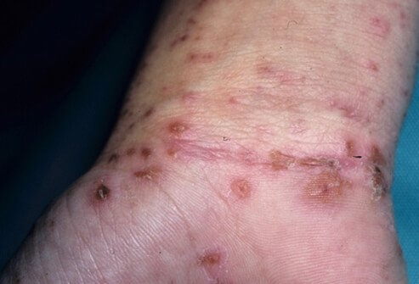
SCABIES
It is a skin infestation caused by a mite known as the Sarcoptes scabiei. Scabies is found between the fingers, inner surfaces of the wrist and elbow, the axillae, the female nipple, the penis, the belt line and the gluteal creases.

Slide 28
Causes
direct skin contact.
transmitted through infested clothing or bedding.
Sexual contact
Clinical Manifestation
Red brown burrows lesions on the skin covered with vesicles
Itching at night
Skin rash

Slide 29
Treatment
Scabicide lotion (lindane) or 5% permethrin applied to entire skin for 12-24 hours except face and scalp.
Oral scabicidal drugs
Nursing management
Advice to wear clean clothes and clean bedding
Wash clothes in hot water and dried in sun as mite survive upto 36 hours in linen.
Apply lotion at same time, same day everyday.
Before application of lotion advice to take warm soapy bath.

Slide 30
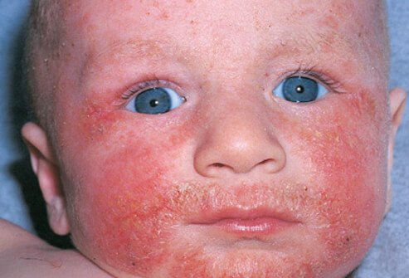
INFLAMMATORY DISORDERS OF SKIN
DERMATITIS /ECZEMA
Dermatitis is an inflammation of the skin. It occurs in many forms. It usually involves an itchy rash on swollen, reddened skin.

Slide 31
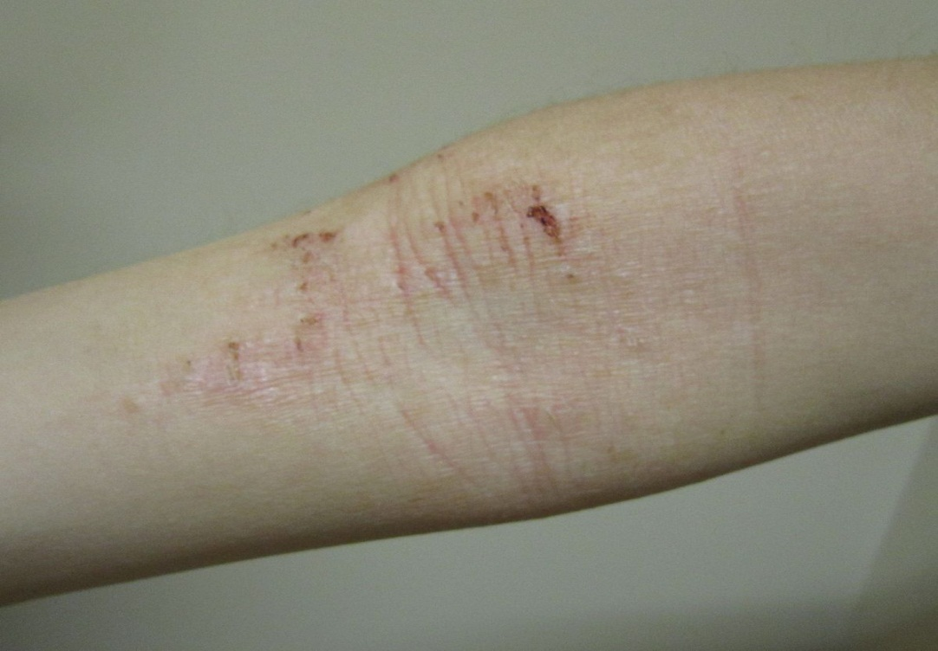
Types
Atopic dermatitis (eczema): Usually beginning in infancy. It is a red, itchy rash which occurs where the skin flexes (inside the elbows, behind the knees and the front of the neck). Form crust if rashes scratched.

Slide 32
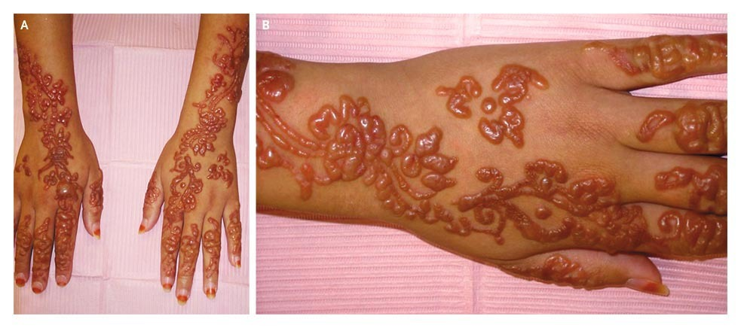
Contact dermatitis: Rash occurs on areas of the body that are in contact with substances that irritate the skin or cause an allergic reaction, such as poison, soap and oils. The red rash may burn, sting or itch. Blisters may develop.

Slide 33
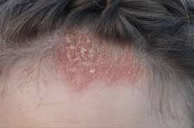
Seborrheic dermatitis: it causes scaly patches, red skin and dandruff. It usually affects oily areas of the body, such as the face, upper chest and back.

Slide 34
Causes
Atopic dermatitis (eczema): Due to dry skin, a gene variation, an immune system dysfunction, bacteria on the skin and environmental conditions.
Contact dermatitis: Due to direct contact with one of many irritants or allergens — such as poison , jewelry containing nickel, cleaning products, perfumes, cosmetics, and even the preservatives in many creams and lotions.
Seborrheic dermatitis: Due to yeast (fungus) that is in the oil secretion on the skin. It come and go depending on the season.

Slide 35
Risk factors
Age.
Allergies and asthma.
Occupation.
Health conditions.

Slide 36
Pathophysiology
Various exogenous and endogenous agents
Initiate inflammatory response of the skin
Erythema, vesicles, scales and pruritis occur
Cause scratching in response to irritation and edema, serous discharge and crusting occurs
Long term irritation also causes thickened leathery and darker skin

Slide 37
Prevention
Advice to avoid dry skin
Advice to take short baths or showers (5 to 10 minutes) with warm water and Bath oil.
Advice to use fragrance-free nonsoap cleansers or mild soaps.
Advice to pat skin dry with a soft towel.
Advice to moisture with an oil or a cream.

Slide 38
Treatment
Antipruritic medication
Antihistamine to suppress immune reaction
Oral or topical corticosteroids for swelling
Anti-infective medication

Slide 39
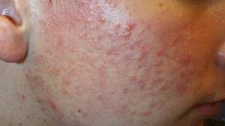
ACNE DISORDERS
Acne is a common skin disease characterized by pimples on the face, chest, and back. It occurs when the pores of the skin become clogged with oil, dead skin cells, and bacteria.

Slide 40
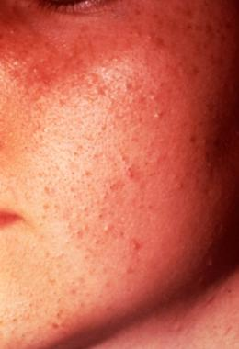
Types
Acne Vulgaris: Acne vulgaris is a common chronic skin disease involving blockage and inflammation (hair follicles and their accompanying sebaceous gland). Acne can present as non inflammatory lesions, inflammatory lesions, or a mixture of both, affecting mostly the face but also the back and chest.

Slide 41
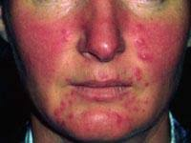
Rosacea is a long-term skin condition that typically affects the face. It results in redness, pimples, swelling, and small and superficial dilated blood vessels. Found on the nose, cheeks, forehead, and chin.

Slide 42
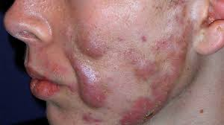
Acne Conglobata: It is uncommon severe type of acne that starts in middle adulthood. It is characterized by burrowing, interconnecting abscess and irregular scars.

Slide 43
causes
Excessive sebum production
Bacterial infection
Change in hormone
Family history
Psychological factors
Diet such as cow milk, salt, chocolate, high fat and glucose diet, hot spicy foods, tea, coffee, alcohol
Sun light

Slide 44
Pathophysiology
Sebaceous glands stimulated by various factors
Secrete sebum which flow out on to a skin surface
pilosabaceous ducts got plugged
Comedones appeared

Slide 45
Clinical Manifestation
Lesions on face, neck, back, chest and shoulder
Black and white heads, pustules, papules, nodules
Deep scar or pigmentation
Facial flushing
Enlarged pores

Slide 46
Medical management
Diet therapy: limited diet which increase acne
Anti acne medicines: isotretinoin, azelaic acid
Antibiotics: erythromycin, tetracycline and clindamycin in topical or oral form.

Slide 47
Nursing management
Advice to wash the face with soap at least twice a day.
Shampoo hair 2-3 times a week
Advice to eat well balanced diet
Advice regular exercise and yoga
Advice to avoid manipulation of lesions
Advice to avoid frequent touching of face
Advice to avoid sun exposure

Slide 48
Anti-acne management
Avoid medication for pregnant women, hypersensitive to sun.
Advice to test the cream for reaction before use.
Apply the cream to dry clean skin
Avoid frequent skin preparation like after shave, lotion, menthol use.
Avoid cream to eyes, mouth, angle of nose and mucous membranes.
Advice to take pills with food.

Slide 49
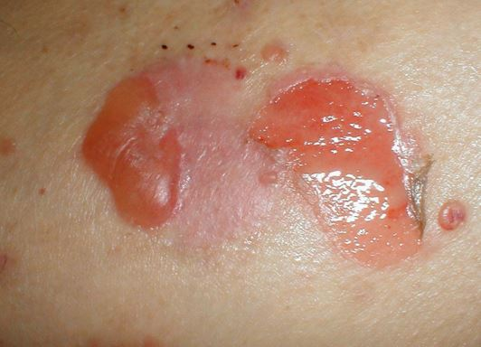
PEMPHIGUS VULGARIS
It is a rare autoimmune disease that causes painful blistering on the skin and mucous membranes.

Slide 50
Risk factors
More common in middle and older adults
Certain drugs penicillamine and captropil
Clinical manifestation
painful blisters that start in the mouth, scalp and spread to larger areas like face, back, chest, umbilicus and groin.
oozing, crusting, or peeling at the blister site.
Fluid and electrolyte imbalance due to fluid loss

Slide 51
Medical management
Topical corticosteroids
Oral corticosteroids after meals
Antacids to prevent gastric ulcers
Plasmapheresis to remove antibodies from serum.

Slide 52
Nursing management
Advice oral hygiene by mouth wash
Examine areas for blister
Keep the lip moist with lip balm
Keep the environment humid
Advice cool wet dressing or bath
Apply non irritating powder
Advice cool non-irritating fluid
Advice high calorie and protein diet

Slide 53
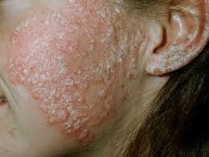
PSORIASIS
It is a chronic, non-infectious, recurrent erythematous inflammatory disorder involving keratin synthesis. It is characterized by raised, reddened, round circumscribed plaques covered by silvery white scales. It can occur in any age.

Slide 54
Risk Factors
Family history
Environmental factors
Hormonal fluctuation
Anxiety and stress

Slide 55
Pathophysiology
Keratinocytes epidermis cells migrate from basal cell to the stratum corneum within 14 days
Takes 14 days for sloughing
hyperkeratosis

Slide 56
Normal cell maturation and growth does not occur
Erythema of lesions due to increased vascularity
Cytokines is ( a protein) secreted by immune cells
inflammation and plaque formation

Slide 57
Clinical Manifestation
Eruption lesions occurs on scalp, elbows, knees, genitalia and sacral regions.
Symmetrical
Lesions are small and painful tissues
Nail is yellow or brown color
Pustular lesions on palm and soles.

Slide 58
Medical Management
Topical medicine: corticosteroids
Corticosteroids topical injection into lesions
Anti-inflammatory drugs
Topical anthralin for plaque patches
Calcipotriene for short and long term treatment.
Photo chemotherapy: drug administered orally and after 2 hours ultra violet rays given.

Slide 59
Nursing management
Teach patient skin care
Advice patient not to scratch or pull scales
Advice patient to take warm water bath
Dry the skin by blotting with towel
Lubricate skin with coconut oil
Gently rub lesions in circular motion with clean wash cloth
Apply medicine in thin layer
Keep medicine away from eyes and mucous membrane

Slide 60
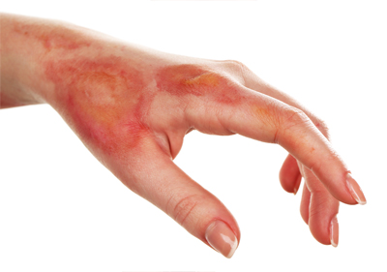
BURNS
It is damage to the skin or other body parts caused by extreme heat, flame, contact with heated objects, or chemicals.

Slide 61
Causes
Thermal burn
Chemical burn
Electrical burn
Radiation burn
Inhalation injury

Slide 62
Classification
According to the burn depth:
Superficial partial thickness or first degree burn: minimal tissue damage on upper layer of skin. Eg: sunburn
Redness, pain and minor swelling, dry skin with blister
Heals within 3 to 6 days

Slide 63
Deep partial thickness or second degree burns: affects both the epidermis, dermis, sweat glands and hair follicles.
Redness, pain, swelling, blisters and scar
Heals within 1 to 3 weeks

Slide 64
full thickness wound or third degree burns:
Affects epidermis, dermis, hypodermis, organs, tissues, muscle and bones.
Dry surface, waxy white, leathery, brown with no pain or little pain
Slow healing usually with skin grafting

Slide 65
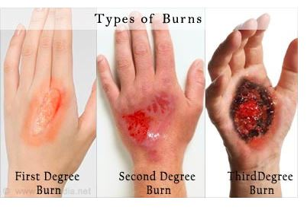
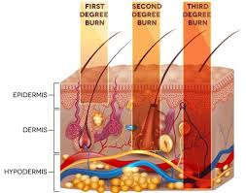

Slide 66
Fourth degree burns: damage muscle, bone and tendons exposed to surface due to electrical or chemical injuries. In this amputation required.

Slide 67
according to severity:
Minor burns: all first degree and second degree burns less than 10% of body surface.
Moderate burns: burns on hands, feet, face or genitals more than 10% of body surface.
Severe burns: full thickness burn with 25% of body surface area.

Slide 68
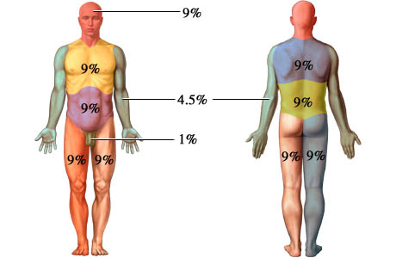
According to the extent of body surface area injured:
The rule of nine

Slide 69
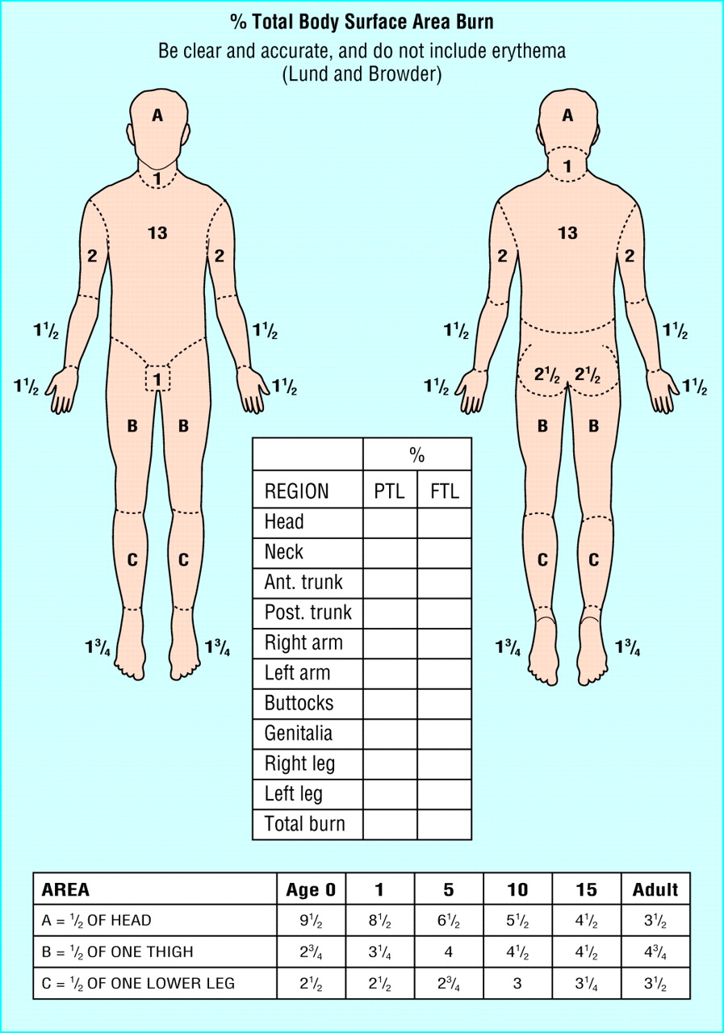
2. Lund and browder method

Slide 70
Effects of burns
Local effects
Tissue damage
Inflammation
Infection
b) Systematic effects
Fluid loss
Multiple organ failure
Inhalation injury

Slide 71
Management of burn
Medical treatment
Water-based treatments
Fluids to prevent dehydration
Pain and anxiety medications
Burn creams and ointments : bacitracin and silver sulfadiazine
Dressings
IV antibiotics
Tetanus shot

Slide 72
Surgical treatment
Skin grafts. A skin graft is a surgical procedure in which sections of your own healthy skin are used to replace the scar tissue caused by deep burns. Donor skin from deceased donors or pigs can be used as a temporary solution.
Plastic surgery. Plastic surgery (reconstruction) can improve the appearance of burn scars and increase the flexibility of joints affected by scarring.

Slide 73
types
Skin grafts. This is often used for burn patients; skin is removed from one area of the body and transplanted to another. ...
Microsurgery. Have you lost a finger, toe, ear, or even a lip? ...
Free flap procedure. ...
Tissue expansion
Complication :reactions to the medications, breathing problems, bleeding, and infection. ... The most common reason for graft failure is the formation of a hematoma, or collection of blood in the injured tissues.

Slide 74
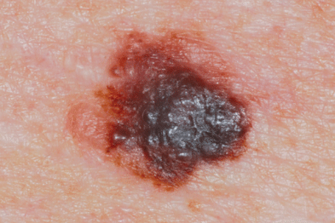
MALIGNANT MELANOMA
It is a cancer of melanocytes, which produce melanin.
It is the most deadly cancer of skin
Melanoma has the ability to metastasize to any organ including brain and heart.

Slide 75
Causes and Risk Factors
Exact cause is unknown
Chronic UV exposure without sun protection
Over exposure to artificial light ( tanning bed)
Fair skinned people, blond hair or blue eyes
Immuno suppressive medicines
Past history of melanoma
Over age 50
High no. of moles or large moles
herbicides

Slide 76
Pathophysiology
Melanocytes cells produce melanin
It transfers to keratinocytes
Where it accumulates and form shied of pigments over nucleus (for protection against uv rays)
Tumor develop within epidermis( flat and benign)

Slide 77
l
Lesion penetrate the dermis, mix with blood and lymph vessels (to metastasize)
Nodular lesions appearance around periphery

Slide 78
Clinical manifestation
Change in skin lesion (observed once a period of month): Change in diameter, bleeding, itching, ulceration, change in color, palpable lymph nodes.
Various shades of brown, black or blue within one lesion.
Irregular raised surface.

Slide 79
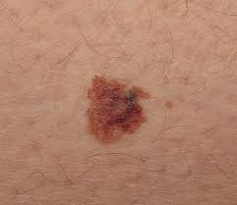
Classification
Superficial spreading melanoma: is a type of skin cancer that slowly grows horizontally across the top layer of skin before moving to the deeper layers. It's the most common form of melanoma, accounting for 70 percent of all cases.

Slide 80
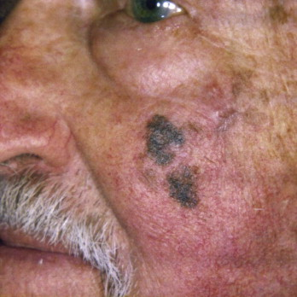
2. Lentigo maligna melanoma:
They are usually found on chronically sun damaged skin such as the face and the forearms of the elderly.

Slide 81
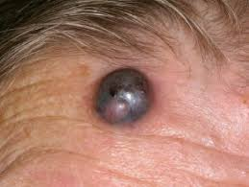
3. Nodular melanoma
Is the most aggressive form of melanoma. It tends to grow more rapidly in thickness (penetrate the skin) than in diameter. Instead of arising from a pre-existing mole, it may appear in a spot where a lesion did not previously exist .

Slide 82
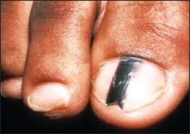
4. Acral lentiginous melanoma
Is a specific type of melanoma that appears on the palms of the hands, the soles of the feet, or under the nails. Melanocytes contain your skin color (known as melanin or pigment). In this type of melanoma, the word “acral” refers to the occurrence of the melanoma on the palms or soles.

Slide 83
Diagnostic evaluation
Assess the melanoma: asymmetry, border irregularity, color variation, diameter >6mm
Biopsy
Blood test: CBC
CT and MRI scan
Liver scan

Slide 84
Surgical management
Immunotherapy
Radiation therapy

