Slide 1
ANGINA PECTORIS
By: Gincy Samuel
Asst. Professor
Department: MSN

Slide 2
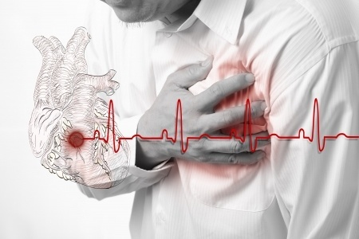
Definition
Angina is chest pain due to coronary heart disease resulting from myocardial ischemia cause pressure in the anterior chest.

Slide 3
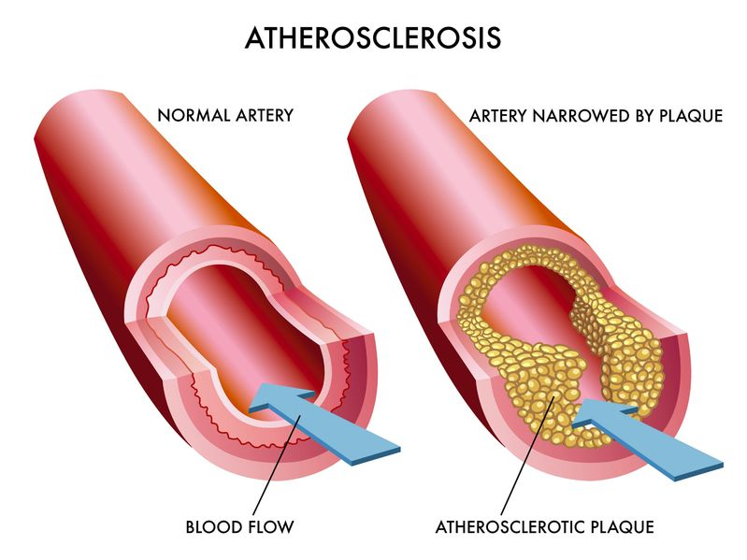
Etiology
It is mainly due to imbalance between oxygen supply and demand.
1. Coronary artery disease: Atherosclerosis
Atherosclerosis is a condition in which a fatty substance/cholesterol builds up inside the blood vessels.

Slide 4
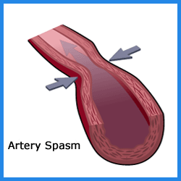
2. Coronary artery spasm:
Spasm of the muscles surrounding the coronary arteries causes them to narrow or close off temporarily.

Slide 5
Other causes.
Blockage of a coronary artery by a blood clot or by compression from something outside the artery.
Inflammation or infection of the coronary arteries.
Injury to one or more coronary arteries.
Poor functioning of the tiny blood vessels of the heart (microvascular angina)

Slide 7
Types:
STABLE ANGINA
This type of chest pain occurs with activities that involve exertion or emotional stress and is relieved by rest or medication. It has a stable pattern of onset, duration.
2. UNSTABLE ANGINA
This type of chest pain occurs with activities that involve exertion or emotional stress but it is not relieved by rest or medication. It increases in onset, duration.

Slide 8
3. Variant angina or vasospastic angina.
It results from the coronary artery spasm it may occur at rest, usually night.
4. Micro vascular angina.
Chest pain but no blockage.
Silent ischemia angina.
No chest pain but imbalance between myocardial oxygen and demand.

Slide 9
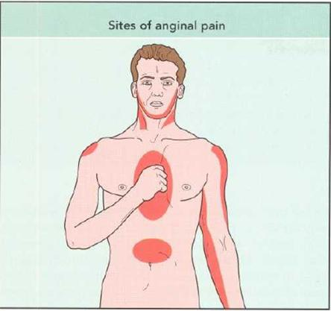
Signs and symptoms:
Pain which radiate to the shoulders, jaw, arm, neck, and back and it may be crushing, squeezing pain may occur. It may last from 5 min to 20 min.
Dyspnoea
Pallor
Sweating
Palpitation and tachycardia
Dizziness and faintness
Hypertension

Slide 10
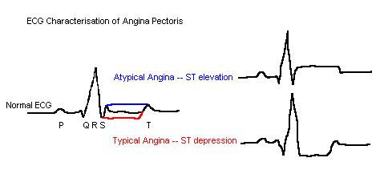
Assessment and diagnosis:
History and physical examination.
ECG: it will be normal in the rest time but during the pain ST depression or elevation can be seen and also T wave inversion can be seen.

Slide 11
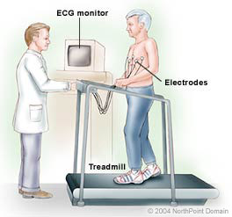
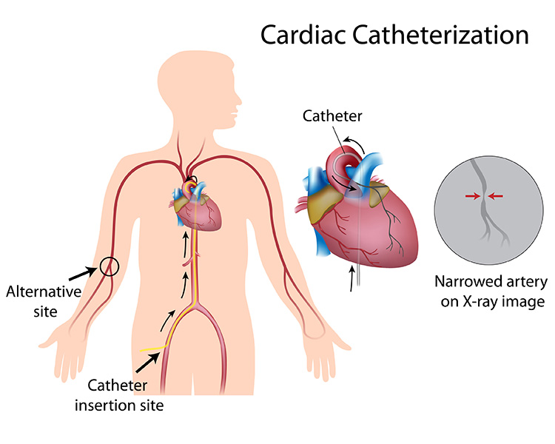
Echocardiogram, chest x-ray
Lipid profile.
TMT, CT, coronary angiography
Cardiac catheterisation.

Slide 12
Medical management
Nitroglycerin: it is a sublingual (under the tongue) medication relieves angina symptoms by expanding blood vessels and decreasing the muscle's need for oxygen.
Beta blockers: Beta blockers lessen the heart's workload.
Calcium channel blockers
Aspirin: Daily aspirin decrease blood clot
Statins: Statins lower cholesterol
Antihypertensive drugs

Slide 13
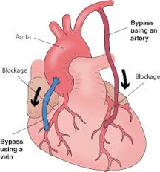
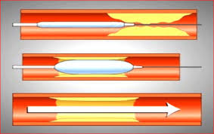
Surgical treatment:
Coronary Artery Bypass Surgery
Percutaneous trans luminal coronary angioplasty

Slide 14
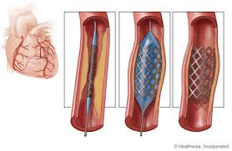
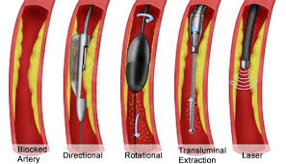
Coronary stent
Atherectomy

Slide 15
Prevention:
The best action is to reduce risk factors early in life.
Stop smoking
Control high blood pressure.
Lower blood fats (through diet, exercise, and medications).
Maintain a healthy weight.
Control diabetes and blood sugar
Do not use stimulants such as cocaine

