Slide 1
CELLULITIS
By: Gincy Samuel
Asst. Professor
Department: MSN

Slide 2
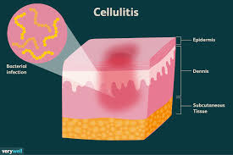
CELLULITIS
Cellulitis is a bacterial infection in the deeper layers of skin , fat and soft tissue underneath. It affects the skin on the lower legs, face, arms and other areas of the body.

Slide 3
Causes
streptococcus and staphylococcus bacteria
staphylococcus infection called methicillin-resistant Staphylococcus aureus (MRSA)
animal bites
dry, swollen skin, crack or break in the skin

Slide 4
Risk factors
Injury: such as cut, fracture, burn
Disease: such as diabetes, leukemia and HIV/AIDS
Certain medications
Skin conditions. eczema, athlete's foot
Chronic swelling of the arms or legs (lymphedema
History of cellulitis
Obesity

Slide 5
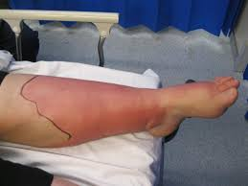
Symptoms
Red skin and Swelling
Tenderness and Pain
Warmth
Fever
Red spots and Blisters
Skin dimpling

Slide 6
Complications
damage the lymphatic drainage system
deep-layer infection
chronic swelling of the affected limb

Slide 7
Diagnostic test
History collection
Physical examination
Blood test

Slide 8
Treatment
Oral antibiotic for 10 to 14 days (minimum)
IV antibiotics if fever and chronic cellulitis
Analgesics for pain
Advice to elevate the affected part of the body.
Advice to apply cool, damp cloth on the affected area

