Slide 1
CARDIOGENIC SHOCK
By: Gincy Samuel
Asst. Professor
Department: MSN

Slide 2
Cardiogenic shock
It occurs when the heart is unable to supply enough blood to the vital organs of the body.
As a result of the failure of the heart to pump enough nutrients to the body, blood pressure falls and organs begins to fail.

Slide 3
Causes
Heart attack
Myocarditis
Endocarditis
Pulmonary embolism
Pericardial tamponade
Drug overdose or poisoning which affects heart's pumping ability.

Slide 4
Risk factors
Previous history of heart attack
Plaque deposition in the coronary arteries
Long-term valvular disease

Slide 5
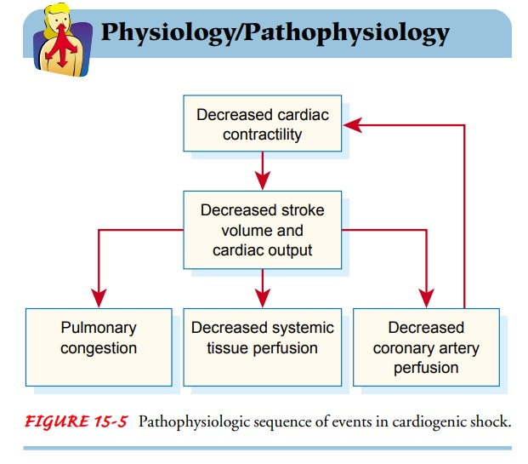

Slide 6
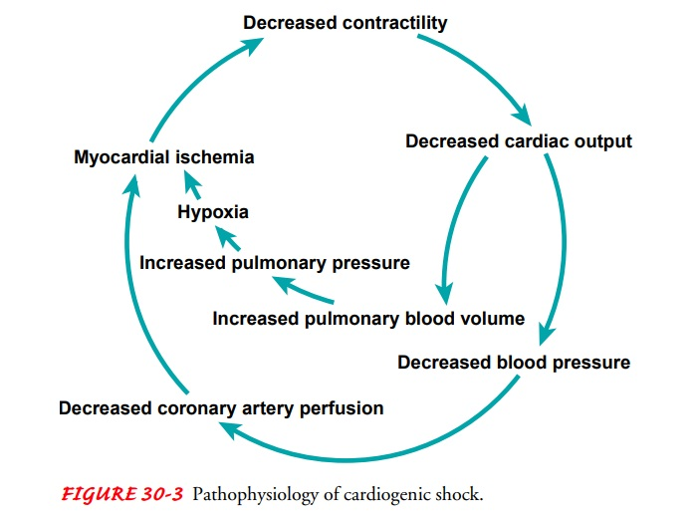

Slide 7
Symptoms
Rapid breathing
Severe shortness of breath
Loss of consciousness
Weak pulse
Hypotension
Sweating
Pale skin
Cold hands or feet
Oliguria or Anuria

Slide 8
Diagnostic Test
Blood pressure measurement
Chest X-ray
Blood tests
Echocardiogram
Cardiac catheterization (angiogram)

Slide 9
Treatment
Inotropic agents: dopamine, to improve the heart function by improving the pumping strength
Aspirin: to reduce blood clotting (anti-clotting action)
Thrombolytics: dissolve a blood clot which blocks the blood flow to the heart.
Blood-thinning: heparin, blood less likely to form clots

Slide 10
Surgical Treatment
Angioplasty and stenting
Balloon pump
Extracorporeal membrane oxygenation (ECMO)
Coronary artery bypass surgery
Damaged heart valve repair
Ventricular assist device
Heart transplant

