Slide 1
HEART BLOCK
By: Gincy Samuel
Asst. Professor
Department: MSN

Slide 2
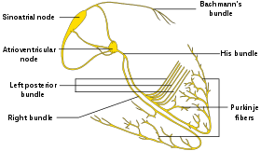
Heart block
It is an abnormal heart's rhythm where the heart beats too slowly (bradycardia). The electrical signals partially or totally blocks between the upper chambers (atria) and the lower chambers (ventricles).

Slide 3
Causes
Congenital heart block
Autoimmune diseases
Certain heart surgery
Change in the genes
Damage from a heart attack
Heart issues like clogged arteries inflammation of the heart muscle, and heart failure
Muscle disorders

Slide 4
Risk Factors
Well-trained athletes, teenagers and young adults.
Diseases such as coronary artery disease, rheumatic heart disease or other structural heart disorders

Slide 5
Degrees of Heart Block
First degree: This is the mildest form of heart block. The heart’s electrical signal is slowed but no need of treatment.

Slide 6
Second degree: few signals don’t reach the right place due to which the heart beats more slowly or miss the beats. It can be asymptomatic or symptomatic.

Slide 7
Third degree (complete heart block): No electrical impulses passes due to which heartbeat stop completely. This type of heart block is life threatening.

Slide 9
Symptoms
Second-degree heart block
Third-degree heart block
Chest pain
Dizziness
Fainting
Fatigue
Nausea
Shortness of breath
Missed heart beat
Cardiac arrest
Dizziness
Fainting
Severe tiredness
Irregular heartbeat
New palpitations

Slide 10
Diagnosis
Physical examination
Health history
ECG
Holter monitor

Slide 11
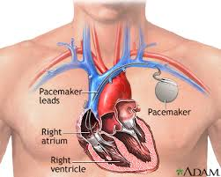
Treatment
For third degree block
Pacemaker: A pacemaker is a credit card-sized device that is implanted just under the skin in the chest or abdomen.

Slide 12
Prevention
Educate the patient about pacemaker.
Advice to inform all the health care providers about the pacemaker.
Advice to wear a medical bracelet or necklace, to inform others about pacemaker in an emergency.

Slide 13
Cont..
Advice to stay away from electrical devices with strong magnetic fields.
Advice to skip contact sports like football ,hockey.
Advice for follow up to check the pacemaker condition.

