Slide 1
ENDOCARDITIS
By: Gincy Samuel
Asst. Professor
Department: MSN

Slide 2
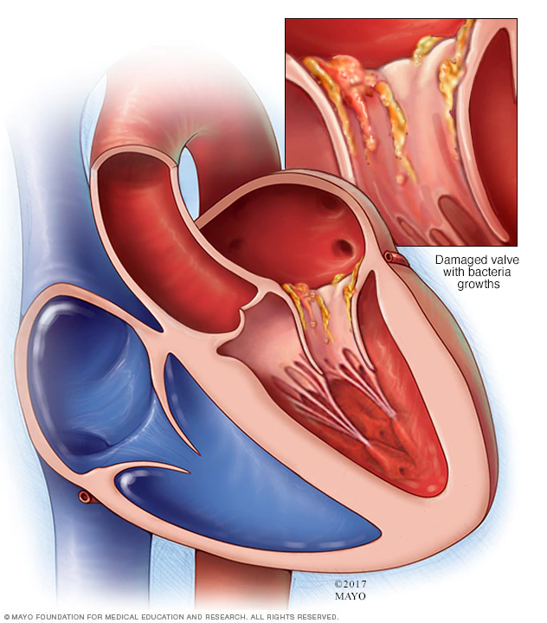
Endocarditis
Endocarditis is an infection of the endocardium, which is the inner lining of the heart chambers and heart valves.

Slide 3
Causes
Bacterial, fungal or germs in the bloodstream
Infection such as gum disease, STD, intestinal disorders
Tattoos and body piercing
Contaminated needles and syringes
Dental procedures
Catheter placed for a long period of time

Slide 4
Risk factors
Artificial heart valves
Congenital heart defects
History of endocarditis
Damaged heart valves
History of intravenous (IV) illegal drug use

Slide 5
Symptoms
Flu symptoms (fever and chills)
Heart murmur
Fatigue
Aching joints and muscles
Night sweats
Shortness of breath
Chest pain during breathing
Swelling in the feet, legs or abdomen

Slide 6
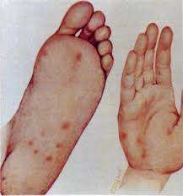
Cont…
Unexplained weight loss
Blood in the urine
Tenderness in the spleen
Janeway lesions: Red spots on the soles of the feet or the palms of the hands

Slide 7
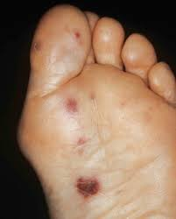
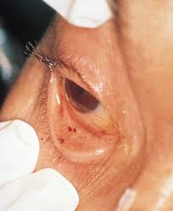
Osler's nodes: Red, tender spots under the skin of the fingers or toes
Petechiae: Tiny purple or red spots on the skin, whites of the eyes, or inside the mouth

Slide 8
Complications
Heart failure
Stroke
Seizure
Paralysis
Abscesses in the heart, brain, lungs and other organs
Pulmonary embolism
Kidney damage
Enlarged spleen

Slide 9
Diagnostic Test
Blood tests
Echocardiogram
Electrocardiogram (ECG)
Chest X-ray
Computerized tomography (CT) scan
Magnetic resonance imaging (MRI).

Slide 10
Treatment
Antibiotics : high doses of intravenous (IV)
Surgery: Repairing the damaged valve by
Biological tissue valve
Or
Mechanical valve

