Slide 1
HEART FAILURE [CONGESTIVE HEART FAILURE]
By: Gincy Samuel
Asst. Professor
Department: MSN

Slide 2
HEART FAILURE
Heart failure also known as congestive heart failure. It is the failure of the heart to pump blood with normal efficiency. Due to which the heart is unable to provide adequate blood flow to other organs, such as the brain, liver, and kidneys.

Slide 3
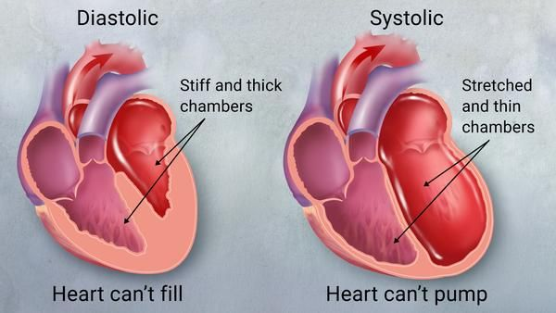
Types
Left-sided heart failure
Right-sided heart failure
Systolic heart failure
Diastolic heart failure

Slide 4
Causes
Coronary artery disease and heart attack
High blood pressure (hypertension)
Valvular heart disease
Damage to the heart muscle (cardiomyopathy)
Myocarditis
Congenital heart defects
Abnormal heart rhythms

Slide 5
Other diseases: Such as diabetes, HIV, hyperthyroidism, hypothyroidism
Acute heart failure due to
viruses that attack the heart muscle
severe infections
allergic reactions
blood clots in the lungs
use of certain medications

Slide 7
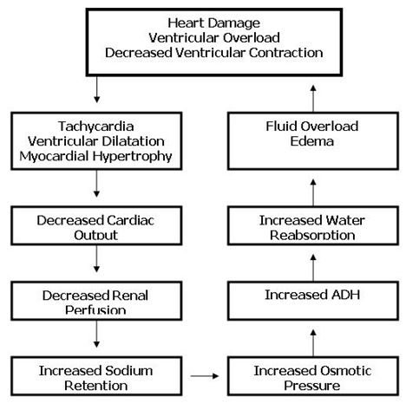

Slide 8
Symptoms
Shortness of breath (dyspnea)
Fatigue and weakness
Edema in legs, ankles and feet
Rapid or irregular heartbeat
Reduced ability to exercise

Slide 9
Cont..
Persistent cough or wheezing (white or pink)
Increased urination at night
Swelling of abdomen (ascites)
Rapid weight gain from fluid retention
Lack of appetite and nausea
Difficulty concentrating or decreased alertness

Slide 10
Complications
Kidney damage or failure
Heart valve diseases
Heart rhythm abnormalities
Liver damage or failure

Slide 11
Diagnostic test
Blood tests
Chest X-ray, Stress test
Electrocardiogram (ECG) and Echocardiogram
Cardiac computerized tomography (CT) scan
Magnetic resonance imaging (MRI)
Coronary angiogram
Myocardial biopsy

Slide 12
Medical Treatment
Angiotensin-converting enzyme (ACE) inhibitors: it widens the blood vessels
Beta blockers: it reduces blood pressure
Diuretics: it decreases fluid in the lungs
Inotropes: it improve heart pumping function
Digoxin: it increases the strength heart muscle contractions

Slide 13
Surgical Treatment
Coronary bypass surgery
Heart valve repair or replacement
Implantable cardioverter-defibrillators (ICDs) The ICD monitors the heart rhythm. If the heart starts beating abnormal or stops, the ICD give shocks to heart for normal rhythm.

Slide 14
Ventricular assist devices (VADs)
Heart transplant

