Slide 1
LEUKOCYTOSIS AND LEUKEMIA
Mrs. Gincy Samuel

Slide 2
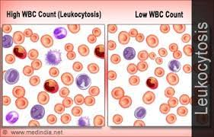
LEUKOCYTOSIS
It is a condition in which the white cell (leukocyte count) is greater than 11,000 per mm³ in the blood. Due to infection, or certain parasitic infections or bone tumors / leukemia.

Slide 3
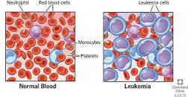
LEUKEMIA
Leukemia is cancer of the blood-forming tissues, including the bone marrow and the lymphatic system.

Slide 4
Causes and Risk Factors
Idiopathic
Smoke
Exposed to radiation or certain chemicals
Cancer treatment
Family history of leukemia
Genetic disorder like Down syndrome

Slide 5
Pathophysiology
Certain abnormalities cause the cell to grow and divide more rapidly and to continue living when normal cells would die. Over time, these abnormal cells can crowd out healthy blood cells in the bone marrow, leading to fewer healthy white blood cells, red blood cells and platelets, causing the signs and symptoms of leukemia

Slide 6
Classifications
based on the time it develops
Acute leukemia
Chronic leukemia
Based on the type of white blood cell affected
Lymphocytic leukemia
Myelogenous leukemia

Slide 7
Acute leukemia
In acute leukemia, the abnormal blood cells are immature blood cells which doesn’t carry normal functions, and multiply rapidly. This type of leukemia worsens quickly. Acute leukemia requires aggressive, timely treatment.

Slide 8
Chronic leukemia
Chronic leukemia involves more mature blood cells. These blood cells replicate or accumulate more slowly and can function normally for a period of time. Some forms of chronic leukemia initially produce no early symptoms and can go unnoticed or undiagnosed for years.

Slide 9
Lymphocytic leukemia
This type of leukemia affects the lymphoid cells (lymphocytes), which form lymphoid or lymphatic tissue. Lymphatic tissue helps to form immune system.

Slide 10
Myelogenous leukemia
This type of leukemia affects the myeloid cells. Myeloid cells helps to form red blood cells, white blood cells and platelet-producing cells.

Slide 11
Types of leukemia
Acute lymphocytic leukemia (ALL) is the most common type of leukemia in young children. ALL can also occur in adults.
Acute myelogenous leukemia (AML) is a common type of leukemia. It occurs in children and adults. AML is the most common type of acute leukemia in adults.

Slide 12
Cont…
Chronic lymphocytic leukemia (CLL) is the most common chronic adult leukemia, no symptoms for years and without treatment.
Chronic myelogenous leukemia (CML) is type of leukemia mainly affects adults, few or no symptoms for months or years before entering a phase in which the leukemia cells grow more quickly.

Slide 13
Symptoms
Weakness
Bleeding
Fever or chills
Repeated Infections
Pain in the bones or joints
Headache, Seizures
Vomiting
Weight loss
Night sweats
Shortness of breath
Swollen lymph nodes or spleen

Slide 14
Diagnostic test
Physical examination: pale skin from anemia, swelling of the lymph nodes, and enlargement of the liver and spleen.
CBC test

Slide 15
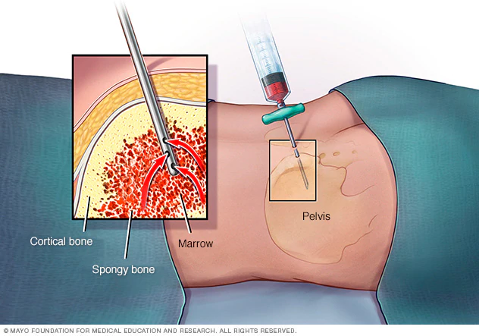
Bone marrow test
It is a procedure to remove sample of bone marrow from the hipbone. The bone marrow is removed
using a long,
thin needle.

Slide 16
Treatment
Chemotherapy
Radiation therapy
Stem cell transplant: It is a procedure to replace the diseased bone marrow with healthy bone marrow.

