Slide 1
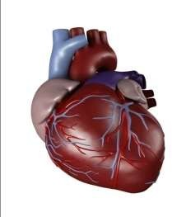

Slide 2
Heart failure
CHF is defined as the pathophysiologic state in which the heart is unable to pump blood at a rate commensurate(proportionate) with the body's metabolic needs (oxygen delivery).
Heart failure occurs when the heart cannot deliver adequate cardiac output to meet the metabolic needs of the body.

Slide 3
Factors Affecting Cardiac Performance
Cardiac output depends on: stroke volume and heart rate.
Stroke volume is dependent on three important factors:
preload,
afterload and
contractility.

Slide 4
Factors Affecting Cardiac Performance
Preload:
Preload (volume overload, End Diastolic Volume).
preload (such as in VSD, PDA, or valvular insufficiency).
Afterload:
Afterload is the resistance (pressure) against which the heart must
pump blood: e.g; systemic vascular resistance.
Afterload (such as with aortic stenosis, pulmonary stenosis, or coarctation of the aorta)
Contractility
Contractility (Cardiac Performance Independent of Preload or
Afterload)
Volume overload is the most common cause of CHF in children

Slide 5
Factors Affecting Cardiac Performance
Preload (Left Ventricular Diastolic Volume)
Total blood volume
Venous tone (sympathetic tone)
Body position
Intrathoracic and intrapericardial pressure
Atrial contraction
Pumping action of skeletal muscle
Afterload (Impedance Against Which the Left Ventricle Must Eject Blood)
Peripheral vascular resistance
Left ventricular volume (preload, wall tension)
Physical characteristics of the arterial tree (elasticity of vessels or presence of outflow obstruction)
Contractility (Cardiac Performance Independent of Preload or Afterload)
Sympathetic nerve impulses*
Circulating catecholamines*
Anoxia, acidosis†
Loss of myocardium†
Heart Rate
Autonomic nervous system
Temperature, metabolic rate

Slide 6
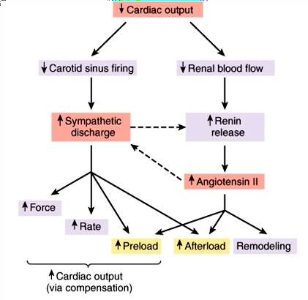

Slide 7
Compensatory mechanisms in heart failure
Cardiac compensation
increased HR and cardiac contractility
Cardiac dilatation (The Frank-Starling mechanism)
Myocardial hypertrophy
Systemic compensation
Increase the blood volume
Redistribution of blood flow
Increase of erythrocytes
Increased ability of tissues to utilize oxygen
neurohormonal compensation
Sympathetic nervous system
Renin-angiotensin system
Atrial natriuretic peptide; endothelin

Slide 8
Etiology of Heart Failure
Fetus | Premature Neonate
Severe anemia (hemolysis, fetal-maternal transfusion) | Fluid overload
Supraventricular tachycardia | PDA
Ventricular tachycardia | VSD
Complete heart block
Atrioventricular valve insufficiency
Full-Term Neonate | Infant-Toddler
Asphyxial cardiomyopathy | Left-to-right cardiac shunts (VSD)
Left-sided obstructive lesions (coarctation of aorta) | Metabolic cardiomyopathy
Transposition of great arteries | Acute hypertension (hemolytic-uremic syndrome)
Viral myocarditis | Supraventricular tachycardia
Anemia | Kawasaki disease
Supraventricular tachycardia
Complete heart block
Child-Adolescent
Rheumatic fever | Acute hypertension (glomerulonephritis)
Viral myocarditis | Thyrotoxicosis
Endocarditis | Cor pulmonale (cystic fibrosis)
Arrhythmias | Chronic upper airway obstruction (cor pulmonale)
Cardiomyopathy

Slide 9
Etiology of Heart Failure
In the first weeks of life, CHF is most commonly due to an excessive afterload being placed on the myocardium.
CHF presenting around 2 months of age is usually due to increasing left-to-right shunts of congenital heart defects that become apparent as the pulmonary vascular resistance decreases.
Acquired heart disease, such as myocarditis and cardiomyopathy, can present at any age.

Slide 10
Classification of heart failure
According to the course of disease
Acute HF
Chronic HF
According to the severity
mild HF or complete compensation
middle HF or incomplete compensation
severe HF or decompensation 3)According to the cardiac output (CO)
Low-output HF: due to volume overload, pressure overload & contractility problems.
High-output HF: Heart Rate is primarily affected;3A(Anemia, Arrythmia, AV Fistula)

Slide 11
(4) According to the location of heart failure
Left -side heart failure (LHF)
Right-side heart failure (RHF)
Biventricular failure (whole heart failure)
According to the function impaired
systolic failure :Myocarditis, hypertension
Diastolic failure: restrictive cardiomyopathy, cardiac tamponate.

Slide 12
CLINICAL MANIFESTATIONS
Clinical presentation of CHF in infants includes poor feeding, failure to thrive, tachypnea, and diaphoresis with feeding.
Older children may present with shortness of breath, easy fatigability, and edema.
The physical examination findings depend on whether pulmonary venous congestion, systemic venous congestion, or both are present.
Tachycardia, a gallop rhythm, and thready pulses may be present with either cause.
If left-sided failure is predominant, tachypnea, orthopnea, wheezing, and pulmonary edema are seen.
If right-sided failure is present, hepatomegaly, edema, and distended neck veins are present.

Slide 13
IMAGING STUDIES
chest x-ray: cardiomegaly.
ECG: Arrhythmias
An echocardiogram assesses the heart chamber sizes, measures myocardial function accurately, and diagnoses congenital heart defects when present.

Slide 14
Treatment principles
(1) Correct the underlying causes of HF
(2) Diet; (low salt and high calories)
(3) Digitals; Improve the cardiac contractility
(4) Diuretics; Reducing preload: frusemide
(4) Dilators; Reducing afterload; ACE
Remember 4 D

Slide 15
Treatment of Heart Failure
General Care
Rest | Reduces cardiac output
Oxygen | Improves oxygenation in presence of pulmonary edema
Sodium, fluid restrictions | Decreases vascular congestion; decreases preload
Other
Transplantation | Removes diseased heart
Carvedilol | β-blocking agent

Slide 16
Diuretics; Reducing preload
Diuretics
Furosemide | Salt excretion by ascending loop of Henle; reduces preload; afterload reduced if hypertension improves; may also cause venodilation
Combination of distal tubule and loop diuretics | Greater sodium excretion

Slide 17
Improve the cardiac contractility
Inotropic Agents
Digitalis | Inhibits membrane Na⁺, K⁺-ATPase and increases intracellular Ca²⁺, improves cardiac contractility, increases myocardial oxygen consumption
Dopamine | Releases myocardial norepinephrine plus direct effect on β-receptor, may increase systemic blood pressure; at low infusion rates, dilates renal artery, facilitating diuresis

Slide 18
Dilators; Reducing afterload
Afterload Reduction
Hydralazine | Arteriolar vasodilator
Nitroprusside | Arterial and venous relaxation; venodilation reduces preload
Captopril/enalapril | Inhibition of angiotensin-converting enzyme; reduces angiotensin II production

Slide 19
Thanks

