Slide 1
ANATOMICAL TERMS AND POSITIONS
Mrs.Mercy Deva Priya
Asst.Prof.
Dept of MHN

Slide 7
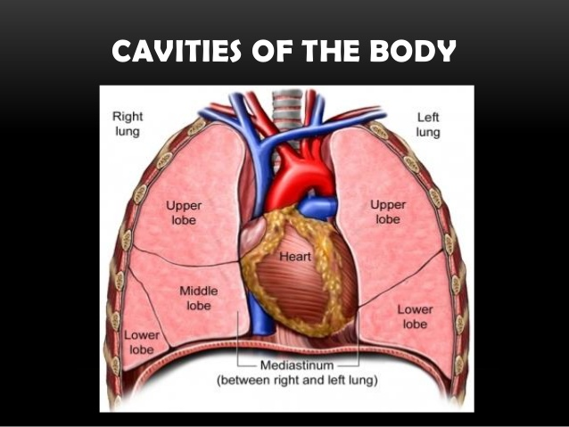

Slide 8
