Slide 1
RESPIRATORY SYSTEM

Slide 2
INTRODUCTION
Blood provides the transport system for these gases between the lungs and the cells of the body.
Exchange of gases between the blood and the lungs is called external respiration and that between the blood and the cells internal respiration.

Slide 3
The organs of the respiratory system are:
nose
pharynx
larynx
trachea
two bronchi (one bronchus to each lung)
bronchioles and smaller air passages
two lungs and their coverings, the pleura
muscles of respiration — the intercostal muscles and
the diaphragm.

Slide 5
NOSE AND NASAL CAVITY
Position and structure
The nasal cavity is the first of the respiratory organs and consists of a large irregular cavity divided into two equal passages by a septum.
The posterior bony part of the septum is formed by the perpendicular plate of the ethmoid bone and the vomer.
Anteriorly it consists of hyaline cartilage

Slide 6
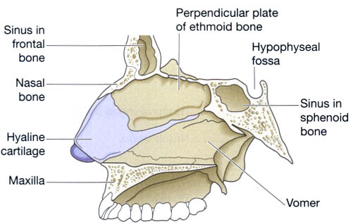

Slide 7
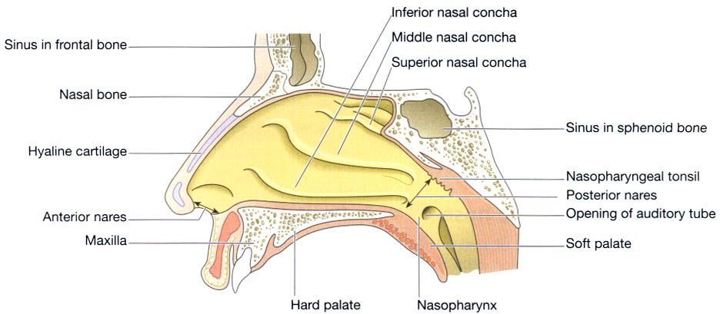

Slide 8
Respiratory function of the nose
The function of the nose is to begin the process by which the air is warmed, moistened and 'filtered'.
Warming.
Filtering and cleaning of air.
Humidification.
Olfactory function of the nose

Slide 9
PHARYNX
Position
The pharynx is a tube 12 to 14 cm long that extends from the base of the skull to the level of the 6th cervical vertebra.
It lies behind the nose, mouth and larynx and is wider at its upper end.

Slide 10
Structures associated with the pharynx
Superiorly — the inferior surface of the base of the skull
Inferiorly — it is continuous with the oesophagus
Anteriorly — the wall is incomplete because of the openings into the nose, mouth and larynx
Posteriorly — areolar tissue, involuntary muscle and the bodies of the first six cervical vertebrae.

Slide 11
The pharynx is divided into three parts: nasopharynx, oropharynx and laryngopharynx.
Structure
The pharynx is composed of three layers of tissue:
1. Mucous membrane lining.
2. Fibrous tissue.
3.Muscle tissue

Slide 12
Blood and nerve supply
By several branches of the facial artery.
The venous return is into the facial and internal jugular veins.
The nerve supply is from the pharyngeal plexus,
formed by parasympathetic and sympathetic nerves.
Parasympathetic supply is by the vagus and glossopharyngeal nerves.
Sympathetic supply is by nerves from the superior cervical ganglia

Slide 13
Functions
Passageway for air and food.
Warming and humidifying.
Taste.
Hearing
Protection
Speech

