Slide 1
Uterine tubes (Fallopian tubes)
Mrs.Mercy Deva Priya
Asst.Prof.
Dept . Of MHN

Slide 2
The uterine tubes are about 10 cm long and extend from the sides of the uterus between the body and the fundus.
They lie in the upper free border of the broad ligament and their trumpet-shaped lateral ends penetrate the posterior wall, opening into the peritoneal cavity close to the ovaries.
The end of each tube has fingerlike projections called fimbriae. The longest of these is the ovarian fimbria which is in close association with the ovary.

Slide 3
Structure of the uterine tubes
The uterine tubes have an outer covering of peritoneum (broad ligament), a middle layer of smooth muscle and are lined with ciliated epithelium.
Blood supply, lymph drainage and nerve supply
These are the same as for the uterus.

Slide 4
Function of the uterine tubes
The uterine tubes convey the ovum from the ovary to the uterus by peristalsis and ciliary movement.
The mucus secreted by the lining membrane provides ideal conditions for movement of ova and spermatozoa.
Fertilisation of the ovum usually takes place in the uterine tube, and the zygote is propelled into the uterus for implantation.

Slide 5
Ovaries
The ovaries are the female gonads, or glands.
They lie in a shallow fossa on the lateral walls of the pelvis.
They are 2.5 to 3.5 cm long, 2 cm wide and 1 cm
thick.
Each is attached to the upper part of the uterus by the ovarian ligament and to the back of the broad ligament by a broad band of tissue, the mesovarium.
Blood vessels and nerves pass to the ovary through the mesovarium

Slide 6
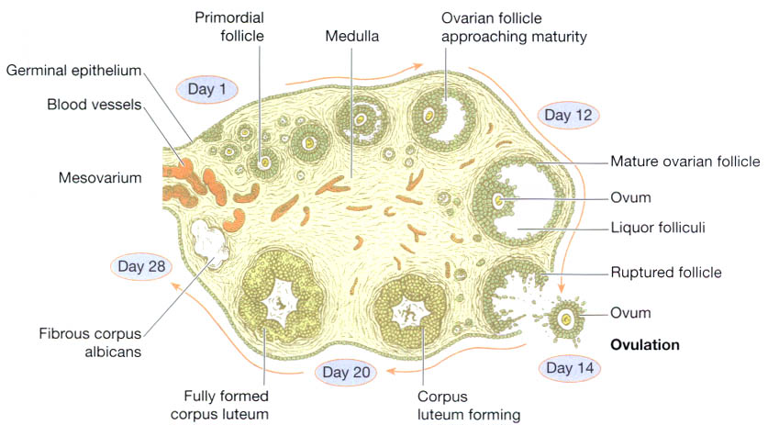

Slide 7
Structure of the ovaries
The ovaries have two layers of tissue.
The medulla. This lies in the centre and consists of fibrous tissue, blood vessels and nerves.
The cortex. This surrounds the medulla. It has a framework of connective tissue, or stroma, covered by germinal epithelium.
It contains ovarian follicles in various stages of maturity, each of which contains an ovum.

Slide 8
Before puberty the ovaries are inactive but the stroma already contains immature (primordial) follicles, which the female has from birth.
During the childbearing years, about every 28 days, one ovarian follicle (Graafian follicle) matures, ruptures and releases its ovum into the
peritoneal cavity.
This is called ovulation and it occurs during most menstrual cycles

Slide 9
Blood supply, lymph drainage and nerve supply
Arterial supply by the ovarian arteries
Venous drainage into a plexus of veins behind the uterus from which the ovarian veins arise.
Lymph drainage to the lateral aortic and pre-aortic lymph nodes.
Nerve supply by parasympathetic nerves from the sacral outflow and sympathetic nerves from the lumbar outflow.

Slide 10
Functions of the ovaries
Maturation of the follicle is stimulated by follicle stimulating hormone (FSH) from the anterior pituitary, and oestrogen secreted by the follicle lining cells.
Ovulation is triggered by a surge of luteinising hormone (LH) from the anterior pituitary, which occurs a few hours before ovulation.
After ovulation, the follicle lining cells develop into the corpus luteum (yellow body), under the influence of LH from the anterior pituitary.
The corpus luteum produces the hormone progesterone and some oestrogen.

Slide 11
If the ovum is fertilised it embeds itself in the
wall of the uterus where it grows and develops and produces the hormone human chorionic gonadotrophin (hCG), which stimulates the corpus luteum to continue secreting progesterone and oestrogen for the first 3 months of the pregnancy.

Slide 12
If the ovum is not fertilised the corpus luteum degenerates and a new cycle begins with menstruation.
At the site of the degenerate corpus luteum an inactive mass of fibrous tissue forms, called the corpus albicans.
Sometimes more than one follicle matures at a time, releasing two or more ova in the same cycle.
When this happens and the ova are fertilised the result is a multiple pregnancy.

Slide 13
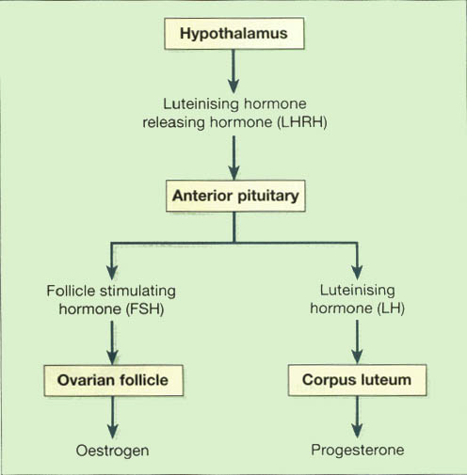
Female reproductive hormones and target tissues.

Slide 14
Puberty in the female
Puberty is the age at which the internal reproductive organs reaches maturity.
This is called the menarche, and marks the beginning of the childbearing period.
The ovaries are stimulated by the gonadotrophins from the anterior pituitary, follicle stimulating hormone and luteinising hormone.
The age of puberty varies between 10 and 14 years and a number of physical and psychological changes take place at this time:
the uterus, the uterine tubes and the ovaries reach maturity
the menstrual cycle and ovulation begin (menarche)
the breasts develop and enlarge
pubic and axillary hair begins to grow

Slide 15
there is an increase in the rate of growth in height and widening of the pelvis
there is an increase in the amount of fat deposited in the subcutaneous tissue, especially at the hips and breasts.

Slide 16
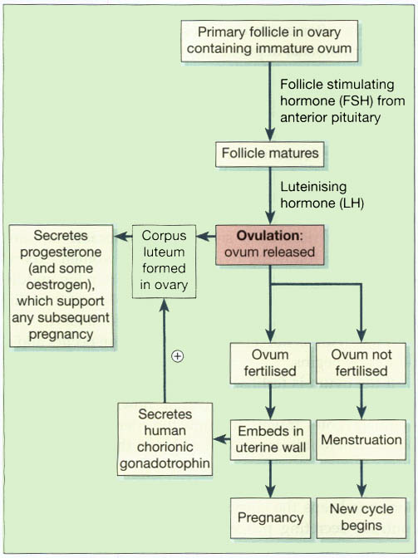
Summary of the stages of development of the ovum and the associated hormones.

