Slide 1
MOTIVATION
Mrs.Mercy Deva Priya
Asst.Prof.Dept of MHN

Slide 3
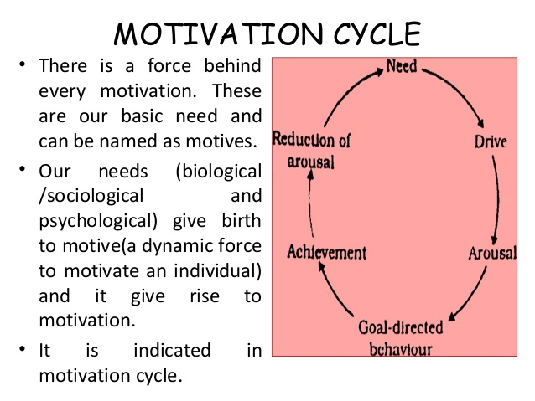

Slide 14
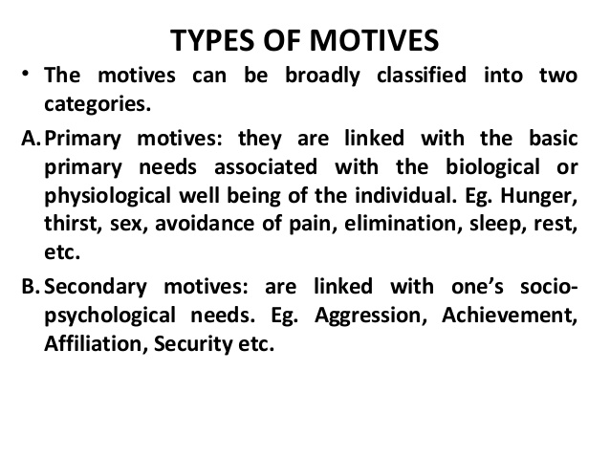

Slide 15
