Slide 1
Mrs. S Elaiyarasi S
Asst. Professor

Slide 2
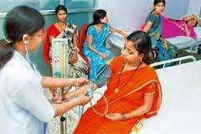
PRIMARY HEALTH CARE

Slide 3
PRIMARY HEALTH CARE
“Primary Health Care is essential health care made universally accessible to individuals & acceptable to them, through their full participation & at a cost the
community & country can afford”.

Slide 4
CHARACTERISTICS OF PHC
COST EFFECTIVE HEALTH CARE

Slide 5
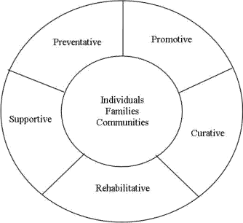
NATURE OF PHC

Slide 6
ELEMENTS OF PRIMARY HEALTH CARE
Education concerning prevailing health problem & the methods of preventing & controlling them.
Promotion of food supply & proper nutrition.

Slide 7
3.An adequate supply of safe water & basic sanitation.
4.Maternal & child health care, including family planning.
5.Immunization against major infectious diseases.

Slide 8
6.Prevention & control of locally endemic diseases.
7.Appropriate treatment of common diseases & injuries.
8.Provision of essential drugs.

Slide 9
PRINCIPLES OF PRIMARY HEALTH CARE
1.Equitable distribution.
2.Community participation.
3.Intersectoral coordination.
4.Appropriate technology.
5. Prevention

Slide 10
EQUITABLE DISTRIBUTION
Health services must be shared equally by all people irrespective of their ability to pay.
Rich or poor / rural or urban must have access to health services.

Slide 11
80% percentage of people live in rural areas & only 20% live in the urban areas, but the proportion of the health services is grossly inversely propotionate.ie, 80% of people are catered by only 20% & 20% are catered by 80% of health services.

Slide 12
This has been termed as social injustice.
Primary Health Care aims to readdress this imbalance by shifting the centre of gravity of the health care system from cities to the rural areas, & bring
these services as near people’s home
as possible.

Slide 13
COMMUNITY PARTICIPATION
Involvement of the individuals & community in promotion of their own health & welfare, is an essential ingredient of primary health care.

Slide 14
There must be a continuing effort to secure meaningful involvement of the community in planning, implementing & maintenance of health services, besides maximum reliance on local resources such as manpower, money & materials.

Slide 15
One approach – the VHG & Trained Dais has been successfully tried in India.
They are selected by the local community & trained locally in the delivery of primary health care to the community they belong.

Slide 16
By overcoming cultural & communication barriers, they provide primary health care in ways that are acceptable to the community.
It is now considered that “Health Guides” & “Trained Dais” are an essential feature of primary health care in India.

Slide 17
It is now considered that “Health Guides” & “Trained Dais” are an essential feature of primary health care in India.
These concepts are revolutionary. They have been greatly influenced by the experience in China where community participation in the from of “bare foot
doctors” took place on an unprecedented scale.

Slide 18
INTERSECTORAL CO - ORDINATION
There is an increasing realization that HFA cannot be provided by the health sector alone.

Slide 19
The declaration of Alma Ata states that primary health care involves in addition to health sector, all related sectors & aspects of national & community development, in particular agriculture, animal husbandry, food, industry, education, housing, public works, communication & other sectors.

Slide 20
To achieve such cooperation, countries may have to review their administrative system, reallocate their resources & introduce suitable legislation to ensure that coordination can take place.
This requires a strong political will to translate values into action.

Slide 21
An important approach is the inter sectoral approach.

Slide 22
APPROPRIATE TECHNONOLOGY
Appropriate technology has been defined as “technology that is
scientifically sound, adaptable to local needs, & acceptable to those who apply it & for those whom it is used & that cab be maintained by the people themselves in keeping with the principles of self reliance with the resources the community & country can afford”.

Slide 23
The term appropriate is emphasized because in some countries luxurious hospitals that are totally inappropriate to the local needs, are built, which absorb a major part of the national health budget, effectively blocking many improvement in general health services.

Slide 24
This also implies use of costly equipments, procedures & techniques when cheaper, scientifically valid & acceptable ones are available. (ORS packets over house to house sand pipe connections)

Slide 25
SERVICES UNDER PHC

Slide 26
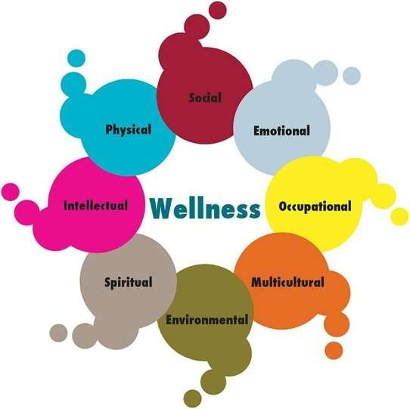
SERVICES IN PRIMARY HEALTH CARE
Education concerning prevailing health problems and the methods of preventing and controlling them.

Slide 27
Promotion of food supply and proper nutrition.

Slide 28
An adequate supply of safe water and basic sanitation.

Slide 29
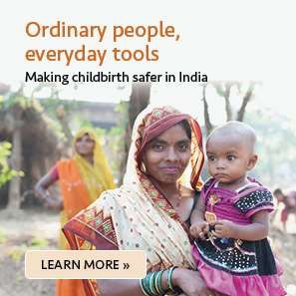
Maternal and child health care, including family planning.

Slide 30
Immunization against major infectious diseases.

Slide 31
Prevention and control of locally endemic diseases.
Appropriate treatment of common diseases and injuries.

Slide 32
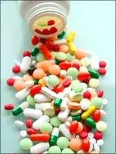
Provision of essential drugs

Slide 33
ROLE OF A NURSE
The role of a nurse to deal health needs and health problems of people at community level was realized by WHO in 1970s.

Slide 34
The same was recognized in 1977 during 30th WHO Assembly and also during International Conference on Primary Health care in 1978 at Alma Ata.

Slide 35
The participants at the meeting suggested to change/ modify basic, post basic and continuing education so that nurses are prepared to fit into national health care system and meet health care needs of people in the context of primary health care.

Slide 36
In 1970, the International Council of Nurses affirmed its commitment to primary health care.

Slide 37
It felt since nurses provide and continue to provide large part of health care in most countries, their training should and role in health care must be enlarged and enriched to fit into the changing health care approach.

Slide 38
It suggested changes in nursing curriculum, nursing practice and nursing administration so that nurses can participate from decision making level to grass root level and contribute to primary health care approach effectively.

Slide 39
The Trained Nurses Association of India (TNAI) affirmed its commitment to HFA through primary Health Care in its conference on Nursing Education in 1979.

Slide 40
It recommended to prepare nurses to work in the community, to re-orient nurses to primary health care, to have nurses at decision making position at the centre and state level and have more nurses in the district and primary health centres.

Slide 41
The Indian Nursing Council (INC) revised and modified the curriculum for ANM and BSc., Nursing ( to prepare nurses to perform primary health care roles and functions)

Slide 42
WHO study group in 1985 highlighted the following roles and functions of nurses in primary health care.

Slide 43
1.DIRECT CARE PROVIDER
The nurse provide direct care to individual, families and community with reference to 8 elements of primary health care.

Slide 44
E.g.,
For MCH care the nurse has to identify pregnant mothers, register them, conduct complete physical and obstetrical examination, identify high risk factors, give TT injection, IFA tablets, and health educate them about diet, rest and sleep, exercise etc.

Slide 45
2. HEALTH EDUCATOR & TEACHER
In order to promote health, prevent disease, regain and maintain health, the nurse educates individuals, families and community at large about healthful behaviour, sanitary environment, prevention of diseases etc.,

Slide 46
Whatever she does, even the care of the sick at home, she educates family members to take are of the sick in her absence and also other preventive measures.

Slide 47
As a teacher, she trains other health workers such as ANMs, health Guides, Village Dais.

Slide 48
3. PLANNER & CARE MANAGER
The nurse working for primary health care makes assessment of health needs, health problems of individuals, families and community.

Slide 49
The nurse plans care accordingly for them and implements the planned care.
The nurses involves individuals, families and community in planning and implementing of the care.

Slide 50
The nurses makes use of the community resources and guides them in giving care.
The nurse listens to and communicates with them and advise them accordingly.

Slide 51
She makes referrals when required.
She maintains the record of care given and evaluates the effectiveness of the same.

Slide 52
4. GUIDE & SUPERVISOR
As a nurse engaged in providing primary health care, she is expected to supervise, guide and help other personnel in providing care, planning health services for families and for the community.

Slide 53
SPECIFIED FUNCTIONS
Assessment of health needs and health problems of individuals and community.

Slide 54
Provide integrated comprehensive primary health care service related to 8 essential elements.
Mobilize involvement of individuals, families and community in providing primary health care.

Slide 55
Surveillance of locally endemic diseases.
Training and supervision of health workers.

Slide 56
Working in collaboration with other socioeconomic sectors.
Maintenance of accurate, complete and up-to-date records of health care services rendered.

Slide 57
Monitoring and analysis of health condition to determine the progress in primary health care.

Slide 58
THANK YOU

