Slide 1
NATIONAL HEALTH POLICY
Mrs. S Elaiyarasi
Asst. Professor

Slide 24
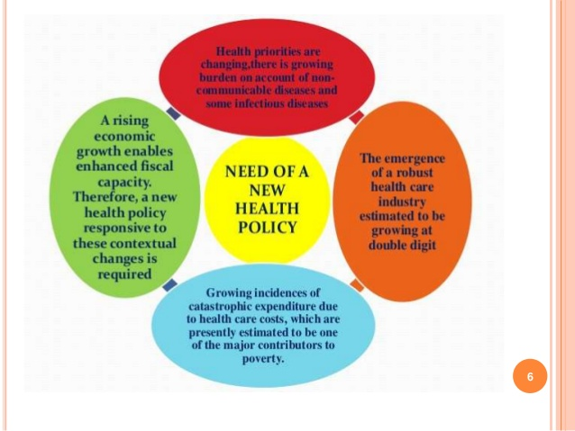

Slide 29
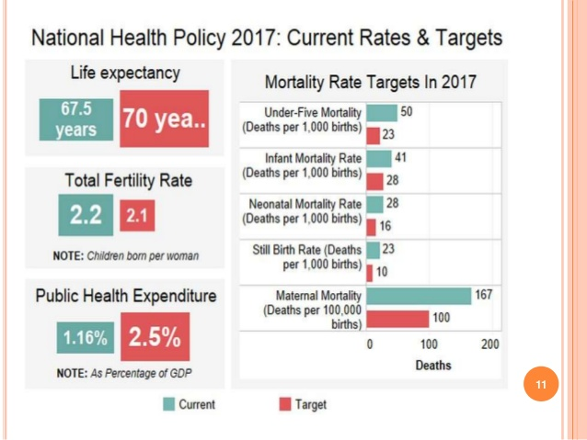

Slide 40
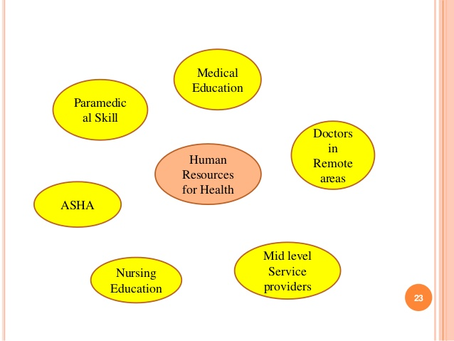

Slide 43
