Slide 1
Adolescents and Reproductive Health
Mrs. Elaiyarasi S
Asst. Professor & H.O.D
Smt. Nagarathnamma College of Nursing
Acharya Institutes

Slide 2
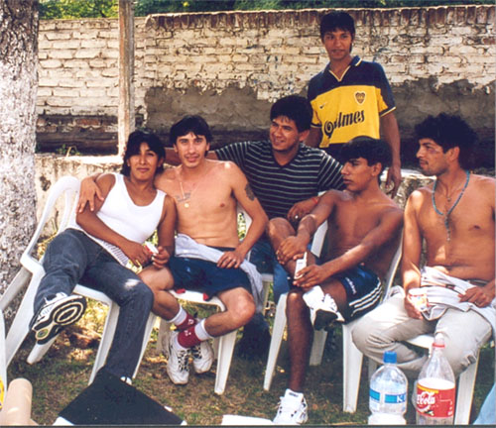
Adolescents are a diverse population group
Different needs
Changing needs
Notes:
Adolescents are a very diverse group.
A boy of 12 is very different from a young man of 19.
A boy of 12 is also very different - physically but also psychologically from a girl of the same age.
A boy of 12 who is part of a caring and financially secure family is growing up in very different circumstances from another of the same age who has run away from home to escape physical violence.
Two boys of 12 who are growing up in very similar conditions may develop in very different ways.
All these categories of adolescents have different needs; different but also changing needs.

Slide 3
1. What do we mean by the term
'adolescents ' ?

Slide 4
ADOLESCENT HEALTH
The term adolescence is derived from the Latin word “adolescere” meaning to grow, to mature.
It is considered as a period of transition from childhood to adulthood.
They are no longer children yet not adults. It is characterized by rapid physical growth, significant physical ,emotional, psychological and spiritual changes.
They are not only in large numbers but are the citizens and workers of tomorrow.
The problems of adolescents are multi- dimensional in nature and require holistic approach.
A large number of adolescents in India are out of school, malnourished, get married early, working in vulnerable situations, and are sexually active.
They are exposed to tobacco or alcohol abuse.

Slide 5
The second decade:
No longer children, not yet adults !
Adolescents 10 - 19 years
Youth 15-24 years
Young people 10-24 years
Source: A picture of health? A review and annotated bibliography of the health of young people in developing countries (WHO, UNICEF, 1995).
Notes:
In this slide, the terms that are commonly used in the literature: adolescents, youth and young people, are listed alongside age bands.
WHO defines adolescents as individuals who are going through a very special phase in their lives – adolescence. A phase during which enormous
physical and psychological changes occur, as do changes in social perceptions and expectations. A phase when an individual is no longer a child, but not yet an adult.
Although according to WHO's definition, adolescents are aged between 10-19, WHO is conscious that adolescence is a phase in an individual's life, rather than a fixed time period.

Slide 6
Adolescent – An age of opportunity
Definition-
A young person in the process of developing from child into an adult. Adolescent stage is crucial and significant period which extends from 9(early adolescence ) to 19(late adolescence)
The Youth Power
As per India’s Census, the total youth
population increased from 168 million in 1971 to 422 million in 2011.
India is seen to remain younger longer than China and Indonesia Around the world 1.2 billion adolescents stand at the crossroads between childhood and the adult world.
Around 243 million of them live in India.

Slide 7
What is special about adolescence ?
(What makes it different from childhood & adulthood ?)
A time of rapid physical and psychological (cognitive and emotional) growth and development.
A time in which new capacities are developed.
A time of changing social relationships, expectations, roles and responsibilities.
Notes:
Adolescence is a time of rapid physical and psychological growth and development, and one in which individuals develop new capacities. It is also a time of changing social relationships, expectations, roles and responsibilities.

Slide 8
2. What do we mean by the term
'health' ?

Slide 9
“Health is a state of complete physical, mental and social well-being and not merely the absence of disease or infirmity."
Source: Constitution of the World Health Organization, 1948.
Notes:
Good health certainly means the absence of disease or infirmity. But it goes beyond that to include well being – physical, mental and social well being.

Slide 10
3. What are the main challenges in adolescent health and development ?

Slide 11
Challenges in adolescent development and health in INDIA:
45% of adolescent girls under nourished
20% of adolescent boys under nourished
Early marriage 26% < 15yrs – girls, 54% < 18yrs
20 – 30% adolescent boys sexually active
10% adolescent girls sexually active
59% adolescents know about condoms
49% adolescents know about contraceptives
4.5% drug abuse
50% of all HIV positive new infections are in the age group of 10 – 25yrs
Adolescent abortion 1 – 4.4millions

Slide 12
Impact of adolescence:
1) Lack of formal or informal education
2) School dropout and childhood labour
3) Malnutrition and anemia
4) Early marriage, teenage pregnancies
5) Habits and behaviours picked up during adolescence period have lifelong impact
6) Lot of unmet needs regarding nutrition , reproductive health and mental health
7) They require safe and supportive environment
8) Desire for experimentation
9) Sexual maturity and onset of sexual activity
10) Transition from dependence to relative independence

Slide 13
Ignorance about sex and sexuality
Lack of understanding
Sub optimal support at family level
Social frustration
Inadequate school syllabus about adolescent health
Misdirected peer pressure in absence of adequate knowledge
Lack of recreational, creative, and working opportunity

Slide 14
3. What are the adolescent health problems?

Slide 15
ADOLESCENT HEALTH PROBLEMS
Anorexia nervosa
Obesity & overweight
Adolescent pregnancy
Micronutrient deficiency
Emotional problems
Behavioural problems
Substance abuse & injuries
Sexually transmitted infection
Thinking and studying problems
Identity problems
Injuries from accidents & intentional violence
Harmful traditional practices e.g. female genital mutilation

Slide 16

Balanced Diet
Activty-1

Slide 17
Eat right , Future Bright
This activity helps the participants to understand the specific nutritional components of the body they eat
Initiating the session list out what all they ate during the breakfast, lunch and dinner separately on the given format
Later he/she explains the nutritional needs and concerns of adolescents and balanced diet chart with appropriate examples
Using the inputs received during the session, participants are asked to identify the nutrients they missed and how they can supplement

Slide 18
Recommended Dietary Allowances for Adolescents
Details | Boys 13-15yrs | Girls 13-15yrs | Boys 16-18yrs | Girls 16-18yrs
Net energy Kcal/d | 2450 | 2060 | 2440 | 2060
Protein(g/d) | 70 | 65 | 78 | 63
Fnt(g/d) | 22 | 22 | 22 | 22
Mg/d | 600 | 600 | 600 | 600
Iron(mg/d) | 41 | 28 | 50 | 30
Vit A (u/d) | 600 | 600 | 600 | 600
Vit C(u/d) | 40 | 40 | 40 | 40

Slide 19
Nutrients needed in diet | Need | Sources of Nutrients
Protein | Builds Muscle | Animal Products-meat, milk, cheese nuts pulses cerels
Carbohydrates | Body gains energy , helps gain weight | Rice, bread, cereals and starchy vegetables – Potatoes, wheat flour, brown rice, oats peas, sweet potatoes beetroot
Vitamins | Regulates our body and keeps it from getting sick, keeps our blood and nervous system healthy | Fruits, vegetables, eggs, fish milk and meat
Fats | Body stores energy and keeps our skin , hair and blood healthy | Animal products like meat butter, oil and nuts
Minerals | Helps in circulatory and digestive system and bone formation | Fruits, vegetables, meat nuts and cereals
Water | Weight management skin health and prevention of heat exhaustion | Water melon, mango and tomato cucumber

Slide 20
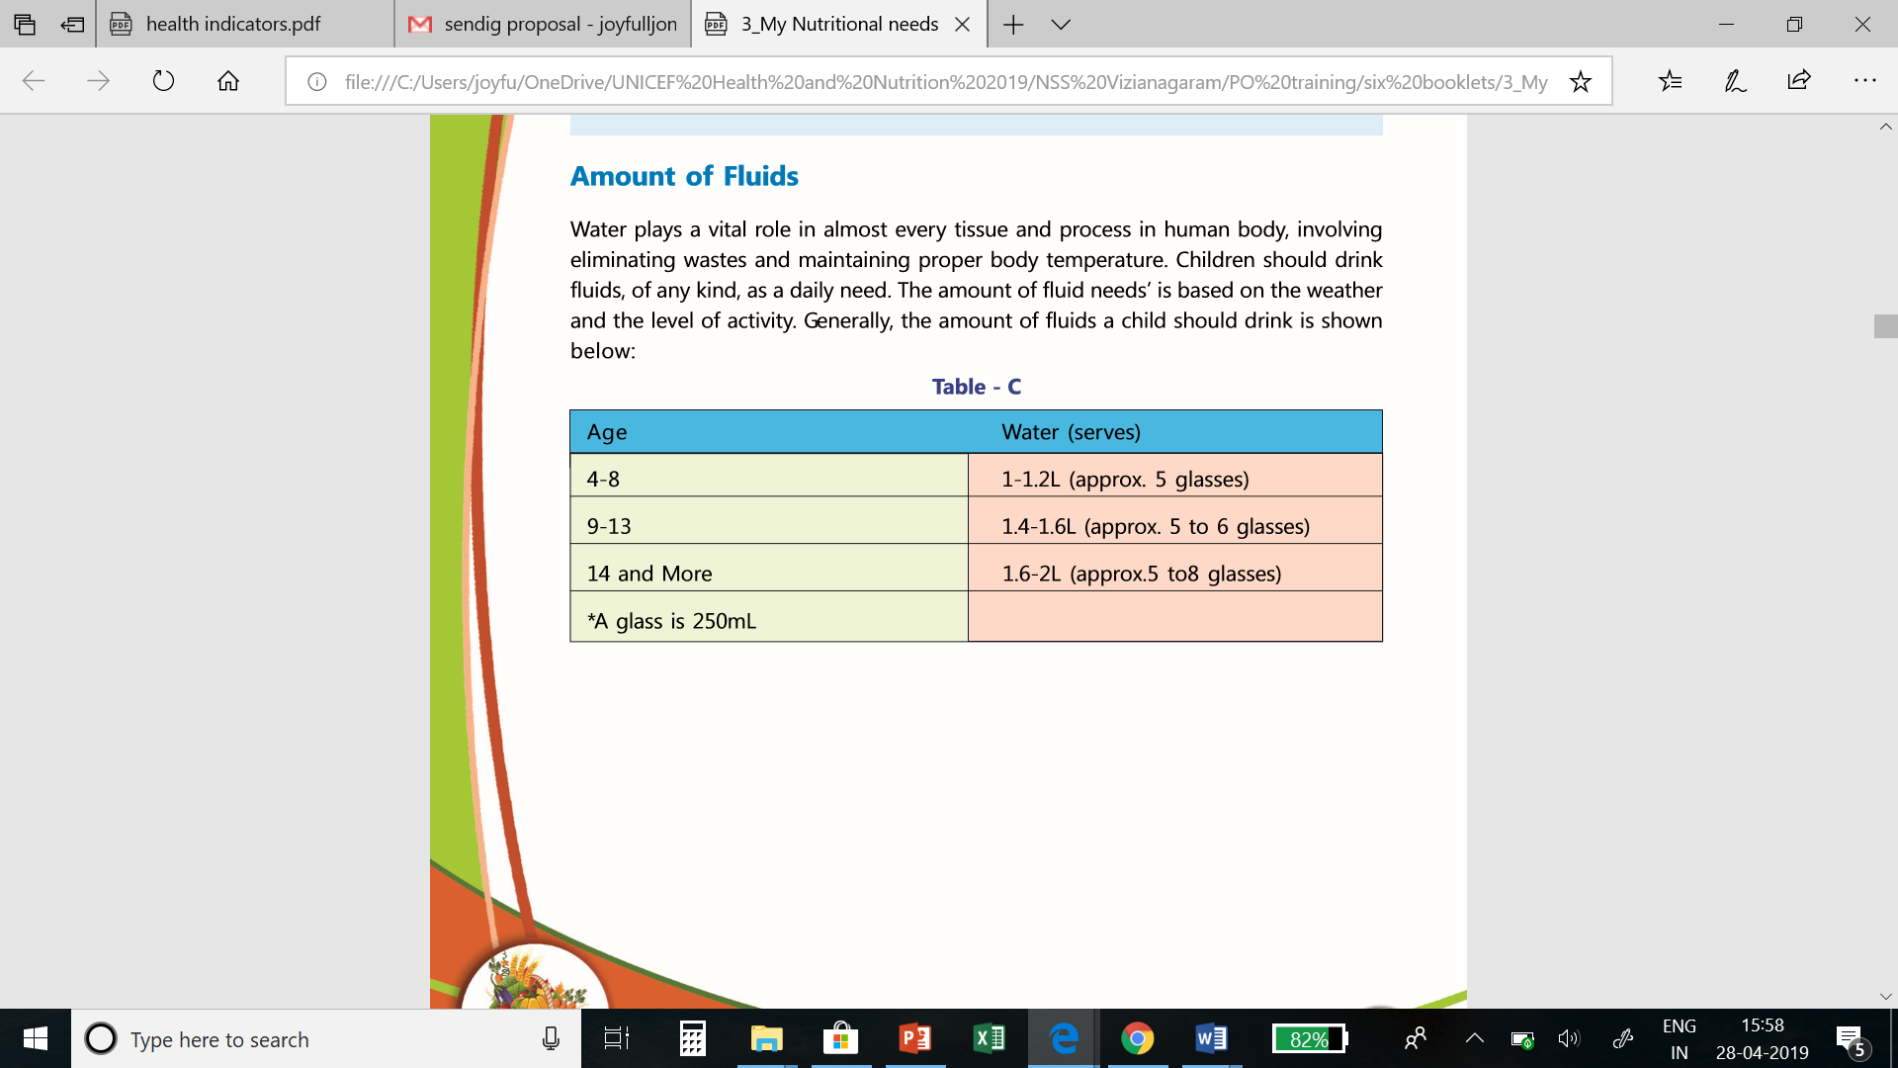
Amount of Fluids

Slide 21
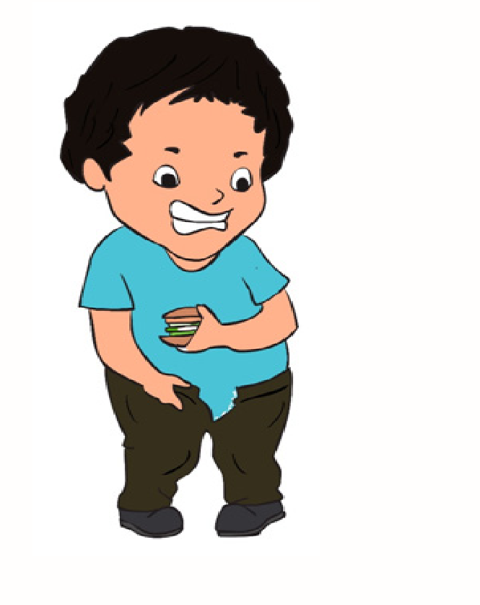
OBESITY IN ADOLESCENTS

Slide 22
overweight and obese
BMI- 25 to 29.9 Over weight
BMI- 30 or more Obese
BMI is a number calculated by dividing a person’s weight in kilograms by his or her height in meters squared. BMI is used in determining obesity

Slide 23
What is Childhood Obesity
Childhood obesity affects more than 15 percent of children, making it one of the common chronic diseases of childhood.
Childhood obesity is not just a cosmetic problem. Today, more and more children are being diagnosed with diabetes, hypertension and other co-morbid conditions associated with obesity and morbid obesity

Slide 24
Causes of Childhood Obesity
Environment
Lack of physical activity
Heredity and family
Dietary patterns
Socioeconomic status

Slide 25
Treating Childhood Obesity
Dietary therapy
Physical activity
Behavior modification
changing eating habits
Increasing physical activity
Becoming educated about the body and how to nourish it appropriately
Engaging in a support group activity and setting realistic weight management goals

Slide 26
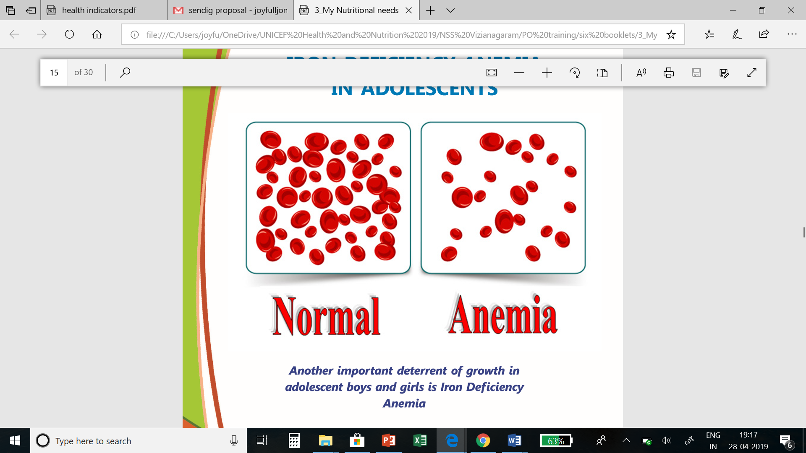
IRON DEFICIENCY ANEMIA IN ADOLESCENTS

Slide 27
Anemia: A sign or Disease
  What is Anemia?
  What are the symptoms of Anemia?
  How to identify if someone is Anemic?
  Do you know of any friend who is Anemic and the issues they have?

Slide 28
What Is Iron Deficiency Anemia
Anemia occurs when the level of Red Blood Cells (RBCs) in the blood is lower than normal.
Iron deficiency anemia is the most common type of anemia, and it occurs when the body doesn’t have enough of the mineral iron
Body needs iron to make a protein called hemoglobin.
When there isn’t enough iron in the blood stream, the rest of the body can’t get the amount of oxygen it needs.

Slide 29
What Causes Iron Deficiency Anemia?
Iron deficiency is the most common cause of anemia.
Causes. Eating too little iron over an extended period of time can cause a shortage in our body.
Foods such as meat, eggs and dark green leafy vegetables are high in iron.
Because iron is essential during times of rapid growth and development, young children may need more iron-rich foods in their diet.

Slide 30
What are the symptoms of Iron Deficiency Anemia
General fatigue
weakness
pale skin
shortness of breath
dizziness
strange cravings to eat items that aren’t food, such as dirt, ice or clay

Slide 31
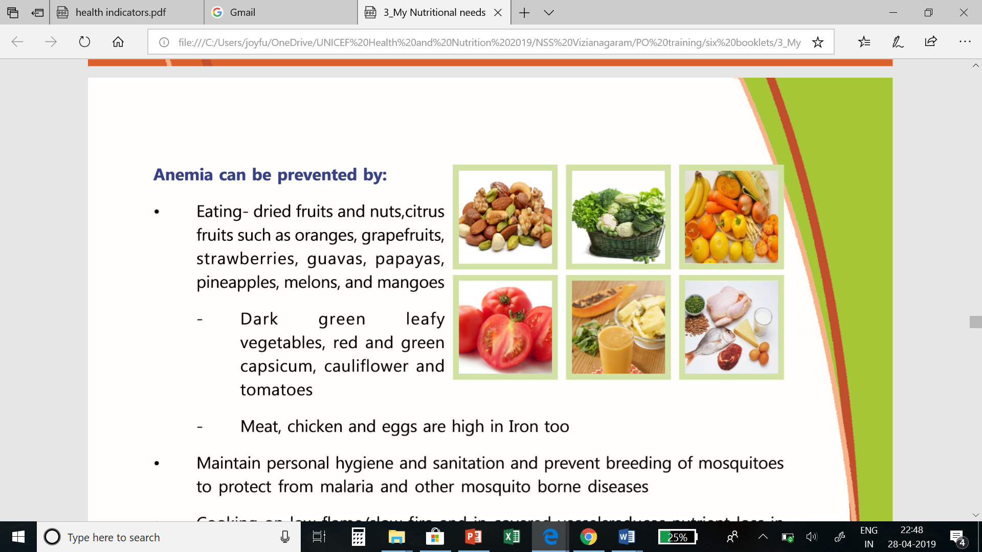
Anemia can be prevented
Maintain personal hygiene and sanitation
prevent breeding of mosquitoes to protect from malaria and other mosquito borne diseases
Cooking on low flame/slow fire and in covered vessels reduces nutrient loss in the food we cook
Wear footwear to prevent worm infestations. De-worming
IFA

Slide 32

Substance Abuse

Slide 33
Substance Abuse
Adolescence is a critical period when the first initiation of substance use usually takes place.
Substance use includes tobacco, alcohol, non-prescription pharmaceutical medications, narcotics and other addictive substances such as glue and adhesives.
Encouragement by peer groups, the lure of popularity, and early availability of tobacco, alcohol and various other non prescription drugs make adolescents an easy prey.

Slide 34
Substance Misuse
Substance misuse refers to the excess use and dependence on a stimulant (smoking, drugs), depressant, chemical substance, and herb leading to effects that are harmful to the individual’s physical and mental health

Slide 35
Types of Substance Users
Compulsive Users
Begin smoking/drinking or drugs largely because of Peer pressure, Curiosity or in Party settings
Habitual users who devote their time and energy in getting the substances that they have become addicted to
Experimenters

Slide 36
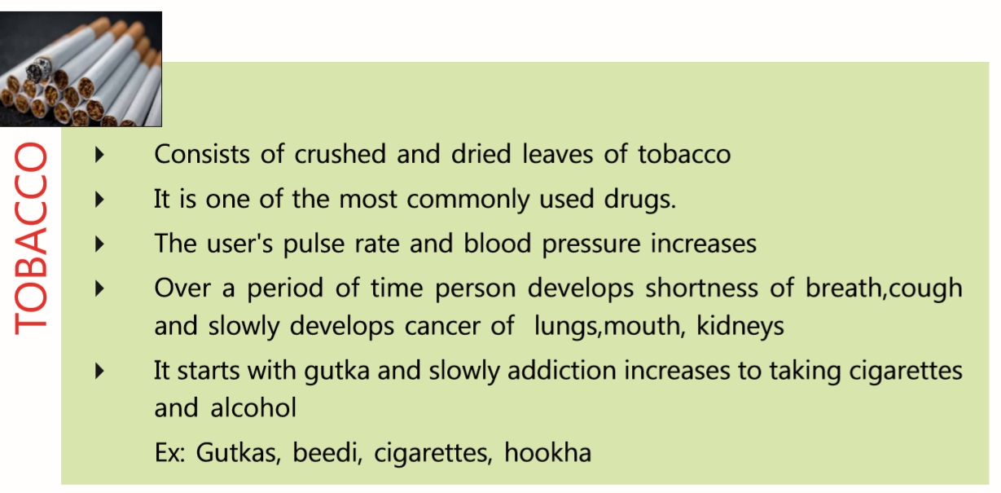
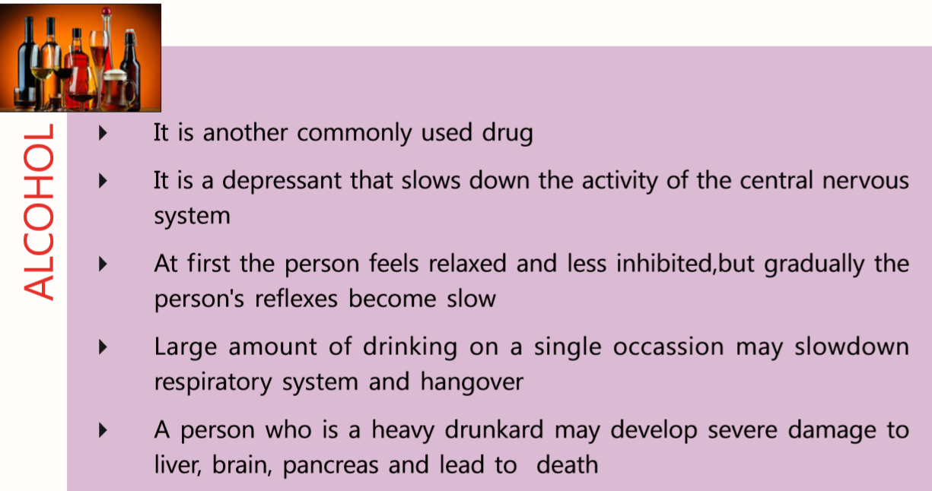
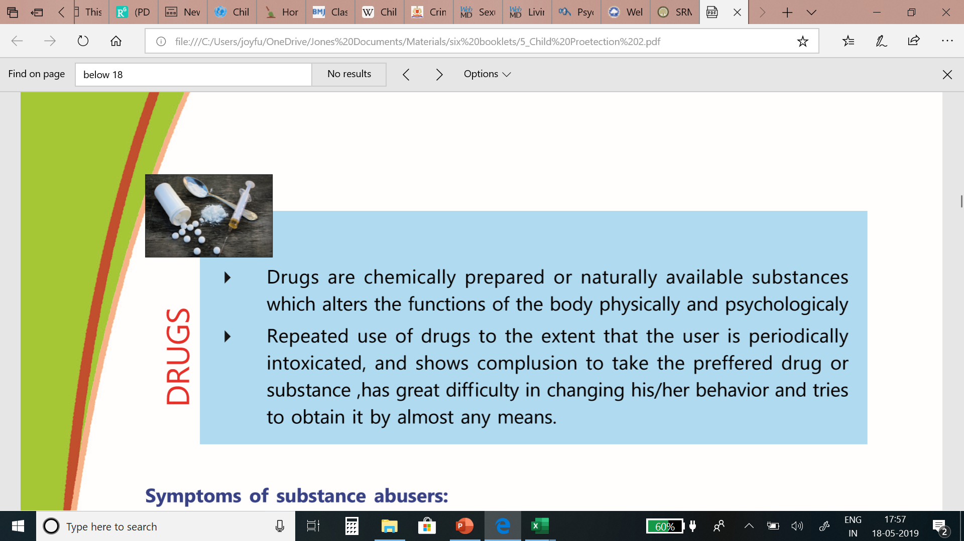
Types of Substances

Slide 37
Causes for Substance misuse:
Factors within a family that influence a child’s early development
Drug or alcohol use, running in the family
Lack of nurturing and parental attachment
Factors related to a child’s socialization outside the family may also increase risk of drug abuse
Inappropriately aggressive or shy behavior
Poor socializing skills
Poor school performance
Association with a unusual peer group

Slide 38
Symptoms of substance abusers
Lose interest in studies, school, and work
Sudden mood swings, irritability and aggressiveness
Have an unexpected need for money and start stealing or selling objects
Appear fearful, anxious or suspicious for no reason
Have tremors, slurred speech or impaired coordination

Slide 39
substance abuse Impacts
Relationships
Job/Employment
Behavior
Financial aspects and Insecurities

Slide 40
Role to combat Substance Abuse
At individual level “Saying NO” to any temptations and being firm is the first step to fight against any form of abuse.
The way to say NO could be: Polite Refusal, Being Firm and assertive and may be Giving in an argument.
Parents, friends, cousins or a trusted adult can easily identify the person who is under the influence of substance misuse by looking for the symptoms.
Unresolved issues, conflicts and problems lead to Anger, anger in turn can disturb or cause harm or lead to other habits, hence finding an amicable solution and talking out the issues with the concern person is another important way to resist bad habits.
Public education campaigns and stricter laws regarding purchase and use of illegal substances could be one of the measures in addressing the problem.
Finally consulting a Doctor is a very necessary solution to find help in case of addiction.

Slide 41
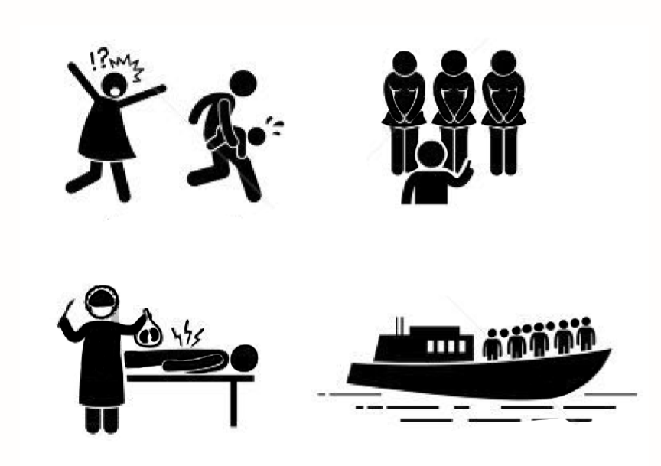
Exploitation

Slide 42
Meaning of Exploitation
“Exploitation” refers to the use of people as a resource, with little or no consideration of their well-being.
This can take the following basic forms:
Taking something off a person or group that rightfully belongs to them. Making somebody to work using somebody against his will, or without his consent or knowledge, imposing an illogical differential treatment of people to the advantage of some and the disadvantage of others

Slide 43
Definitions
Sexual Exploitation Definition: The abuse of power or social position to make money by harming someone sexually; it includes supplying of men/women, sex trafficking, pornography, and other adult entertainment.
Prostitution Definition: Engaging in or offering to engage in a sexual act in exchange for something of value, such as money, drugs, clothing, or shelter.
Human Trafficking Definition: Forcing, pressurizing or deceiving people into labor or commercial sex. A trafficking victim is a person who believes she or he would experience serious harm if she or he tried to leave a labor or commercial sex situation. (Note: anyone under 18 who is engaging in commercial sex is also considered a trafficking victim; it is not necessary to prove force, coercion, deception, or fear of serious harm.)

Slide 44
Different forms of Women Exploitation and abuse
Domestic Violence:
Female Infanticide and Feticide:
Dowry
Psychological/Emotional Abuse:
Sexual Abuse:

Slide 45
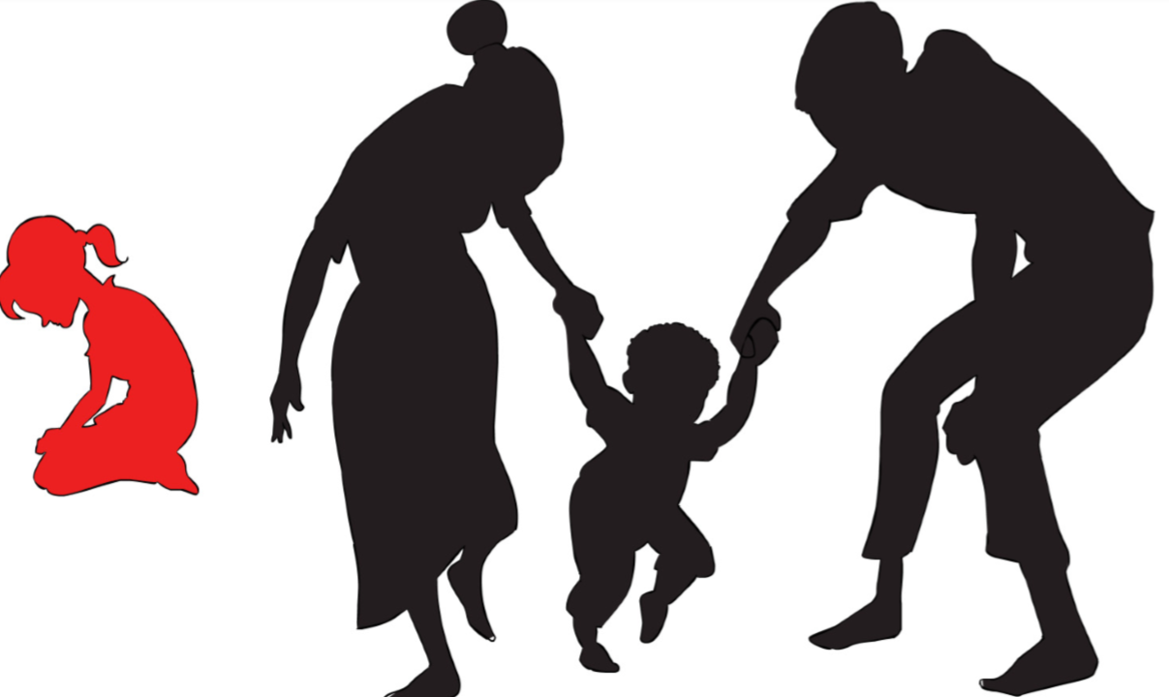
UNDERSTANDING GENDER

Slide 46
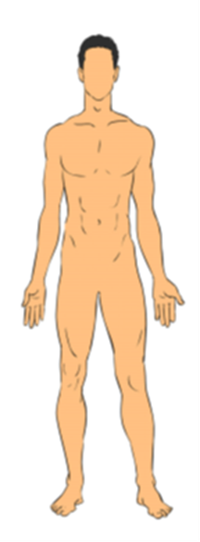
Body Mapping

Slide 47
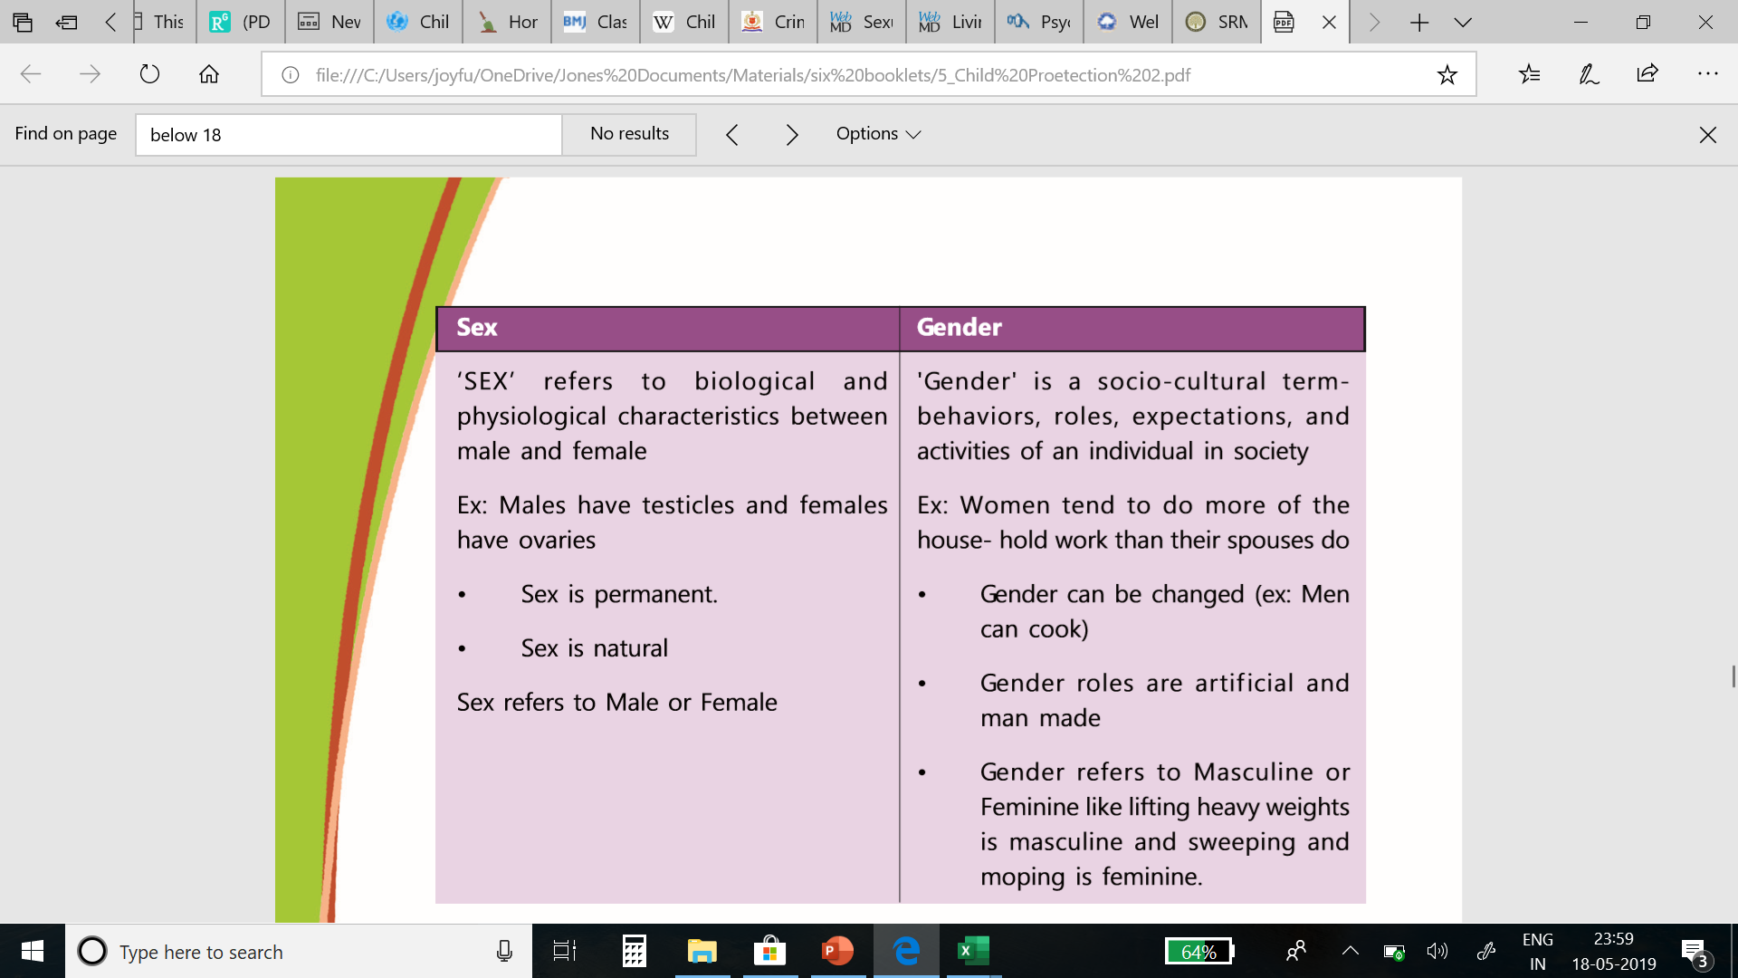

Slide 48
Puberty
Changes that occur in Boys
Changes that occur in Girls
Pubic hair
Facial hair of male
Voice changes and Adam’s apple
Male musculature and body shape
Body Odour
Breast development
Pubic hair
Vagina, uterus and ovaries
Menstruation and fertility
Body shape, fat distribution, and body composition
Body odour and acne

Slide 49
Reproductive system

Slide 50

My Period Story

Slide 51
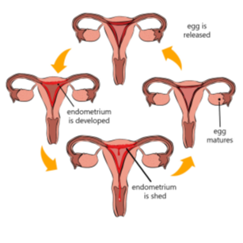
What goes inside Me

Slide 52
What goes inside Me
Menstrual cycle occurs and it is necessary for adolescent health
When a girl becomes 9-12yrs of age, the pituitary gland (a pea shaped gland at the base of the brain) starts to secrete a new kind of hormone every month
This Hormone causes one of the ovaries to release the egg cell/ovum. The Ovum or begins to mature
Every month one ovum egg matures in one of the two ovaries. The ripe egg is released into one of the fallopian tubes from ovary and this called ovulation

Slide 53
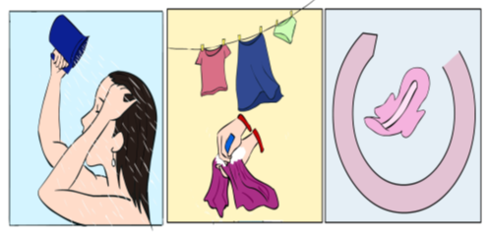
Menstrual Hygiene

Slide 54
Menstrual Hygiene
Most of the girls go through periods secretively and don’t really find out if the practices are hygienic or not. It important to build the capacities of adolescent girls on menstrual hygiene
Change regularly
Don’t use soaps or vaginal hygiene products
Use the right washing techniques
Discard the used sanitary products properly
Have a bath regularly

Slide 55
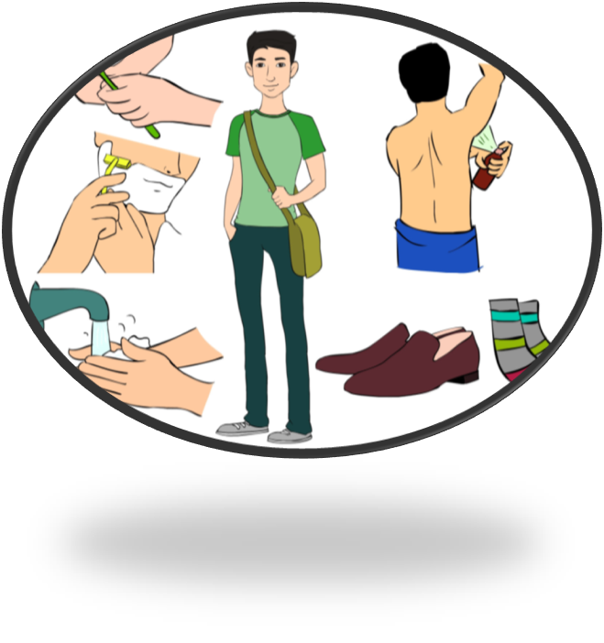
Personal Hygiene- Boys

Slide 56
Personal Hygiene- Boys
Nocturnal Ejaculation
Body Odour
Smelly Feet
Dental Hygiene
The awareness of the reproductive organs in the body forms a basis to understand personal hygiene

Slide 57
Sexual and Reproductive Health

Slide 58
Public health : behaviours
Nearly two thirds of premature deaths and one third of the total disease burden in adults are associated with conditions or behaviours that began in youth.
World Development Report 2007
Age of smoking initiation
Notes:
Our case for attention to adolescent health becomes even stronger as one moves from mortality and morbidity to behaviours.
This is a phase of life when important behaviours – habits if you like – that will determine health and disease in adulthood are formed.
Smoking, diet and exercise behaviours are cases in point.

Slide 59
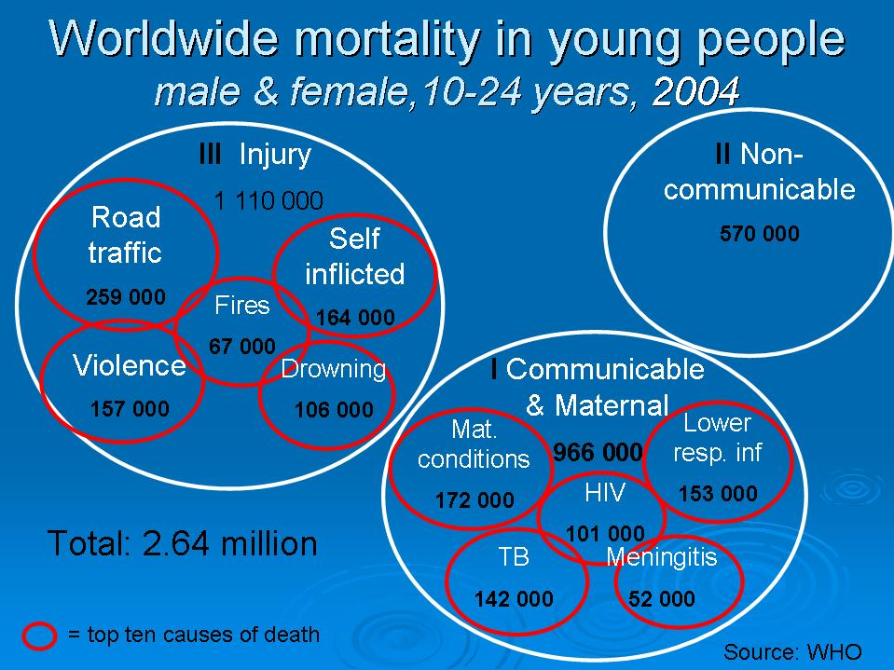
Public health : mortality
There are around 2.6 million deaths among the 10-24 year age group worldwide every year.
97% occur in low and middle income countries.
Notes:
There are an estimated 2.6 million deaths in the 10-24 year age group every year.
97% of them occur in low and middle income countries.
The causes of these deaths are indicated on this slide.
There are substantial regional differences in mortality rates and causes of mortality, but that is beyond the scope of this presentation.

Slide 60
Public health rationale
Health problems / health-related behaviours during adolescence | Age when this has its major impact
 | Adolescence | Adulthood | Childhood (next generation)
Injuries and violence | +++ | +
Too-early pregnancy | ++ | + | ++
Human Papilloma Virus infection | + | +++
Tobacco use | + | +++ | +
HIV infection | + | +++ | ++
Notes:
One final point is that some health problems (illnesses and infections) and health-related behaviours acquired during adolescence have their impact during adolescence; others have their impact in adulthood; and still others have their impact in the next generation.

Slide 61
RTIs and STIs
  What are RTIs and STIs
  Symptoms of RTI and STI
  Symptoms in Men
  Symptoms in Women
  Transmissions
  Effects
  Prevention

Slide 62
Sexually Transmitted Disease
On the increase in the United States
Chlamydia -- bacteria; asymptomatic, leads to sterility from scar tissue formation
Gonorrhea -- bacteria, discharge common, blindness if newborn is infected during delivery
Syphilis -- bacteria, painless sores (chancre), 2nd stage all organs involved, 3rd stage organ degeneration is apparent (neurosyphilis)
Genital Herpes -- virus, incurable, painful blisters
AIDS & hepatitis B --viruses (chapters 22 & 24)

Slide 63
Yeast Infection
Candida albicans is yeastlike fungus that grows on mucous membranes
Causes vulvovaginal candidiasis or vaginitis
  inflammation of the vagina
  severe itching and pain
  yellow discharge with odor
More likely after antibiotic therapy for some other disease

Slide 64
Let us know about AIDS

Slide 65
Public health : morbidity
There are over 10 million young people (15-24) living with HIV/AIDS
Central and
Eastern Europe
430,000
65%
35%
67%
33%
Middle East & North Africa
160,000
East Asia & Pacific
740,000
Industrialized
Countries
240,000
31%
69%
49%
38%
51%
Latin America & Caribbean
560,000
31%
62%
69%
38%
South Asia
1.1 million
62%
Source: UNAIDS/UNICEF, 2002
Sub-Saharan Africa
8.6 million
Notes:
Our case for investing in the health of adolescents becomes stronger when we include those who face illnesses (including nutritional problems) and injuries which hinder their ability to grow and develop to their full potential, and also to function optimally.
UNAIDS and WHO estimate that by the beginning of 2004 over 40 million people were infected with HIV. More than 10 million of these were young people.
The regional distribution as well as the sex distribution in each region are shown on this slide. All the young people, and those who join their ranks, need care and support.
There are other important causes of morbidity including anaemia, depression and vesico-vaginal fistula.

Slide 66
HIV/AIDS
  Definitions of HIV/AIDS
  Difference between HIV and AIDS
  Modes of transmission and prevention
  Prevention of blood related transmission
  Prevention of Mother to child transmission
  Unsafe and un planned sex could lead to teen pregnancies and teen abortions

Slide 67
Let us know about
Teen pregnancies

Slide 68
Teen Pregnancies
Many factors lead to teen pregnancies
  Peer Pressure
  Exposure to media
  Drinking and smoking
  Lack of supportive parents and family
  Exposure to sexual violence
  Stressful life style
  Poverty
  Lack of Proper Sex education
  Nuclear Families
  Child marriage

Slide 69
Risk Factors and complications of Teen pregnancies
Potential complications of Teenage mother:
Death rate at child birth is shocking The feeble teenage bodies cannot take the pressure
Suffer from premature labor
They are highly prone to get Anemia, placental problems
They might undergo depression
Potential Complications for the baby
Born under weight
Pre-mature babies
As they are born Pre- mature and under weight they stand the chance of dying with in the first month itself
It might also lead to mental retardation or other disabilities

Slide 70
Prevention of Teen Pregnancies/unwanted Pregnancy
The use of contraception by the teens is cost effective regardless of the method used. The following are the most commonly used
Condoms
Oral contraception
Emergency Contraception
The above information does not promote sexual indulgence. This is only for awareness and to highlight the risk involve in unprotected , forced and impulsive sexual acts

Slide 71
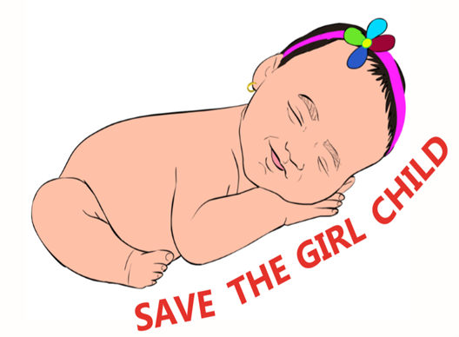
Gender inequality
.
Gender Inequality, in simple words, may be defined as discrimination against women based on their sex.

Slide 72
Gender inequality manifests in varied ways. In India the major indicators
Female Feticide: the practice of aborting a fetus when a person finds out that the fetus is female after
Female Infanticide: the deliberate killing of newborn female children
Sex ratio: 927 girls for every 1000 boys
Female literacy: 64%
Maternal mortality rate: 178 deaths per 100000 live births

Slide 73
A Healthy Mother Healthy Family

Slide 74
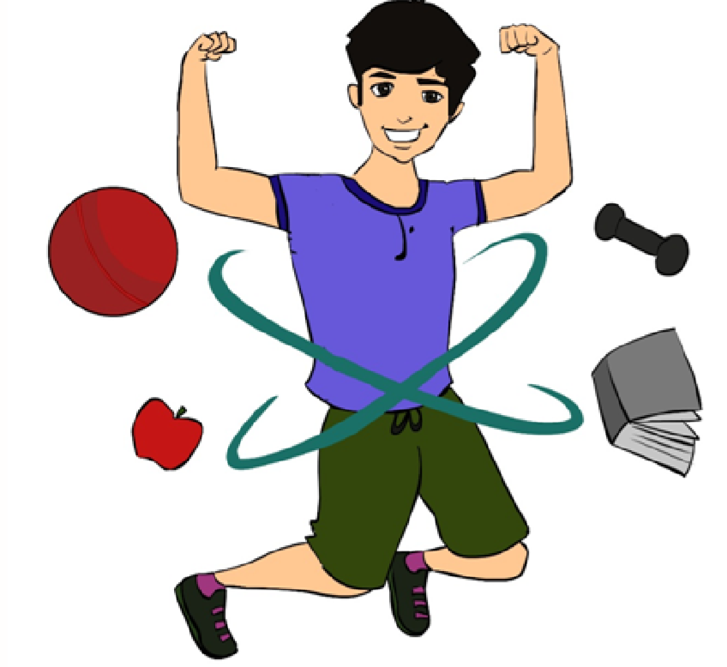
HEALTHY LIFE-STYLE FOR A HEALTHY LIVING

Slide 75
How Does Physical Activity Help?
Physical activity helps to builds strong bones and muscles
Physical activities like exercise, yoga, dance, martial arts, outdoor games etc., help build stamina and fights fatigue
Decreases the likelihood of developing obesity and risk factors for diseases like type 2diabetes and heart disease.
Reduces anxiety and depression and promote positive mental health

Slide 76
How Does Physical Activity Help?
Aerobic Activities
cycle riding, walking, running, dancing, and
Playing active games like tag, soccer, and basketball.
Muscle-strengthening Activities:
push-ups, pull-ups, and weightlifting exercises.
Bone-strengthening Activities:
hopping, skipping, jumping, running, and sports like gymnastics, basketball, and tennis

Slide 77
6. Why should we invest in the health and development of adolescents ?

Slide 78
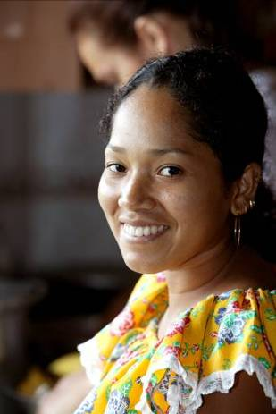
Demographic rationale
Public health rationale
Economic rationale
Human rights rationale
Notes:
There are sound demographic, public health, economic and human rights reasons for addressing the health of adolescents.

Slide 79
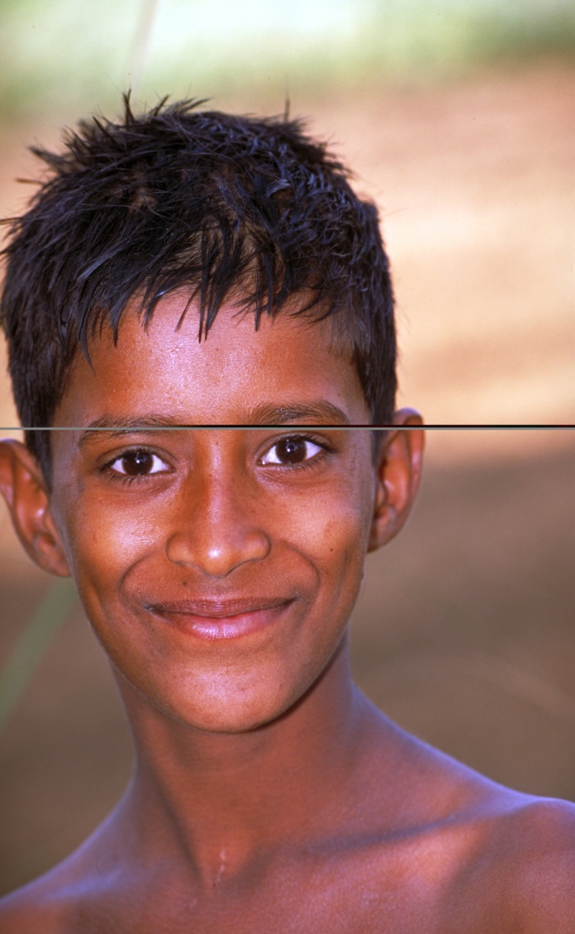
Demographic rationale
One in five individuals in the world today is an adolescent (around 1.2 billion).
The largest number of adolescents in the history of mankind.
Notes:
Adolescents represent one fifth of the world's population.

Slide 80
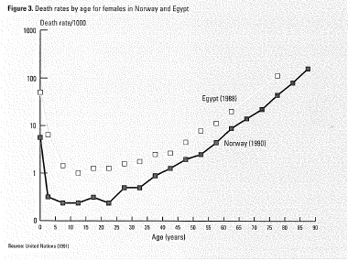
Public health rationale: mortality
A Picture of Health, WHO/UNICEF (1995)
Notes:
Although every death represents a tragedy at the individual, family and community levels, it would be difficult to make a case for addressing adolescent health based on mortality alone. Mortality rates are low in this age group relative to the under-five and the over-twenty age groups.

Slide 81
5. Who needs to contribute to meeting these needs & fulfilling these rights ?

Slide 82
Politicians
Journalists
Bureaucrats
Relatives
Friends
Family friends
Teachers
Sports coaches
Healthcare providers
Religious leaders
Traditional leaders
Parents
Brothers/Sisters
Adolescents
Musicians
Film stars
Sports figures
Notes:
Who needs to contribute to the health and development of adolescents ?
To answer this question, it is useful to think of these players in concentric circles of contact & influence.
At the centre is the adolescent himself or herself. Parents, siblings and some other family members are in immediate contact with the adolescent & constitute the first circle.
The second circle includes people in regular contact with them such as their own friends, family friends, teachers, sports coaches, health workers and religious leaders.
The third circle includes musicians, film stars & sports figures who have a tremendous influence on them from afar.
Finally in the fourth circle, politicians, journalists and bureaucrats (within the government & private sectors) affect their lives in small & big ways, through their words and deeds.

