Slide 1
Acute Respiratory tract Infections
Facilitator:
Mrs. Elaiyarasi S
Asst. Professor

Slide 2
Specific Learning Objectives
At the end of session, the learner shall be able to:
Describe magnitude of problem of ARI
Classification of ARI
Management of ARI
Prevention and control of ARI

Slide 3
Introduction
Acute Respiratory Infections especially pneumonia:
a significant problem in communities
a high rate of under-five mortality
a huge burden on families and the health system.
a priority and is essential in achieving MDG – 4
To reduce the under-five mortality rate by two thirds by 2015, compared to 1990.

Slide 4
Pneumonia – the number 1 killer of young children
Pneumonia kills more children under five years of age than any other illness in every region of the world.
Of the estimated 9 million child deaths in 2007, around 20% were due to pneumonia

Slide 5
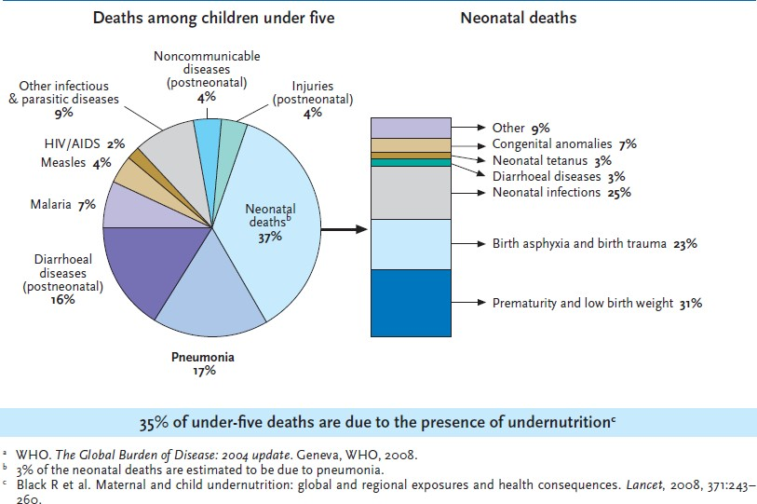
Causes of Death in Neonates and Children Under Five in the World (2004)

Slide 6
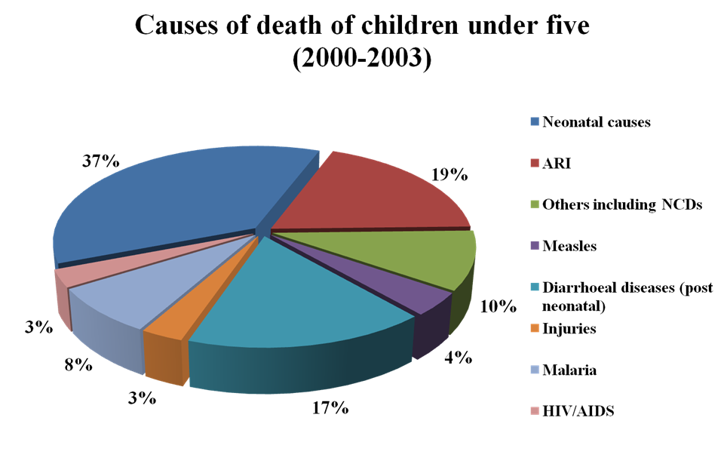
Totals are more than 100 due to rounding
WHO (2005), World Health Report 2005, Make every mother and child count

Slide 7
At the
millennium Summit in 2000, the United
Nations Member States committed to achieving
Millennium Development Goal 4 (MDG4).
Since then, substantial progress has been made in reducing child mortality.
If the current trend continues, an estimated 13.2 million excess deaths will occur between 2010 and 2015

Slide 8
Cost of failure to reach MDG4

Slide 9
In addition to preventive interventions such as
routine vaccination,
exclusive breastfeeding and
complementary feeding,
Strategies that rely on community capacity development can reduce pneumonia mortality in developing countries.

Slide 10
Quality of care at first-level public health facilities
Improving quality of care at first-level public health facilities and ensuring they are financially, logistically and geographically accessible.
Even then, there may be barriers preventing parents from using the facilities.

Slide 11
Improving quality of care in the private sector
In many settings, especially in urban areas, children are often treated in the private sector.
Although active collaboration between public and private sector is a relatively new strategy, and there is no conclusive evidence showing which approach is most effective, interventions involving private practitioners should continue to be pursued.

Slide 12
Increasing access to quality care
Increasing access to quality care can be achieved through community-based care.
Community health workers can be trained to:
assess sick children for signs of pneumonia;
select appropriate treatments;
administer the proper dosages of antibiotics;
counsel parents on how to follow the recommended treatment regimen and provide supportive home care; and
follow-up sick children and refer them to a health facility in case of complications.

Slide 13
The ARI Control Programme was started in India in 1990. It sought to introduce scientific protocols for case management of pneumonia with Co-trimoxazole.
Since 1992 the Programme was implemented as part of CSSM and later with RCH.
comprehensive package for the management of the most common causes of childhood illnesses i.e sepsis, measles, malaria, diarrhoea, pneumonia and malnutrition.
Integrated | Management | of Neonatal | and
Childhood | Illnesses | (IMNCI) offers | a

Slide 16
Management of child with cough or difficult breathing
Assessing the child by asking
Classifying the illness of the child
Decision for treatment
Follow up of cases

Slide 17
Assess
Ask:
How old is the child?
Is the child coughing or having difficult breathing?
For how long?
Age of child | History for danger signs
Age 2 months to 5 years | Is the child able to drink?
Age less than 2 months | Has the child stopped feeding well?
 | For how long?
 | Has the child had convulsions?
 | Has the child had fever?

Slide 18
Look; Listen; and Feel
Count the breaths in one minute
Look for the chest indrawing
Look and listen the stridor
Look and listen the wheeze
See if the child is abnormally sleepy or difficult to wake up
Feel for fever or low body temperature
Look for severe malnutrition
Age of the child | Fast breathing is present if RR is
Less than 2 months | 60 breaths per minute or more
2 months up to 12 months | 50 breaths per minute or more
12 months up to 5 years | 40 breaths per minute or more

Slide 19
Classify the illness
Purpose:
To make decision about severity of disease
Choose line of action or treatment
It is done on basis of danger signs and respiratory rate

Slide 20
Colour coding
Based on signs, the child is classified into:
 | Colour Code | Treatment
Very severe disease | Pink | Refer urgently to hospital
Severe Pneumonia | Pink | Refer urgently to hospital
Pneumonia (not severe) | Yellow | Give an antibiotic and home care
No pneumonia | Green | Home care

Slide 21
Treatment Guidelines and Follow Up
Young infants (0-2 months)
Children 2 months to 5 years

Slide 22
Young infant (0-2 months)
Signs | Stopped feeding well Convulsions Abnormally sleepy or difficult to wake Stridor in calm child Wheezing, or Fever or low body temperature | Severe chest indrawing, or Fast breathng | No severe chest indrawing and No fast breathing
Classify as | VERY SEVERE PNEUMONIA | SEVERE PNEUMONIA | NO PNEUMONIA Cough or Cold
Treatment | Refer URGENTLY to hospital Keep young infant warm Give first dose of an antibiotic | Refer URGENTLY to hospital Keep young infant warm Give first dose of an antibiotic (if referral is not feasible, treat with an antibiotic and follow closely) | Advise mother: Keep young infant warm Breastfeed frequently Clear nose if it interferes with feeding Return quickly if: Breathing becomes difficult; or fast Feeding becomes a problem Young infant becomes sicker
Classification of illness and treatment guidelines. WHO algorithm

Slide 23
Child age 2 months to 5 years
Signs | Not able to drink Convulsions Abnormally sleepy or difficult to wake Stridor in calm child, or Fever or low body temperature | Chest indrawing (if also recurrent wheezing, go directly to treat wheezing)
Classify as | VERY SEVERE DISEASE | SEVERE PNEUMONIA
Treatment | Refer URGENTLY to hospital Give first dose of an antibiotic Treat fever, if present Treat wheezing, if present If cerebral malaria is possible, give an antimalarial | Refer URGENTLY to hospital Give first dose of an antibiotic Treat fever, if present Treat wheezing, if present (if referral is not feasible, treat with an antibiotic and follow closely)
Classification of illness and treatment guidelines. WHO algorithm

Slide 24
Child age 2 months to 5 years
Signs | No chest indrawing, and Fast breathing |  |  |  |  | No chest indrawing No fast breathing
Classify as | PNEUMONIA |  |  |  |  | NO PNEUMONIA COUGH OR COLD
Treatment | Advise mother to give home care Give an antibiotic Treat fever, if present Advise mother to return with child in 2 days for reassessment, or earlier if the child is getting worse.
Reassess in two days a child who is taking an antibiotic for pneumonia
Signs |  | WORSE: Not able to drink Has chest indrawing Has other danger signs |  |  | SAME |  | IMPROVING: Breathing slower Less fever Eating better
Treatment |  | Refer URGENTLY to hospital |  |  | Change antibiotic or Refer |  | Finish 5 days of antibiotic
Classification of illness and treatment guidelines. WHO algorithm

Slide 25
Treatment of Pneumonia in Young infants aged less than 2 months
Antibiotic | Dose | Frequency
 |  | Age <7 days | Age 7 days to 2 months
Inj. Benzyl Penicillin OR | 50,000 IU/kg/dose | 12 hourly | 6 hourly
Inj. Ampicillin AND | 50 mg/kg/dose | 12 hourly | 8 hourly
Inj. Gentamycin | 2.5 mg/kg/dose | 12 hourly | 8 hourly

Slide 26
Treatment of Severe Pneumonia in children aged 2 months to 5 years
Antibiotics Dose Interval
Mode
A First 48 hours Benzyl Penicillin OR
Ampicillin OR
Chloramphenicol
50,000 IU/kg/dose 6 hourly IM
50 mg/kg/dose 6 hourly IM
25 mg/kg/dose 6 hourly IM
50,000 IU/kg Once
50 mg/kg/dose 6 hourly
25 mg/kg/dose 6 hourly
B If condition IMPROVES, then for the next 3 days: Procaine penicillin
OR
Ampicillin OR
Chloramphenicol
If NO IMPROVEMENT, for next 48 hours: CHANGE ANTIBIOTIC
IM
Oral
Oral
C Provide symptomatic treatment for fever and wheezing, if present D Monitor fluid and food intake
E Advise mother on home management on discharge.

Slide 27
Treatment of Pneumonia
Daily Dose Schedule of Cotrimoxazole
Age/Weight | Paediatric Tablet: Sulphamethoxazole 100mg and Trimethoprim 20mg | Paediatric syrup: Each spoon (5ml) contains: Sulphamethoxazole 200mg and Trimethoprim 40mg
< 2 months (wt. 3-5 kg) | One tab BD | Half spoon BD
2-12 months (wt. 6-9 kg) | Two tab BD | One spoon BD
1-5 years (wt. 10-19 kg) | Three tab BD | One and half spoon BD

Slide 28
Home Care
Mother should
Keep the baby warm
Continue breast feeding and feeding the child
To increase feeding after recovery
To clear the nose if it interferes with feeding
Proper dose of antibiotic for 5 days
Cough can be relieved by home made decoctions
To bring back the child after 2 days for reassessment
To watch for danger signs

Slide 29
Key strategies for treating, preventing and protecting from pneumonia
Case management at all levels
Improvement of nutrition and reduction of low birth weight
Vaccination
Control of indoor air pollution
Prevention and management of HIV infection
These interventions, if implemented, have the potential to reduce pneumonia mortality and morbidity by more than half.
Global Action Plan for Prevention and Control of Pneumonia (GAPP)

Slide 30
Effective case management at the community and health facility levels is an essential part of pneumonia control.
Countries with significant rates of under-five mortality should adopt plans to expand adequate case management of pneumonia at hospital, health facility and community levels to achieve 90% coverage within a predetermined time frame.

Slide 31
Promotion of exclusive
breastfeeding and zinc
of
supplementation are an important element
pneumonia prevention.
Strategies to reduce rates of low birth weight and malnutrition will prevent pneumonia and should be encouraged.

Slide 32
All countries should take steps to achieve Global Immunization Vision and strategy (GIVs) targets for measles, HIB, Pneumococcal Pneumonia and pertussis containing vaccines;
Countries that have not yet done so should add Hib and conjugate pneumococcal vaccines to their national immunization programmes, especially if they have high child mortality.

Slide 33
Indoor air pollution increases the risk of pneumonia.
New technologies can reduce indoor air pollution, and additional research is needed to demonstrate the health benefits of these interventions.
Strategies to reduce indoor air pollution may prevent pneumonia and should be encouraged.

Slide 34
Strategies to prevent mother-to-child transmission of HIV and to improve the management of HIV infection and P. jiroveci pneumonia prophylaxis in children should be promoted in countries where HIV is prevalent.

