Slide 1
TWENTY POINT PROGRAM
Mrs. S Elaiyarasi
Asst. Professor
Dept. Community Health Nursing

Slide 4
OBJECTIVE
The basic objective of the 20-Point Programme is to eradicate poverty and to improve the quality of life of the poor and the under privileged population of the country.

Slide 6
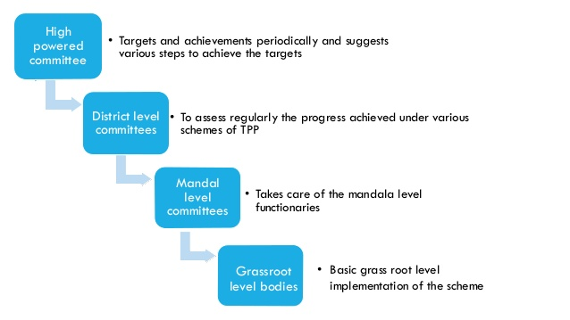

Slide 18
