Slide 1
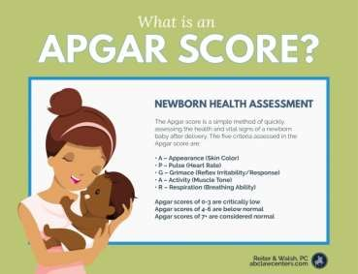
APGAR SCORE care of newborn
BY: MANJULA T
ASST.PROFESSOR
OBG DEPATMENT

Slide 2
INTRODCUTION
What is the APGAR SCORE?
The Apgar score is a scoring system doctors and nurses use to assess newborns one minute and five minutes after they’re born.
Dr. Virginia Apgar created the system in 1952, and used her name as a mnemonic for each of the five categories that a person will score. Since that time, medical professionals across the world have used the scoring system to assess newborns in their first moments of life.
Medical professionals use this assessment to quickly relay the status of a newborn’s overall condition. Low Apgar scores may indicate the baby needs special care, such as extra help with their breathing.

Slide 3
Usually after birth, a nurse or doctor may announce the Apgar scores to the labor room. This lets all present medical personnel know how a baby is doing, even if some of the medical personnel are tending to the mom.
When a parent hears these numbers, they should know they’re one of many different assessments medical providers will use. Other examples include heart rate monitoring and umbilical artery blood gases. However, assigning an Apgar score is a quick way to help others understand the baby’s condition immediately after birth.

Slide 4
How does the APGAR SCORE work?
The APGAR SCORING system is divided into five categories. Each category receives a score of 0 to 2 points. At most, a child will receive an overall score of 10. However, a baby rarely scores a 10 in the first few moments of life. This is because most babies have blue hands or feet immediately after birth.

Slide 5
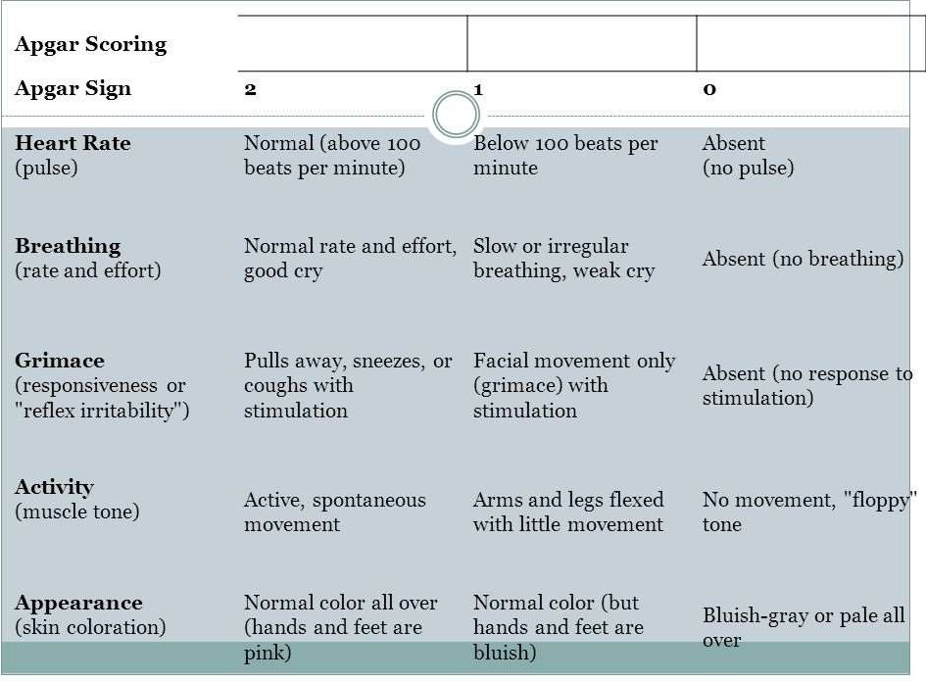

Slide 6
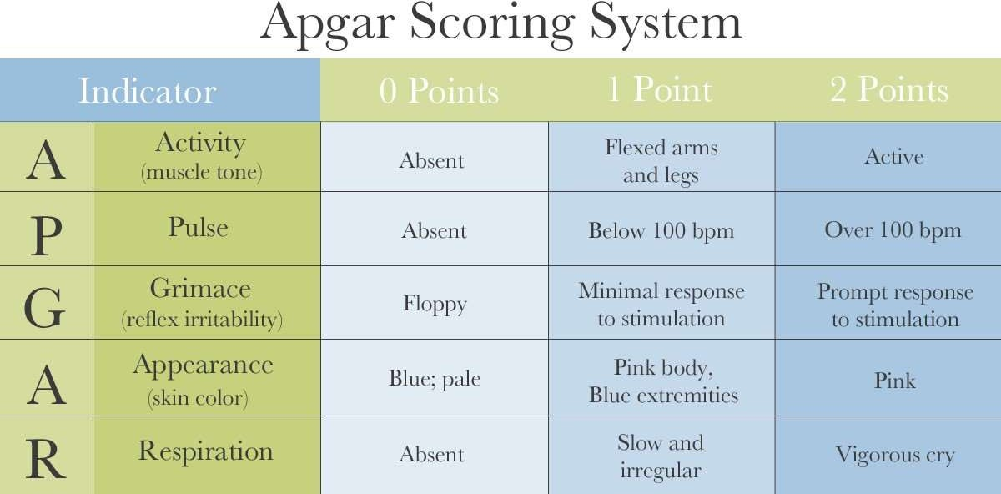

Slide 7
CONTD….
A: Activity/muscle tone
0 points: limp or floppy
1 point: limbs flexed
2 points: active movement
P: Pulse/heart rate
0 points: absent
1 point: less than 100 beats per minute
2 points: greater than 100 beats per minute
G: Grimace (response to stimulation, such as suctioning the baby’s nose)
0 points: absent
1 point: facial movement/grimace with stimulation
2 points: cough or sneeze, cry and withdrawal of foot with stimulation

Slide 8
CONTD….
A: Appearance (color)
0 points: blue, bluish-gray, or pale all over
1 point: body pink but extremities blue
2 points: pink all over
R: Respiration/breathing
0 points: absent
1 point: irregular, weak crying
2 points: good, strong cry

Slide 9
CONTD….
The APGAR SCORES are recorded at one and five minutes. This is because if a baby’s scores are low at one minute, a medical staff will likely intervene, or increased interventions already started.
At five minutes, the baby has ideally improved. If the score is very low after five minutes, the medical staff may reassess the score after
10 minutes. Doctors expect that some babies may have lower
APGAR SCORES.
These include:
premature babies
babies born via cesarean delivery
babies who had complicated deliveries
•

Slide 10
What’s considered a normal APGAR SCORE?
A score of 7 to 10 after five minutes is “reassuring.” A score of 4 to 6 is “moderately abnormal.”
A score of 0 to 3 is concerning. It indicates a need for increased intervention, usually in assistance for breathing. A parent may see nurses drying off a child vigorously or delivering oxygen via a mask. Sometimes a doctor, midwife, or nurse practitioner may recommend transferring a patient to a neonatal intensive care nursery for further assistance.
Many doctors don’t consider the Apgar scoring system to be perfect. There are modifications to this scoring system, such as the Combined-Apgar score. This scoring system describes not only the baby’s Apgar score, but also the interventions an infant has received.
The maximum score of the Combined-Apgar score is 17, which indicates a baby who hasn’t received any interventions and receives all points. A score of 0 indicates the baby didn’t respond to interventions.

Slide 11
TOTAL SCORE 10
NO DEPRESSION 7-10
MILD DEPRESSION 4-6
SEVERE DEPRESSION 0-3

Slide 12
THANK YOU

