Slide 1




APPENDICITIS
By,
Ms. Kapu Manjula
Assistant professor

Slide 2

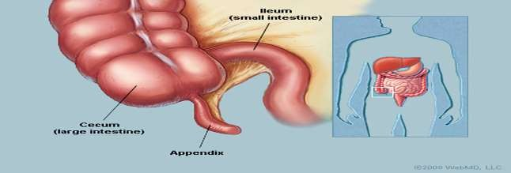
ANATOMY & PHYSIOLOGY
.
The appendix sits at the junction of the small intestine and large intestine.
It’s a thin tube about four inches long. Normally, the appendix sits in the lower right abdomen.

Slide 3

INTRODUCTION
Appendicitis is an inflammation of the appendix, a finger-shaped pouch that projects from colon on the lower right side of abdomen. Appendicitis causes pain in lower right abdomen. However, in most people, pain begins around the navel and then moves. As
inflammation worsens, appendicitis pain
eventually becomes severe.
typically Although
increases and
anyone can develop appendicitis, most often it occurs in people between the ages of 10 and 30..

Slide 4

DEFINITION
Appendicitis is an inflammation of the vermiform appendix that develops most commonly in adolescents and young adults.
( Joyce M Black)
Appendicitis is an acute inflammation appendix.
( B.T Basuvanthapa)
of the

Slide 5

INCIDENCE
Appendicitis is the most common acute surgical condition of the abdomen.
Approximately 7 % of the population will have appendicitis in their lifetime,
with the peak incidence occurring between the ages of 10 and 30 years.

Slide 6

ETIOLOGY
OBSTRUCTIVE CAUSES
Fecalith ( a fecal calculus or stone ) that occlude lumen of the appendix.
Kinking of the appendix ( Twisting or curling)
Swelling of bowel wall
NONOBSTRUCTIVE CAUSES
Haematogenous spread of infection
Vascular occlusion
Trauma
Diet lacking fibres

Slide 7






PATHOPHYSIOLOGY
DUE TO ETIOLOGICAL FACTORS
OBSTRUCTION OF APPENDIX ( DUE TO FECALITH, TUMOR)
INCREASED INTRALUMINAL PRESSURE
ISCHEMIC INJURY

Slide 8








BACTERIAL PROLIFERATION
( Tissues become infected by Bacteria in the digestive tract)
..
PUSS ACCUMULATION
IMPAIRMENT IN BLOOD SUPPLY

Slide 9







RUPTURE OF APPENDIX
.
DIGESTIVE CONTENTS ENTERS INTO THE ABDOMINAL CAVITY
PERITONITES ( Inflammation of
peritoneum )

Slide 10

CLINICAL FEATURES
SYMPTOMS
Pain : severe colicky type initially felt in the umbilical region & it is due to the distension of appendix.
Vomiting
Anorexia
Fever ( 100⁰ F )
Haematuria ( uncommon )
Constipation

Slide 11




CARDINAL SIGNS
The 5 important cardinal signs of appendicitis
are
PSOA’S SIGN
ROVSING’S SIGN
OBTURATOR’S SIGN
BLOOMBERG’S SIGN
MCBURNEY’S SIGN

Slide 12

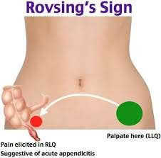
ROVSING’S SIGN
The Rovsing’s sign is positive when pressure over the patient’s left lower quadrant causes pain in the right lower quadrant.

Slide 13

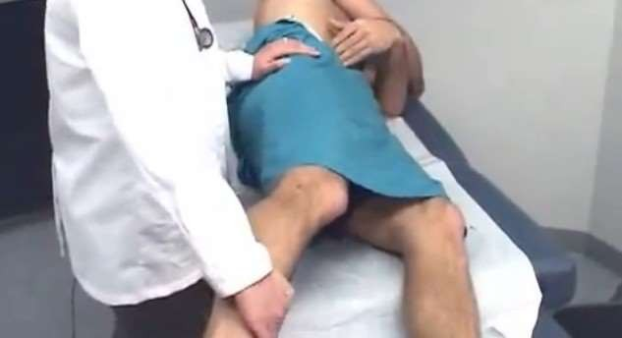
PSOA’S SIGN
Psoas sign is right lower-quadrant pain that is produced with the patient extending the hip due to inflammation of the peritoneum. Straightening out the leg causes the pain because it stretches the muscles.

Slide 14

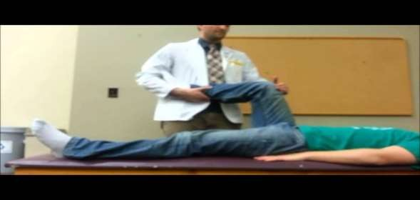
OBTURATOR’S SIGN
Pain on passive internal rotation of the flexed thigh. Examiner moves lower leg laterally while applying resistance to the lateral side of the knee resulting in internal rotation of the femur.

Slide 15

BLOOMBERG’S SIGN
BLOOMBERG’S SIGN Also referred as rebound tenderness .
Deep palpation of the viscera over the suspected inflamed appendix followed by sudden release of the pressure causes the severe pain on the site.
This indicates positive Blumberg's sign & peritonitis.

Slide 16
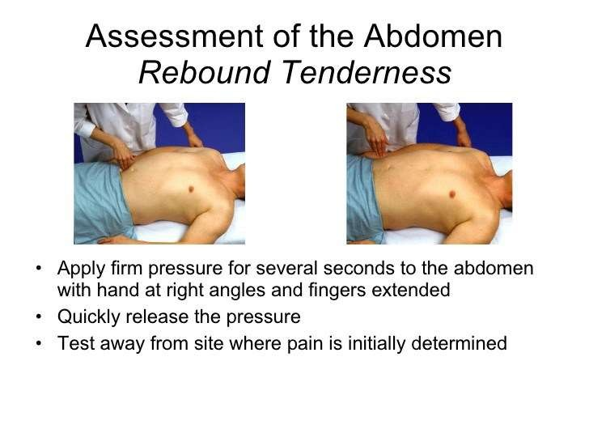
Continue……..
.

Slide 17

MCBURNEY’S SIGN
Mc Burney’s Point is two third away from umbilicus to Anterior superior iliac spine
To elicit Mcburney’s sign patient should be in supine position with his knees slightly flexed and his abdominal muscles relaxed.
Palpate deeply and slowly in the right lower quadrant over McBurney’s point ,located about 2” from the Rt. Ant. Sup. Iliac Spine, On a line between the spine and umbilicus.
pain and tenderness is a positive sign and indicates appendicitis.

Slide 18

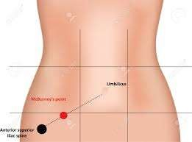
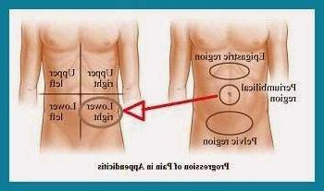
.
.

Others include
Cough tenderness
Indicate inflammation of Parietal Peritoneum

Slide 19

Guarding and Rigidity
Present in the right iliac fossa.
  Rectal examination
There is tenderness in the right rectal wall
  Per Vaginal Examination
Presence of ovarian mass, tenderness on movement of cervix.

Slide 20






MURPHY’S TRAID
  Pain first, Followed by vomiting and then fever
is called Murphy’s traid of syndrome of appendicitis ( Murphy’s Syndrome)
VOMITIN G
PAIN
FEVER

Slide 21

CLINICAL STAGES
The stages of appendicitis can be divided into early, suppurative, gangrenous.
Early stage appendicitis
In the early stage of appendicitis, obstruction of the appendiceal lumen leads to
Mucosal edema,
mucosal ulceration,
bacterial diapedesis,
appendiceal distention due to accumulated fluid, and increasing intraluminal pressure.

Slide 22
o The visceral afferent nerve fibers are stimulated, and the patient perceives mild visceral periumbilical or epigastric pain, which usually lasts four to six hours
Gangrenous appendicitis —
Intramural venous and arterial thrombosis , resulting in gangrenous appendicitis.

Slide 23

Suppurative appendicitis
Increasing intraluminal pressures eventually exceed capillary perfusion pressure.
Transmural spread of bacteria causes acute suppurative appendicitis.
When the inflamed serosa of the appendix comes in contact with the parietal peritoneum, patients typically experience the classic shift of pain from the periumbilicus to the right lower abdominal quadrant (RLQ), which is continuous and more severe than the early visceral pain.

Slide 24
DIAGNOSTIC MEASURES
History collection
Physical examination
White cell count (WCC) – usually mildly elevated, around 11-14,000
C reactive protein (CRP) – elevated .
Urinalysis
Complete blood count

Slide 25

CT - Scan
.
Ultrasound - visualise tubular structures & cysts
USG is not accurate as CT sometimes difficult to see appendix
Magnetic resonance imaging
x- ray

Slide 26

Management
Medical management
Surgical management
Nursing management

Slide 27

Medical Management
Goal of medical management includes
To treat infections
To prevent further complications
Medication therapy includes
Antibiotic therapy examples cephalosporin
Anti inflammatory drugs. Metrogyl
Analgesics
Fluid therapy.

Slide 28

SURGICAL MANAGEMENT
The surgical procedure for the removal of the appendix is called an appendectomy.
Appendectomy can be performed through open or laparoscopic surgery.
Laparoscopic appendectomy has several advantages over open appendectomy as an intervention for acute appendicitis.

Slide 29
Pre- operative Preparation
Once diagnosis is suspected, the Patient is Admitted to hospital
IV Fluid s – isotonic Saline or Ringer lactate is given.
Ryle’s tube is not necessary in simple appendicitis.
Second generation Cephalosporin along with metronidazole is given.
Informed consent is taken.

Slide 30

Appendicectomy
Appendicectomy is a surgical procedure to remove the appendix from the abdomen. It can be performed either with a small incision on the abdomen or laparoscopically (key hole surgery).
Indications for open appendicectomy
Dense adhesions due to inflammation or prior surgical procedures.
Perforated or gangrenous appendicitis.
Generalized peritonitis.

Slide 31

Lap . Appendicectomy
Become popular nowadays
Less post operative pain
Speedy recovery
If intraoperative complications that cannot be handled with laparoscopy arise during laparoscopic appendectomy, conversion to an open appendectomy

Slide 32

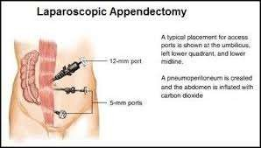
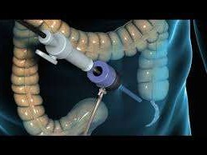
.

Slide 33

NURSING MANAGEMENT
.

Slide 34

Nursing Assessment
.➢History collection
Medical history
complaints of pain in postoperative wound appendectomy,
nausea, vomiting, increased body temperature, increased leukocytes.
Past medical history
Physical Examination
Cardiovascular System
To determine vital signs, presence or absence of jugular venous distension, pallor, edema, and abnormal heart sounds.

Slide 35
Hematologic System
To determine whether there is an increase in leukocytes ( sign of infection and bleeding).
Urogenital System
Assess Whether or not the tension of the bladder and lower back pain complaints.
Musculoskeletal System
To determine whether there is difficulty in movement,
pain in bones, joints and there is a fracture or not.
The immune system
To determine whether there is lymph node enlargement.

Slide 36

Investigations
Routine blood tests
To determine an increase in leukocytes is a sign of infection.
Abdominal examination
To know the existence of post-surgical complications.

Slide 37

NURSING DIAGNOSIS
Preoperative Appendectomy
Acute pain related to distention of the intestinal tissue by inflammation.
Anxiety related to change in health status.
Risk for deficient fluid volume related to preoperative vomiting.

Slide 38

Postoperative Nursing Diagnosis
Acute pain related to the presence of postoperative wound appendectomy.
Impaired nutrition less than body requirements related to reduced anorexia, nausea.
Deficient knowledge about the care and diseases related to lack of information
Risk for infection related to surgical incision.

Slide 39

COMPLICATIONS
Appendicitis can cause serious complications, such as
A ruptured appendix.
A rupture spreads infection throughout abdomen (peritonitis).
life-threatening.
This condition requires immediate surgery to remove the appendix
and clean your abdominal cavity.
A pocket of pus that forms in the abdomen.
If appendix bursts, Patient may develop a pocket of infection (abscess).
In most cases, a surgeon drains the abscess by placing a tube through
abdominal wall into the abscess site
The tube is left in place for two weeks,
Antibiotics are given to clear the infection

Slide 40

ASSIGNMENT
Write an assignment on Post operative care of patient undergone appendecetomy

Slide 41

RESEARCH STUDY
Research studies on Status of Day Care Laparoscopic
Appendectomy in Developing Countries.
RESULT
The results were encouraging with 87% patients discharged on the same day
13% on the next day in the early morning.
Among the next day discharged cases, only 03% stayed for medical reasons (nausea, vomiting, and pain) while 10% stayed as their attendants declined to leave (social reasons), even though they were medically eligible for discharge from the hospital.
There were no significant postoperative complications except tolerable
pain in all patients and mild to moderate nausea/vomiting in 80%.
There was no readmission. The mean length of hospital stay was
11.20 hours

Slide 42

CONCLUSION
Appendicitis is an inflammation of the appendix, a finger-shaped pouch that projects colon on the lower right side of your abdomen. Appendicitis causes pain in your lower right abdomen. However, in most people, pain begins around the navel and then moves. As inflammation worsens, appendicitis pain typically increases and eventually becomes sever.

Slide 43

BIBLIOGRAPHY
BLACK M. JOYCE, Medical Surgical Nursing, published by Elsevier, Edition 8th ,volume -2,page no.1406
Brunner and Suddarth’s,Textbook of medical surgical nursing, published by Lippincott Williams and Wilkins, Edition 11th ,volume 1,page no. 854
Smeltzer C. Suzane,Textbook of medical surgical nursing, published by Lippincott ,Edition 9th, page no. 789

Slide 44


.

