Slide 1








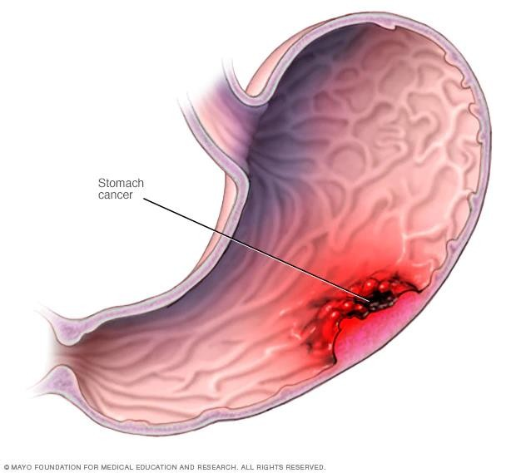







PRESENTED BY KAPU MANJULA M.SC NURSING
(Medical-Surgical )
ASST. PROFESSOR

Slide 2
Cancer of the Stomach

Most gastric cancers are adenocarcinomas; they can occur anywhere in the stomach. The tumor infiltrates the surrounding mucosa, penetrating the wall of the stomach and adjacent organs and structures.
Prognosis is poor because most metastases (liver, pancreas, and duodenum) at the time of diagnosis.
patients have
esophagus or

Slide 3
Risk factors

It typically occurs in males and people older than 40
years (occasionally in younger people).
The incidence of gastric cancer is much greater in Japan. Diet appears to be a significant factor (ie, high in smoked foods and lacking in fruits and vegetables).
Other factors related to the incidence of stomach cancer include chronic inflammation of the stomach, Helicobacter pylori infection, pernicious anemia, smoking, achlorhydria, gastric ulcers, previous subtotal gas- trectomy (more than 20 years ago), and genetics.

Slide 5

Clinical Manifestations

 Early stages: Symptoms may be absent or may resemble those of patients with benign ulcers (eg, pain relieved with antacids).
 Progressive disease: Symptoms include dyspepsia (indigestion), early satiety, weight loss, abdominal pain just above the umbilicus, loss or decrease in appetite, bloating after meals, nausea and vomiting, and symptoms similar to those of peptic ulcer disease.
 Advanced gastric cancer may be palpable as a mass.

Slide 6

Assessment and
Diagnostic Methods

 biopsy and cytologic washings is the diagnostic study of choice.
 Barium x-ray examination of the upper GI tract, EUS, and CT may be used.

Slide 7
Surgical Management

 Removal of gastric carcinoma; curative if tumor can be removed while still localized to the stomach
 Effective palliation (to prevent symptoms such as obstruc-tion) by resection of the tumor; total gastrectomy; radical subtotal gastrectomy; proximal subtotal gastrectomy; esoph-agogastrectomy

Slide 8
Chemotherapy & Radiation therpy
 Chemotherapy for further disease control or palliation (5-fluorouracil, cisplatin, doxorubicin, etoposide, mitomysin C )
 Radiation for palliation
 Tumor marker assessment to determine treatment effectiveness

Slide 9

Nursing Management
THE PATIENT WITH STOMACH CANCER
Assessment
 Elicit history of dietary intake.
 Identify weight loss, including time frame and amount; assess appetite and eating habits; include pain assessment.
 Obtain smoking and alcohol history and family history (eg, any first- or second-degree relatives with gastric or other cancer).
 Assess psychosocial support (marital status, coping skills, emotional and financial resources).
 Perform complete physical examination (palpate and percuss abdomen for tenderness, masses, or ascites).

Slide 10
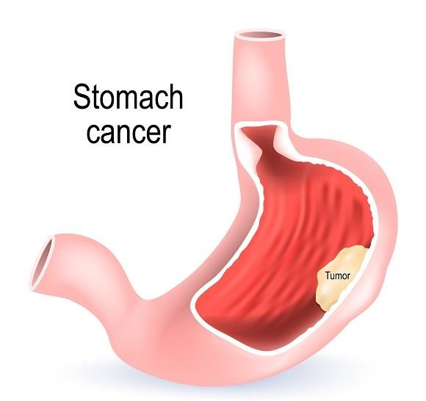
Nursing Diagnoses


Slide 11
Anxiety related to disease and anticipated treatment

 Provide a relaxed, nonthreatening atmosphere (helps patient express fears, concerns, and anger).
 Encourage family in efforts to support the patient, offering
 assurance and supporting positive coping measures.
 Advise about any procedures and treatments.

Slide 12

Imbalanced nutrition, less than body requirements, related to early satiety or anorexia

 Encourage small, frequent feedings of nonirritating foods to decrease
gastric irritation.
 Facilitate tissue repair by ensuring food supplements are high in calories and vitamins A and C and iron.
 Administer parenteral vitamin B₁₂ indefinitely if a total gastrectomy is performed.
 Monitor rate and frequency of IV therapy.
 Record intake, output, and daily weights.
 Assess signs of dehydration (thirst, dry mucous membranes, poor skin turgor, tachycardia, decreased urine output).
 Review results of daily laboratory studies to note any meta-bolic abnormalities (sodium, potassium, glucose, BUN).
 Administer antiemetic agents as prescribed.

Slide 13
Pain related to tumor mass

 Administer analgesic agents as prescribed (continuous infusion of an opioid).
 Assess frequency, intensity, and duration of pain to deter-mine effectiveness of analgesic agent.
 Work with the patient to help manage pain by suggesting nonpharmacologic methods for pain relief, such as position changes, imagery, distraction, relaxation exercises (using relaxation audiotapes), back rubs, massage, and periods of rest and relaxation.

Slide 14
Anticipatory grieving related to diagnosis of cancer

 Help patient express fears, concerns, and grief about diag- nosis.
 Answer patient’s questions honestly.
 Encourage patient to participate in treatment decisions.
 Support patient’s disbelief and time needed to accept
diagnosis.
 Offer emotional support, and involve family members and significant others whenever possible; reassure that emotional responses are normal and expected.

Slide 15

THE END


