Slide 1
COLORECTAL
CANCER
Mr. Kapu Manjula
Assistant professor

Slide 2
COLORECTAL CANCER
 Cancer of colon / rectum
 More common and third most common sites of
cancer in the human body
 Hereditary colon cancer accounts for about 6 percentage of all colon cancers
 Second leading cause of cancer related death
 Usually asymptomatic till the cancer is advanced
 Regular screening is necessary to detect
precancerous lesions
 Adenocarcinoma is most common

Slide 3
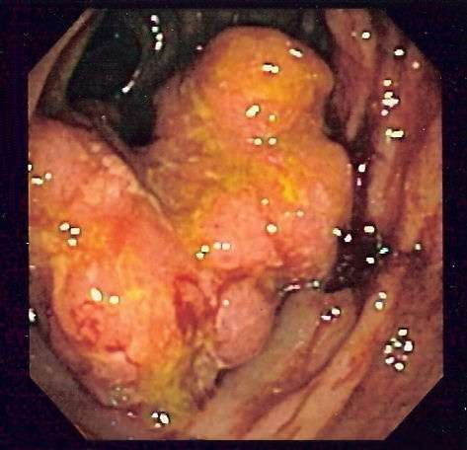

Slide 4
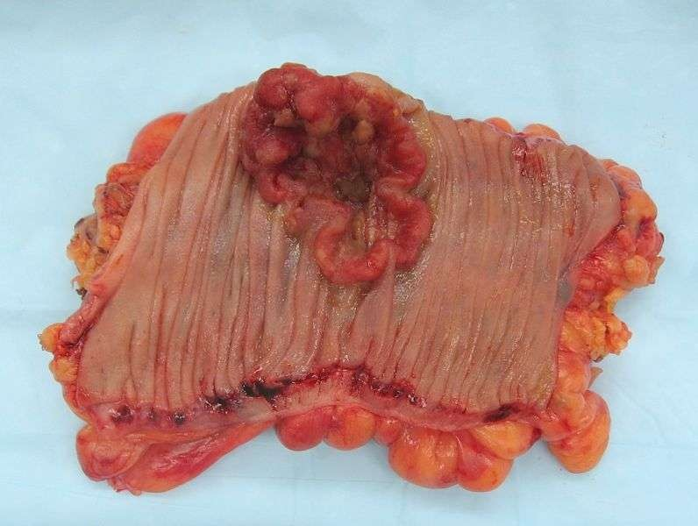

Slide 5
Etiology and Risk factors
 The cause of colorectal cancer remain unclear
 Familial history of colorectal cancer
 Advanced age > 50
 Previous history of adenomatous polyps
 High consumption of alcohol
 Smoking
 Obesity
 History of gastrectomy
 History of breast / ovarian / endometrial cancer in women
 History of inflammatory bowel disease
 High fat , high protein, low fiber diet [ controversial effect]

Slide 6
Pathophysiology
Predominantly arise as adenocarcinoma[arising from the epithelial lining of the intestine
Start as benign and later become malignant
Invade and destroy normal tissues
Extend into surrounding tissues and structures
Cancer cells migrate away from the primary tumor sites and spread to other parts of the body / metastasis [liver , peritoneum and lungs]

Slide 7
Clinical manifestations
The symptoms are determined by the location of tumor, stages of disease, functions of the affected intestinal portions…..the most
common are the follows……
Change in bowel pattern
Presence of blood in stool
Anemia
Anorexia
Weight loss
fatigue

Slide 8
Cont…..
Symptoms associated with RIGHT side of colon
Abdominal pain
Malena
Symptoms associated with LEFT side of colon
Cramping
Narrowing of stool
Constipation
Abdominal distention
Bright red stool

Slide 9
Cont….
Symptoms associated with rectal cancer
1.Tenesmus [ painful straining while
defecation]
2.Rectal pain
3. Bloody stool
4.Feeling of incomplete evacuation of
bowel

Slide 10
Duke’s staging system /
classification of colo rectal cancer
classification
A
description
 Negative nodes , lesions
limited to mucosa
 Negative nodes , extension of lesion through mucosa but still with in bowel wall
B1
 Negative nodes
,extension of lesion through the entire bowel wall
B2

Slide 11
Cont.......
 C1
 Positive lymph nodes limitated to bowel wall
 Positive lymph nodes , extension of lesion through the entire bowel wall
 C2
 Presence of distant , unresectable metastasis
 D

Slide 12
Assessment / diagnostic findings
 History
 Abdominal and rectal examination [ physical
examination]
 Fecal occult blood test
 Blood routine investigations
 Barium enema
 Proctosigmoidoscopy
 Colonoscopy [ biopsy / cytological smear testing]
 Carcino embryonic antigen test [ CEA]-reliable in predicting the prognosis of cancer . It will return to normal level with in 48 hours after removal of the tumor

Slide 13
Cont.........
 The normal range for CEA in an adult non- smoker is <2.5 ng/ml and for a smoker <5.0 ng/ml.

Slide 14
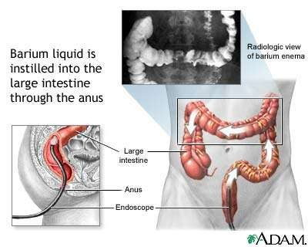

Slide 15
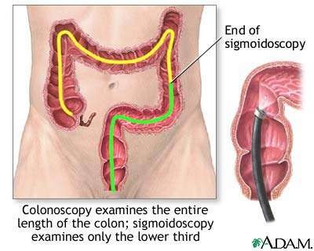

Slide 16
COMPLICATIONS
 PARTIAL / COMPLETE BOWEL OBSTRUCTION
 HEMORRHAGE [ ULCERATION OF INTESTINE]
 PERFORATION
 ABCESS FORMATION
 PERITONITIS
 SEPSIS
 RARELY SHOCK

Slide 17
MANAGENENT
 MEDICAL MANAGEMENT
The patient with GI obstruction treated with iv
fluids , naso-gastric suction
Significant bleeding is present , provide blood component therapy
Treatment of colorectal cancer is based on the stages of cancer and it consists of the
followings…
Surgical removal of tumor
Adjuvant therapy[ chemotherapy and radiation therapy]

Slide 18
Adjuvant therapy
 The standard adjuvant therapy is administered to patients with Duke’s class C or non metastasized colon cancer.
 Agents include- 5 FLUROURACIL , LEUCOVORIN CALCIUM , OXALIPLATIN , CAPECITABINE [ XELODA]
 For CLASS B & C , 5 FU along with high dose of pelvic irradiation is given. Some times Mitomycin is also used .

Slide 19
Cont....
RADIATION THERAPY
May be external / internal type
Used before / during / after the surgery . To shrink the tumor size and to achieve better results from the surgery.
And also as palliative treatment for advanced lesions which provide symptomatic relief
Post operative radiation therapy also reduces the risk of recurrence.

Slide 20
Surgical management
 Surgery is the primary management and only curative treatment.
 It may be curative / palliative type surgeries
 Success of the surgery depends upon the resection of the tumor with adequate margin of healthy bowel and regional lymph nodes resection
 Modern advances in the surgery techniques can enable the patient with cancer to have sphinctor saving devices that restore continuity of the gastrointestinal tract
 Type of the surgery depends on the location and size of the tumor

Slide 21
if cancer is limited to small area
 Colonoscopic removal
 Laproscopic colotomy with polypectomy
 Laproscopic colectomy
 Resection of colon is indicated CLASS A, B & C

Slide 22
Advanced surgeries
Right hemicolectomy-
cancer in cecum, ascending colon,
hepatic flexure, transverse colon
A portion of terminal ileum, ileocecal valve, appendix are removed
Ileotransverse colon anastamosis is
performed

Slide 23
Left hemicolectomy
 It involves resection of left transverse
colon, spleenic flexure ,descending colon
, sigmoid colon, upper portion of the rectum

Slide 24
Abdomino perineal resection
 Performed when the tumor is located within
5cm of the anus
 In this procedure abdominal incision is made and the proximal sigmoid colon is brought through the abdominal wall in a permanent colostomy. The distal sigmoid colon and anus is removed through the perineal incision .
Perineal incision may be closed around drain or left open with packing to allow healing by granulation.

Slide 25
Sphincter saving procedure
 Performed in patient with poor operative risk and for the patient with elderly disease
 Procedure involves resection of the local tumor and the anal sphincters are left intact

Slide 26
Laparoscopic colectomy
 Removal through laparoscopic means
 Benefits include faster return of bowel function , fewer incisional infection , short hospital stay , improved cosmetic appearance.

Slide 27
Ostomy surgery………………….
 An ostomy is a surgical procedure in which the an opening is made to allow passage of intestinal contents from the bowel to an incision / stoma.
 Stoma is an opening on the surface of abdomen, is created when intestine is brought through the abdominal wall and sutured to skin
 It may be temporary / permanent.

Slide 28
types
Ileostomy
 Also called conventional ileostomy /
Brooke ileostomy
 In this procedure an opening is made from the ileum through the abdominal wall [ usually performed in conditions like ulcerative colitis, familial poyposis, crohn’S disease

Slide 29
Cecostomy
 Is an opening between the cecum and
abdominal wall
 Cecostomy , asecending colostomy are uncommon procedure. They usually performed temporary for fecal diversion prior to other surgeries [ palliative surgeries]

Slide 30
Colostomy
 Is an opening between the colon and abdominal wall
 Proximal end of colon is sutured to to the skin
Types based on locations of the colostomy
ascending colostomy
Descending colostomy
Sigmoid colostomy [single barreled]
Transverse colostomy[ double barreled]

Slide 31
characcstoef srtiosmtiacasnod fdesstcoripmtionaof causes
Color
Red – viable stoma mucosa Pale- may indicate anemia
Dark red to purple- indicate inadequate blood supply to stoma or bowel from adhesions, excessive tension on the bowel during construction

Slide 32
Edema
 Mild to moderate edema- normal in initial post operative period, trauma to stoma, any medical condition that results in edema
 Moderate to sever edema- obstruction of the stoma, allergic reaction to food items, gastroenteritis

Slide 33
Bleeding
 Small amount-oozing from the stoma is common when touched, because of high vascularity
 Moderate to large amount- coagulation factor deficiency, stomal varices secondary to portal hypertension

