Slide 1
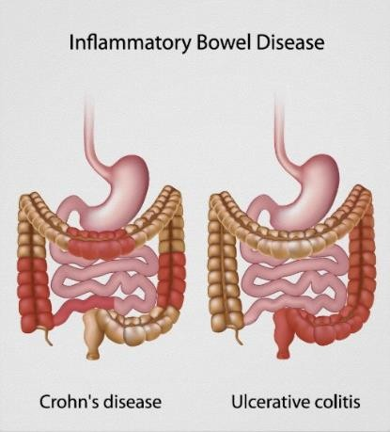


INFLAMMATORY BOWEL DISEASE

Slide 2
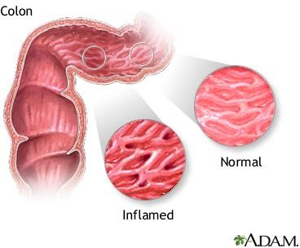
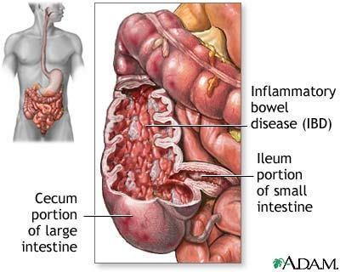
Introduction
2
Inflammatory bowel disease (IBD) represents a group of intestinal disorders that cause prolonged inflammation of the digestive tract.
It is a spectrum of chronic idiopathic inflammatory condition.

Slide 3
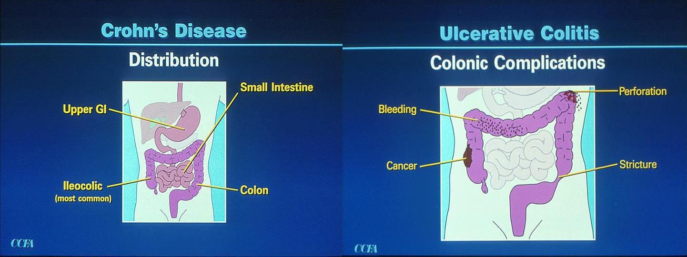
Classification
3
Ulcerative colitis: Ulcerative colitis is a disease that causes mucosal inflammation and sores (ulcers) in the lining of the large intestine (colon ).
Chron’s disease: Crohn’s disease is a chronic, relapsing and remitting inflammatory disease of the gastrointestinal tract, affecting any site from mouth to anus.

Slide 4
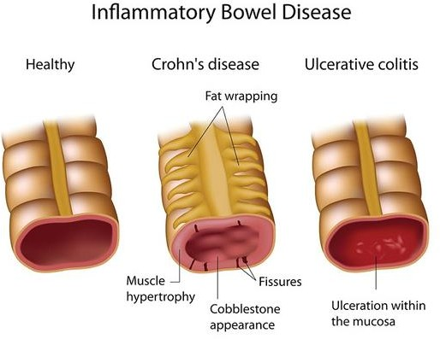
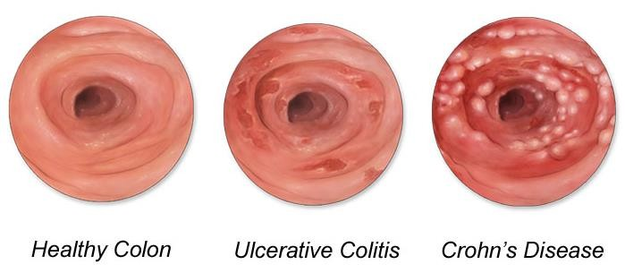
4

Slide 5
Epidemiology
5
Ulcerative colitis is slightly more common in males, while Crohn’s
disease is more frequent in women.
Diet, oral contraceptives, perinatal and childhood infections, or atypical mycobacterial infections have been suggested, but not proven, to play a role in developing IBD.
Prevalence (number of existing cases per 100,000 population)
Crohn's disease | Ulcerative colitis
26 to 199 cases per 100,000 persons² | 37 to 246 cases per 100,000 persons²
201 per 100,000 adults¹ | 238 per 100,000 adults¹

Slide 6
Etiology
6
Infectious agents
Viruses (Measles) Bacteria (Mycobacteria)
Genetics
Environmental factors
Diet Smoking
Psychological factors
Stress
Emotional or physical trauma

Slide 7
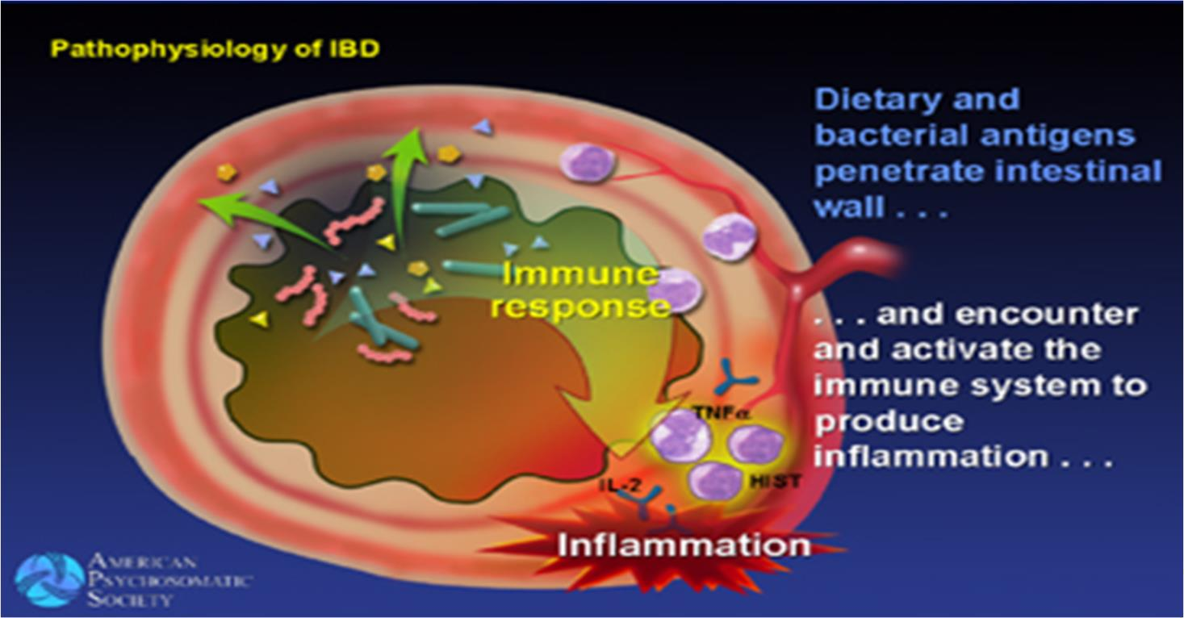
Pathophysiology
7
ALTERED MUCOSAL IMMUNE RESPONSE
Dietary and bacterial antigens penetrate into the intestinal wall and activates the immune system.
This causes increased production of pro-inflammatory mediators which will lead to inflammation of the mucosal layer.

Slide 8
Pathophysiology
8

Slide 9
Cont.
9
Variety of epithelial defects have been described in Crohn’s
disease and Ulcerative Colitis.
Defects in epithelial cells will lead to influx of bacterial components such as dendritic cells and macrophages which activates CD+4 cells.
Activated CD+4 cells activate other inflammatory cells like B-cells
and variable | T-cells | or recruit | more inflammatory | cells by
stimulation of | homing | receptor | on leucocytes and | vascular
epithelium.
Inflammation in IBD is maintained by an influx of leukocytes from the vascular system into sites of active disease. This influx is promoted by expression of adhesion molecules (such as α 4- integrins) on the surface of endothelial cells in the microvasculature in the area of inflammation.

Slide 10
Clinical Manifestations
11
Clinical symptoms are same in both case.
Diarrhoea
Abdominal pain, cramping & bloating due to bowel obstruction
Hematochezia : Blood in stool
Low fever
Decreased appetite
Weight loss and anorexia
Fatigue
Arthritis

Slide 11
Diagnosis
12
Physical Examination
Endoscopy
Biopsy
Radiology
Blood Test

Slide 12
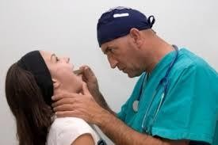
Physical Examination
13
The main features to look for are: oral aphtosis, abdominal tenderness and masses, anal tags, fissure and fistulae, nutritional deficiency.
An important children is retardation.
feature in
growth

Slide 13
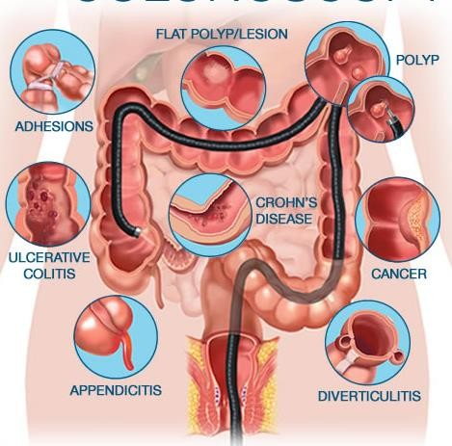
Endoscopy/ Colonoscopy/ Sigmoidoscopy
14
Colonoscopy helps to determine the pattern and severity of
colonic and terminal
and
ileum
allows
inflammation
biopsies to be obtained.
Endoscopic features are aphtous ulcers, deeper ulceration, postinflammatory polyps (which
indicate previous
severe
but always by intervening
inflammation), accompanied
normal mucosa,
which is an
important differential feature between CD and UC .

Slide 14
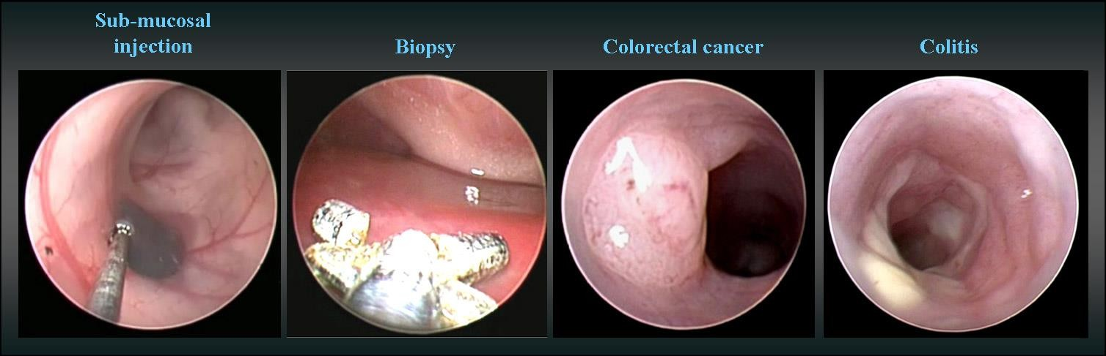
Biopsy
15
Rectal and colonic biopsies should be examined to find the nature of the inflammation (ulcerative colitis versus CD), collagenous colitis or microscopic inflammation if macroscopic appearance is normal, and infection.

Slide 15
Radiology
16
Barium enema
Barium inserted rectum
Fluoroscopy used to image bowel
Rarely used due to colonoscopy
Useful for identifying colonic strictures or colonic fistulae
Barium Small bowel follow- through X-ray
Barium sulfate suspension drink
Fluoroscopic images of bowel taken over time
Useful for looking for inflammation and narrowing of small bowel
into

Slide 16
Blood Test
17
Anemia may be present due to blood loss (iron deficiency), chronic inflammation or B12 malabsorption (macrocytic).
Hypoalbuminemia suggests severe disease with denutrition. The best markers of inflammation severity are elevation of the C-reactive protein and platelet count.
Anti-saccharomyces cerevisiae antibodies (ASCA) are positive in 50-60% of CD patients while anti-neutrophil polynuclear antibodies (ANCA) are positive in 50-60% of UC patients.

Slide 17
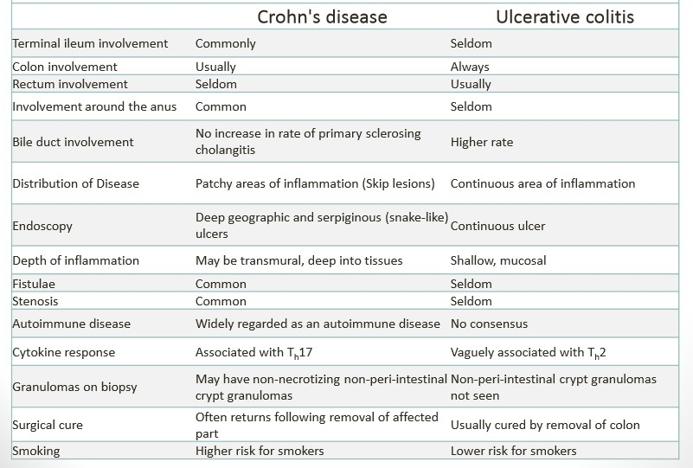
18

Slide 18
Goals of Treatment
19
Maintain or improve quality of life.
Terminate the acute attack and induce clinical remission.
Prevent symptoms during chronic symptomatic periods.
Prevent or reduce complication.
Use the most cost-effective drug treatment.
Avoid surgery if possible.
Replacement of vitamin A, D, K if necessary in case of malabsorption.

Slide 19
Non-Pharmacological Treatment
20
To avoid smoking cessation
To reduce alcohol consumption
To avoid the use of NSAIDs
To avoid spicy and fried/oily food
To take fiber rich diet as tolerated that include tender cooked vegetables, canned or cooked fruits, and starches like cooked cereals and whole wheat noodles and tortillas.
To incorporate more omega-3 fatty acids in the diet. These fats may have an anti-inflammatory effect. They are found most probably in fish.

Slide 20
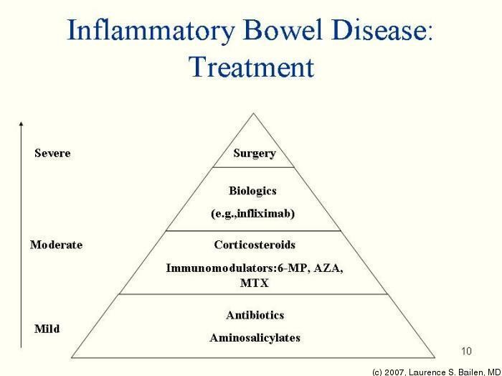
21

Slide 21
Surgery for Ulcerative Colitis
22
Proctocolectomy (removing the colon and rectum) with ileostomy: If UC is severe, surgery may be required to remove the entire colon and rectum, plus bring the ileum (end of the small intestine) through a stoma (opening) in the abdominal wall to allow drainage of intestinal waste out of the body. The second part of the procedure is called ileostomy. After the procedure, an external bag must be worn over the opening to collect waste.
Restorative proctocolectomy, also known as ileoanal pouch anal anastomosis (IPAA): It involves removing the colon and rectum, but the patient can continue to pass stool through the anus — in place of an ileostomy, the ileum is fashioned into a pouch and pulled down and connected to the anus.

Slide 22
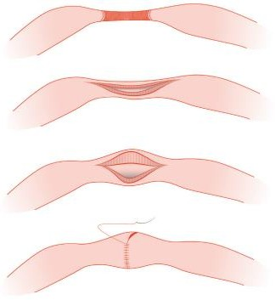
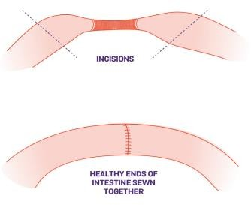
Surgery for Crohn’s Disease
23
Strictureplasty: If an area of the bowel narrows, this widens the area without removing any portion of the small intestine.
Resection (removing portions of the intestines): This involves removing affected areas of the intestine, and then joining together the two ends of healthy intestine in a procedure called anastomosis.

Slide 23
Cont..
24
Surgery for abscesses and fistulas: Sometimes abscesses (pus-filled mass) need to be removed surgically. And surgery may be required if a fistula (abnormal tract) is causing symptoms that don't respond to medication.
Colectomy (removing the colon) or proctocolectomy (removing the colon and rectum): If only the colon is affected, a colectomy may be needed. But if the colon and rectum are affected, a proctocolectomy may be needed, along with ileostomy — bringing the ileum (end of the small intestine) through a stoma (opening) in the abdominal wall to allow drainage of intestinal waste out of the body. After the procedure, an external bag must be worn over the opening to collect waste.

Slide 24
Pharmacological Treatment
25
The major types of drug therapy used in IBD include
Aminosalicylates
Corticosteroids
Immunosuppressive agents
TNF – Tumor Necrosis Factor Inhibitor
Antimicrobials

Slide 25
Aminosalicylates / 5-ASA
26
These agents have anti-inflammatory effects. They are used to maintain remission and to induce remission of mild flares of disease.
Egs., Sulfasalazine, Mesalamine
Sulfasalazine and mesalamine are used to treat mild to moderate disease and to maintain remission induced by corticosteroids.
Sulfasalazine is useful for ileocolonic and colonic disease.
The side effects are hemolytic anemia & pruritic dermatitis.
Pentasa is a recently developed sustained-release preparation (coated with ethylcellulose) that delivers 5-ASA to the distal ileum and colon.

Slide 26
Corticosteroids
27
Corticosteroids (I mg/kg/day) are effective in decreasing disease activity and inducing remission in most patients. However, due to undesirable side effects, long-term use of corticosteroids is not recommended.
Oral or parenteral corticosteroids are indicated for the treatment of ambulatory patients with moderate to severe colitis whose symptoms cannot be controlled by aminosalicylates.
The adverse effects include cosmetic effects, suppression of linear growth in children and osteopenia.
Egs., Prednisolone, Budenoside

Slide 27
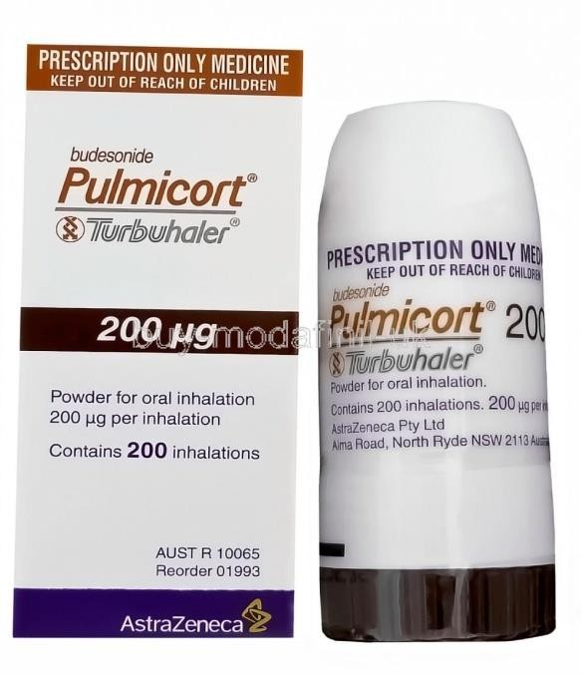
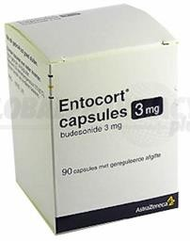
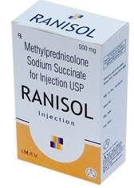
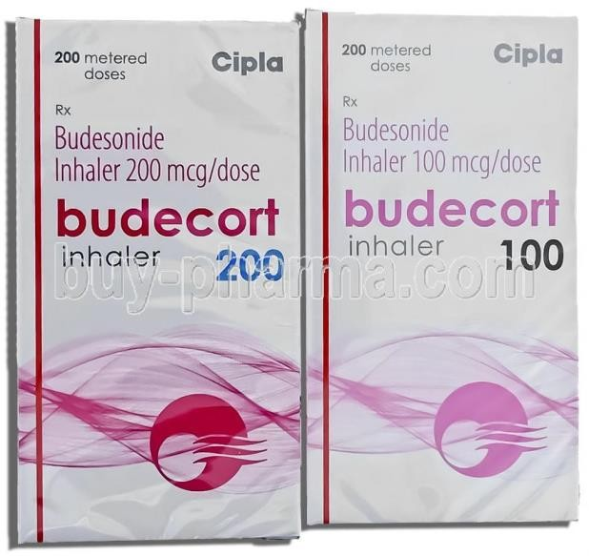
Cont..
28
Ambulatory patients are usually treated with prednisolone.
Budesonide, a potent steroid that undergoes extensive ﬁrst- pass hepatic metabolism, is useful, but approximately one- third of patients experience adverse effects related to budesonide use.

Slide 28
Immunosupressive Agents
29
If it is impossible to taper corticosteroids or frequent relapses occur, immunomodulating therapy should be considered. However, the use of immunomodulators is not approved by the national health insurance scheme.
Azathioprine and 6-mercaptopurine are used due to their steroid - sparing or steroid - reducing effects, since approximately 50% of patients experience adverse effects from corticosteroids.
Due to delayed onset of action, these agents are not used to treat acute colitis.
Cyclosporine and tacrolimus have been used to treat acute steroid-refractory UC when surgery seemed inevitable.

Slide 29
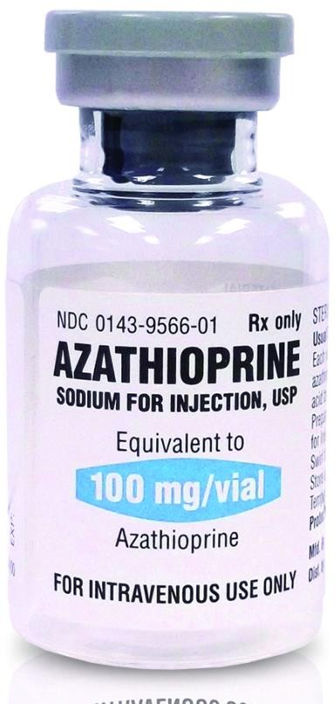
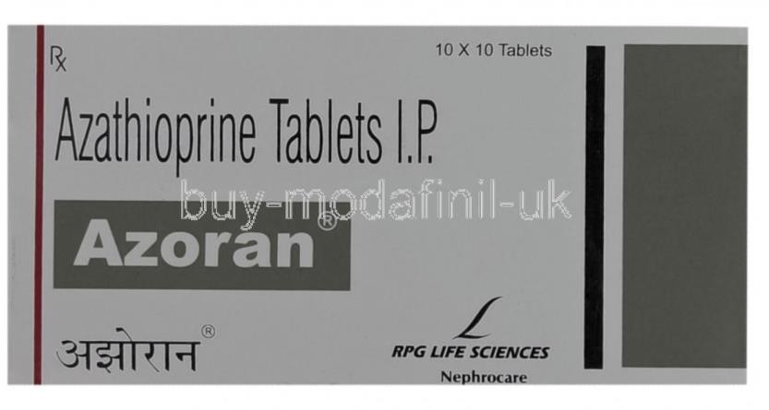
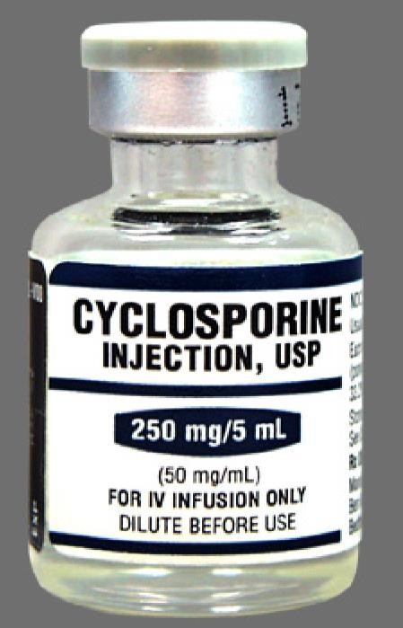
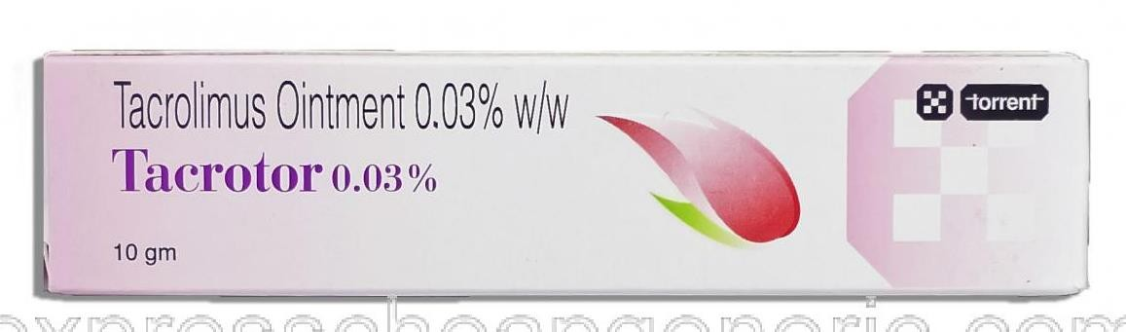
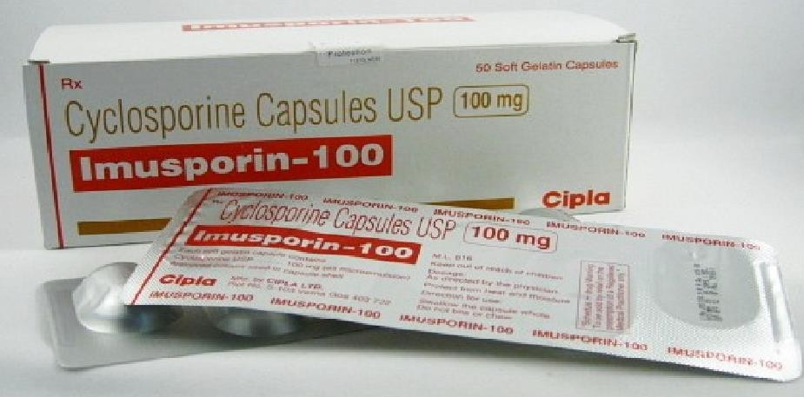
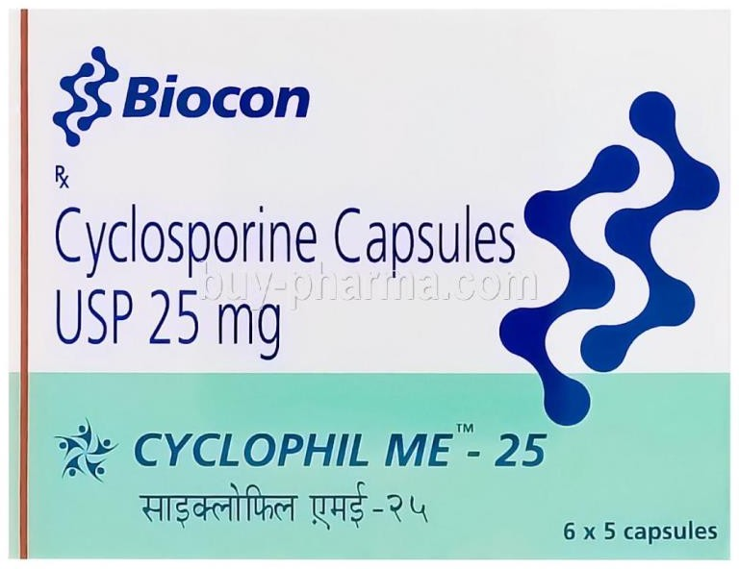
30

Slide 30
TNF Inhibitors
31
Increased production of inﬂammatory cytokines, especially tumor necrosis factor alpha (TNF-α), has been described in both normal and inﬂamed mucosa.
These agents prevent the endogenous cytokine from binding to the cell surface receptor and exerting biological activity. These agents adversely affect normal immune responses.
Thalidomide, originally used for its sedative and antiemetic properties, has recently been shown to inhibit TNF-α production by monocytes and other cells.
Infliximab is a chimeric mouse-human monoclonal antibody to TNF. It binds free and membrane-bound TNF and thus prevents the cytokine from binding to its cell surface receptor .

Slide 31
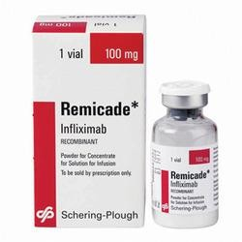
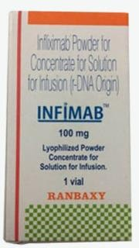
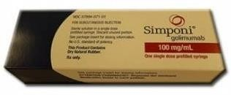
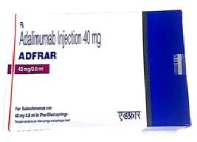
Cont..
32
Golimumab is a human anti-TNF-α monoclonal antibody that blocks the inflammatory activity of TNF-α.
Adalimumab is a recombinant human anti-TNF-alpha IgG1 monoclonal antibody that blocks the inflammatory activity of TNF-α. It specifically binds to TNF-α and blocks its interaction with p55 and p75 cell surface TNF receptors.

Slide 32
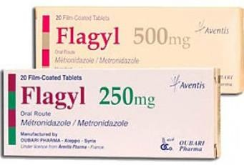
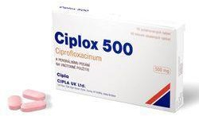
Antimicrobial Agents
33
Metronidazole and ciproﬂoxacin are useful in the treatment of mild to moderate disease, particularly in patients with perianal disease and infectious complications.
Sensory neuropathy, which may be seen with long-term metronidazole use, usually resolves completely or improves after discontinuation of the drug.

Slide 33


