Slide 1
PEPTIC ULCER DISEASE (PUD)
By,
Kapu Manjula

Slide 2
INTRODUCTION
A peptic ulcer is loss of tissue from the lining of the digestive tract. Normally a mucous barrier protects the lining from the digestive fluids.
When the barrier fails, pepsin and hydrochloric acid injure the unprotected tissue.

Slide 3
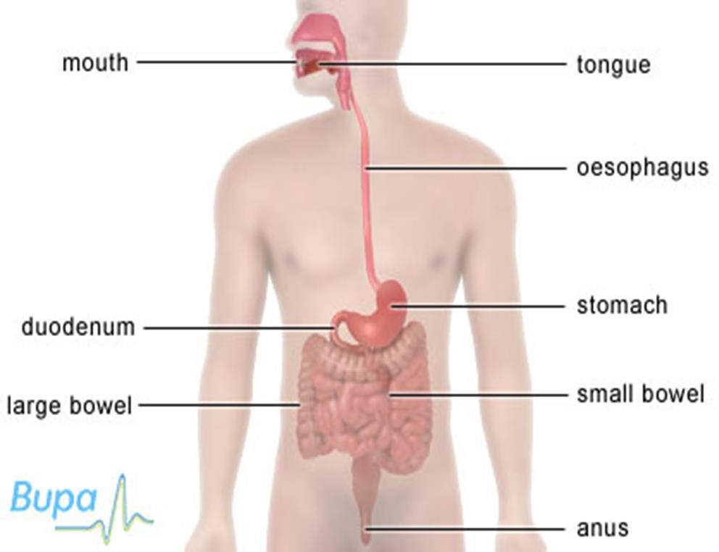
ANATOMY REVIEW

Slide 4
DEFINITION
This is the erosion of the gastrointestinal mucosa resulting from the digestive action of hydrochloric acid and pepsin (Basavanthappa,2005).
It is a break in the continuity of the GIT that may involve the mucosa, submucosa or muscular layer of esophagus, stomach, duodenum.

Slide 5
CAUSE/PREDISPOSING FACTORS OF PUD
Peptic ulcers can be classified according to duration as well as location.
According to duration there is acute and chronic.
Peptic ulcers can be classified according to duration as well as location.
According to duration we have acute and chronic.
The cause is unknown; however, there are predisposing factors and these include: -
Regular and prolonged use of non-steroidal anti-inflammatory drugs e.g. Aspirin.

Slide 6
PREDISPOSING FACTORS OF PUD CONT’
Excessive regular alcohol consumption and heavy cigarette smoking which may accelerate gastric acid production.
Infection with Helicobacter Pylori.
Pathologic hyper secretory states such as Zollinger-Ellison syndrome.

Slide 7
PATHOPHYSIOLOGY
The mechanisms of mucosal injury in gastritis and PUD are thought to be imbalance of aggressive factors such as acid production, production of pepsin and defensive factors such as mucous production, bicarbonate and blood flow.
Erosive gastritis usually is associated with serious illness or with various drugs. Stress, bile, ethanol and non-steroidal anti- inflammatory drugs (NSAIDS) disrupt the gastric mucosal barrier making it vulnerable to break down forming ulcerations. Infection with helicobacter pylori is the leading factor in PUD formation and is associated with all ulcers not induced by NSAIDS.

Slide 8
PATHOPHYSIOLOGY CONT’
The pylori colonize the deep layers of the mucosal gel that coats the gastric mucosa and disrupts its protective properties.
NSAIDs also interfere with the protective mucus layer by inhibiting mucosal activity, reducing mucosal prostaglandins which cause abnormal permeability of the mucus layer.
The common sites where ulcerations occur are: duodenum, antrum, lesser curvature, and gastro- esophageal junction

Slide 9
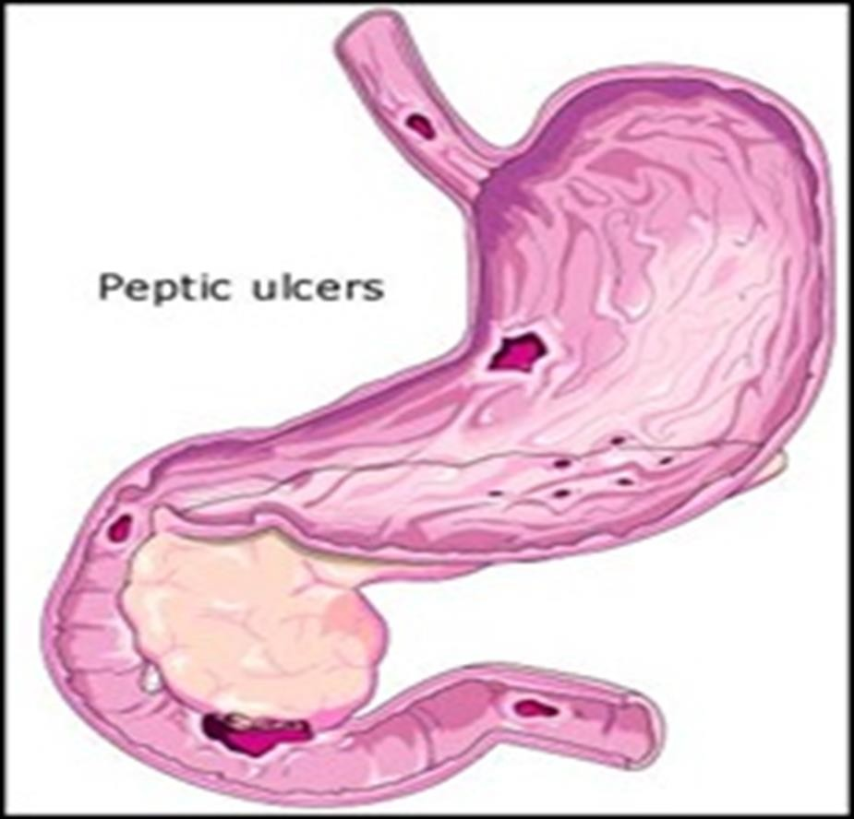

Slide 10
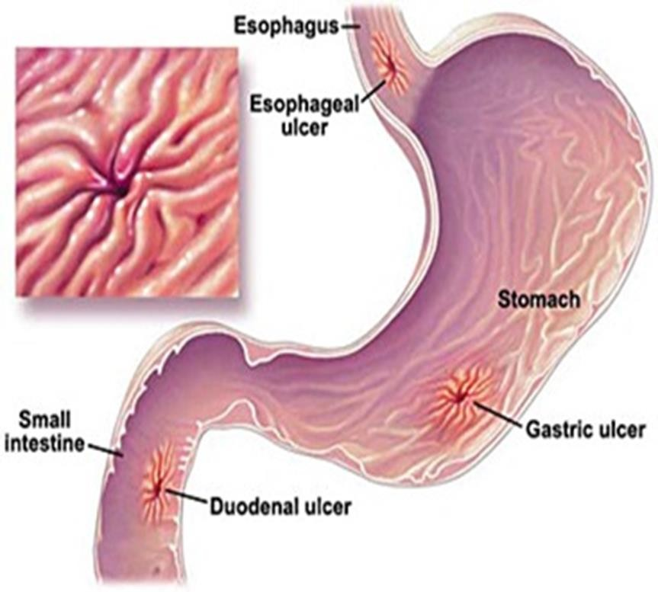

Slide 11
Signs and Symptoms
Epigastric pain which is burning and relieved by food or antacid. (Duodenal ulcers) or dull pain and not usually relieved by food or antacid (gastric ulcer).
Persistent vomiting due to pyloric stenosis and acid regurgitation.
Nausea, vomiting and anorexia – common in gastric ulcers due to vagus nerve which stimulate the hypothalamus and consequently the vomiting center.
Dyspepsia (Indigestion) and Heartburn due to regurgitation of Gastric contents.

Slide 12
S/S CONT’
Occult Blood in stool due to bleeding from a perforated ulcer.
Weight loss due to painful gastric ulcers which occurs soon after eating food. But there is weight gain in duodenal ulcers because pain is relieved by food intake.
Hematemesis and Malaena
Anaemia – may be present in chronic peptic ulcer cases due to hemorrhage from perforated ulcers & poor Nutrition.

Slide 13
COMPARISON BETWEEN GASTRIC AND DUODENAL ULCERS
GASTRIC | DUODENAL
Location: stomach/gastric And is common in ages 50yrs and above | Location: duodenum And is common in ages 30-60yrs
There is normal or hypo-secretion of acids | There is hyper secretion of stomach acids
There is weight loss | There is weight gain
Pain occurs immediately 30-60 minutes after meals Rarely occurs at night. | Pain occurs 2-4 hours after meals usually occurs at night.
Ingestion of food aggravates pain. | Ingestion of food relieves pain.
Vomiting is common | Vomiting is rare
Hemorrhage is common often leads to hematemesis and melena | Hemorrhage is rare

Slide 14
Investigations:
History taking
Physical examinations
Special radiology (Barium meal) is done to visualize the ulcer, after the patient has taken the barium sulphate.
Gastroscopy and duodenoscopy to observe the mucosa.
Biopsy may be done for gastric ulcers to diagnose benign or malignant changes.
Stool examination to detect presence of blood (occult or fresh) in stool which may be a sign of bleeding from the gut.
Gastric juice analysis.

Slide 15
MANAGEMENT’
Medical Treatment
One aspect of treating peptic ulcers is neutralizing or decreasing stomach acidity, this process begins with eliminating possible stomach irritants such as non-steroidal anti-inflammatory drugs (NSAIDs), alcohol and nicotine.
Although, bland diet may have a place in the treatment of ulcers, no strong evidence supports the belief that such diets speed healing or keep ulcers from recurring. Nevertheless, people should avoid foods that seem to make pain and bloating worse.

Slide 16
MGT CONT’
Aims of treatment: -
To relieve discomfort
Protection of mucosa barrier to promote healing.
Prevention of complications and recurrence.

Slide 17
MGT CONT’
The aims can be achieved through the use of drugs such as antacids, H2 –receptor antagonists, proton pump inhibitors, analgesia and antibiotics.
Antacids: Magnesium Trisilicate
Presentation-tablet 250mg and 500mg
Dosage-adult 250 to 500mg chewed 8hourly or PRN (pro-re-nata)
Side effects-diarrhea
Caution-to be taken with caution in patients with renal impairment

Slide 18
MGT CONT’
H2- receptor antagonists
These inhibit the action of histamine on the parietal cells thereby inhibit the secretion of acids. An example of antagonist is:
Cimetidine
Presentation-tablets 200mg, 400mg and Injectable 100mg/ml, 150mg/ml.
Dosage-20-30mg/kg body weight in divided doses.
Side effects-alopecia, confusion, dizziness impotence peripheral neuropathy,
Caution-Avoid intravenous injections particularly in high doses, and in cardiovascular impairment.

Slide 19
MGT CONT’
Proton pump inhibitor
An example is:
Omeprazole (Prilosec)
Presentation-Capsules 20mg
Dosag-20mg orally 6hourly for 4 to 6 weeks
Pediatric dose is not established
Side Effects-Headache, dizziness, diarrhea abdominal pains, vomiting Flatulence, rash, back pain.
Antibiotics are increasingly being used when the bacterium helicobacter pylori is the underlying cause of peptic ulcers.
Metronidazole, amoxicillin or tetracycline is commonly used.
Analgesics for pain may be prescribed. Panadol

Slide 20
MGT CONT’
NURSING CARE
EMPHASIS MUST BE PUT ON;
Diet – non irritating foods (bland diet)
Rest and stress reduction
Avoidance of Smoking
Avoidance of Alcohol intake .

Slide 21
COMPLICATIONS
Hemorrhage – resulting from excessive erosion of blood vessels in the GIT.
Perforation – due to continuous erosion of the mucosa of the stomach or duodenum. A peptic ulcer may perforate through into the peritoneal cavity and cause acute abdomen.
Pyloric obstruction – which occurs distal to the pyloric sphincter as a result of edema of the inflamed tissues or due to scarring of the previous ulcers.
Malignant change – resulting from the chronicity of the ulcers.

Slide 22
REFERENCES
Cahill, M. et al (1997), Nurse’s Drug Guide, Springhouse, Pennsylvania.
Cahill, M. (1998), Diseases, Springhouse Corporation, Pennsylvania.
Dewit, C. S. (1998), Essentials of Medical-Surgical Nursing, 4th Ed., W.B. Saunders Company, London.
Lewis, S. M. et al (2004), Medical- Surgical Nursing, Mosby, Texas.

Slide 23
Q1. Discuss Zollinger-Ellison Syndrome?
Q2. Describe how you can manage perforation and pyloric obstruction
. as a result of complication of peptic ulcer disease (PUD).
Q3. Describe the pathophysiology of PUD.
Q4. What are the differential diagnosis of PUD?

