Slide 1
Management of normal Pueperium

Slide 3
Principles in management are :
To give all out attention to restore the health status of the mother and baby.
To prevent infection
To take care of the breast including promotion of lactation and nursing of the child.
To motivate the mother for contraception

Slide 6
Hospital stay
Early discharge from the hospital is an almost universal procedure. If adequate supervision by trained health visitors is provided, there is no harm in early discharge. In most of the hospital patients are discharged within 24 hrs to 48 hrs and by 3 to 5 days in those who have perineal stitches.

Slide 13
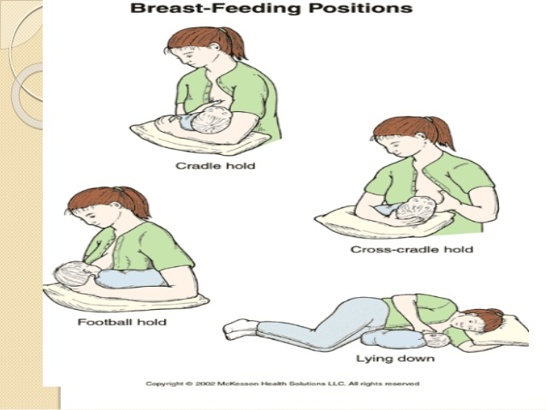

Slide 15
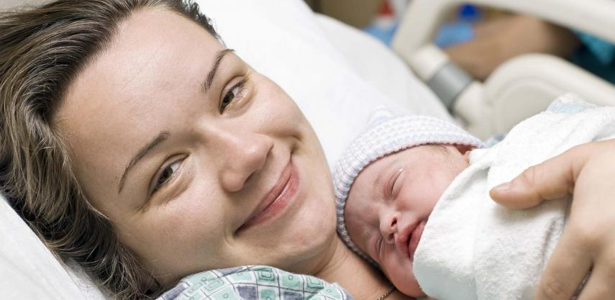
Maternal infant bonding (rooming in )
It starts from first few moments after birth. This is manifested by fonding , kissing , cuddling and gazing at the infant. The baby should be kept in her bed .

Slide 16
Asepsis and antiseptics
Asepsis must be maintained specially during first week of Pueperium . Liberal use of antiseptic, aseptic measure during perineal wound dressings, use of clean bed linen and clothing's are positive steps. Clean surrounding and limited number of visitors could be of help in reducing nosocomial infection.

Slide 17
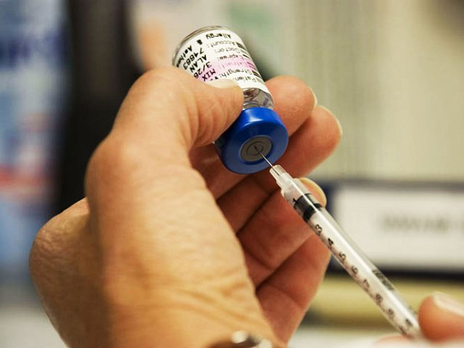
Immunization
Administration of anti D gamma globulin to un immunized Rh negative mother bearing Rh Positive baby.
Women who are susceptible to rubella can be vaccinated safely with rubella vaccine.
The booster dose of TT should be given at the time of discharge if it is not given during pregnancy.

Slide 18
Post natal exercise
The aim is to
To improve the muscle tone which are stretched during pregnancy and labour
To educate the mother about the correct posture to be attained when the patient is getting up from the bed.
To minimize the risk of puerperal venous thrombosis
To prevent back ache
To prevent genital prolapse and stress incontinence of urine.

