Slide 1
BLOOD
Mrs.Mercy Deva Priya
Asst.Prof.
Dept of MHN

Slide 5
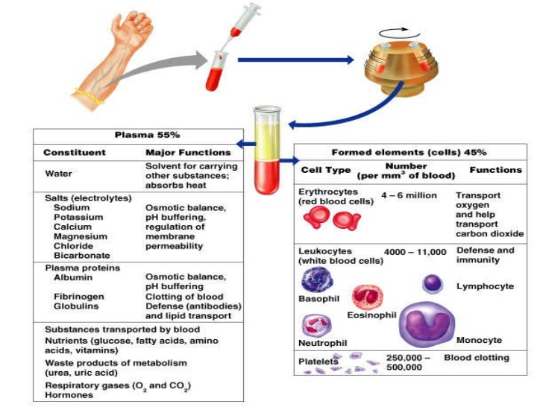

Slide 6
