Slide 1
ANNUAL REPORT 2017-2018
Students’ Admission
Result Analysis
Placement
Research Publication and Funding
Mou & Collaborations
Extension Activity and Faculty ,Student Achievement
Roadmap
Smt. Nagarathnamma School and College of Nursing

Slide 2
Program details
Sl.No | Yr of Estd. | Programme | Duration | Sanctioned Intake by Apex Body | Student Admitted 2017-2018 | Student Admitted 2018-2019 | Tot. Sts. on Roll
1 | 2003 | B.Sc Nursing [Basic] | 4 year | 60 | 46 | 60 | 230
2 | 2010 | B.Sc Nursing [Post Basic] | 2 year | 25 | 00 | 02
3 | 2008 | M.Sc in Nursing Medical surgical Nursing Obst & Gyne Nursing Pediatric Nursing Psychiatric Nursing Community Health Nursing | 2 year | 25 [each 5] | 01 | 02
4 | 2003 | DGNM | 3 Year | 60 | 17 | 60

Slide 3
Pass Percentage
S.N | Components | Program | Academic Year 2016-2017
 |  |  | 1 Yr | Pass% | 2Yr | Pass % | 3rd Yr | Pass % | 4th Yr | Pass %
1 | Tot. No of students appeared | M.Sc N | 02 | 100 | 03 | 100 | -- | - | - | -
2 | Tot. No of students appeared | DGNM | 13 | 100 | 10 | 90 | 9 | 100 | - | -
3 | Tot. No of students appeared | P.B.B.Sc | 02 | 100 | 02 | 100
4 | Tot. No of students appeared | B.Sc N | 46 | 55 | 33 | 90 | 16 | 100 | 13 | 100

Slide 4
RESEARCH PROJECTS AND PUBLICATIONS
Sl.No | Name of the Department | Projects | Publication
1. | Medical –Surgical Nursing | University Grants Applied:1 Faculty Projects:3 Student Project :PG:04:UG:04 | 02
2. | Community Health Nursing | University Grants Applied:1 Faculty Projects :1 Student Project :PG:0:UG:01 | 19
3. | Child Health Nursing | University Grants Applied:1 Faculty Projects:3 Student Project :PG:0:UG:01 | 02
4. | OBG | University Grants Applied:1 Faculty Projects:01 Student Project :PG:0:UG:01 | 01
5. | Mental Health Nursing | University Grants Applied:1 Faculty Projects:02 Student Project :PG:0:UG:01 | 06

Slide 5
RESEARCH THRUST AREAS
Sl.No | Name of the Department | Research Thrust Area | INNOVATION IN TEACHING
1. | Medical –Surgical Nursing | NUTRITION | SIMULATION PBL OSCE FIPPED CLASSROOM MICRO TEACHING e –Learning
2. | Community Health Nursing
3. | Child Health Nursing
4. | OBG
5. | Mental Health Nursing

Slide 6
    PLACEMENT
Name of the Organization | Year | Tot. Students
HCG Consultant | 2016-2017 | 01 in B.Sc[N] & 01 in GNM
Vyedhi Institute of MedicalSciencse Bangalore | 2016-17 | 01 B.Sc[N]
BRS | 2016-17 | 01 From B.Sc[N]
Columbia asia Hospital | 2017-2018 | 04

Slide 7
    PLACEMENT AND COLLABORATIONS
Name of the Organization | Year | Tot. Students
HCG Consultant | 2016-2017 | 01 in B.Sc[N] & 01 in GNM
Vyedhi Institute of MedicalSciencse Bangalore | 2016-17 | 01 B.Sc[N]
BRS | 2016-17 | 01 From B.Sc[N]
Dr.Ambedkar Medical College and Hospital, Bengaluru
ESIC Hospital ,Peenya, Bengaluru
Sapthagiri Institute of Medical science and Hospital
DHO for Primary Health Centre of Urban and Rural area for Community Training
Victoria and Vanivilas and KIDWAI Hospital
CND-Centre for Nursing Development for Joint Programme and faculty development
Old age Home ,Hospice car Centre and Rehabilitation Centre for Extension and Outreach Community Services
Adopted Village and School for Extension Activity Selected NGOs for Community Out reach Programme

Slide 8















SNCN Placement : Corporate, MNC, Consultancy ,Marketing & Placement agencies
RA Infotech
SAGITUS solutions Pvt. ltd

Slide 9
ACHIEVEMENTS
Academic
Secured Toppers @ University Level
International seminar -01
State level seminar -01
Field visits -07
Educational tour -01
Administrative visits -03
CNEs -12
Continuous nursing
development (CND) - 05
Faculty development
Programme -02
Faculty workshops
conferences (attended) - 08
Departmental seminars -05
Journal presentations- 21
Placement activity -01
Workshops -02
SNA programmes -08
Problem based learning -10
Research and Publication
Research events -02
Research workshops - 10
iARC) -04
Advanced Research methods
Poster presentation awards 02
RGUHS research workshop -02
Extension Activity
NSS programmes -21
Women’s cell -04
Community outreach
programmes -02

Slide 10
ROAD MAP AY -2018-2019
Feedback -and SWOT Analysis
Faculty JD and Action Plan ,SOP,SWOC
Administrative and Academic Audit
Faculty Review
Min. 2 faculty have to be enrolled for P.hd Programme
Academic Planning 2019-2020
Alumni Meet
Career Counseling Program-1 no
Campus Placement drive
Faculty Exchange Programmes 2 nos
NSS Residential Camp
Faculty enrollment for MOOC Courses [Min 2]
Funding Research Projects atleast 1Nos.
Budget Planning
Curriculum enrichment Program 1 No
CNE Programme @ SIM 14 No
Ifield Visit 11 Nos
International and national Workshop 1 No
Departmental Seminar-% Nos
Certificate Course [Short] 2
E-Learning Courses -4 Nos.
MoU for Collaboration 1 no.
AQAR Submission
Value added Course 2 nos
Plan for Campus Visit 2no
Monitoring the Academic Progress
ASNA Sport –Leading to a part of National Level SNA Participation
Clinical Linkages People Tree Hospital
Health Promotion Activities as per WHO Model for Vulnerable group
Auditing
Faculty review
Apr-June
Oct-Dec
Jan-March
Jul-Sep

Slide 11
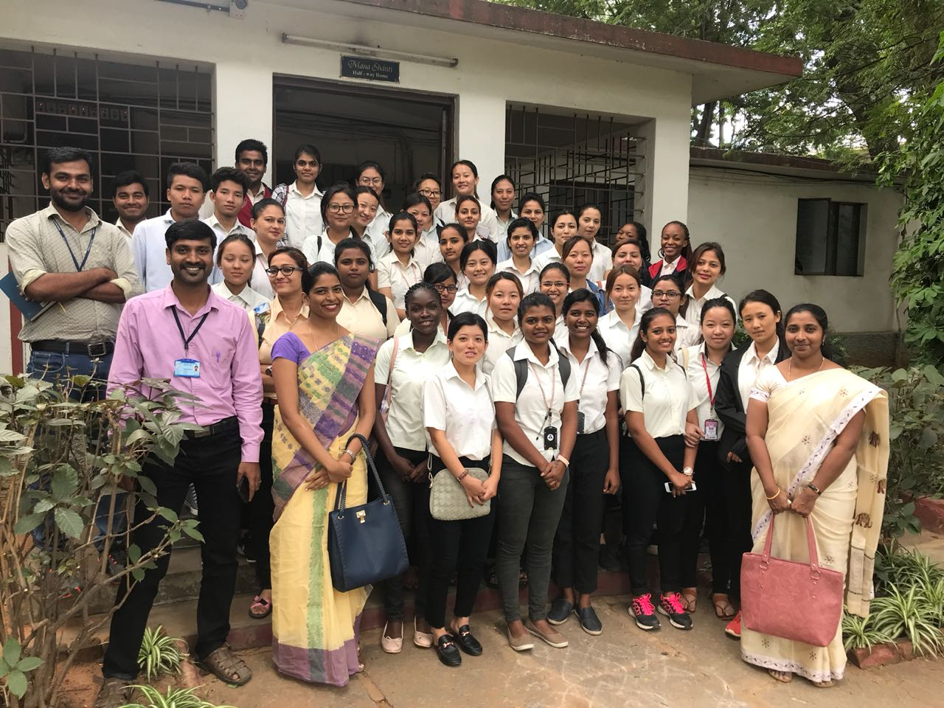
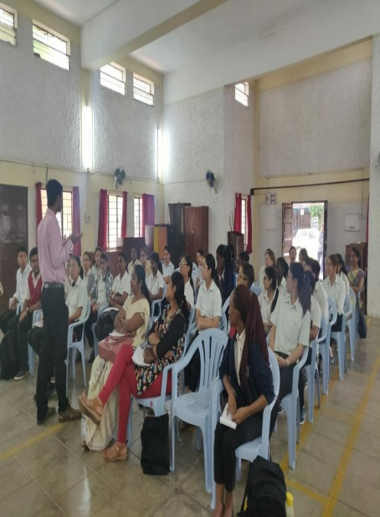
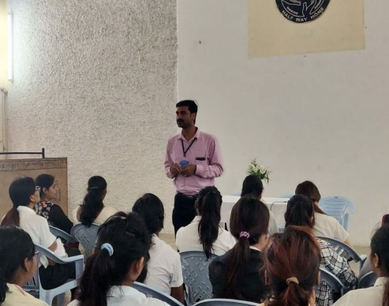
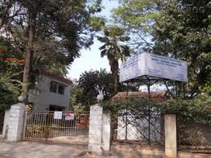
MEDICO PASTORAL ASSOCIATION- HALF WAY HOME

Slide 12

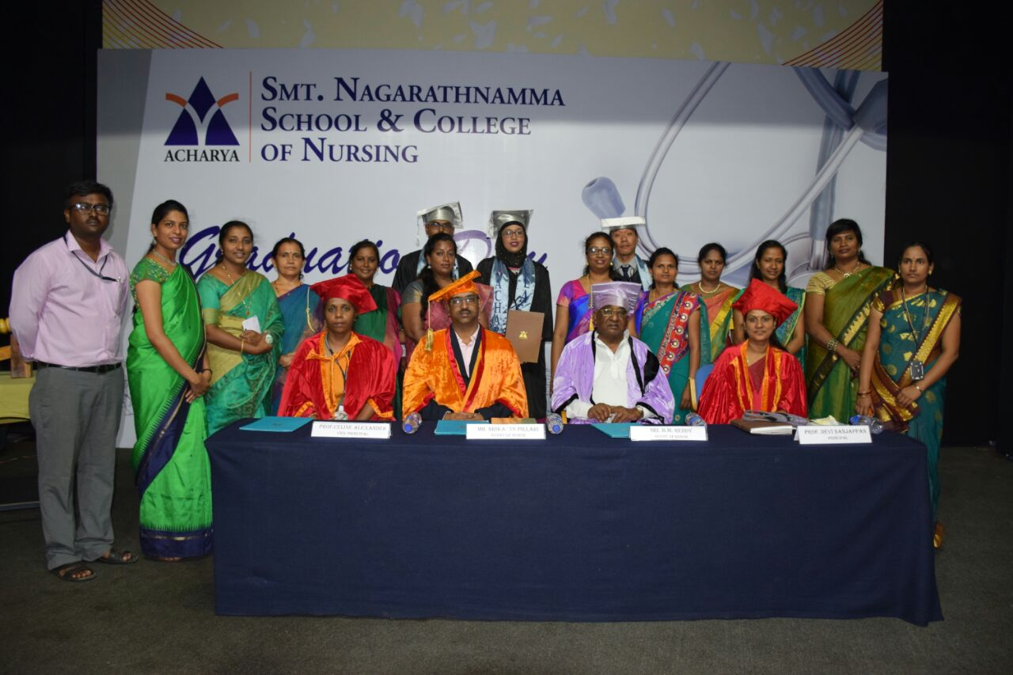
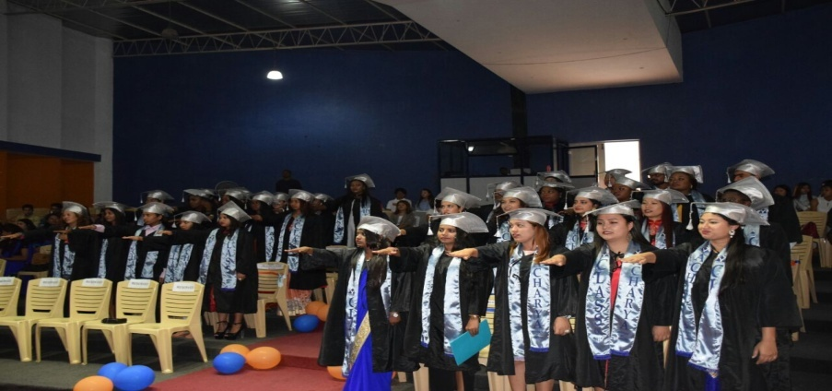
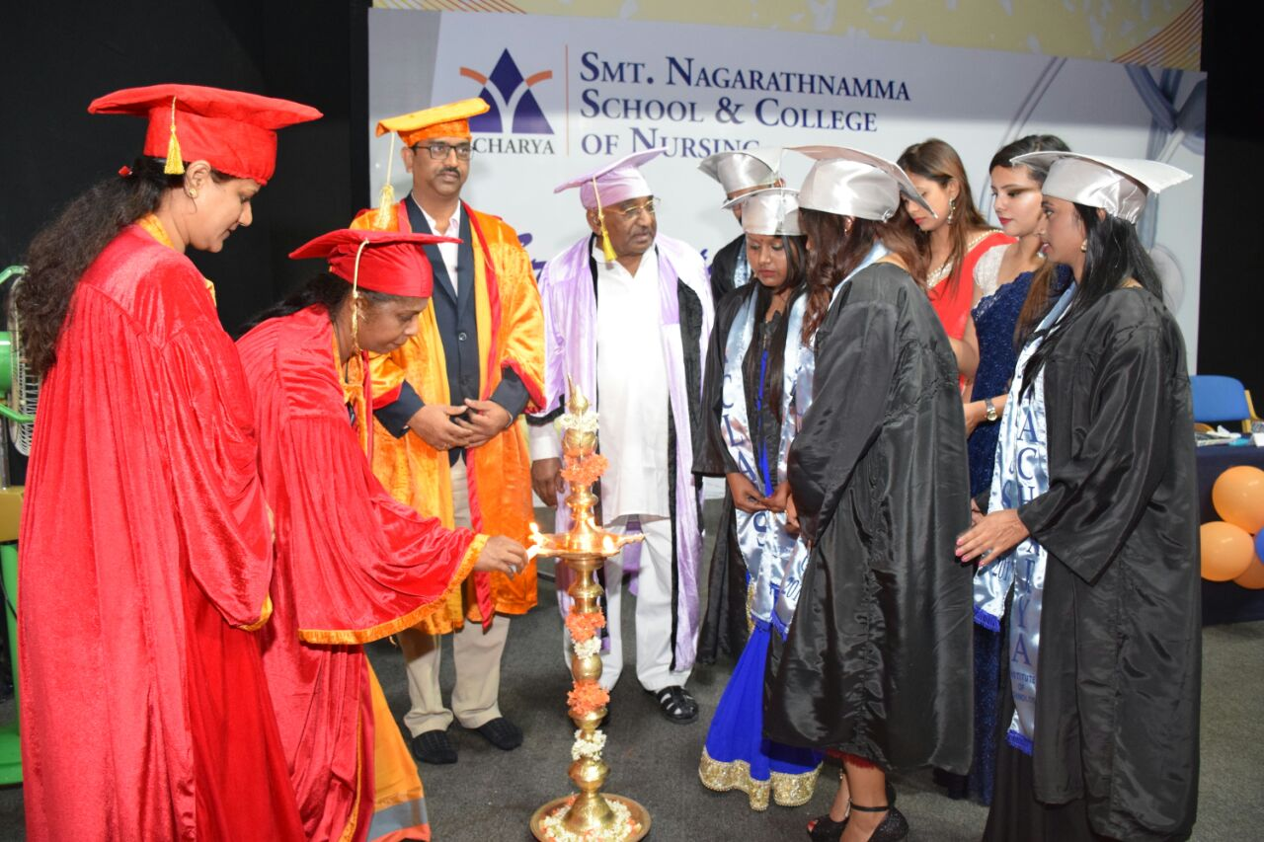
Graduation Day ceremony Class of 2017

Slide 13
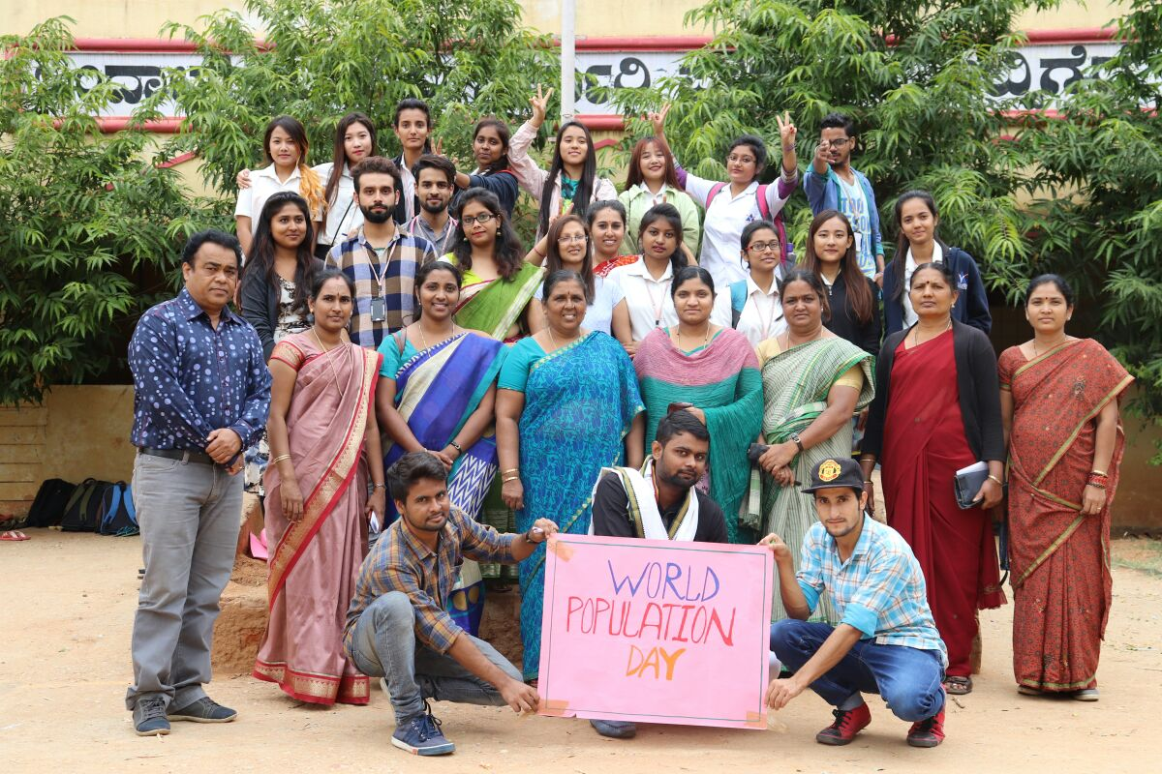
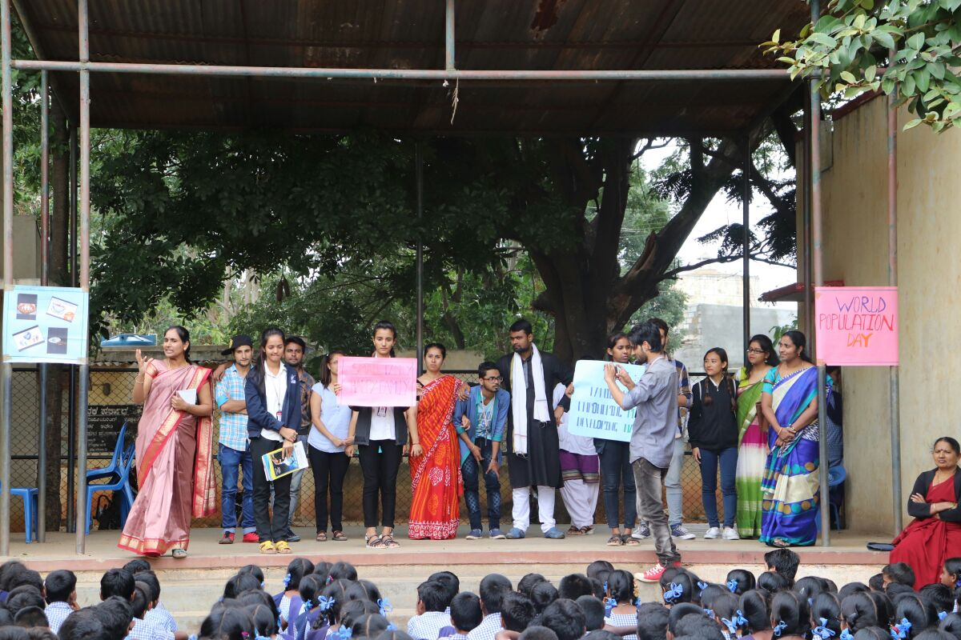
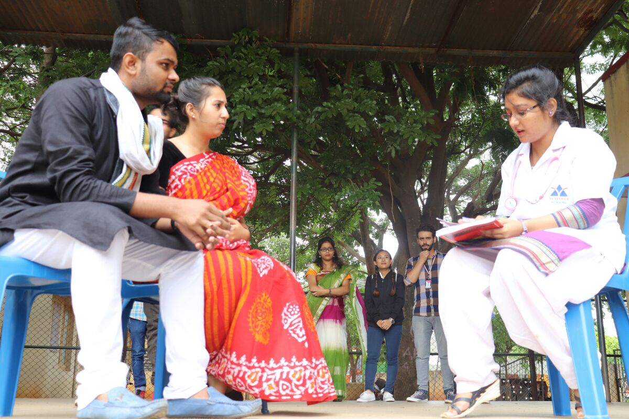
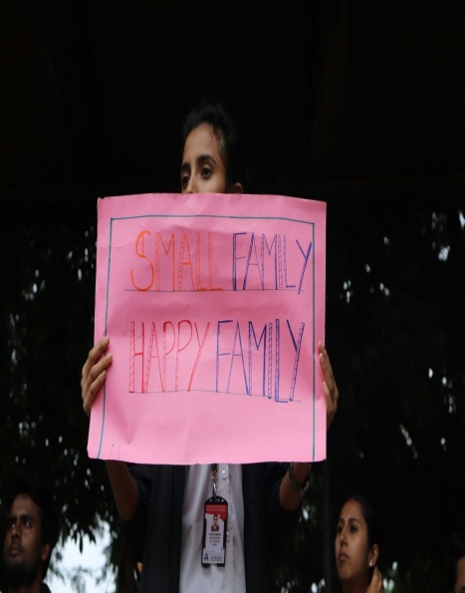
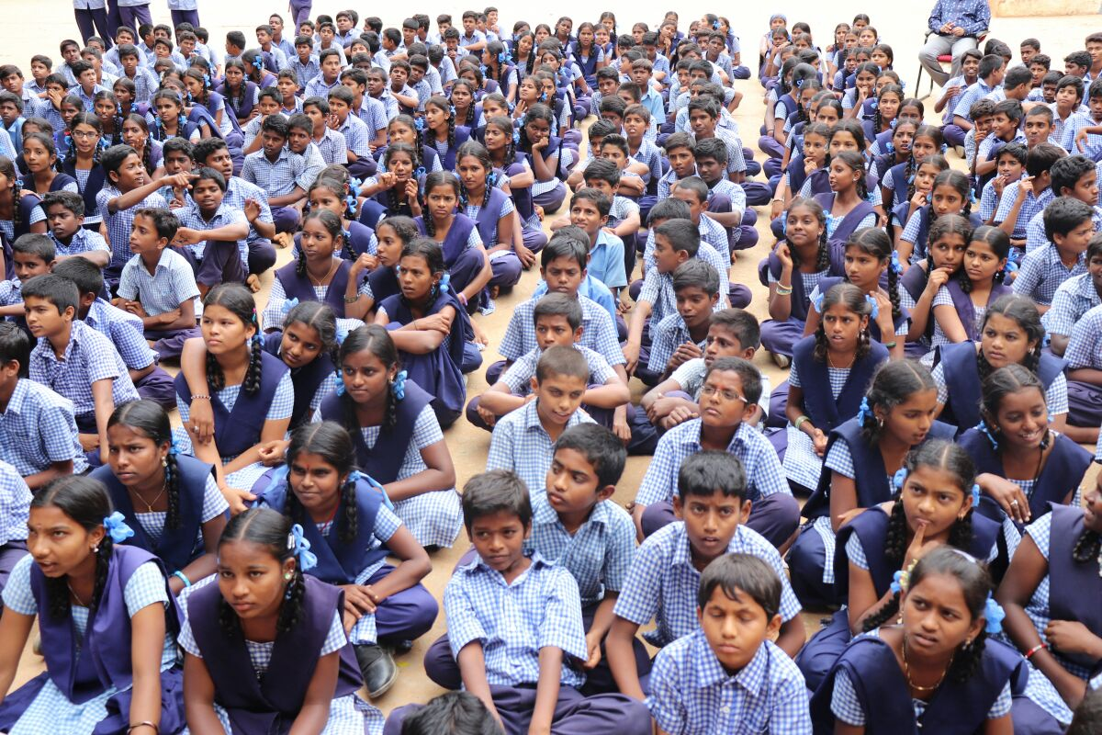
World Population Day

Slide 14
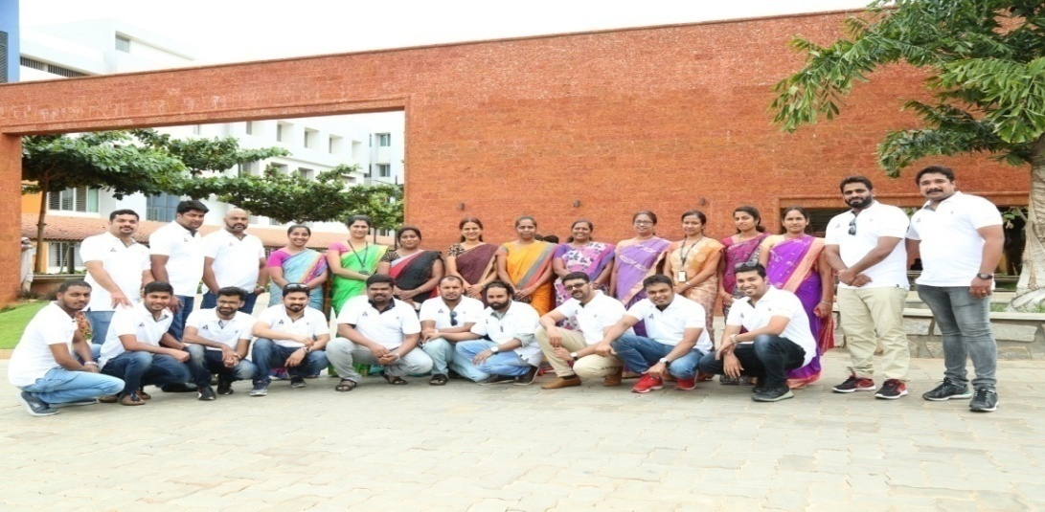
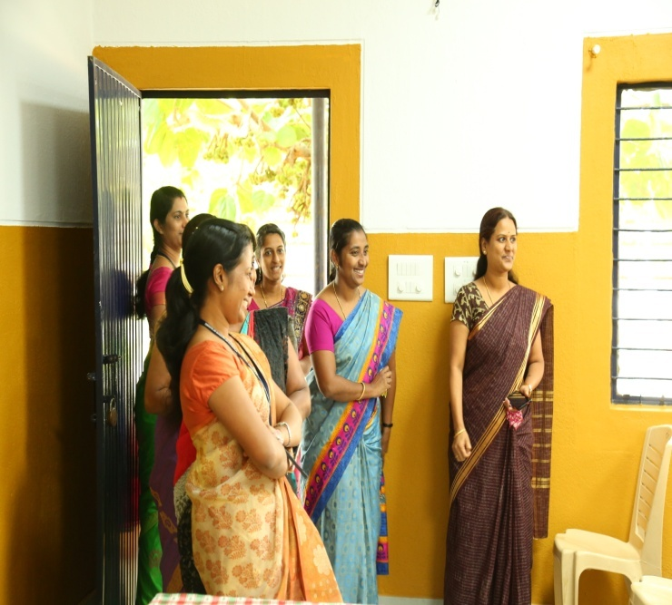
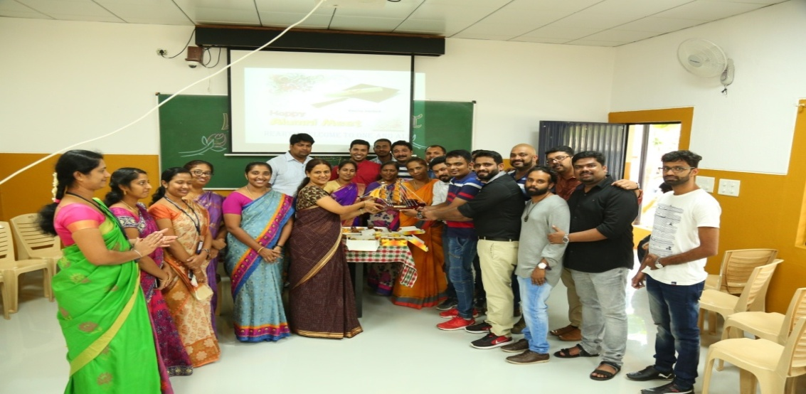
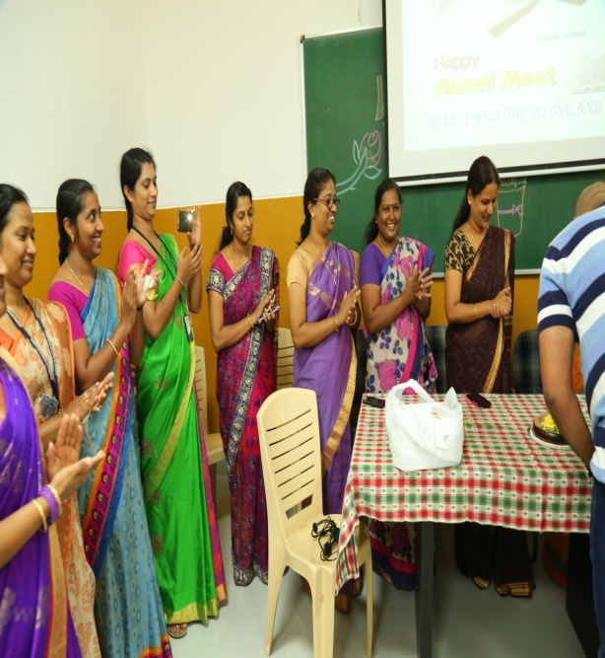
Alumni Meet – I Reunion

Slide 15
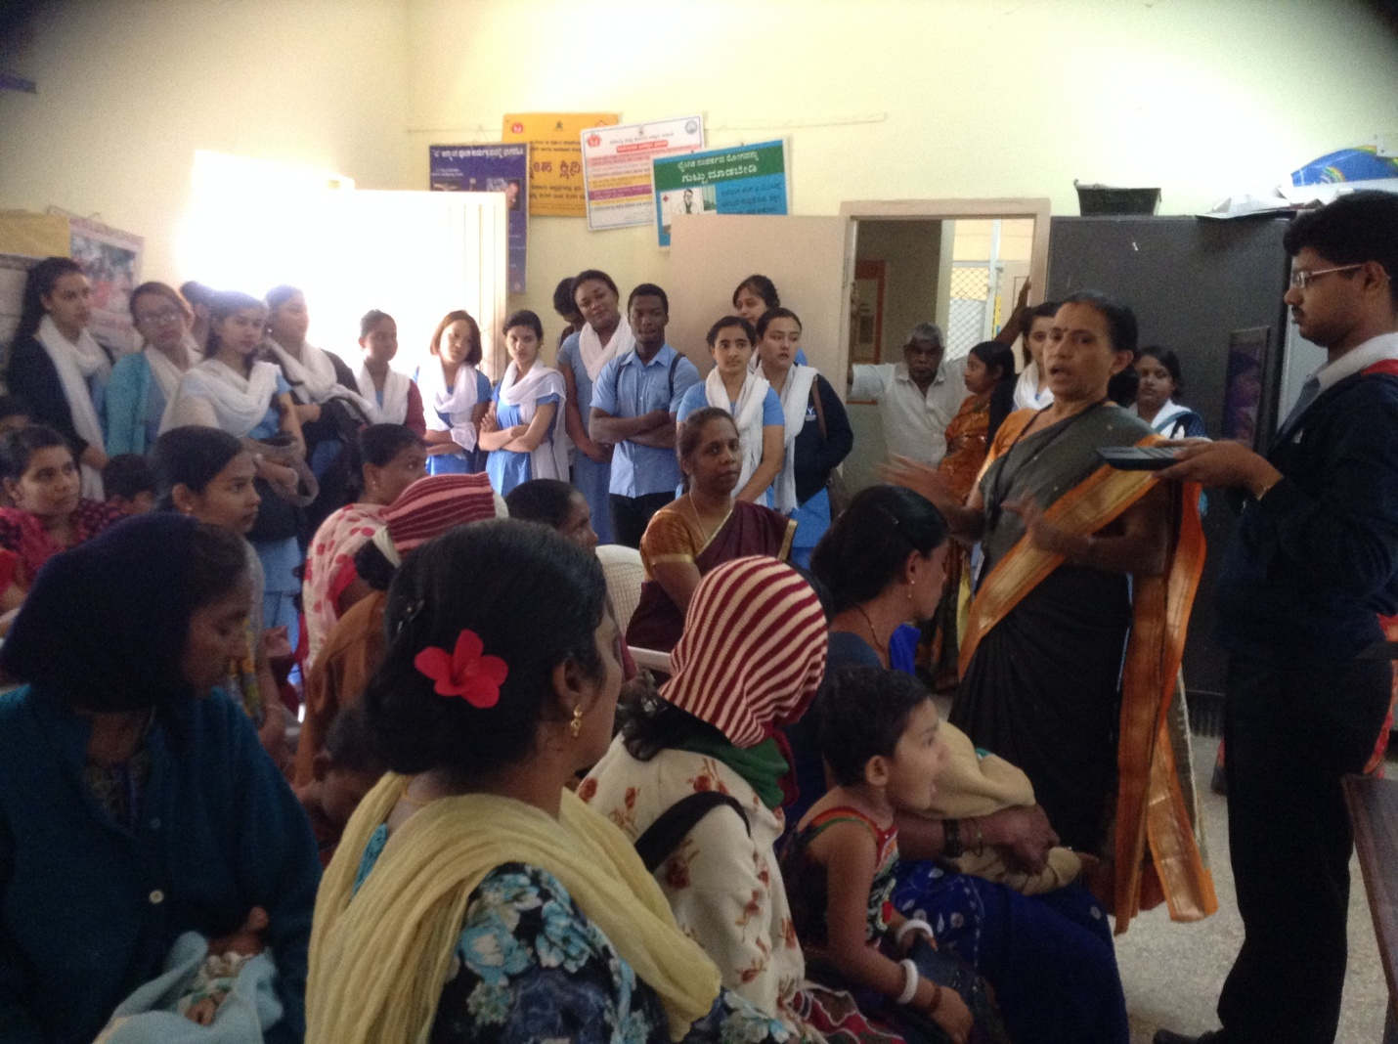
WORLD BREAST FEEDING WEEK

Slide 16
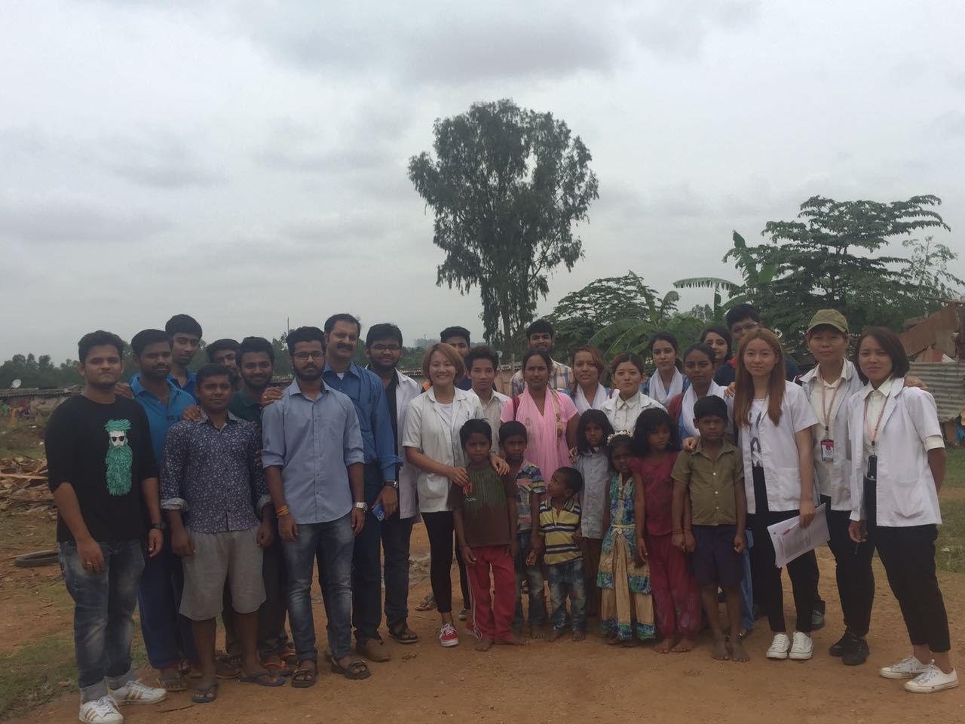
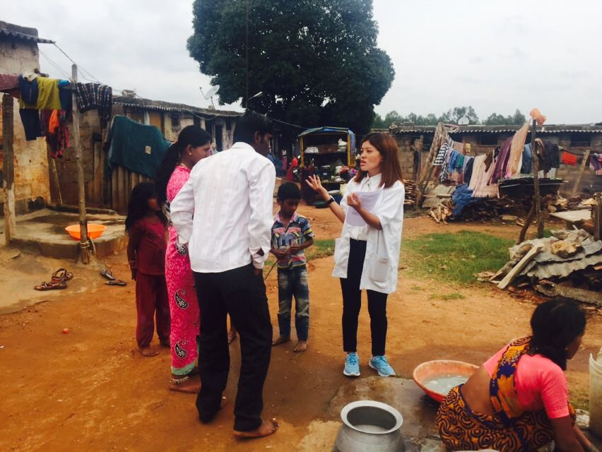
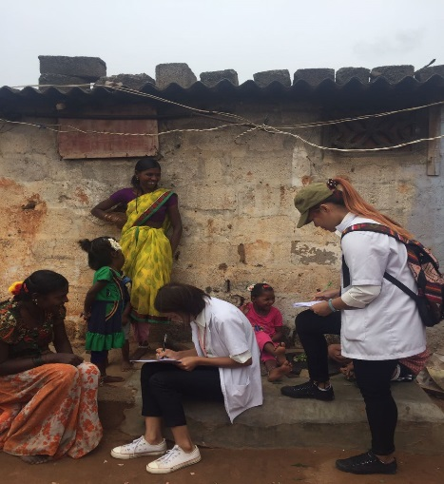
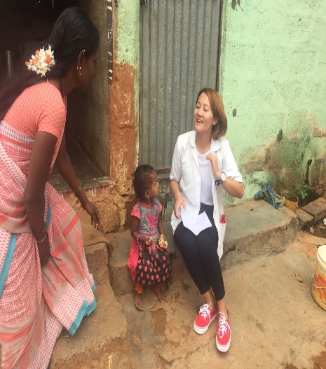
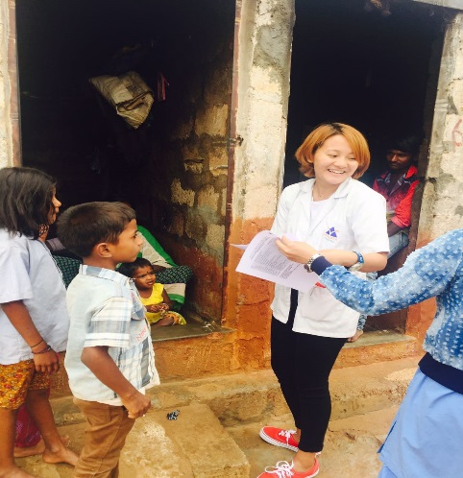
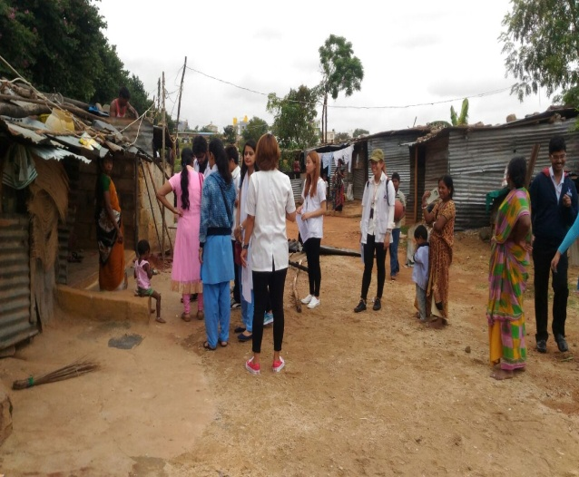
SURVEY OF IMMUNIZATION STATUS AND AWARENESS AMONG LABORERS' CHILDREN

Slide 17
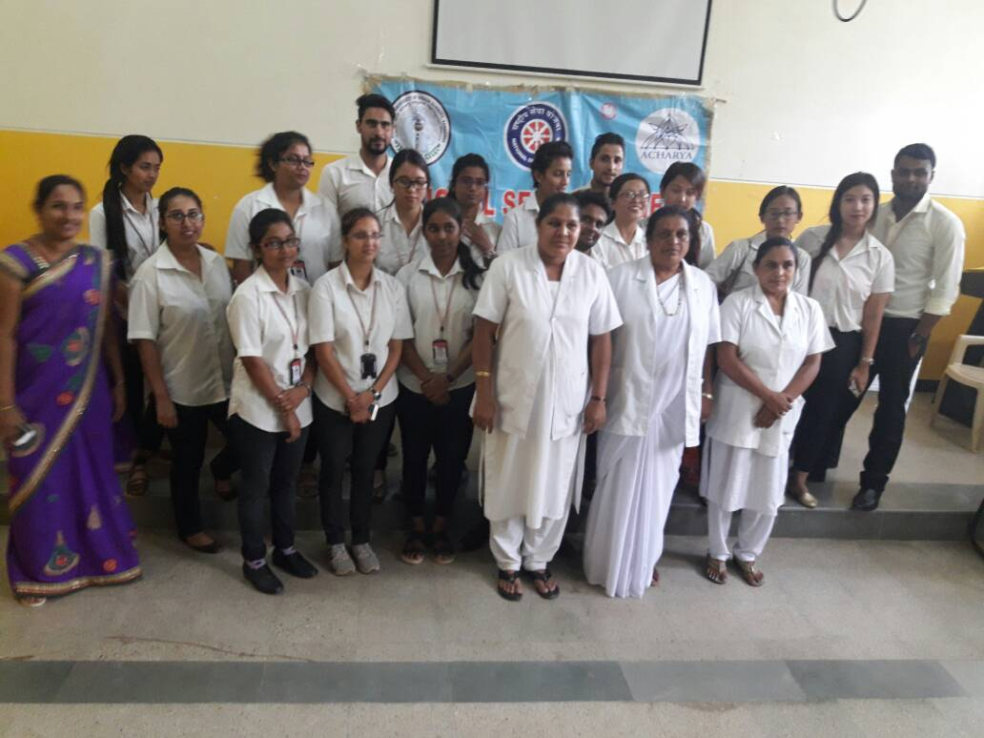
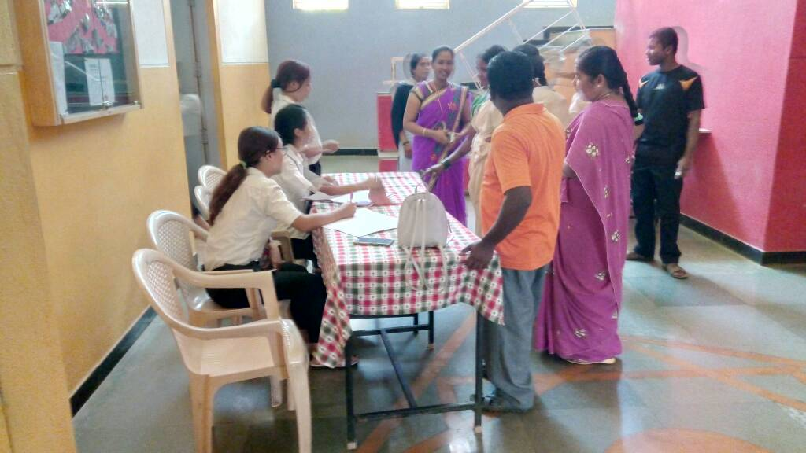
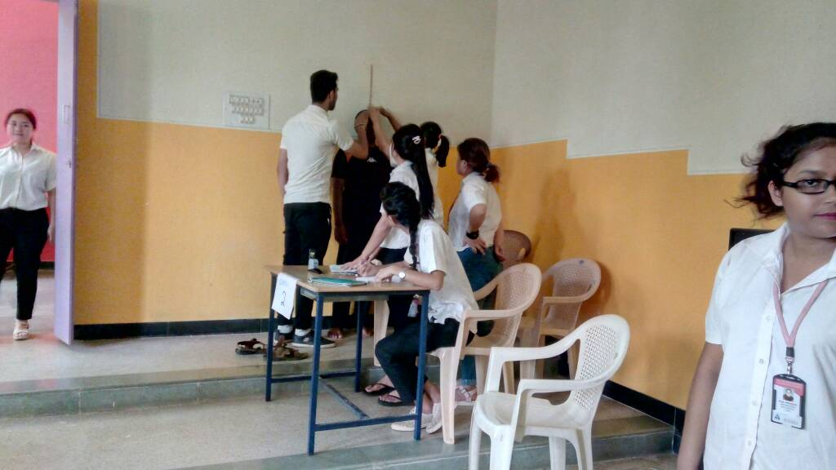
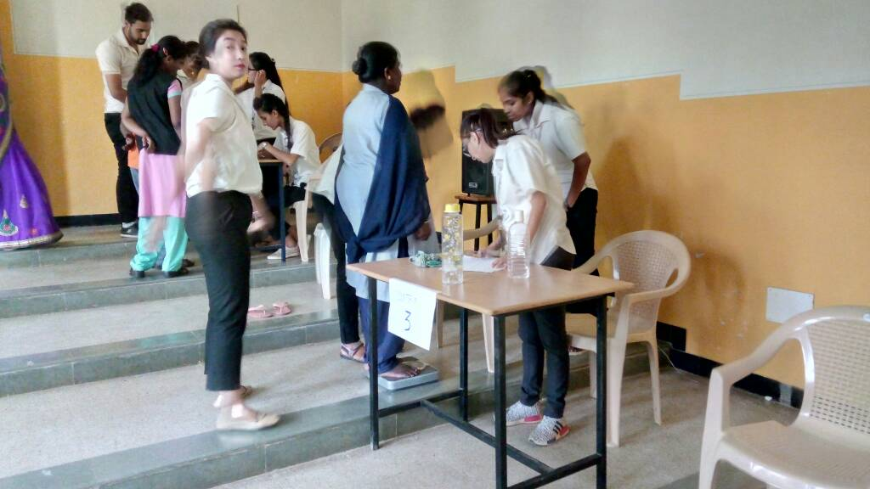
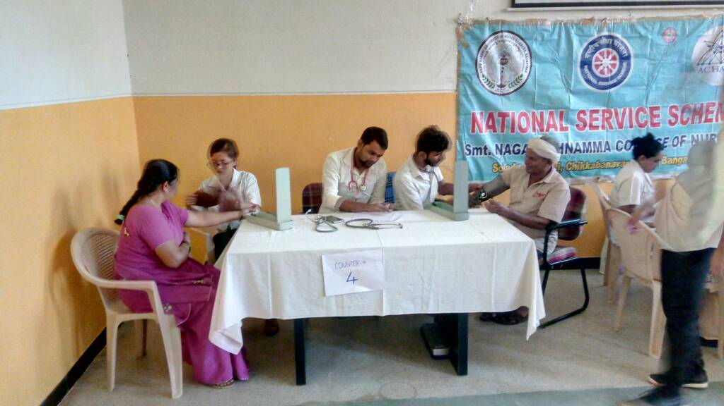
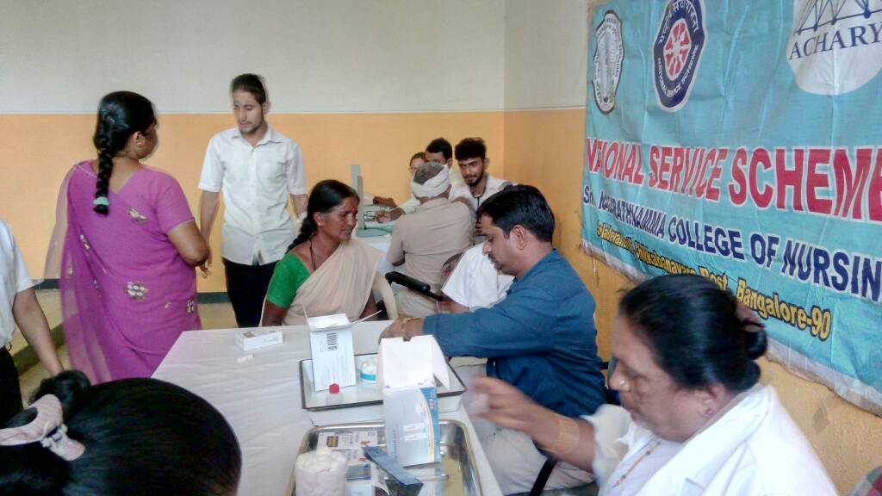
Diabetes Mellitus Screening Programme

Slide 18
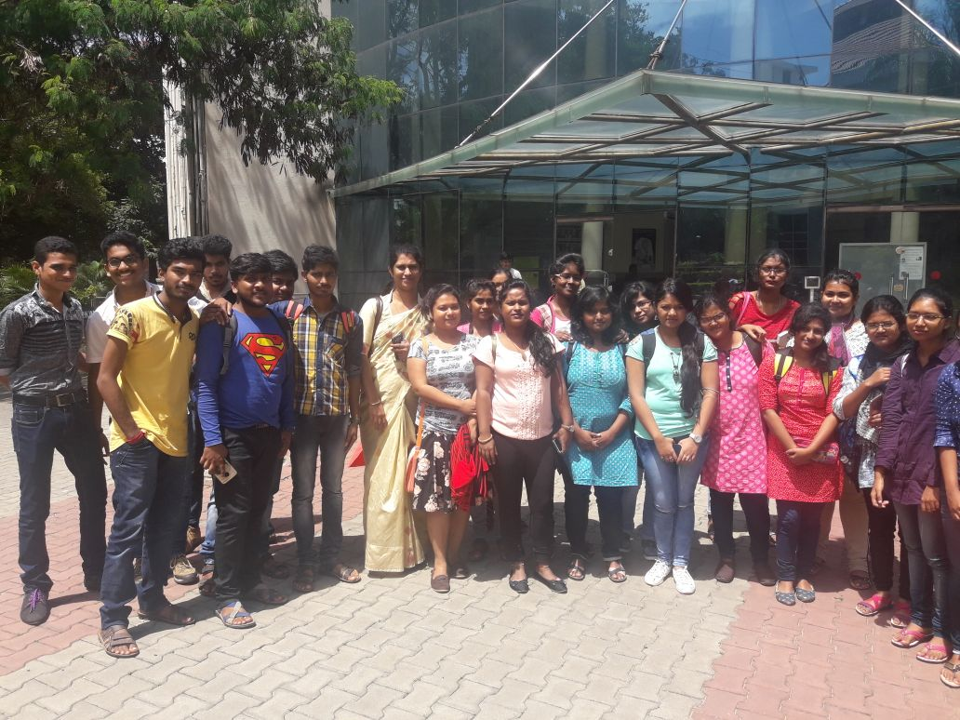
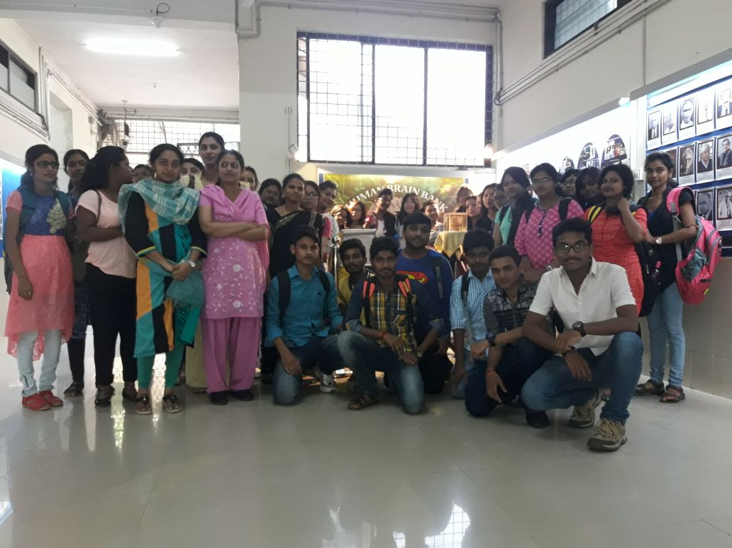
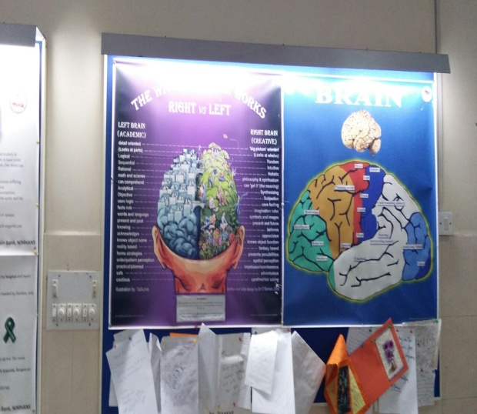
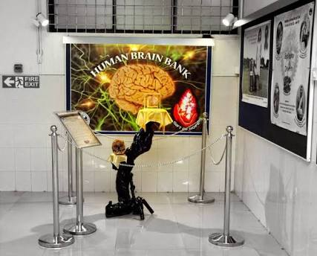
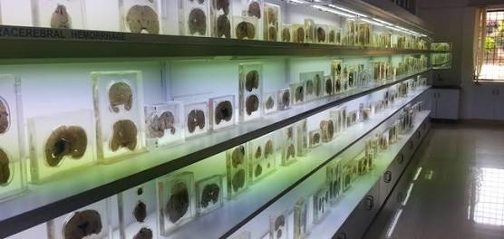
BRAIN MUSEUM VISIT

Slide 19
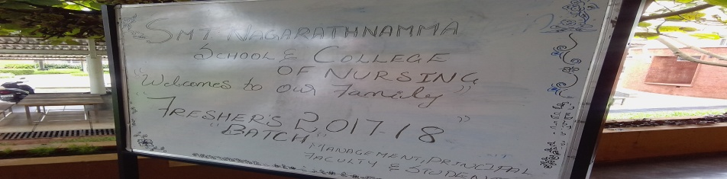
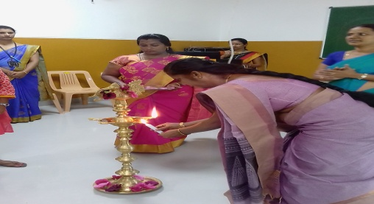
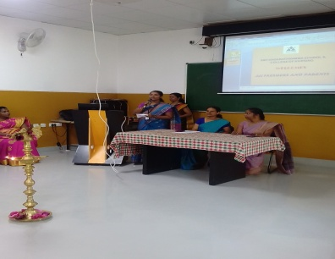
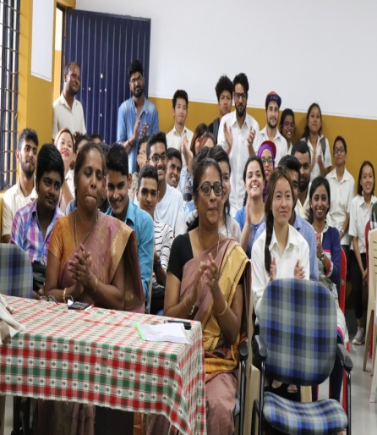

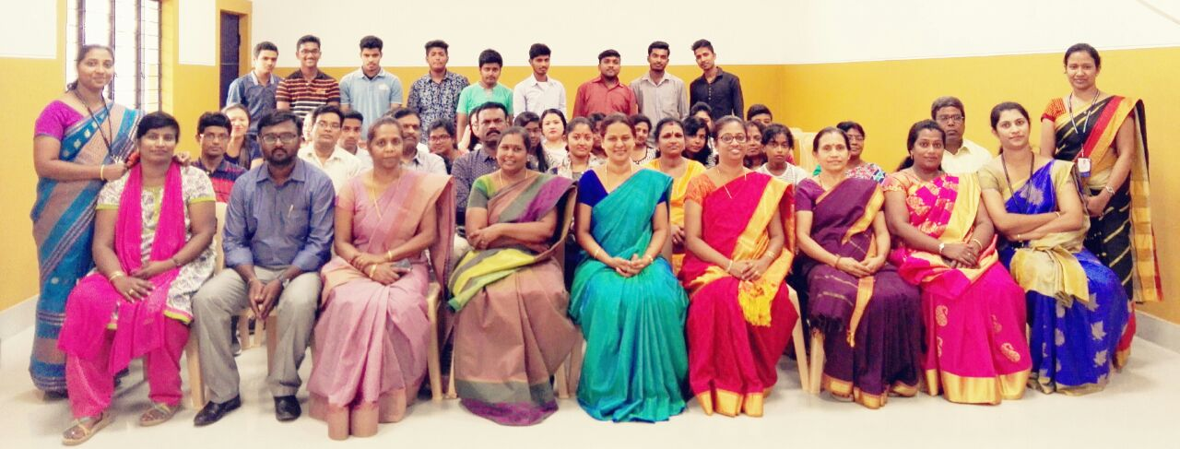
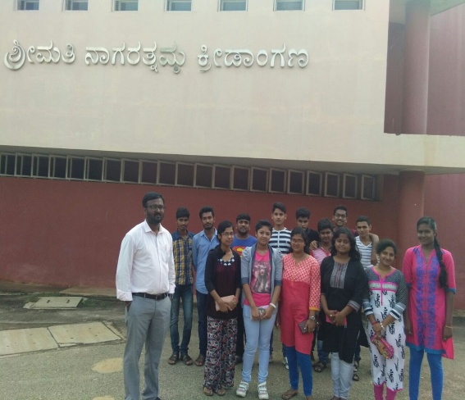
INDUCTION PROGRAMME

Slide 20
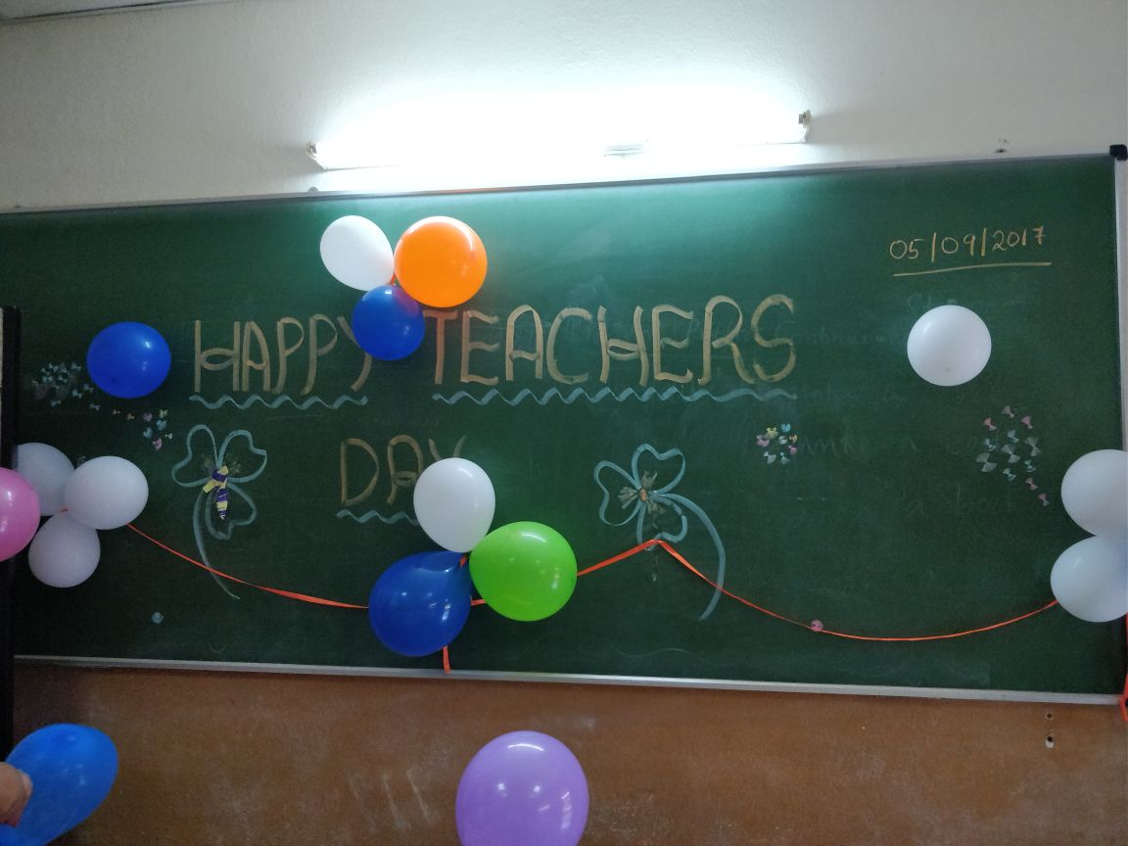
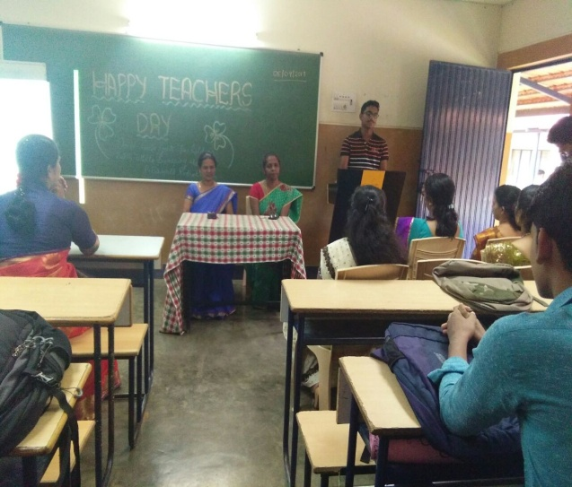
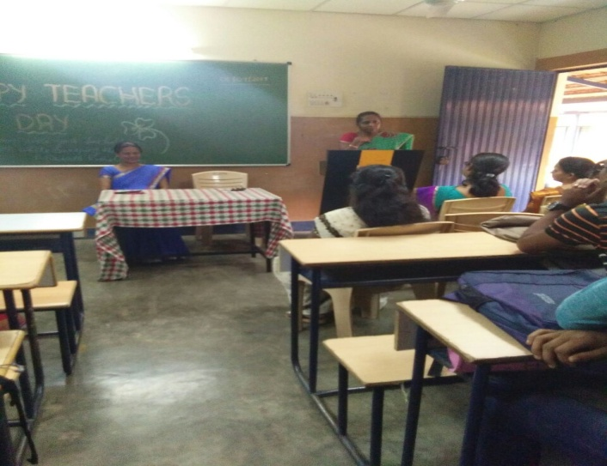
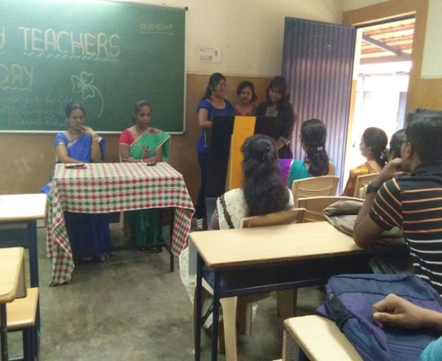
TEACHERS DAY

Slide 21
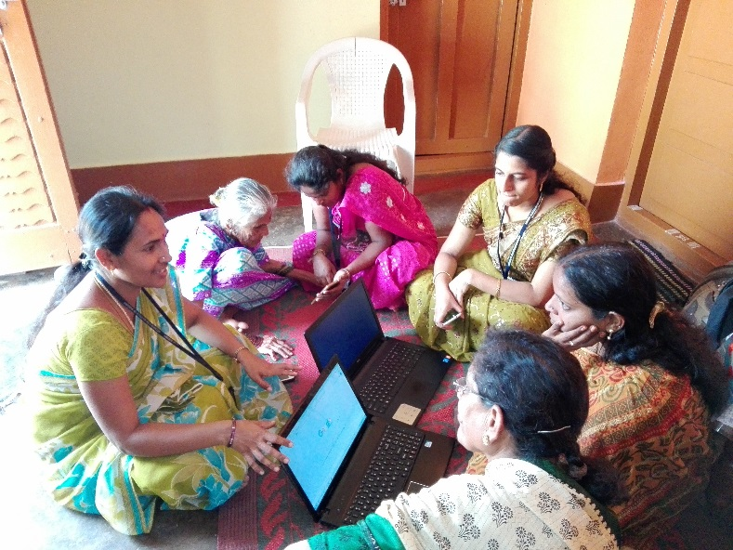
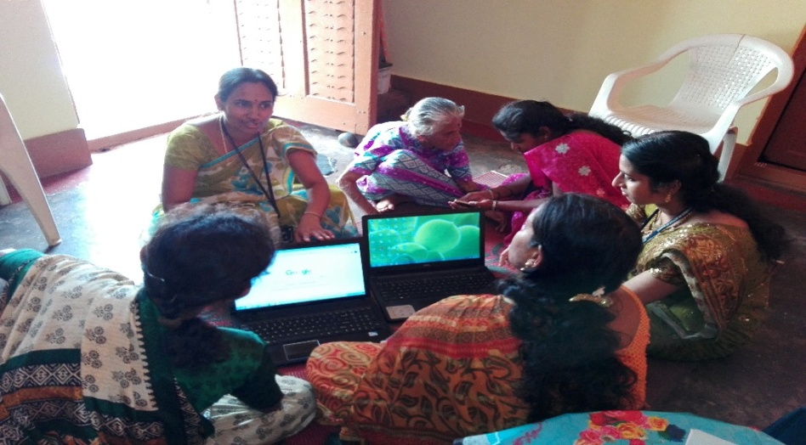
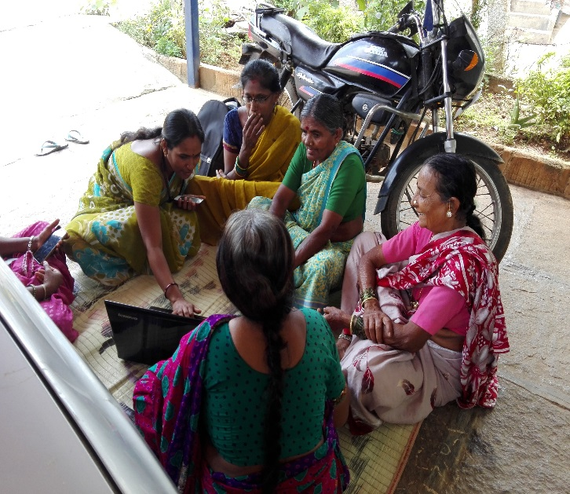
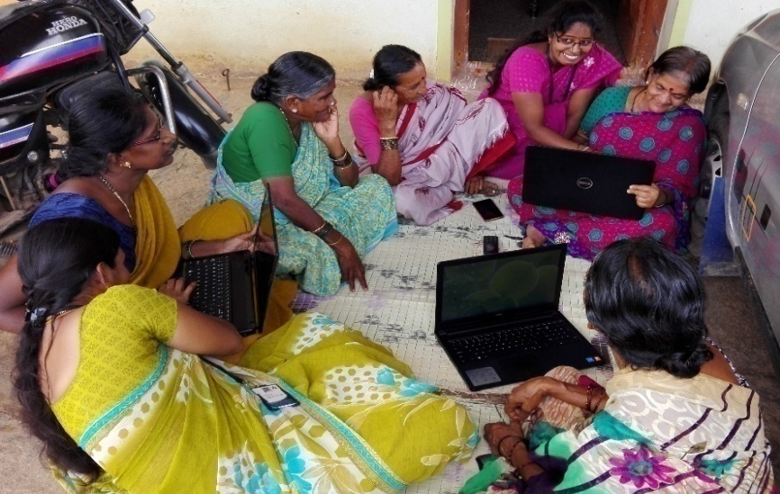
INTERNATIONAL LITERACY

Slide 22
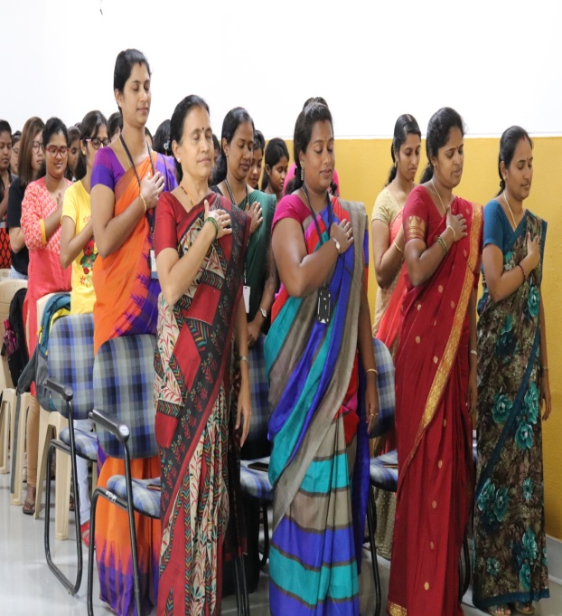
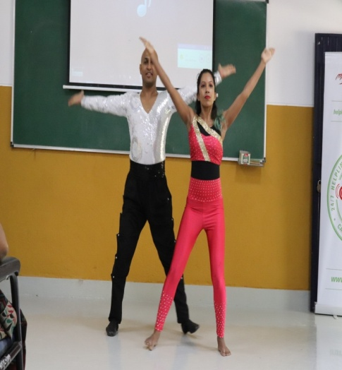




SUICIDE PREVENTION DAY

Slide 23



NSS UNITY DAY

Slide 24

TRAFFIC SAFETY AWARENESS PROGRAM

Slide 25


WORLD FOOD DAY

Slide 26



CHILREN’S DAY PROGRAMME

Slide 27


Life Skills Training

Slide 28








NURSING DEDICATION DECREMONY

Slide 29











SNA SPORTS & CULTURAL EVENTS

Slide 30




WORLD PREMATURITY DAY

Slide 31





World HIV/ AIDS Day

Slide 32



School Health Programme

Slide 33




STAFF DEVELOPMENT

Slide 34





Effective Tuberculosis Diagnosis & Treatment campaign

Slide 35







Report On International Conference On Robotic Surgery In Urology And Critical Care Assessment

Slide 36






National Youth Day

Slide 37



NATIONAL PULSE POLIO TRAINING PROGRAM

Slide 38




Smt. Nagarathnamma Jayanthi

Slide 39



OBG DEPARTMENTAL SEMINAR

Slide 40




MENTAL HEALTH NURSING – DEPARTMENT SEMINAR

Slide 41




Educational Tour

Slide 42


Health Check Up Camp

Slide 43






Seminar Report
“Leadership Practices in Nursing”

Slide 44




PEDIATRIC DEPARTMENTAL SEMINAR

Slide 45


FACULTY ORIENTATION

