Slide 1



Slide 2
ANNUAL REPORT 2021-2022
* SNCN
* SNSN
28th July 2022 @ Nursing Graduation ceremony

Slide 3
ANNUAL REPORT 2021-2022
Mull over the below:
Profile of the institution
Reports of
Academics
IQAC
Clinicals
Placement
Department
Research
Faculty Development
NSS and SNA

Slide 4

why Annual Report ?
Intended to provide sum of institutional activities to the stakeholders

Slide 5
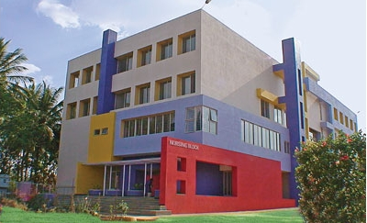
Annual Report Presenter
Prof.Devi Nanjappan
Principal
Smt.Nagarathnamma School and College of Nursing
28th July ,2022
Bangalore

Slide 7
VISION :
“Acharya Institutes, committed to the cause of value- based education in all disciplines, envisions itself as a fountainhead of innovative human enterprise, with inspiration initiatives for academic excellence”
MISSION :
"The Institution is committed to provide quality education that prepares resilient professional nurses who care and practice holistically to meet the ever- changing challenges of the 21st century, through a culture of evidence -based practice. The Mission is accomplished through a collaborative, accepting environment, fostered by mentoring and role modeling"
QUALITY POLICY :
“We at Acharya Institutes, promise to continually strive towards total quality in all our endeavors through equity with accessibility, commitment with honesty, adaptability with efficiency while blending concern for environment and social development”
MOTTO :
“Nurturing Aspirations Supporting Growth”

Slide 8
New Initiatives in 2021-2022
NAAC External Audit
Hostel –Faculty Roaster
Empowered IQAC (QA)
Work Schedule Mapping
Empowered Coordinators Functions
Student Counselling
CR meet
Green Inniatives
Containment measures and CAPA
SIP,FIP,OSPE ,PTM,FEEDBACKS (academics)
Mental Health Nursing Lab and DAB

Slide 9
REPORT OF ACADEMICS

Slide 10
BEST PRACTICE 1
Title :Student Engagement
Aim : to meet the learning outcome
Objective: Students Regularity
Briefing :Academic reforms
Monthly TT and monitoring
QP , SE,SSS, category of ABC and remedial measures (template )
line of communication
Methods of teaching
outcome : improved student attendance and engagement by team.

Slide 11

BEST PRACTICES 2
Title : Faculty Readiness
Aim : to prepare the team to meet the institutional outcome
Brief :Faculty Induction Program
Faculty Preparedness on Nursing Skill
Schedule for DAY OUT
Outcome : Positive Vibe ,confident and reflects in Academic control

Slide 12
BEST PRACTICE 3
Title : Institutional Monthly updates
Aim : Keep abreast on overall institutional development
Objective: SWOC & seamless operation
Process : Adept the system driven
Outcome :expected to meet the targets

Slide 13
Topper List for 2020-2021
Register No. | Student Name | Subject | Max Marks | Obtained Marks | %
16S1391 | PUJA CHOUDHURY | NUTRITION & BIOCHEMISTRY | 100 | 76 | 76
16S1374 | DEBASREE SAHA | SOCIOLOGY | 100 | 77 | 77
16S1374 | DEBASREE SAHA | PHARMACOLOGY,PATHOLOGY,GENETIC | 100 | 74 | 74
16S1374 | DEBASREE SAHA | MEDICAL SURGICAL NURSING-II | 200 | 173 | 86.5
16S1374 | DEBASREE SAHA | COMMUNITY HEALTH NURSING-II | 200 | 167 | 83.5

Slide 14
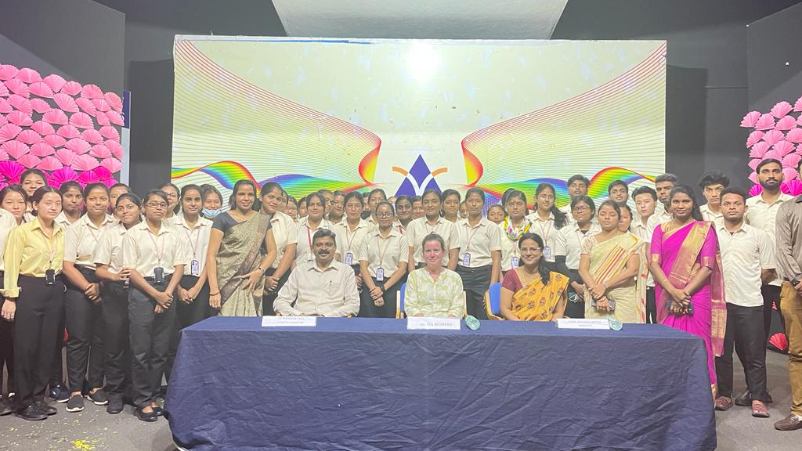
FACULTY AND STUDENT EXCHANGE PROGRAMME
INTERACTIVE SESSION BY DR.PIA WITH STUDENTS-20/04/22.

Slide 15
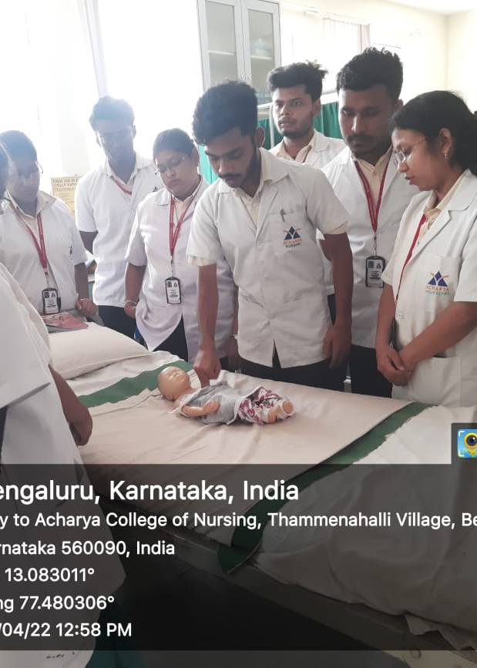
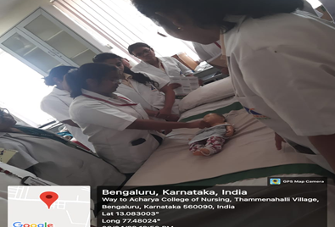
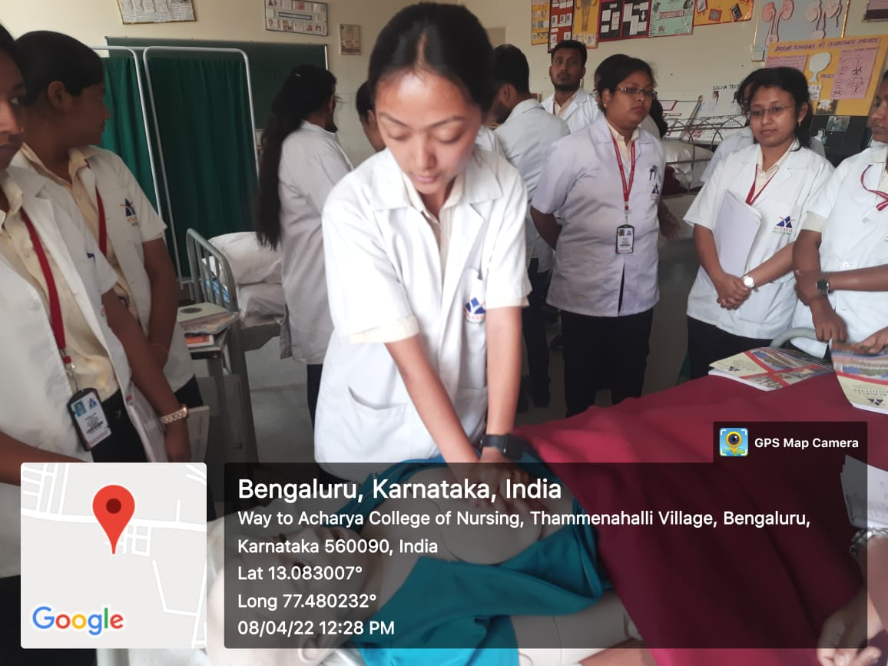
BLS ON CARDIO PULMONARY RESUSCITATION

Slide 16
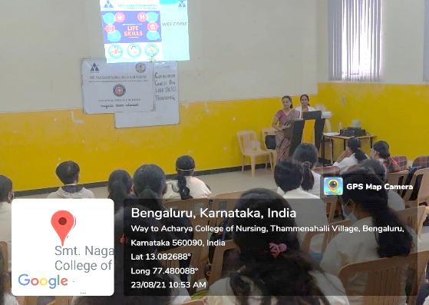
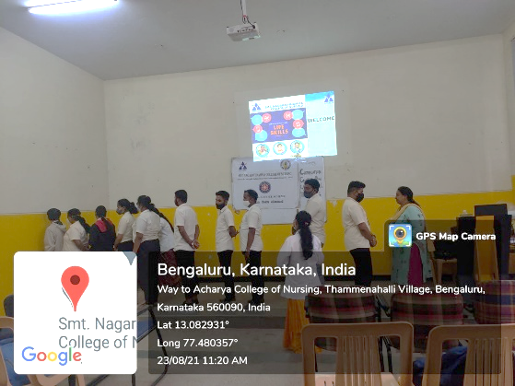
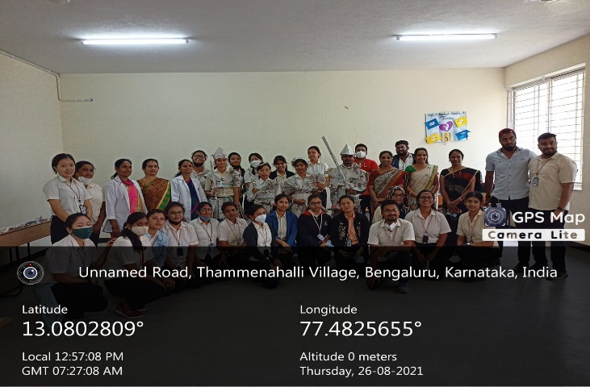
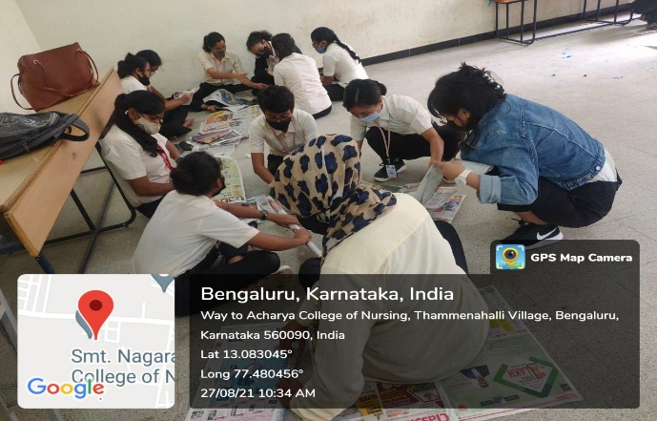
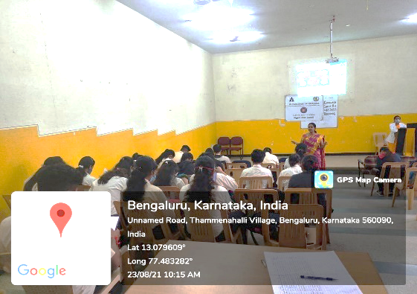
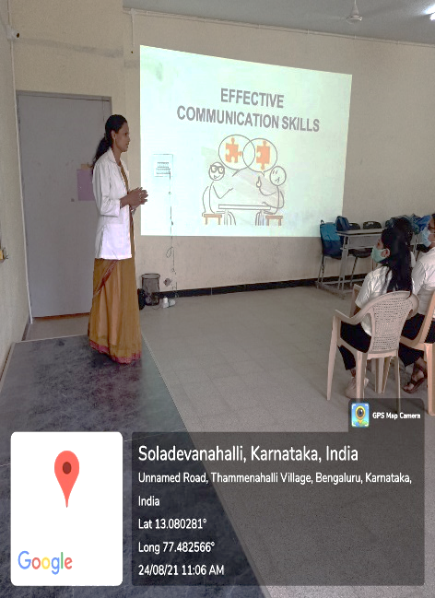
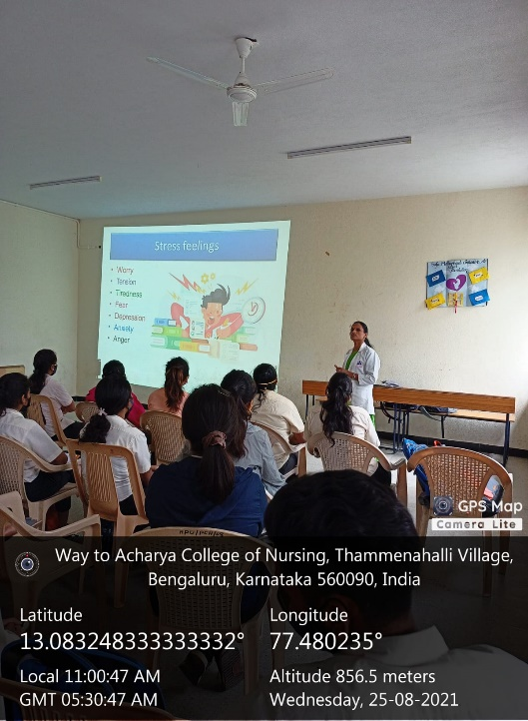
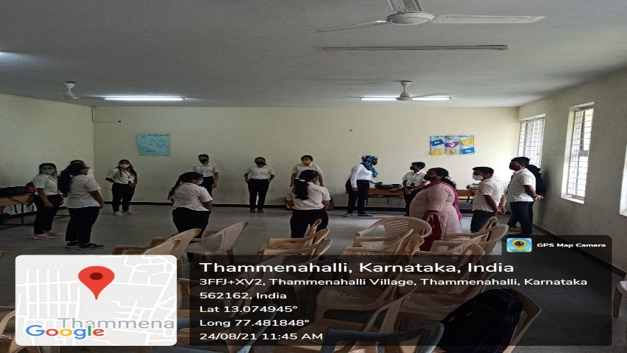
Life Skill Program

Slide 17
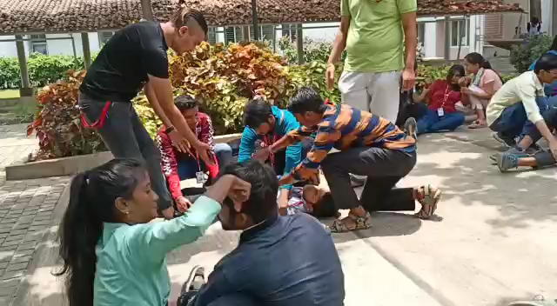
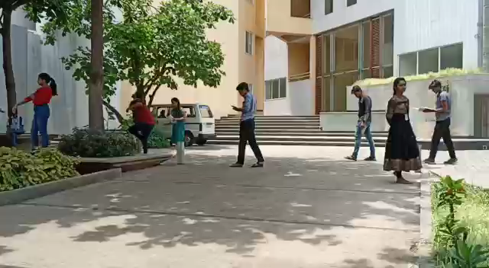
MOCK DRILL ON DISASTER TRIAGE-11/04/22

Slide 18

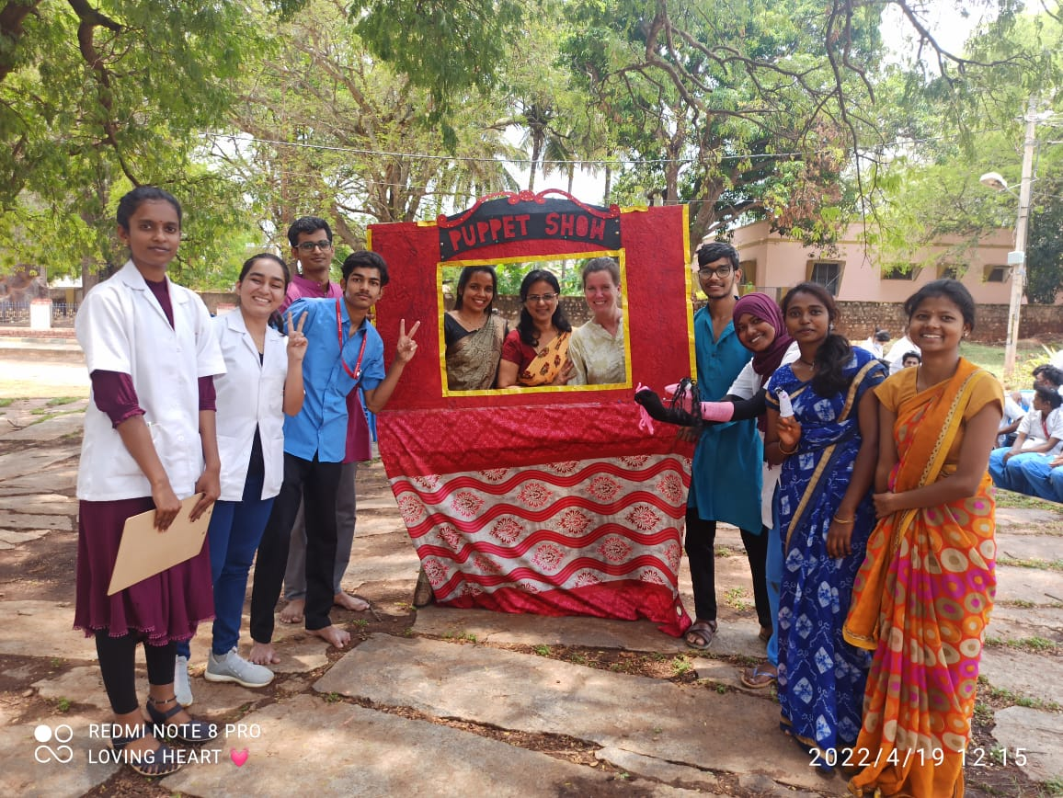
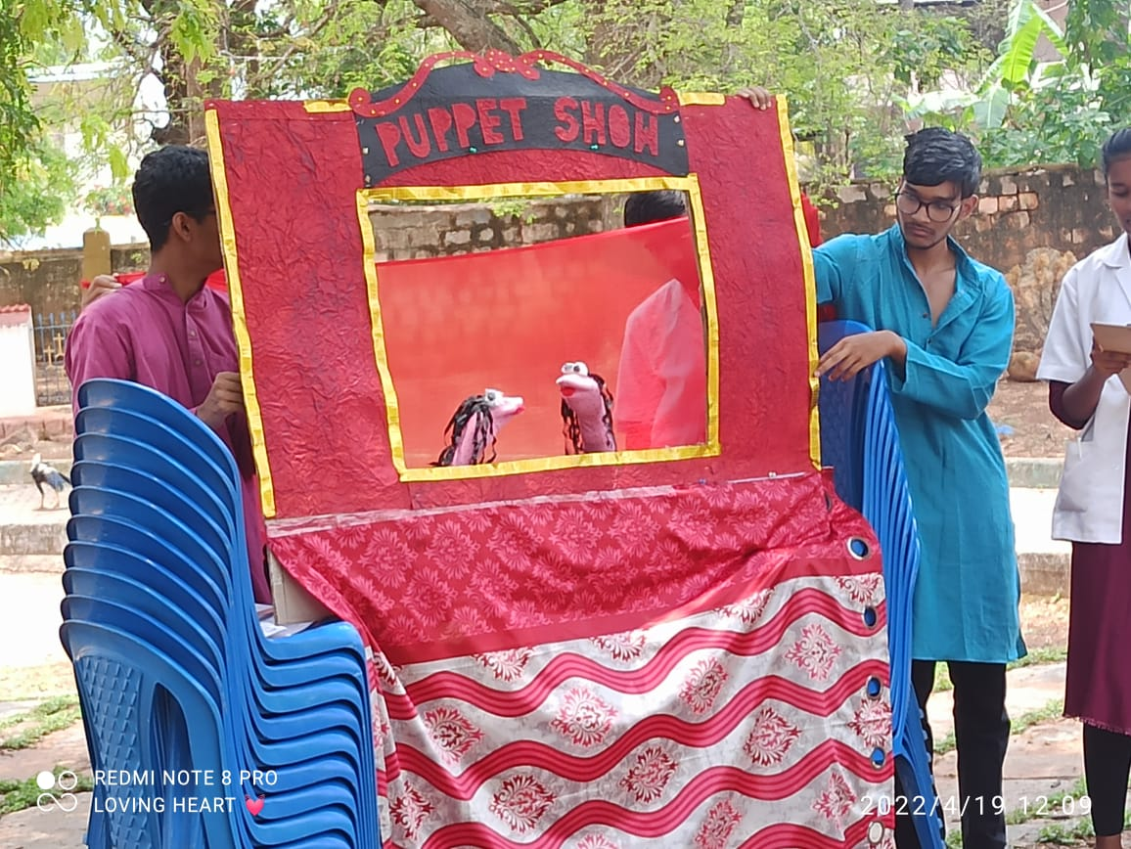
FACULTY AND STUDENT EXCHANGE PROGRAMME: PUPPET SHOW AND ROLE PLAY AT COMMUNITY ON IMPORTANCE OF IMMUNIZATION /VACCINATION -19/04/22

Slide 19
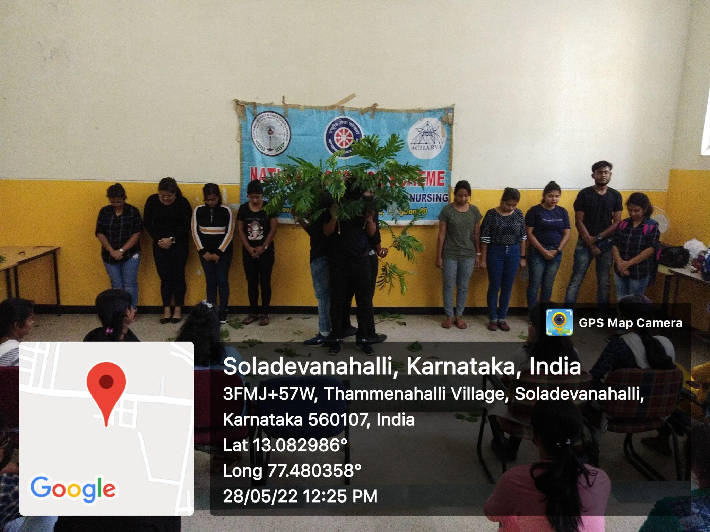
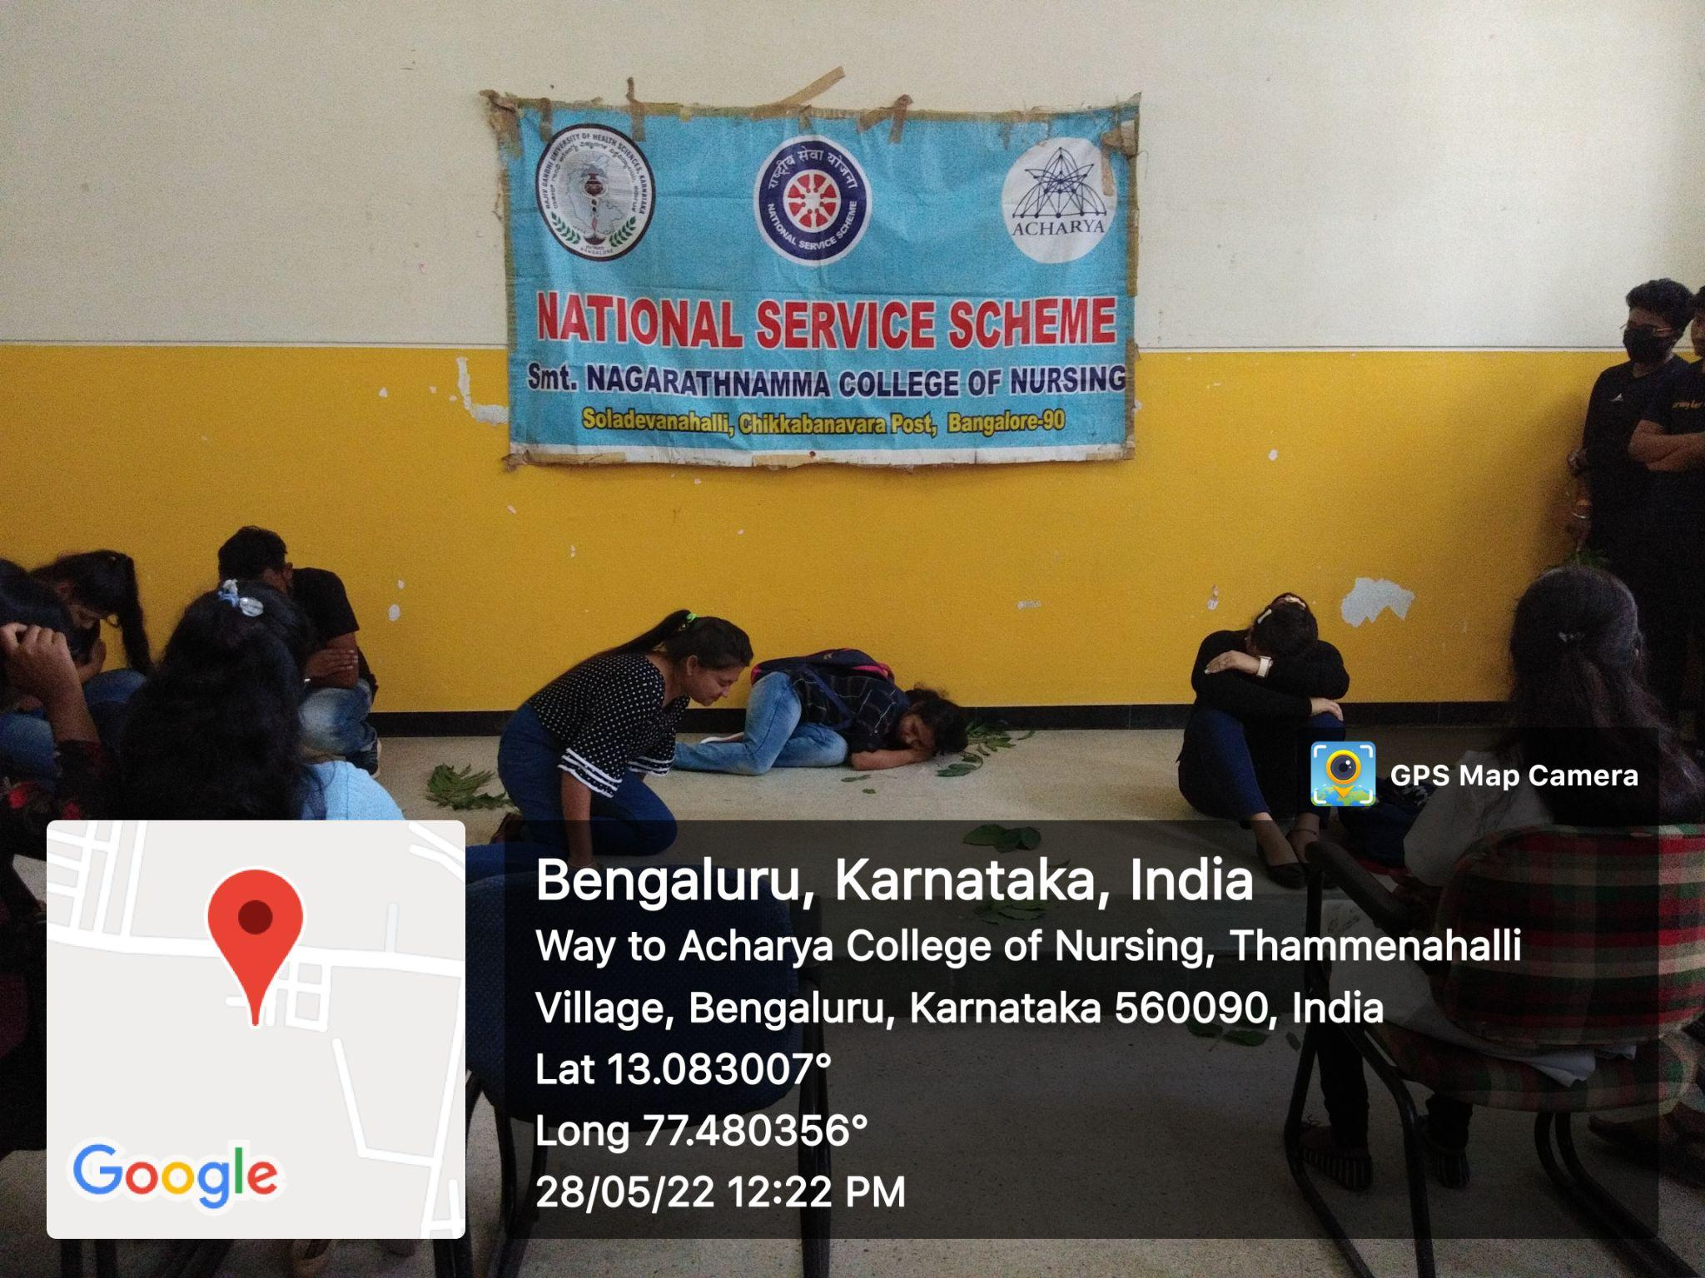
ROLE PLAY ON SAVE TREE AND SAVE LIFE:28/05/2022

Slide 20
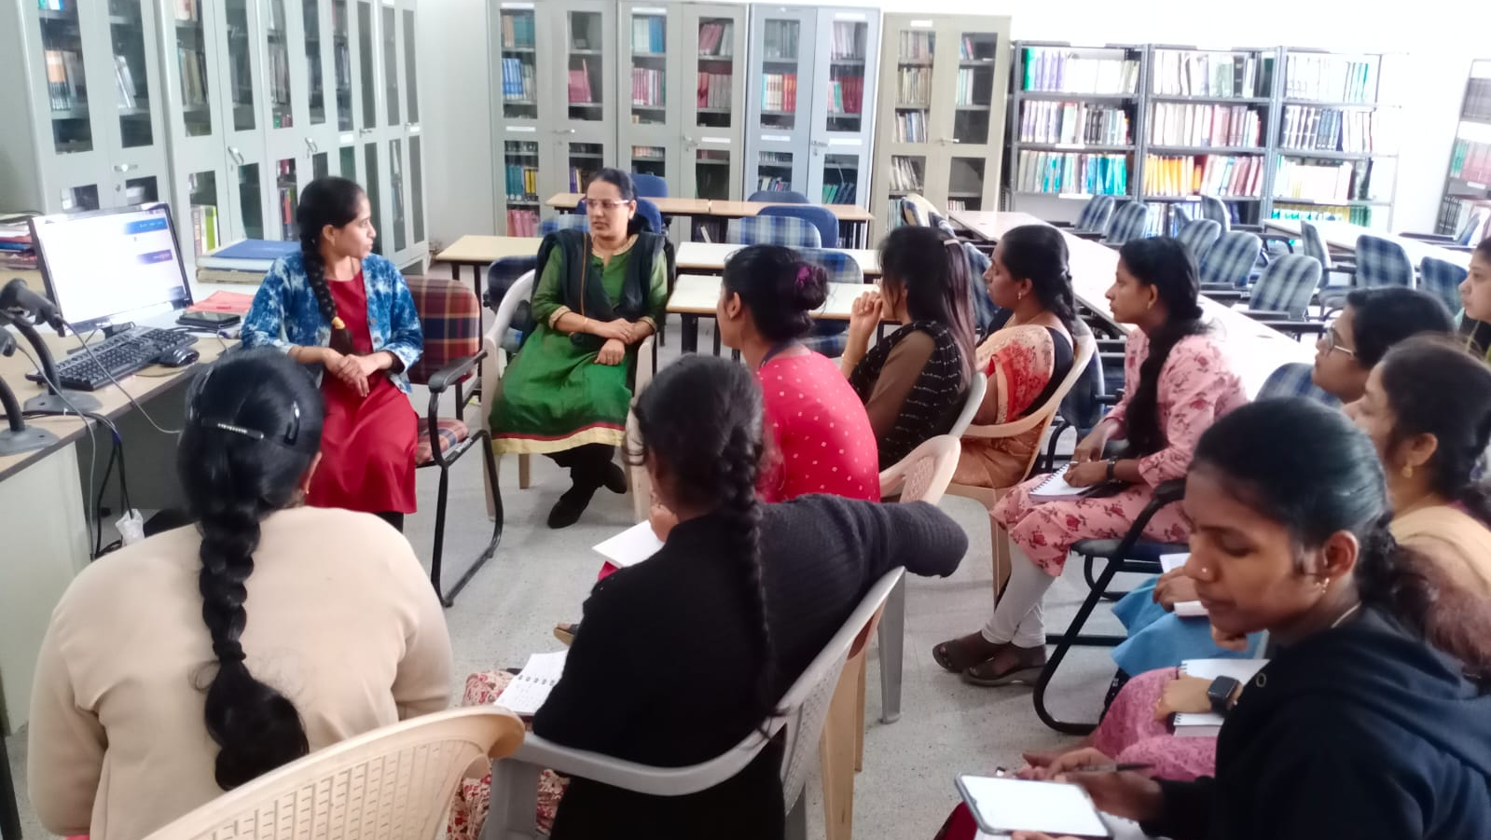
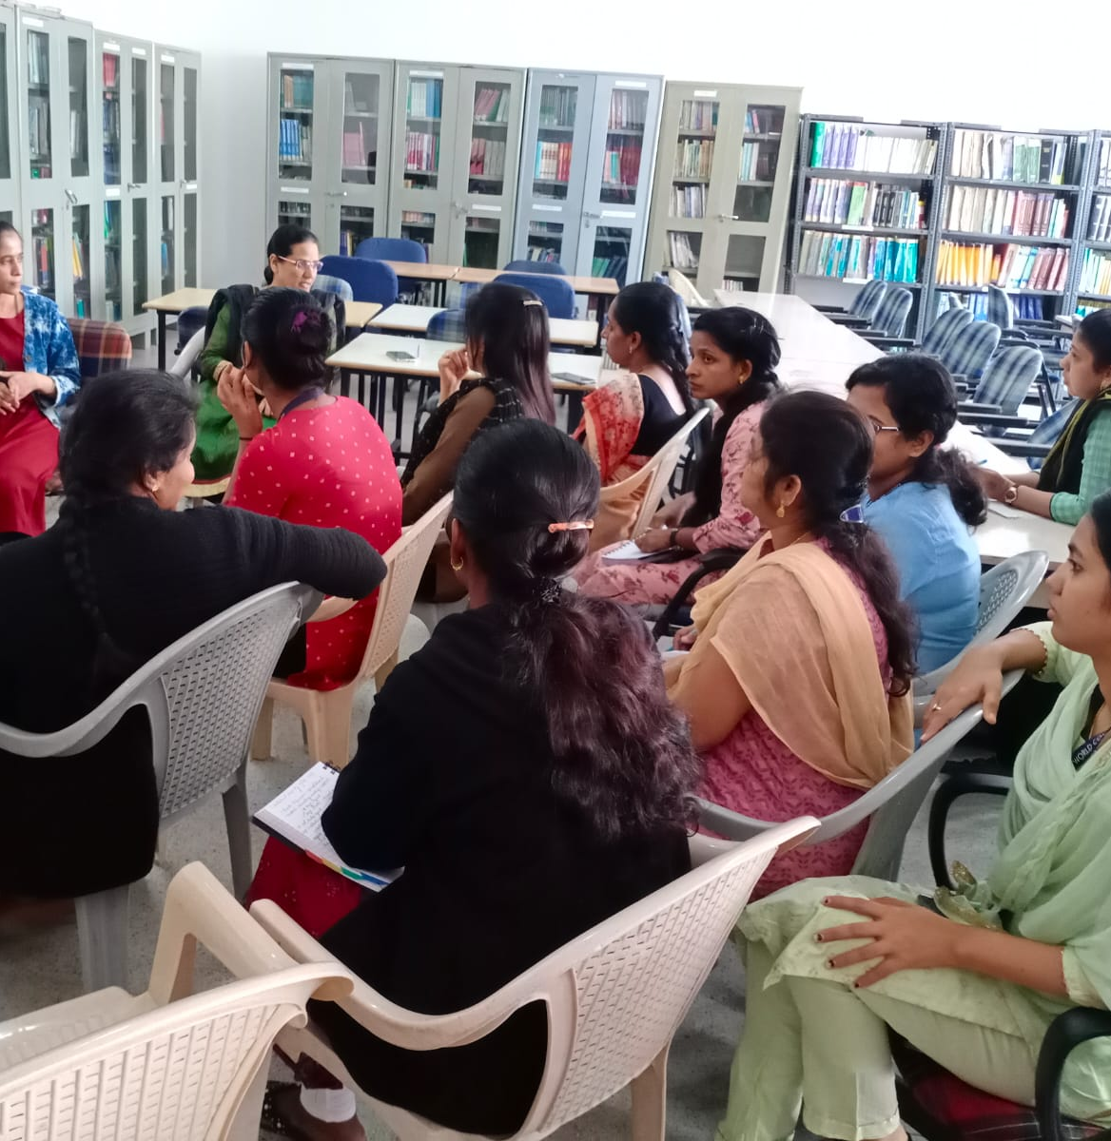
Library Orientation Programme

Slide 21
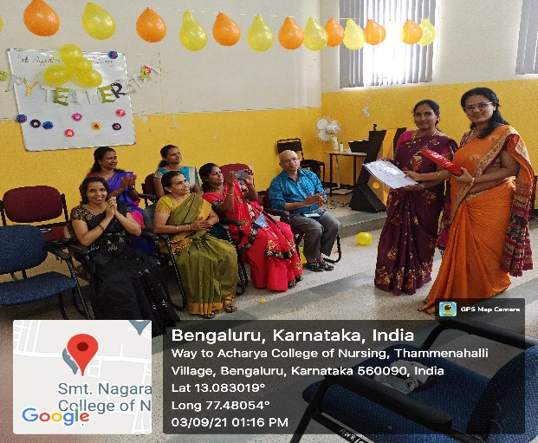
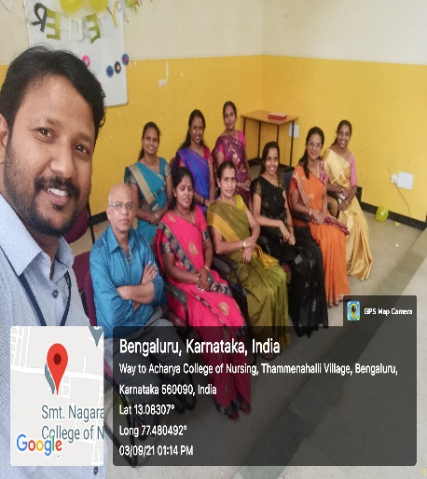
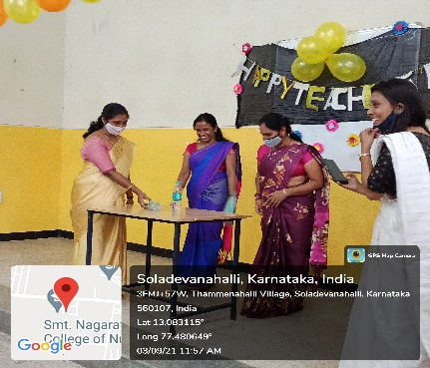

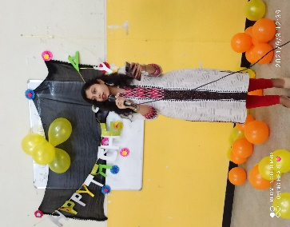
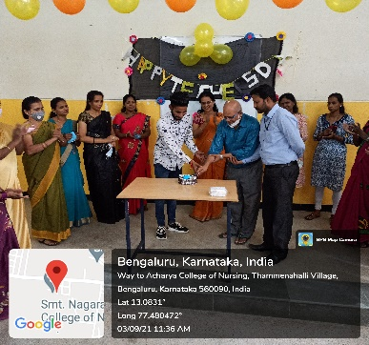
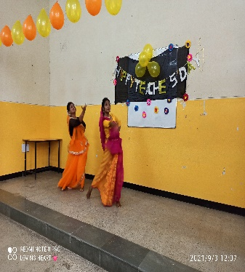
TEACHERS DAY CELEBRATION

Slide 22
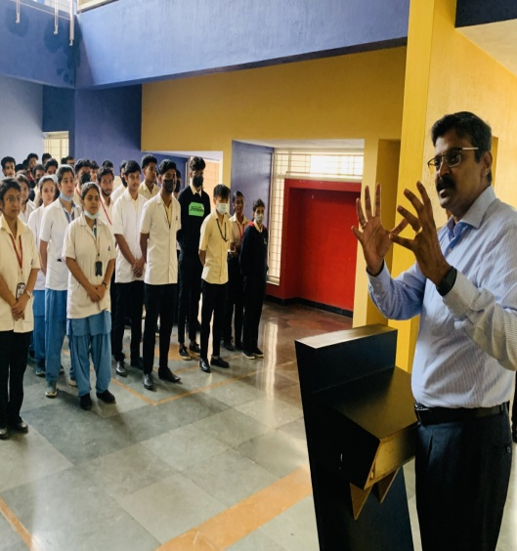
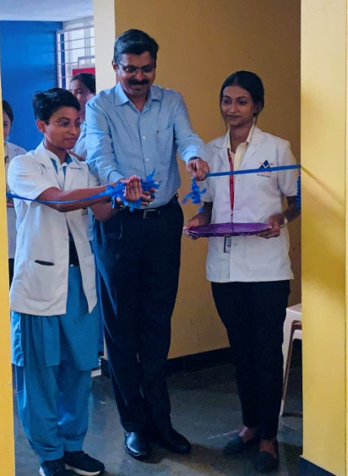
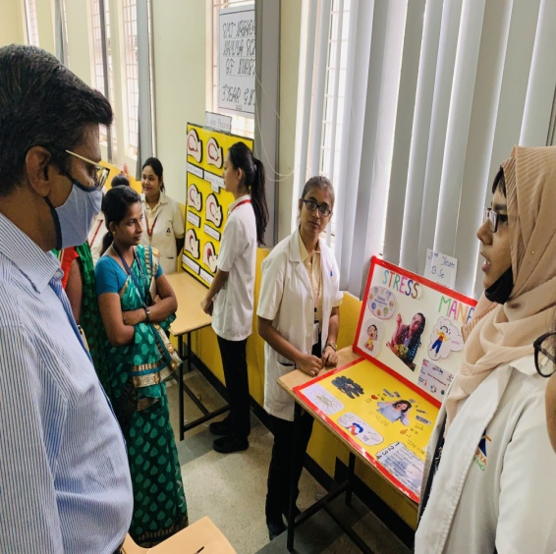
NURSING EXPO:11/05/22

Slide 23
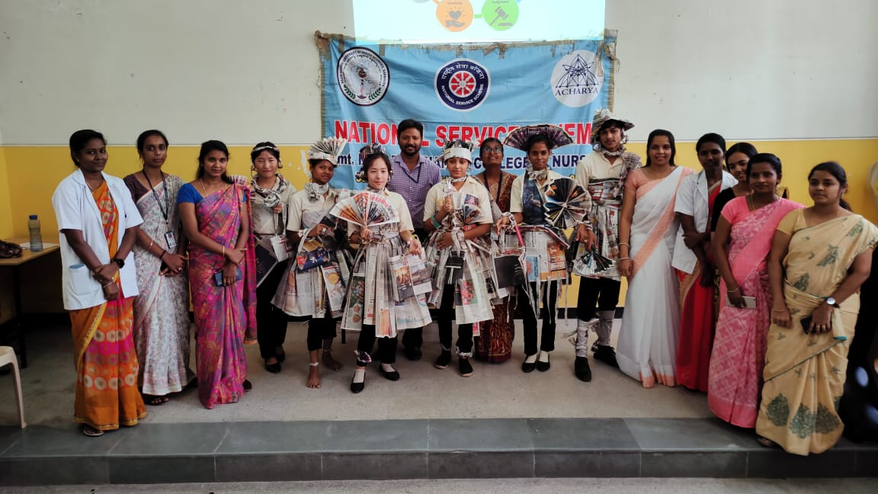
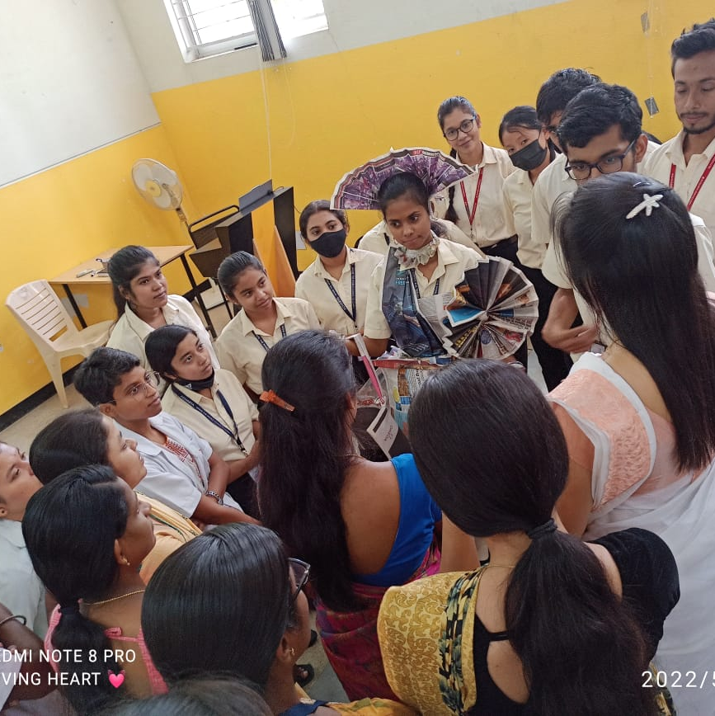
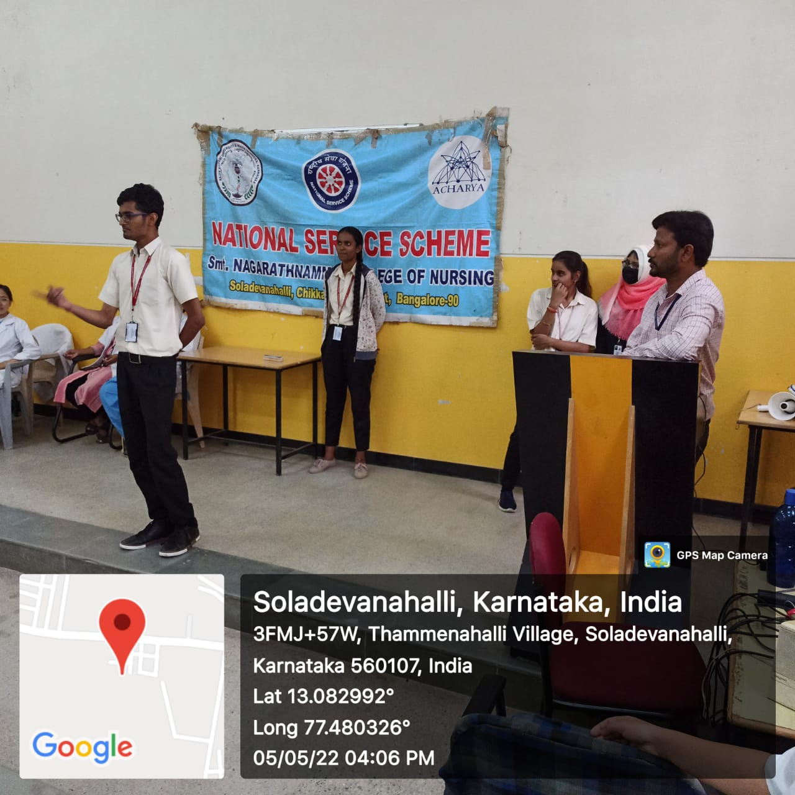
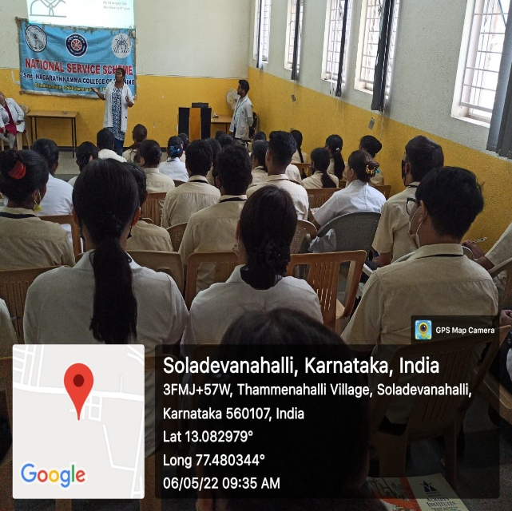
BASIC LIFE SKILLS TRAINING PROGRAMME-05/05/22-07/05/22

Slide 24
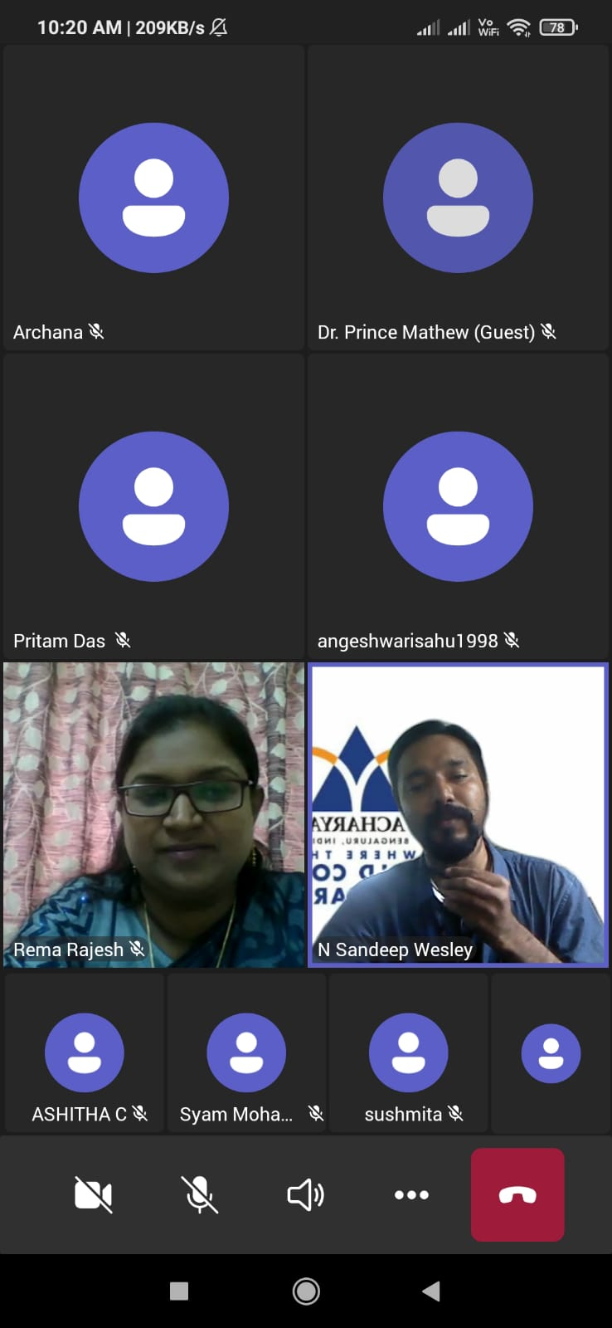
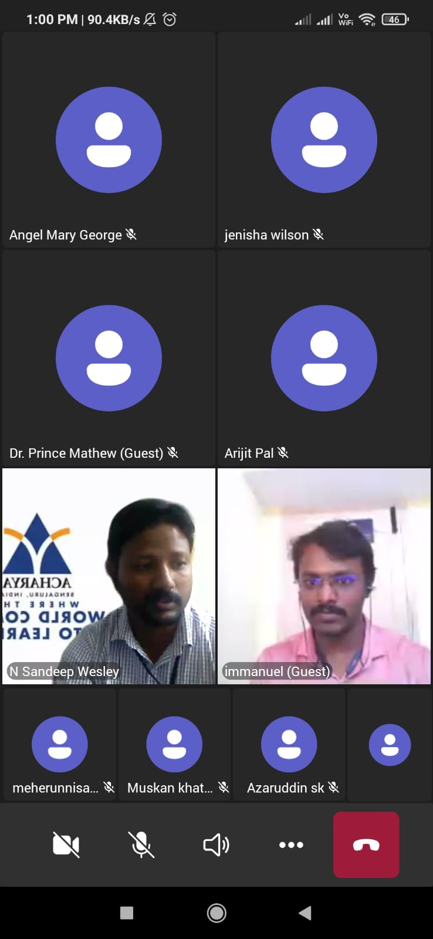
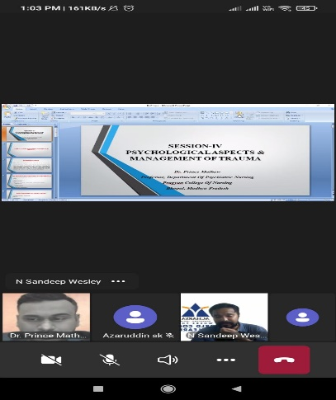
NATIONAL
E-CONFERENCE:15/06/2022

Slide 25
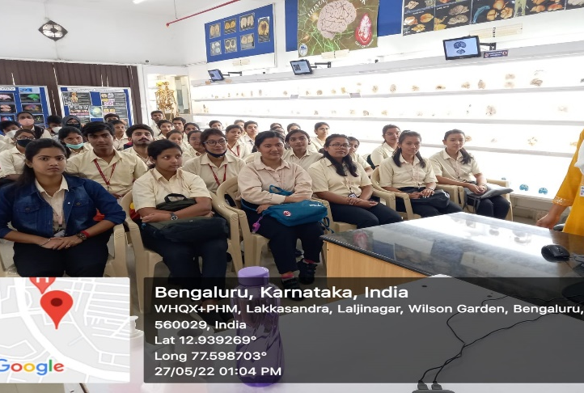
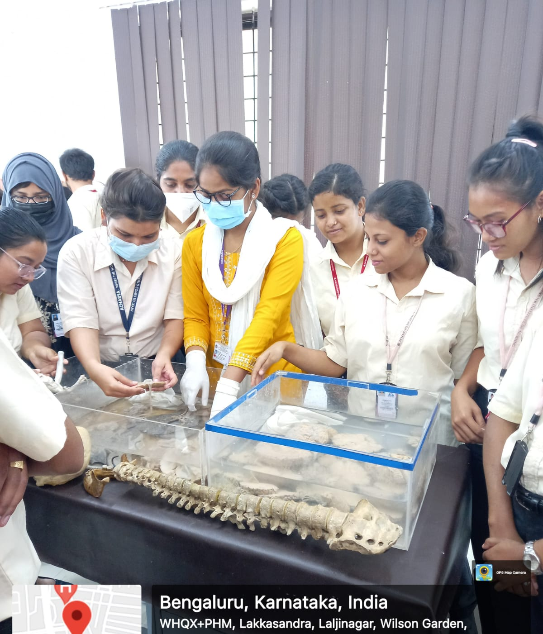
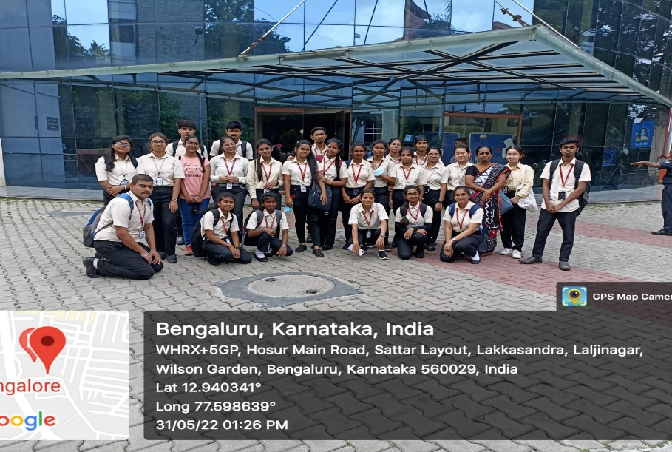
FIELD VISIT TO BRAIN MUSEUM:27/05/2022&31/05/2022

Slide 26
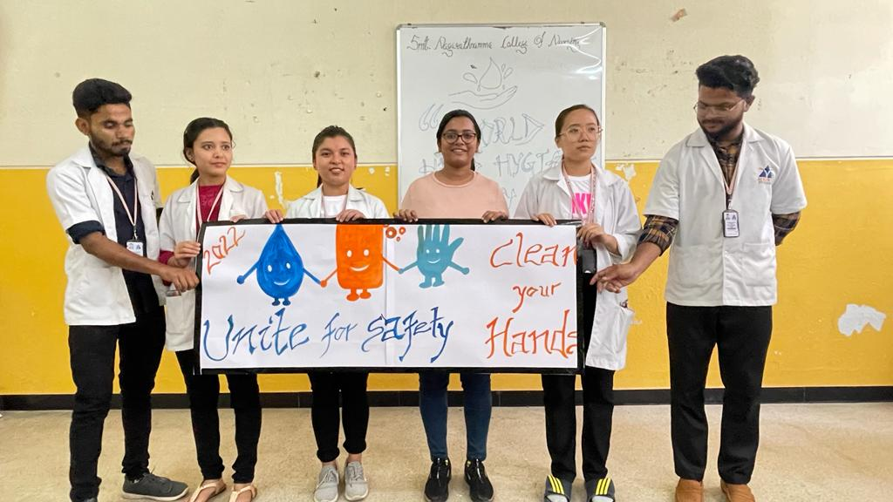
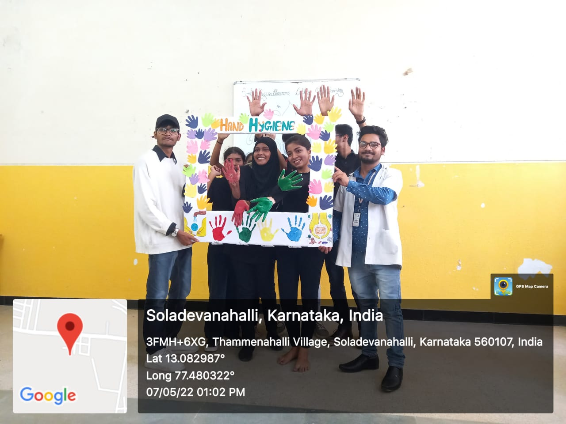
HAND HYGIENE WEEK -07/05/22

Slide 27
IQAC Report
2021-2022

Slide 28
INTERNAL QUALITY ASSURANCE CELL (IQAC)
Activities :
Academic Calendar- yearly
Action Plan –yearly
COE –monthly
Conformance Report –monthly
Documentation of all college events –monthly
Submission of all college events to Principal –monthly
Preparation of AAA-yearly
Preparation & coordination of AQAR –yearly
Coordination of Quality related activities with QA office

Slide 29
INTERNAL QUALITY ASSURANCE CELL (IQAC)
10. Student Annual Feedback –yearly & Action taken .
11.Exit Interview –yearly
12. Feedback by students on academic
13.Coordination & Preparation of NAAC –SSR submission process
14. Participation & Organization of Quality related Seminars & Workshops .

Slide 30
INTERNAL QUALITY ASSURANCE CELL (IQAC)
Sl | Action Steps | Resources | Committee /Dept | Beneficiaries
1 | Continuation of short 2 certificate courses BLS –I Year B.Sc (N) ACLS-IV Year B.Sc(N) | Faculty | Principal ,IQAC Coordinator Class coordinators of I Year & IV year B.Sc (N) programmes | Students
2 | Introduction of Life skill for students : Communication skills Time management Human values and professional ethics | Faculty | Principal ,IQAC Coordinator Program coordinator | Students
3 | Continuation of crash course on QP revision | Faculty | Programme coordinators | Students
4 | Introduction of 2value added courses Yoga Constitution of India-I year B.Sc | External faculty | Academic Council | Students

Slide 31
INTERNAL QUALITY ASSURANCE CELL (IQAC)
Sl.no: | Action Steps | Resources | Committee /Dept | Beneficiaries
5. | Introduction of e -learning courses MOOC courses for II B.Sc & III B.Sc | Faculty | Faculty Development /student development Class coordinators | Students & Faculty
6 | High level emphasis on latest teaching methodology : Concept mapping Problem based learning Group discussions (small & large group) Flipped classroom | Faculty | Programme coordinators Class coordinators | Students & Faculty
7 | Curricular feedback : Stakeholders | Faculty | IQAC Coordinator Programme coordinators | Students and faculty

Slide 32
INTERNAL QUALITY ASSURANCE CELL (IQAC)
Sl.no: | Action Steps | Resources | Committee /Dept | Beneficiaries
8 | Research Workshop on Qualitative Research Methodology. Research Projects : UG & PG students Departmental research projects Publications . | Faculty and students | IRB ,CNE coordinator HODs | Faculty and students
9 | To continue the NSS activities & women’s cell activities | Faculty and students | NSS Officer Women’s cell coordinator | Society

Slide 33
INTERNAL QUALITY ASSURANCE CELL (IQAC)
Sl.no: | Action Steps | Resources | Committee /Dept | Beneficiaries
10 | Consultancy services School health promotional activities at govt.schools First aid –AIGS NSS volunteers Adoption of 4 villages for exchange of knowledge and for social betterment . | Faculty and students | NSS Officer Principal | Society
11 | Online Feedback system Student feedback Annual institutional feedback Alumni feedback Exit interview Parents Employers |  | IQAC Members

Slide 34
INTERNAL QUALITY ASSURANCE CELL (IQAC)
Sl.no: | Action Steps | Resources | Committee /Dept | Beneficiaries
12 | AQAR Submission of AQAR | Faculty | IQAC TEAM | Society
13 | Academic & Administrative audit | Faculty | IQAC Coordinator Programme coordinators
14 | Workshop for students on “soft skills development “ | External faculty | Programme coordinators | Students
15 | ICT enabled classrooms |  | Principal | Students & faculty

Slide 35
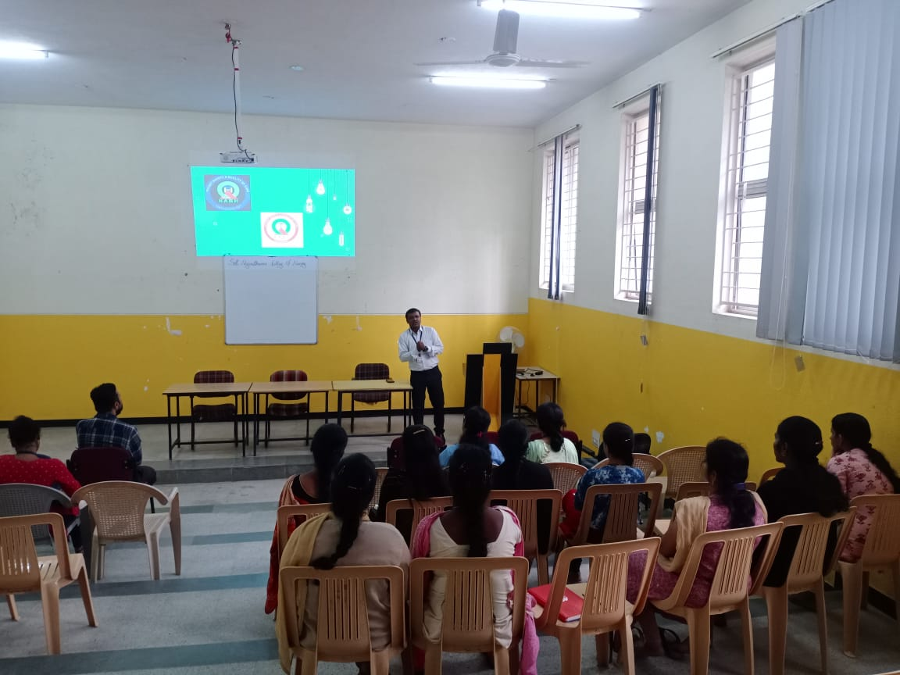
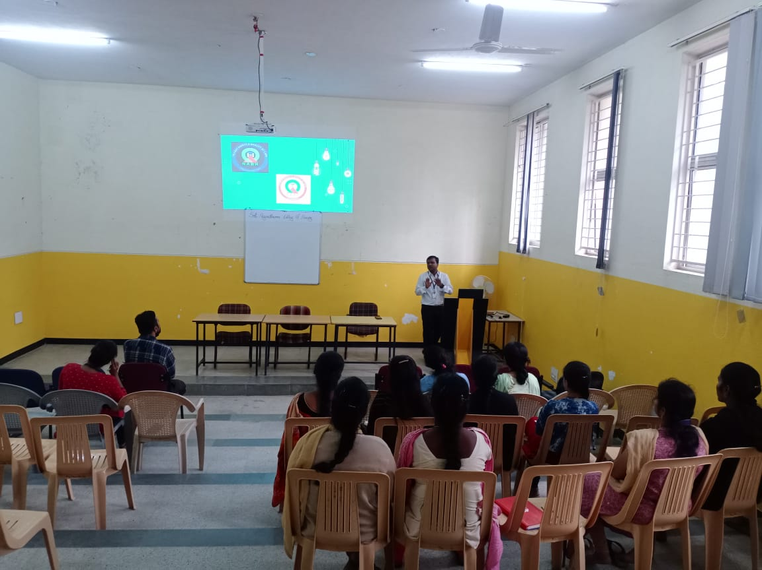
Seminar On Overview On National Accreditation Board For Hospital
As IQAC Inniatives

Slide 36
Clinical Report
2021-2022

Slide 37
List of Hospital affiliated 2021-2022
Clinical Specialty | Name of the Hospital
Nursing Foundation | ESIC Hospital
Medical Surgical Nursing -I | ESIC Hospital
 | Victoria hospital
Community Health Nursing - I | PHC Silebepura village, Susvegatta village
Medical Surgical Nursing -II | ESIC Hospital
 | Victoria Hospital
Mental Health Nursing | Spandana Hospital
 | Indira Gandhi Institute of Child Health
OBG | ESIC Hospital
 | Vanivilas Hospital
Community Health Nursing- II | PHC Silebevepura village, Susvegatta village
MLHP | District Hospital & Community Health Centre
 | Primary Health Centre, & Sub Centre
Internship | ESIC Hospital

Slide 38
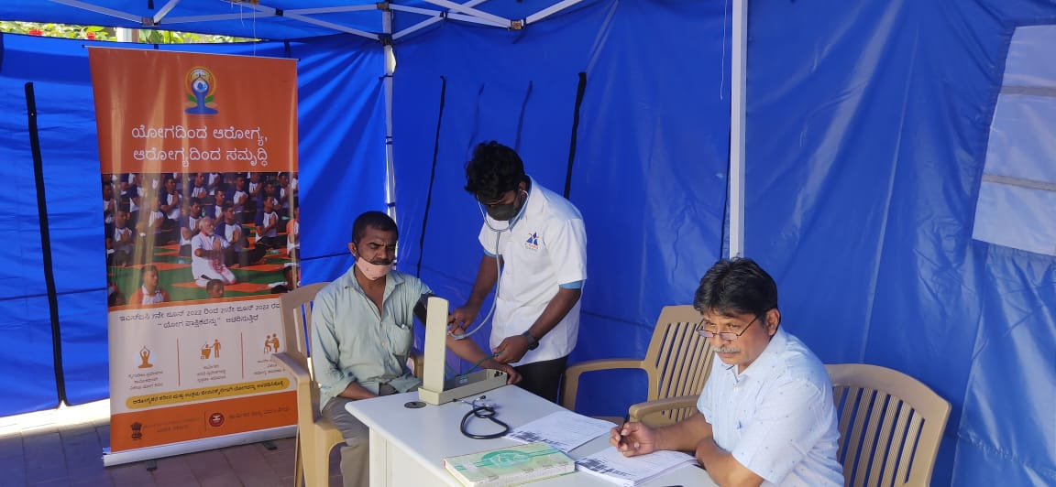
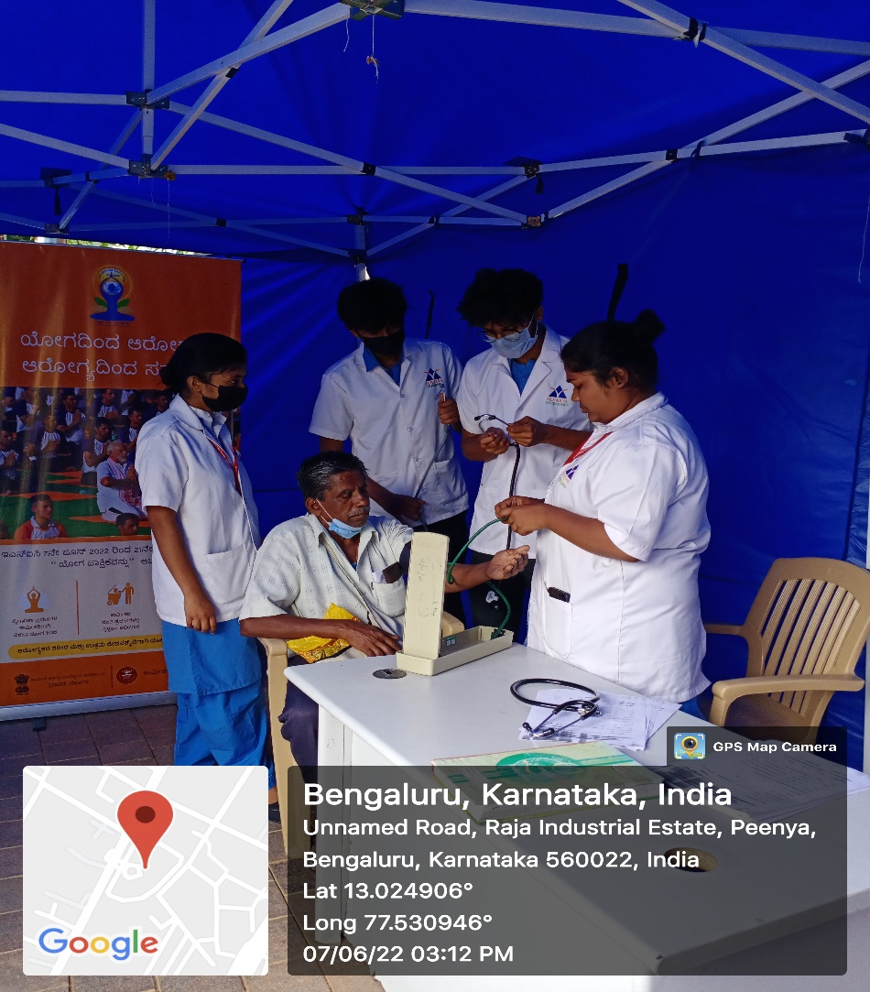
HEALTH CAMP AT ESIC HOSPITAL:07/06/2022

Slide 39
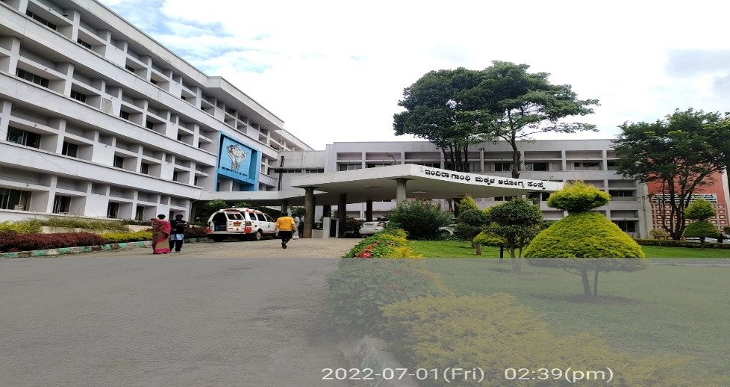
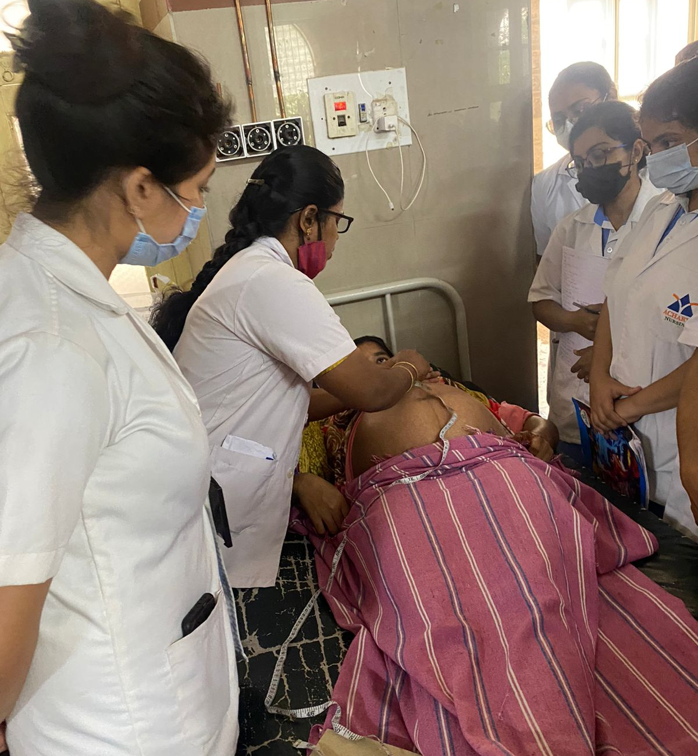
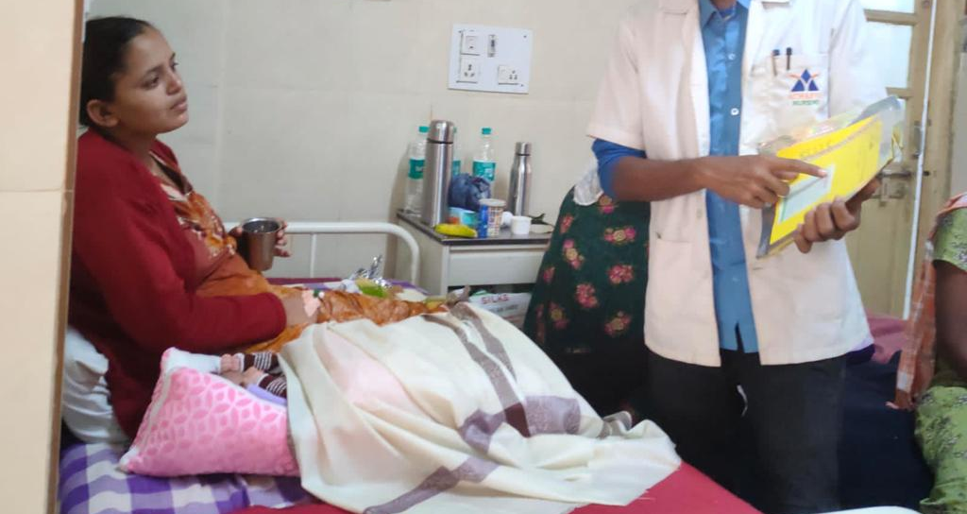
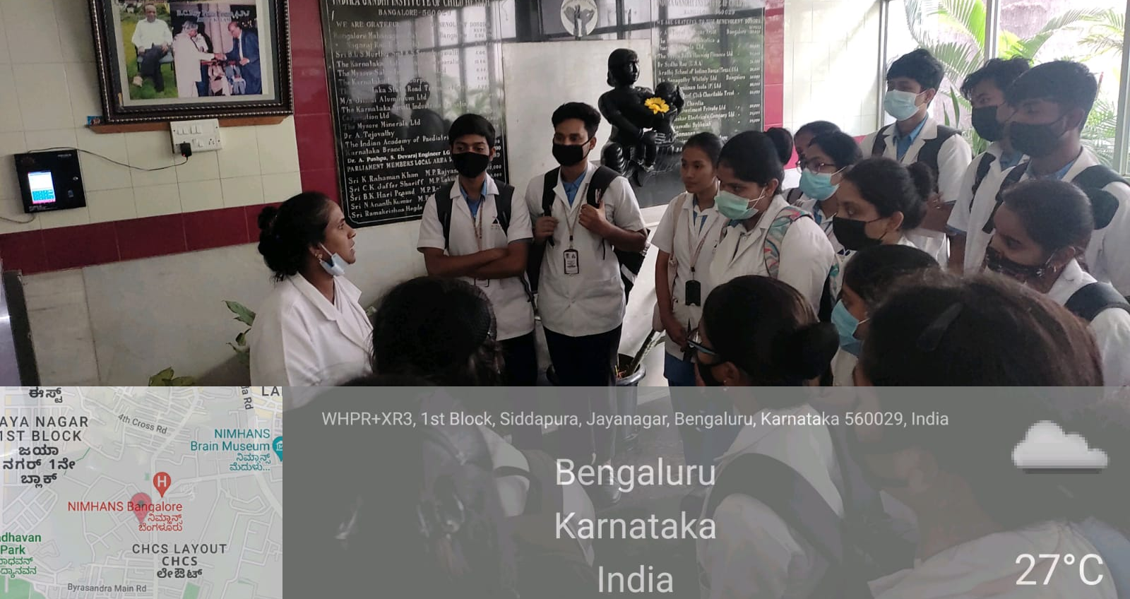
Clinical glance

Slide 40


PULSE POLIO VACCINE DRIVE :01/03/22

Slide 41



RECREATIONAL ACTIVITIES FOR MENTALLY DISABLED-17/03/22

Slide 42
REPORT OF DEPARTMENT ACTIVITIES

Slide 43


Medical-Surgical Nursing
World Heart Day on 29th Sep 2021
World Mental Day on 10th October 2021

Slide 44



DEPARTMENTAL SEMINAR ON CARDIAC REHABILITATION 02/05/22

Slide 45






Medical-Surgical Nursing
ENVIRONMENTAWARENESS DAY on 30th November 2021
Florence Nightingales Dance Competition Award” 2022

Slide 46


World Mental Health Day 10th Oct 2021
Mental Health Nursing
Report on Count down Yoga Programme -22

Slide 47
Mental Health
World Mental Health Day 10th Oct 2021
Report on Count down Yoga Programme -22

Slide 48


Rotaract club
Rotaract club induction meeting was held for all students from 2nd year to final year nursing students on 21st of December 2021
Mr.DLV Sharma briefed all students about Rotaract club and its vision, mission, objectives and benefits to students

Slide 49


OBG Nursing
Cervical Health Awareness Week January 2022

Slide 50


VISIT TO FAMILY PLANNING ASSOCIATION OF INDIA CENTRE -07/03/22

Slide 51


WEBINAR ON UPDATED FAMILY PLANNING METHODS-29/04/22

Slide 52
Placement Report 2021-2022

Slide 53


Be a career champion by implementing 3C model
27/6/2021
No of participants:-84
Webinar on Career Readiness Program
Date 15/2/2022
no of Participants :- 130 Students

Slide 54










Slide 55
REPORT OF FDP and JC

Slide 56
List of webinars
FDP webinar on ‘Research and publication’.
Webinar on ‘IPR and Professionalism’
Webinar on ‘Nurse as navigator’
Webinar on ‘Emotional Intelligence’
Webinar on ‘Transforming Perception’
Webinar on ‘A game changer ;make a difference’
Webinar on ‘ Reboot your life’
Webinar on ‘Research in practice’
Seminar on ‘ Quality on health care’

Slide 57
Journal Presentation
Journal Presentation On" Tar Syndrome’ by Dr.Justin
Journal Presentation On ‘Occupational stress and yoga’ by Mrs. Elaiyarasi
Journal Presentation On ‘Missing tile syndrome’ by Mrs.Gincy Samuel
Journal Presentation On ‘Surgical priorities of Appendicitis ‘ Ms.Sabi
Journal Presentation On’ Epidural Analgesia For Painless Labour’ Mrs.Nagammal
Journal Presentation On Correlation Of Personality And Mental Well Being With Face book Use: Does Gender Play A Role By Mrs.Manjula

Slide 58
Contd..
7.Journal Presentation On Nurse and Diabetes by Mrs.Snehalatha
8.Journal Presentation On Zika virus and its impact by Mr.Syam
9. Journal Presentation On Retrospective study to identify the causes of postnatal depression among postnatal mothers of a selected hospital at Bharuch,Gujarat by Mrs.Keerthi
10. Journal Presentation On Assessing requirement on additional screening for detection of breast cancer by MRI after screening with Ultrasound” by Ms.Geeta

Slide 59
Contd…
11. Journal Presentation On Comparative study to assess knowledge regarding breastfeeding among postnatal mother of rural and urban area.” by Ms.Anjana
12. Journal Presentation On Sleep apnoea on coronary artery disease” by Ms.Dipti
13. Journal Presentation On Assessment of prevalence of ADHD among schoolchildren in selected schools by Ms.Ashitha

Slide 60
List Of Activities
TEACHERS DAY celebration on September 05
faculty preparedness programme from 21/03/2022 to 28/03/2022
3. Faculty Interaction Program on 20/04/22 with Dr .Pia from UMEA University
5. ‘International nurse’s day”. On 12/05/22
6. Faculty interaction programme was conducted on 24/06/22 with Mohan K Krishnan, Assistant professor, dept. Of paediatric, University of South Florida.
7. library orientation programme , on 05/07/22

Slide 61

FDP international seminar on Complications of Anemia
Dr. Mohan K Krishnan

Slide 62


Faculty Induction Programme

Slide 63



faculty development programme report on 21st to 28th March 2022

Slide 64


faculty preparedness programme on 21st to 28th march 2022

Slide 65

WEBINAR ON WORLD IMMUNIZATION WEEK-30/04/22

Slide 66



Faculty exchange program

Slide 67

30/03/2022 seminar was conducted on “Let’s reboosts our teaching strategies” by Ms.Adelarisa

Slide 68


Faculty Development Programme Report
Reboot your life date: 4th September 2021

Slide 69


webinar report o leadership in crisis
27th November 2021

Slide 70


Faculty preparedness programme

Slide 71


“Insight on Quality in health care on 13/05/2022

Slide 72



International Nurse’s Day on 1205/2022

Slide 73


Slide 74



Slide 75

Faculty interaction programme on 24/06/22

Slide 76


FDP WEBINAR ON RESEARCH AND PUBLICATION BY DR.CLEMENT ON 13/02/2021

Slide 77

JOURNAL CLUB
journal presentation
effects of mirror therapy on upper extremity functions among hemiplegic patients
on 27/11/2021

Slide 78

Journal Club Presentation
Journal club presentation was conducted on 29/04/2022 by Ms.Geeta K on the topic of “Assessing requirement on additional screening for detection of breast cancer by MRI after screening with Ultrasound”

Slide 79


JOURNAL CLUB
DIABETES CARE

Slide 80
Research Report

Slide 81
Research publication on pipeline
1. Miss Pravalika- Lecturer
“A study to assess the effectiveness of structured teaching program on knowledge regarding early ambulation of patient after cardiac surgery among staff nurses working in cardiac surgical care unit at Sapthagiri Institute of Medical Sciences & Research Centre Bengaluru”

Slide 82

Research proposal was submitted to RGUHS university for RGUHS grants by Mrs P Snehalatha Reddy Asst Professor and Ms Bhagya,Lecturer from Medical Surgical Nursing department on 15 June 2022.Below is the problem statement.
Effectiveness of selected relaxation techniques on physiological parameters of patients with asthma at a selected hospital in Bengaluru

Slide 83


Slide 84
Research Dissertation
Ms Bhagya,Ms Geeta & Ms Ashitha.C, Lecturers
Research projects was submitted to AJNER journal.
“Effectiveness of structured teaching programme on knowledge regarding Attention deficit Hyperactivity disorder among primary school teachers working in selected primary schools , Bengaluru”

Slide 85


Awareness Program on Intellectual Property Rights (IPRs)

Slide 86


webinar on Research

Slide 87
AAA Report

Slide 88




Alumni Webinars and interaction program

Slide 89
CSR REPORT

Slide 90





HEALTH CAMP FOR SECURITY AND HOUSE KEEPING PERSONNEL-07/04/22

Slide 91






Community Outreach activities

Slide 92



community health camp 2022
Health Camp on 15th February 2022
The health checkup program started at around 10am at Government primary school in Tharabanahalli

Slide 93


INTERNATIONAL YOGA DAY: FOR FEMALE NURSING STUDENTS
Programme was exclusively for Females by NSS volunteers with a purpose stating that Yoga activates the energy chakras and provides strength to women to deal with their physiological and psychological changes.

Slide 94



School health camp

Slide 95


Pulse polio program

Slide 96
NSS REPORT

Slide 97
NSS
DATE | TIME | EVENT
27.12.2021 | 10am to 11am | Inauguration
 | 11am to 12pm | Health awareness – Hand hygiene
 | 12 to 1pm | Health awareness – Dental hygiene
 | 2pm to 3pm | shramadhan
 | 3pm to 4pm | Plantation
28.12.2021 | 9am to 1pm | School health programme
 | 1.30pm to 4pm | Dental Screening camp
29.12.2021 | 9am to 1pm | Diabetic and Hypertension Screening camp
 | 2pm to 3pm | Health awareness – Suicidal Prevention
 | 3pm to 4pm | Yoga for NSS Volunteers
30.12.2021 | 9am to 1pm | Eye camp
 | 2pm to 3pm | Health awareness – Menstrual hygeine
 | 3pm to 4pm | Yoga for NSS Volunteers
31.12.2021 | 9am to 12pm | Covid Awareness and vaccination camp
 | 12 to 1 pm | Anganwadi progamme
 | 2pm to 3pm | Health awareness on Malnutrition & Anaemia
 | 3pm to 4pm | Valedictory
NSS SPECIAL CAMP on “Healthier World for Everyone, Everywhere”
VENUE: Soladevanahalli, Bangalore
DTE: 27th to 31st December 2021.
TIME: 8.30 AM to 5.00 PM

Slide 98




NSS SPECIAL CAMP

Slide 99




NSS SPECIAL CAMP

Slide 100




NSS SPECIAL CAMP

Slide 101


Report on Count down Yoga Programme -22
International Yoga day

Slide 102
SNA REPORT

Slide 103


Report on Smt. Nagarathnamma Jayanthi

Slide 104




Acharya HABBA 2022

Slide 105


FRESHER’S,ETHNIC,NURSES DAY:12/05/2022

Slide 106



World Environment Day :06/06/2022

Slide 107


Nursing Dedication Ceremony class 2022

Slide 108


Fresher’s Day 2022

Slide 109


Florence nightingale Dance Competition 2022

Slide 110


INTER COLLEGE – Nursathon Euphoria

Slide 111




Sports league
SNA Sports Was Conducted For the Year 2021 from 26th September to 30th September 2021

Slide 112









ASNA Cultural

Slide 113
ROAD MAP AY - 2022-2023
Feedback and SWOT Analysis
Faculty JD and Action Plan ,SOP,SWOC
Annual report
Feedback :action taken report
Alumni Meet -6
Career Counseling Program-6 no
Campus Placement drive -10
Faculty Exchange Programmes 2 nos
NSS Residential Camp-1
Faculty enrollment for MOOC Courses [Min 4] and refresh course 2
Funding Research Projects atleast 2Nos.
Research publication -2 each
Budget Planning 23-24
Research IPR –patent
Curriculum enrichment Program 4 No
CNE Programme 4 No
Field Visit 14Nos
International and national Workshop 2 No
Departmental Seminar-%5Nos
Certificate Course [Short] 2
E-Learning Courses -4 Nos.
Academic planning new syllabus
MoU for Collaboration 2 no.
AQAR IQAC planning and NAAC c-3
Admission FOR M.Sc N
Value added Course 2 nos
Plan for Campus Visit 2no
Monitoring the Academic Progress
ASNA Sport –Leading to a part of National Level SNA Participation
Clinical Linkages People Tree Hospital
Health Promotion Activities as per WHO Model for Vulnerable group
Auditing
PBS
NIRF
Webinar NSS,SNA etc.
Apr-June
Oct-Dec
Jan-March
Jul-Sep

Slide 114
BIG Thank you …to

Slide 115

Sri.B.Premnath Reddy, Secretary JMJ Society & Founder Chairman ,Acharya institutes
At Acharya Institutes,
we believe in 'fueling the quest for knowledge by earmarked Sustain quality of Academic Excellence in all the disciplines
We aims to be model for Global University by meeting the global standards

Slide 116

Management and Governance
Smt. Shalini Reddy
Executive Director of Acharya Institutes

Slide 117
on behalf of Management ,
Thanks to Parent ,student, collaborators and clinical Partners in this journey of success.
Thanks to nursing team, for being part of our acharya family and in participating all activities

Slide 118
This report is true ,best of my knowledge
Therefore ,presented for your humble acceptance

Slide 119
Thank you

