Slide 1
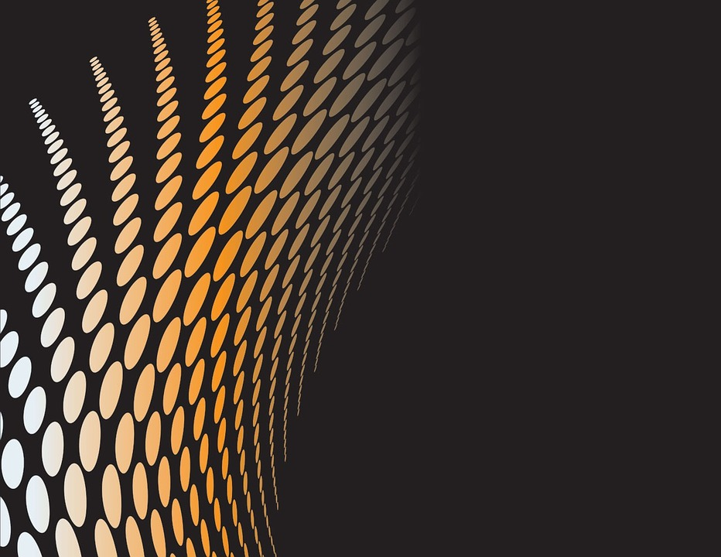
ELEMENTS OF
DESIGN
Notes:
‹#›

Slide 2
OBJECTIVES
To introduce the basic elements of Design
To introduce relation between visual elements
To provide knowledge in application of Visual elements.
.
To provide knowledge in Aesthetics.
To sensitize towards visual experience
To provide skills in Visual representation
Notes:
.
‹#›

Slide 3
DESIGN ELEMENTS
Conceptual Elements – Point, Line, Plane, Volume
Visual Elements- Shape, Size, Colour , Texture
Relational Elements – Direction, Position, Space and Gravity
Practical Elements – Representation, Meaning and Function
Notes:
Conceptual Elements – Point, Line, Plane, Volume
Visual Elements- Shape, Size, Colour , Texture
Relational Elements – Direction, Position, Space and Gravity
Practical Elements – Representation, Meaning and Function
‹#›

Slide 4
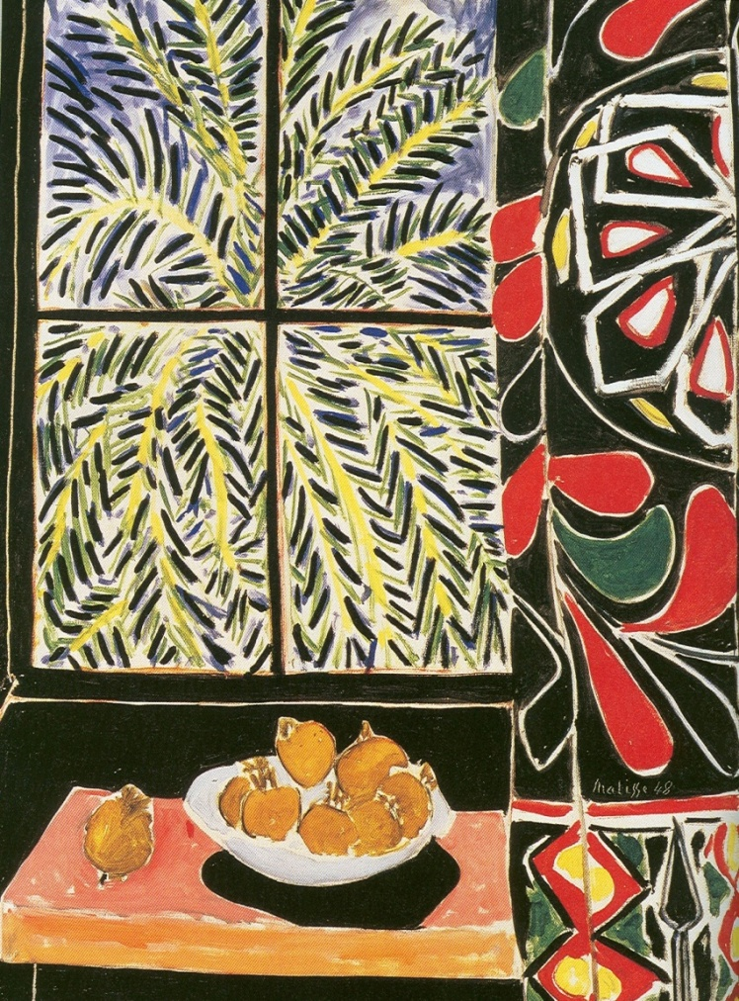
ELEMENTS OF DESIGN
Unlocking and Discovering the Key Building Blocks of Art
Henri Matisse. Interior with Egyptian Curtain 1948. Oil Painting

Slide 5
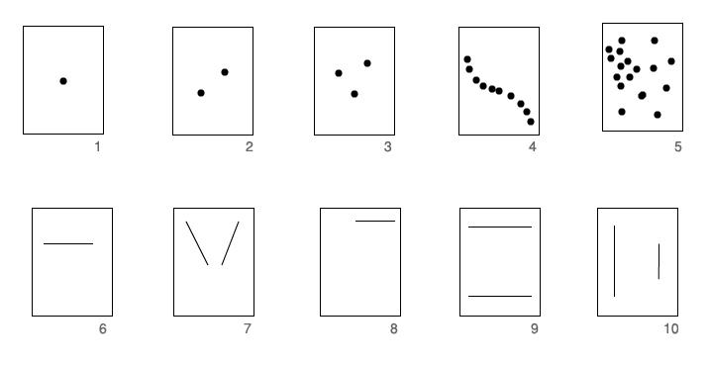
Conceptual Elements – Point, Line, Plane, Volume
POINT
Notes:
‹#›

Slide 6
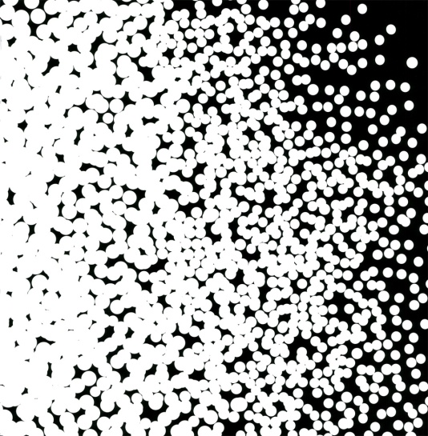
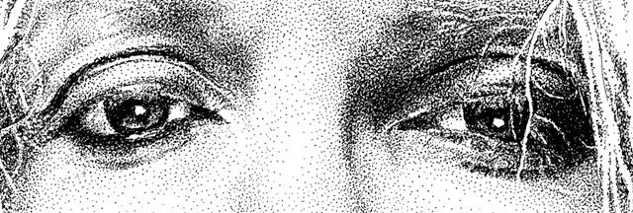

Slide 7
What isline?
Geometrically, it connects two points.
A line is a path traced by a moving point,
i.e. a pencil point or a paintbrush.
We see lines all around us. Line is a vital element of any artwork.
Line is a mark created on any surface
Line is an idea and concept
Line is also a visual experience
A-----------------------------------------------------------B

Slide 8
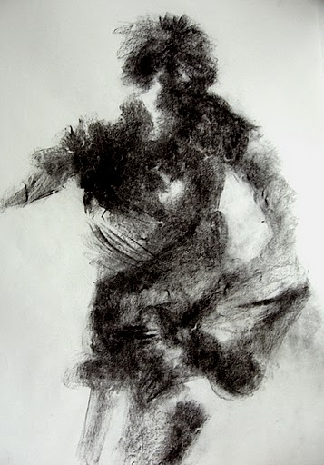
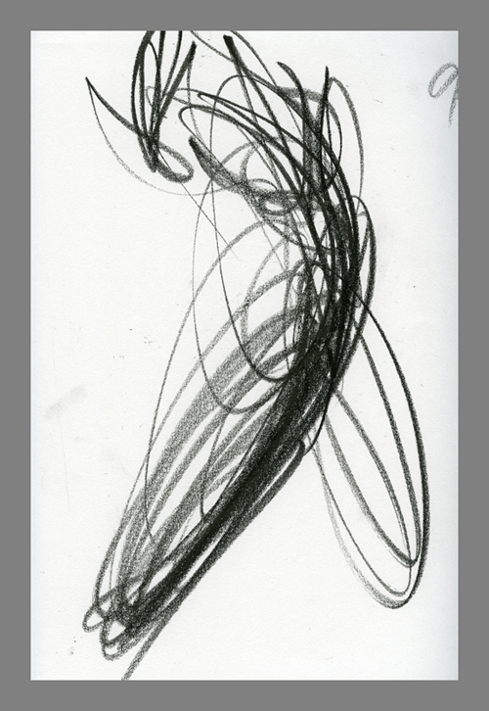
LINE
LINE
MASS
Lines are created by different mediums such as pencil, pen, pastel, brush etc.
Notes:
‹#›

Slide 9
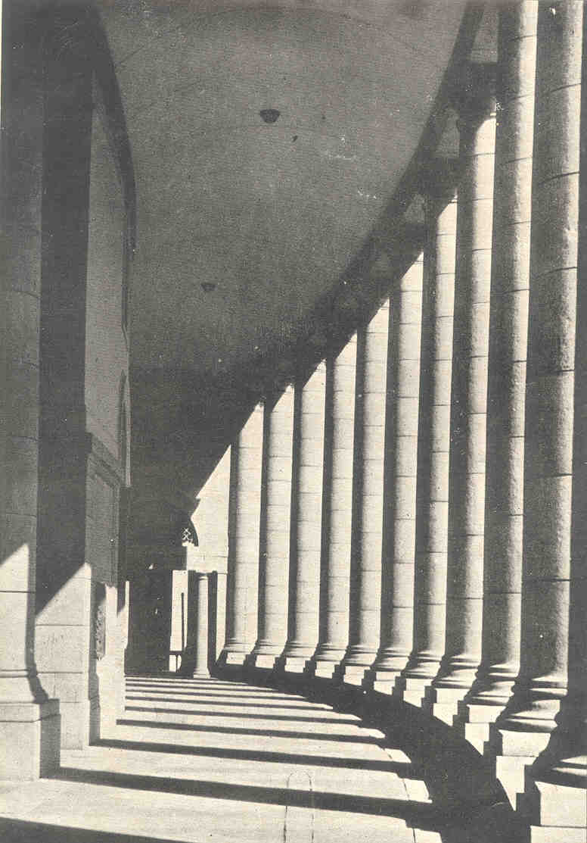
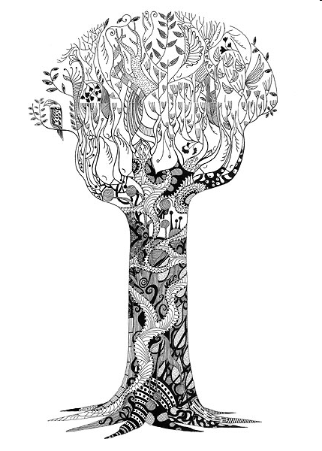
Actual Line : It is a line drawn on paper or any other surface using a tool
Implied Line : It is the feeling of line felt when the edge of any thing
placed against a background.
Notes:
Actual Line
‹#›

Slide 10
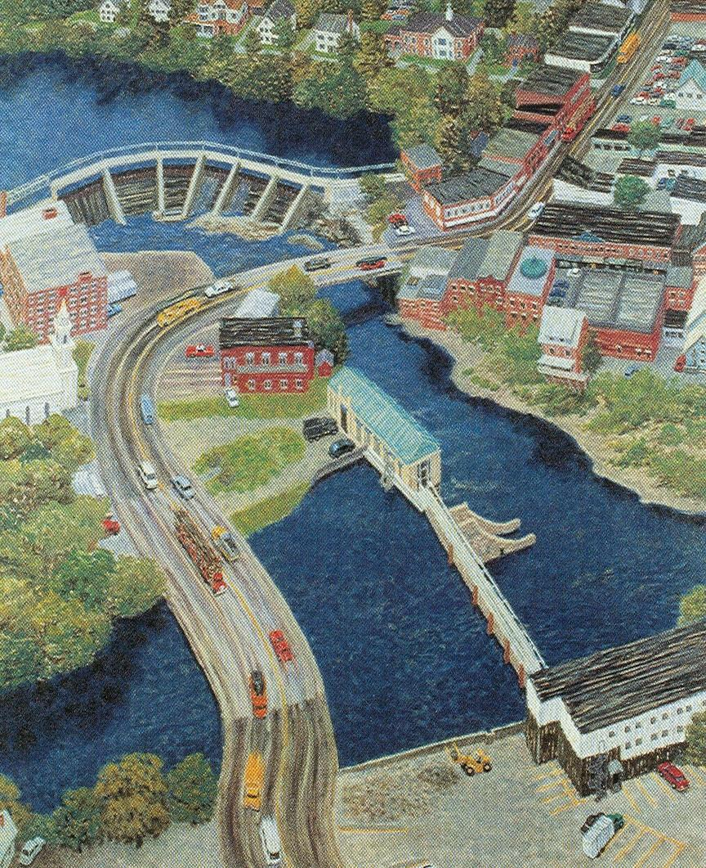
Implied line: An imaginary line that directs the viewer's eye.
Artists use line to lead your eyes around a work of art. This is because the artist wants to lead you through their composition. Line creates movement, and leads your eye into, around, and out of visual images as in this painting by Yvonne Jacquette. Oil, 1988
Notice how the artist uses the line of the highway to pull your eyes into the artwork.
Line has width as well as length, but usually the width of the line is smaller than the length.
Artists create lines in many different ways. A line can be drawn on a paper with pencil or scratched in clay with a stick.

Slide 11
Some lines that we think we see in nature really do not exist. For instance, when you look at the edges of shapes, you think of lines. In the photo of the dogwood blossom, notice that there are no black lines around the flower, only black against white. However in a sketch of the same blossom, lines are used to define the shape of the flower.

Slide 12
Line
When you, as a child, first picked up a crayon, a line might have been the first mark you made. You use lines to write numbers, symbols, and the letter of the alphabet. You use lines to draw pictures. Lines are everywhere.
What type of lines do you see around you?

Slide 13
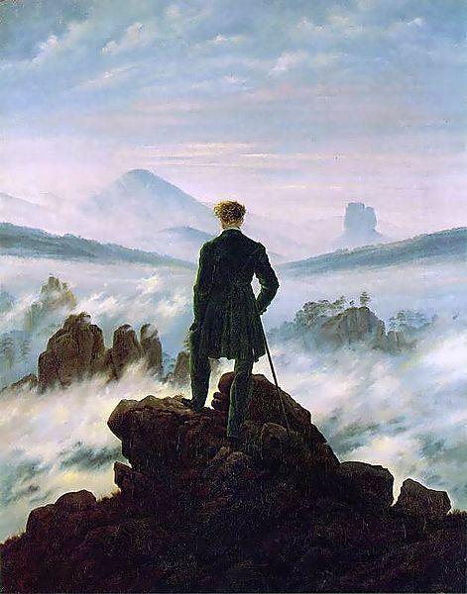
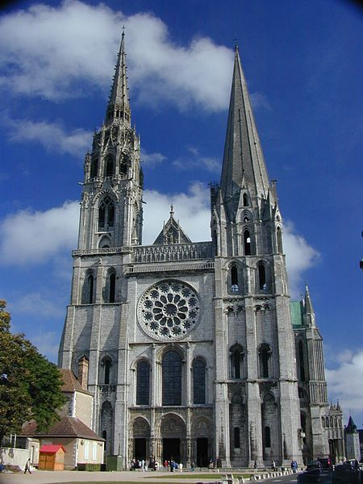
Notes:
‹#›

Slide 17
Kinds Of Line
Curved
Vertical
Diagonal
Horizontal
Zig Zag, or also known as geometric

Slide 18
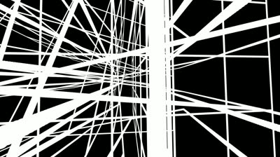
Directional Lines
Abstract composition of all types of lines
Notes:
‹#›

Slide 19
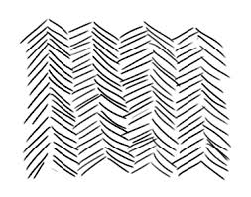
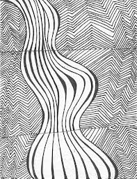
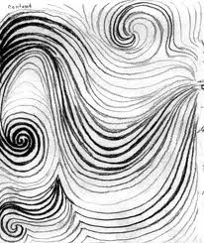
Directional Lines
Notes:
‹#›

Slide 20
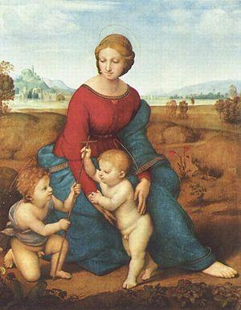
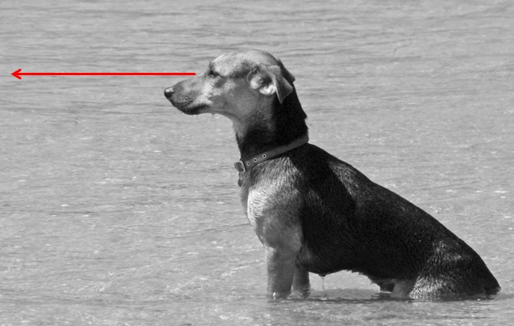
Imaginary Lines
Notes:
‹#›

Slide 21
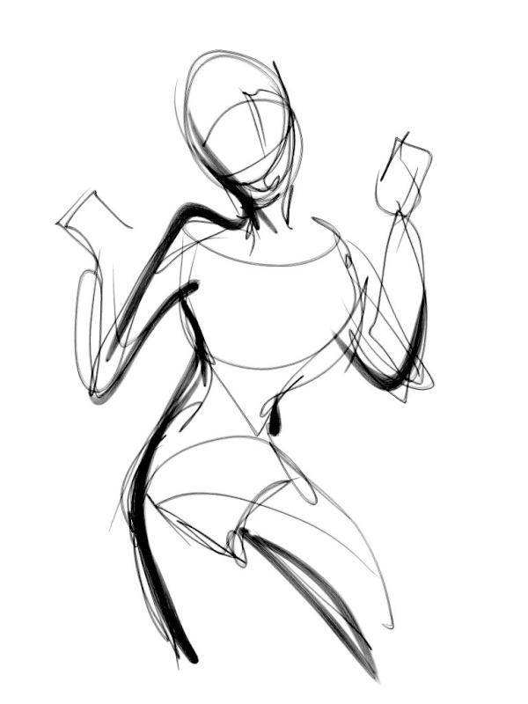
Gesture lines
Notes:
‹#›

Slide 22
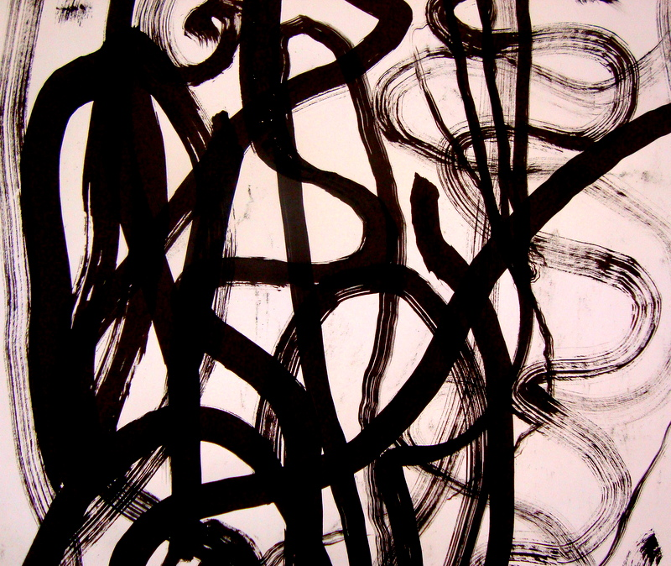
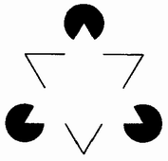
Expressive Lines
Psychic Lines
Notes:
‹#›

Slide 23
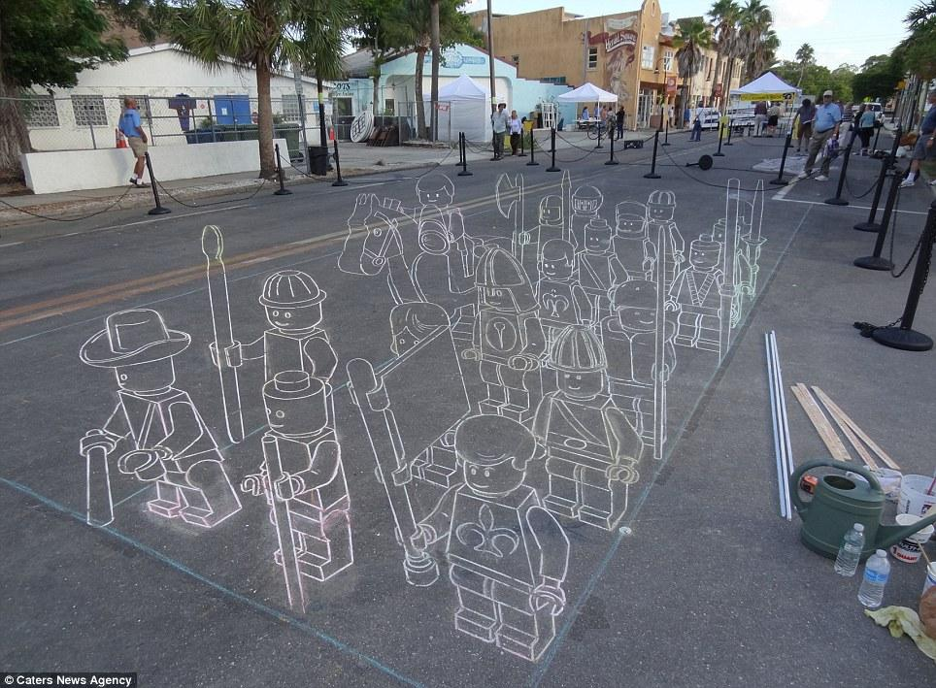
Line and illusion
Notes:
‹#›

Slide 24
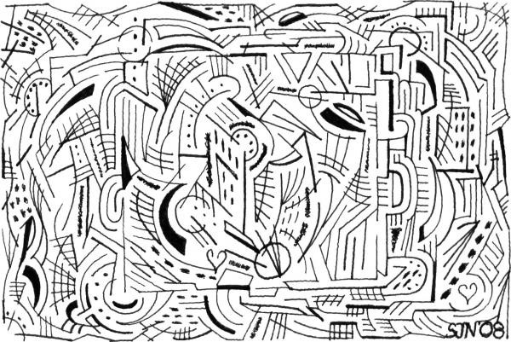
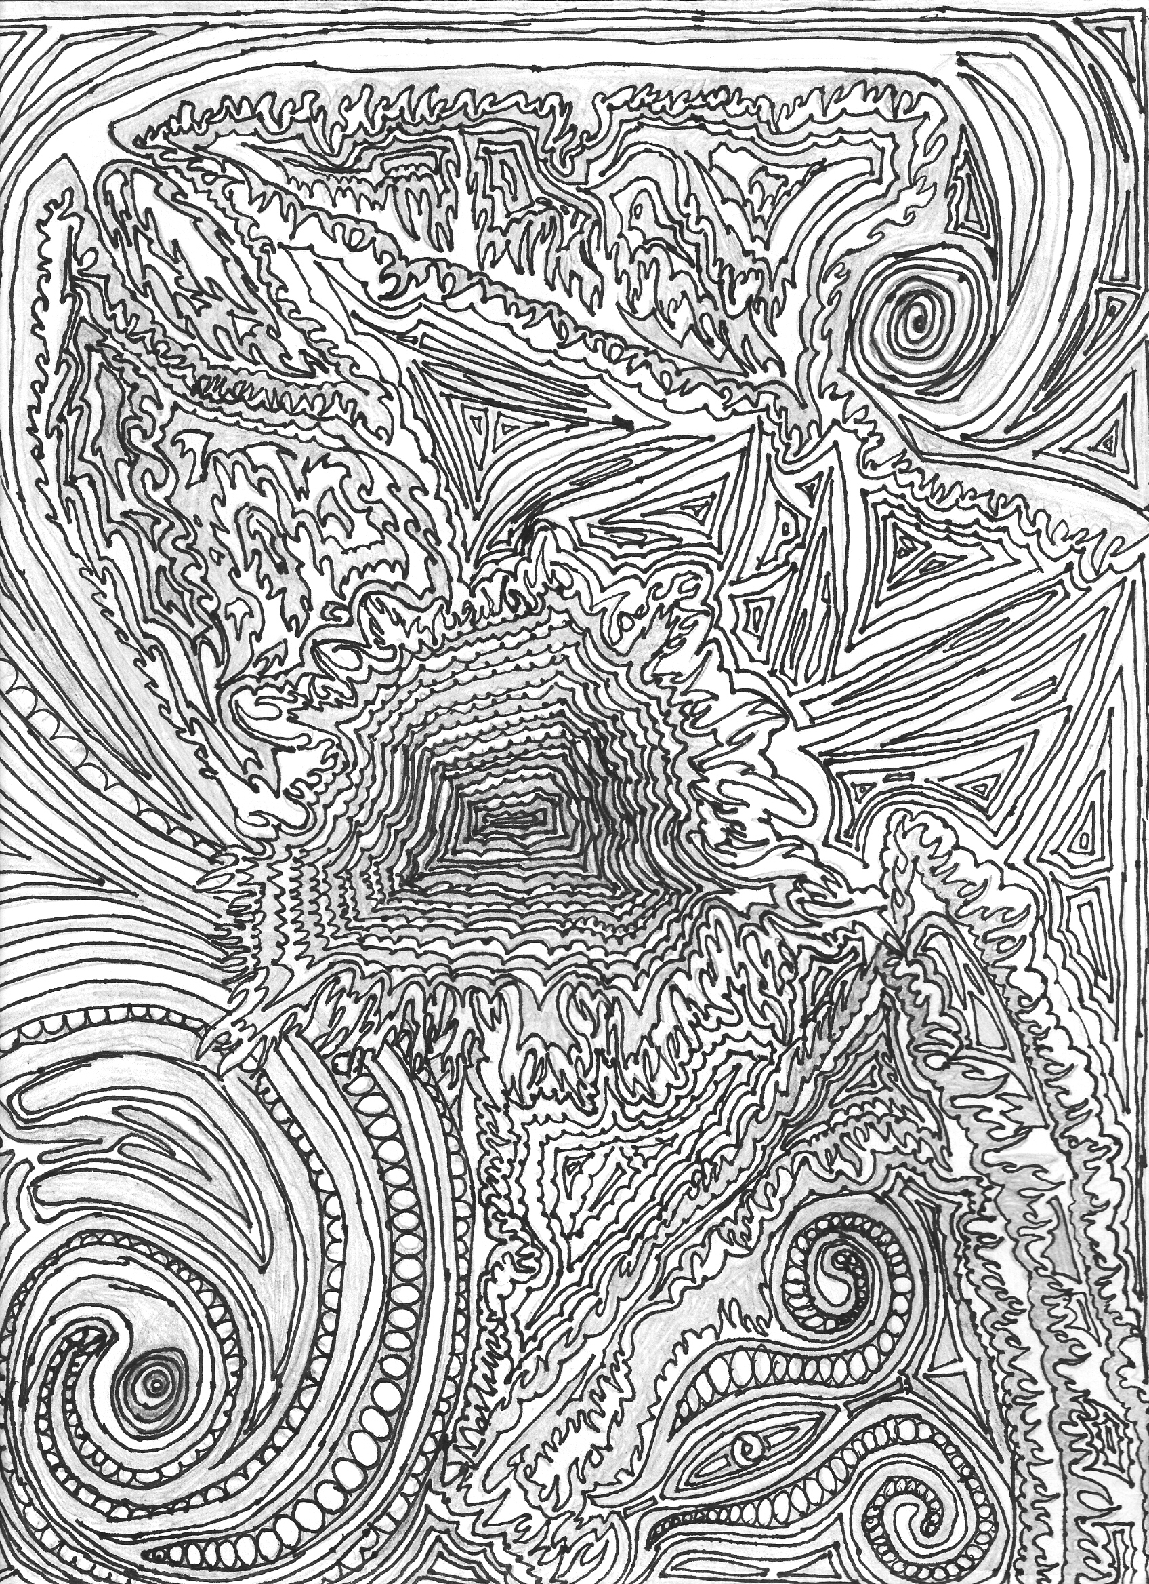
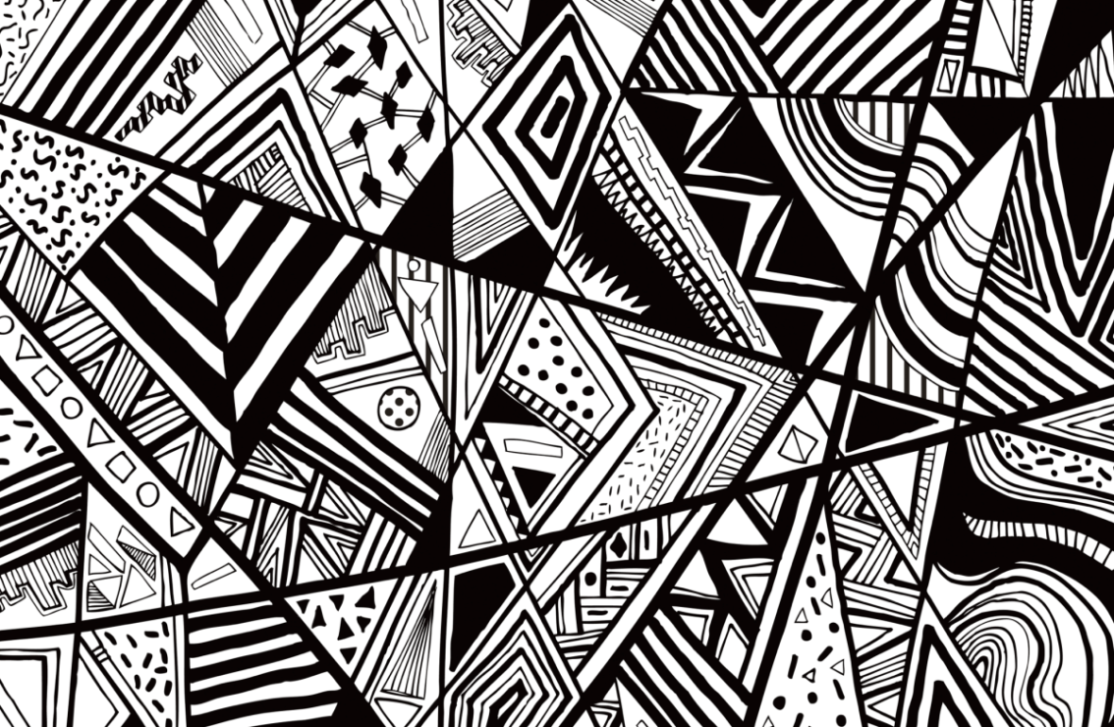
Line as patterns
Notes:
‹#›

Slide 25
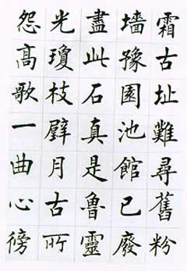
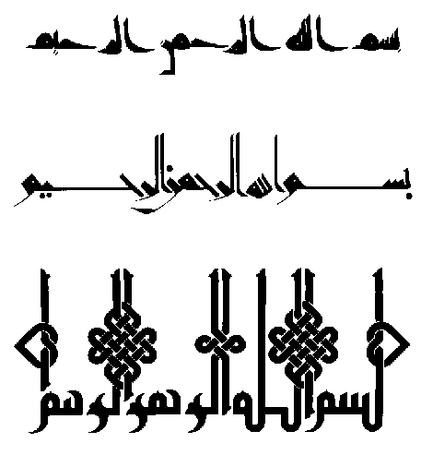
DISCRIPTIVE LINES : CALLIGRAPHY
Descriptive lines give us information. Descriptive lines are used in such things as handwriting, charts and diagrams. They can also be used as decorative elements. Descriptive lines are used in two dimensional work to suggest three dimensionality (i.e. cross-hatching), and texture.
Calligraphy Illustrations bismi-llāhi ar-raħmāni ar-raħīmi
Chinese Calligraphy
Notes:
Chinese Calligraphy
‹#›

Slide 26
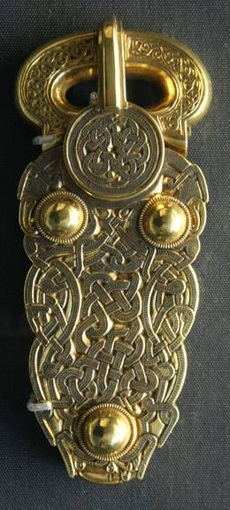
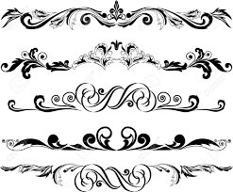
"
Linear Decorative elements
Notes:
‹#›

Slide 27
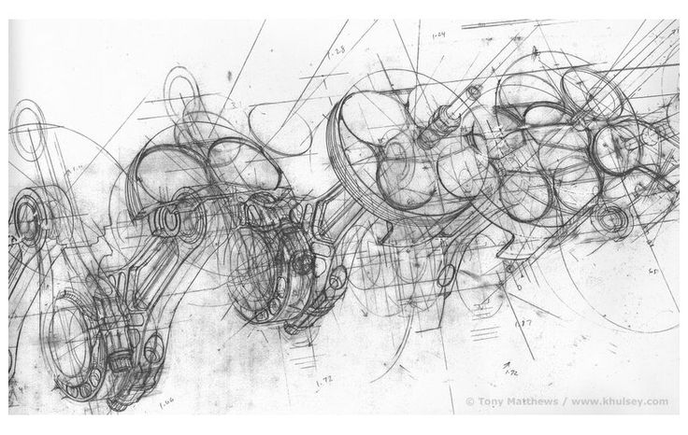
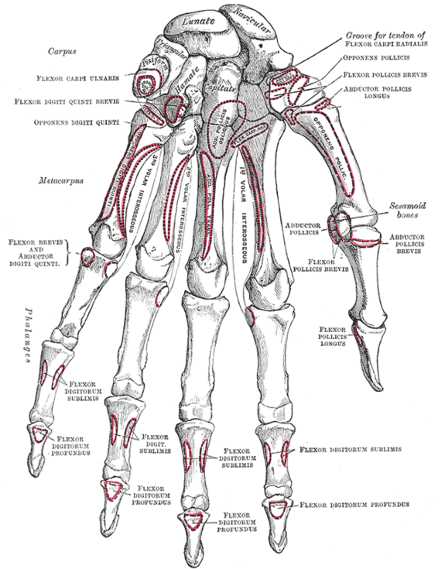
Technical Drawing
Notes:
‹#›

Slide 28
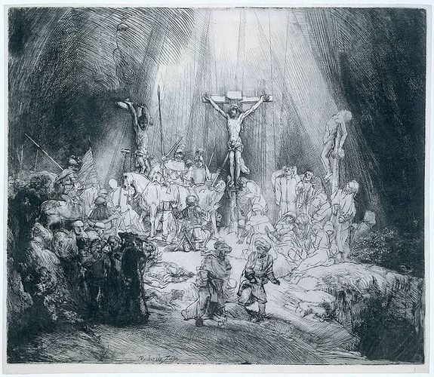
Rembrandt's many prints are excellent examples of cross-hatching, using line to create (or describe) a sense of three dimensionality. Rembrandt also used cross-hatching to create a dramatic contrast between light and dark.
Notes:
Continous
‹#›

Slide 29
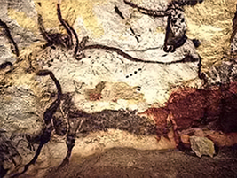
Pre historic Wall painting
Notes:
‹#›

Slide 30
Expressive Qualities of Line
The expressive qualities of line are as variable as each artist’s work.
Lines can be short, long, thick, thin, thick and thin, smooth, textured, broken, flowing, erratic, dark, light, dark and light, heavy, soft, hard, playful, ordered, even, variable, calligraphic, authoritative, tentative, irregular, smudged, uneven, straight, crooked, choppy, ghostly, graceful; the variety is endless.
Each type of line says something different; each evokes a different response. In some way, line is an integral part of every artwork. Careful consideration of the quality of line used support s and enhances the artist’s intent.

Slide 31
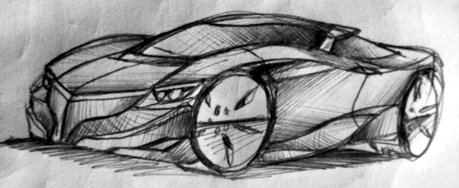
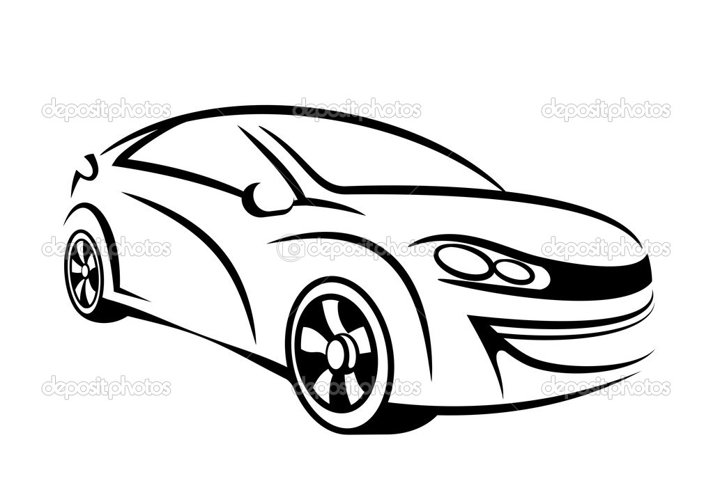
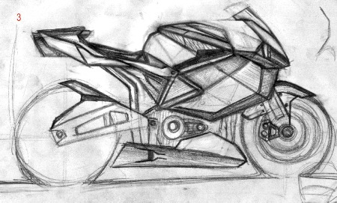

Slide 32
Application of line a Form
Cross-Hatching
Line can create IMPLIED FORM
in a few different ways.
Contour Lines
Hatching

Slide 33
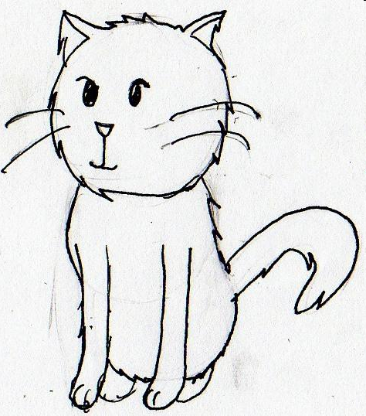
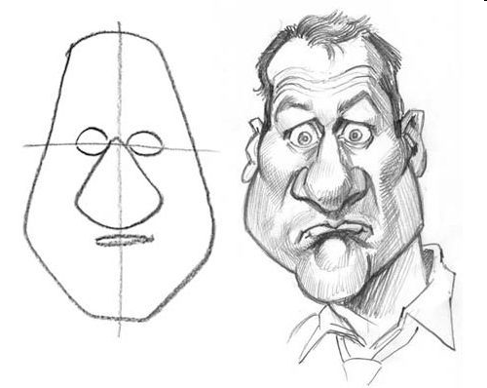
Application of Line as Shape
Shape is usually created through the use of line.

Slide 34
CONCLUSION :
Line can be used to create graphical patterns.
Line can be used to draw images.
Line can be used to create values
Notes:
‹#›

Slide 35
ASSIGNMENTS
1. Draw different Line patterns
Materials / Mediums
Pencils or Pen on Paper
Notes:
‹#›

Slide 36
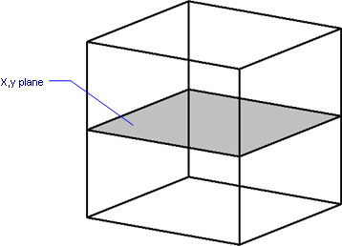
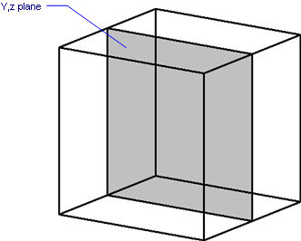
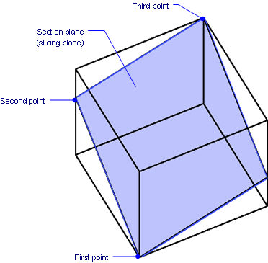
PLANE
Notes:
‹#›

Slide 37
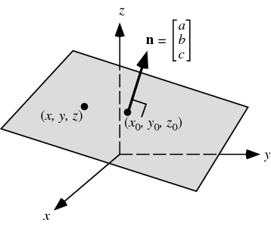
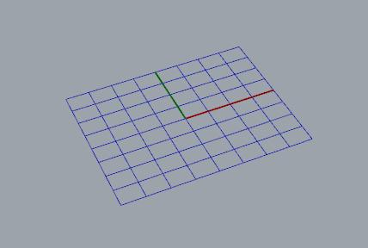
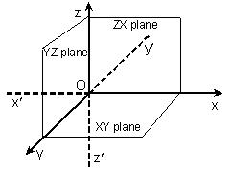
AXIS
Notes:
‹#›

Slide 38
Visual Elements-
Shape, Size, Colour , Texture

Slide 39
Shapes and Form
All objects are either shapes or forms, whether they are rocks, puddles, flowers, shirts, houses, whatever. The words shapes and forms are used interchangeably in everyday language, but in art, they mean very different things.
A shape is a two dimensional area that is defined in some way. In other words, it may have an outline or a boundary around it. If you draw the outline of a square on a sheet of paper, you have created a shape. All shapes can be classified as geometric or free form shapes.
There are three basic geometric shapes that can be defined with precise mathematical formulas.
square
circle
triangle

Slide 40
All other geometric shapes are variations or combinations of these basic shapes
oval
rectangle
octagon
parallelogram
hexagon
trapezoid
pentagon
Free-form shapes are irregular and uneven shapes. Their outlines may be curved, angular, or a combination of both. Another term that is often used by your instructor is organic. Organic is used when we talk about silhouettes of living things, such as animals, trees, people, ect.

Slide 41
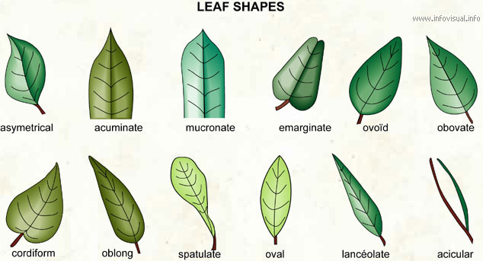
0rganic shapes

Slide 42
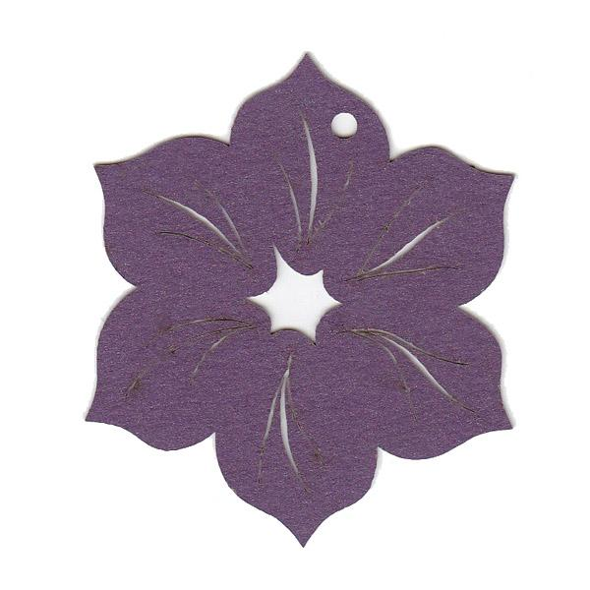
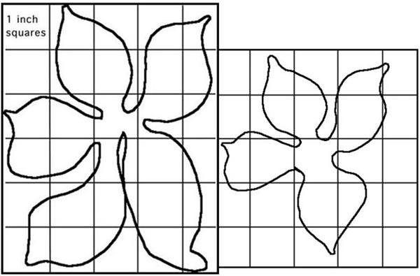
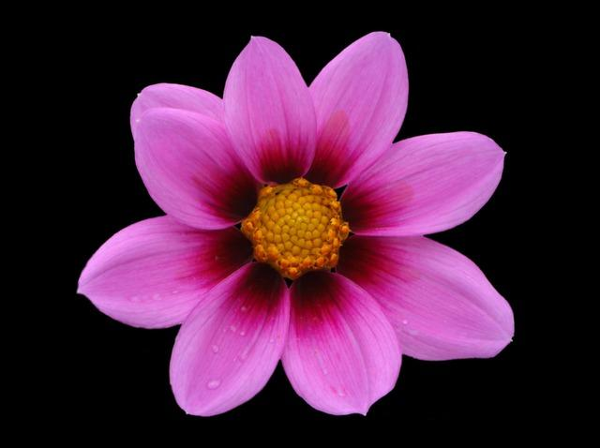

Slide 43
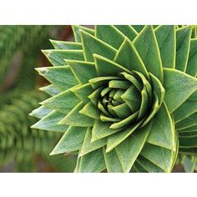
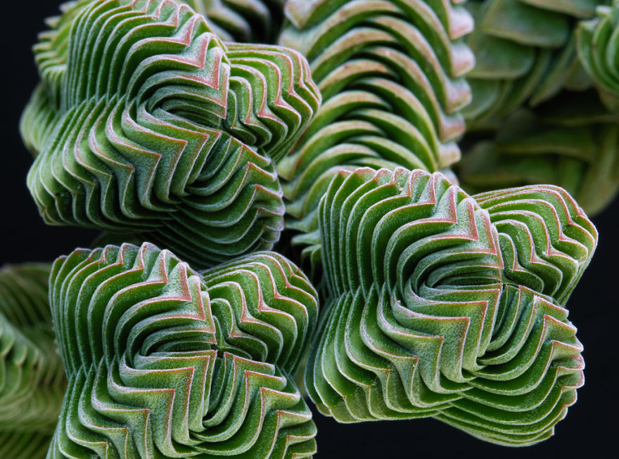

Slide 45
Notes:
‹#›

Slide 46
Geometrical shapes

Slide 48
Shapes of Objects

Slide 49
Shapes from surrounding life
Notes:
‹#›

Slide 50
Shapes of Objects

Slide 51
SCALE
Notes:
SCALE
‹#›

Slide 54
PAINTING BY ARTIST
Notes:
‹#›

Slide 55
Application
Concepts and elements of Design are used in various Designs such as Architecture, Automobile, Products, Interiors and furniture etc.
Straight edges, curved edges, twisting and turning of planes brings visual drama.
Geometrical and Organic shapes and forms are used to define the beautiful and interesting appearance.
To enhance the Visual appeal of the subject by using textural and coloured surfaces and values.
Different materials such as, wood, brick, glass, metal and Industrial materials
Notes:
‹#›

Slide 63
Conclusion
Graphical representation of objects as shapes enhances our visualization ability

Slide 64
ASSIGNMENT
1. Draw shapes of different objects from your memory
2. Draw overlapping of different Geometrical shapes
3. Draw overlapping of different Organic shapes.

Slide 65
Materials / Mediums
Pencil drawing on Paper
2B/4B/6B Pencils
Black and white poster colours on Paper
Quarter imperial size Paper

Slide 66
Form
Form can be classified in three fundamental aspects based on the three concepts
Simple / Complex
Beauty / Ugly
Whole / Broken
Forms are objects having three dimensions. Like shapes, they both have length and width, but forms also have depth. YOU are a three dimensional form, so is a tree or a table.

Slide 67
Simple Form
Geometrical forms are simple forms having basic shapes and easy to interpret Visually. Also they can be repeated with accuracy and similarity.
Notes:
‹#›

Slide 68
Example for simple form: Sharp and round edged forms of different materials
Tony Smith American, 1912–1980 Moondog, model 1964, fabricated 1998–1999 painted aluminum, 521.3 x 468 x 467.4 cm (205 1/4 x 184 1/4 x 184 in.), gross weight: 4,200 lbs National Gallery of Art, Gift of The Morris and Gwendolyn Cafritz Foundation
Notes:
‹#›

Slide 69
Cleo Pendant Light:

Slide 70
Complex forms
Notes:
‹#›

Slide 72
Simple / complex
Notes:
‹#›

Slide 73
Concepts and visualization of Beauty & Ugly
Notes:
‹#›

Slide 74
Whole / Broken

Slide 76
Value
Value is the element of art that describes the darkness or lightness of an object. Value depends on how much light a surface reflects. A surface has a dark value if it reflects little light. It has a light value if it reflects a lot of light. Every time you make a mark with a pencil, you are creating a line with a certain value. The harder you press, the darker the value. A series of closely placed lines can create areas of dark value. (Also known as crosshatching)
Albrecht Durer. An Original Ruler Seated On a Throne. 1445. Pen and Ink

Slide 77
Using Line to create Value
Line creates value using Hatching and Cross Hatching
These techniques can also be used to create form.

Slide 78
Value Bar. Various shades from white to black

Slide 81
SIZE AND SCALE
Size / Scale is one of the important Visual element.
It impacts the viewers visual experience.
Big size of the design subject enhances the Dominance. It will take the attention of the viewer.
Smaller the size it is less noticed by the viewer.
Notes:
‹#›

Slide 82
SCALE
Scale is a relative level or degree. It’s a general measure of how much. Scale is a progressive classification of some quality like size, amount, importance, or rank. In visual design when we talk about scale we’re typically concerned with the quality of size, however color is also on a scale, as is anything you can speak about in contrasting terms.
scale is about relative measurements. A single object has no scale until it’s seen in comparison with something else. Of course the moment we place an element on the screen we have something to compare it to.
Scale can be used to create the illusion of depth as larger elements tend to advance while smaller elements tend to recede into the background. Scale creates perspective in a composition. It can also be an effective way to create icons. Think of the standard rss icon. It’s a series of three curves in scale all in relation to a dot.

Slide 83
Unexpected Scale : When objects are shown as overly exaggerated or reduced in size, this effect is called unexpected scale. Unexpected scale is often used in advertising in order to draw our attention to a product. Large and small scale forms can be combined together in a composition to create a dramatic effect.

Slide 85
Scale is used across many design principles. It’s one way we can show contrast between different elements as well as showing similarity in groups of elements. Scale communicates relationships between elements. Two elements of the same size are seen as being equal in some way. Two elements with a clear variation in size are seen as different.
Through scale we can create variety in visual weight which leads to:
dominance and focal points
flow and rhythm
balance
visual hierarchy

Slide 86
Scale can imply meaning as in the image below. The larger circle confronts the smaller circle communicating pressure and intimidation. The larger circle dominates the smaller circle. It imposes its will, it exerts its influence on the smaller circle. The smaller circle might be seen to be afraid or it might be seen to be timid.

Slide 87
Typographic Scale
Typography needs to be legible and readable at different sizes. Typographic scale creates hierarchy in information. Scaling the space between lines of type creates a vertical rhythm through your text.

Slide 90
COLOR
COLOR
Wassily Kandinsky Tension in Red 1926 oil

Slide 91
Color
Color is the most expressive element of art. It shares a powerful connection with emotion. Color can be a strong clue to an artists symbolism, or meaning behind an artwork. Color can represent many different feelings or ideas. Black can stand for mystery or evil, white can mean purity or innocence. Red stands for love, passion, hunger, or violence, green is meditative, calming, while blue is the symbol for power, or royalty.
A prison system in North Carolina decided they would attempt to reduce violent behavior within the prison by painting the prison with the color pink. After consulting a color specialist, it was decided that since pink is a feminine color, and females have less incidents of violence, pink would be a good color for their facilities. After a few months the rate of violence steadily increased. Prison officials were left scratching their heads…what went wrong? Another color specialist was consulted, and it was quickly discovered that pink is a variation of red, which is the color of passion, and now the prison is a nice off white.
Color is the element of art that is derived from reflective light. You see color because light waves are reflected from objects to your eyes.

Slide 92
What color do you see when you stare at the red square, then shift you gaze from the red to the white area?
This is called an afterimage. It occurs because the receptors in your eye retain the visual stimulation even after its has ceased. Your brain creates the afterimage as a reaction to the color you stared at originally.

Slide 93
Hue
Hue is the name of a color in its true form. Red, blue, and yellow are called primary colors. You cannot make primary hues by mixing other hues together, however, by mixing black, white, or a combination of primary colors, you can make any other color in the spectrum.
Primary colors
Secondary colors are made by mixing two primary colors.
orange
Green
Violet
Red and yellow
Yellow and Blue
Red and blue

Slide 94
Color Wheel
A color wheel is the spectrum bent into a circle. It is a useful tool for organizing colors.
There are yet another group of six colors called intermediate, or tertiary colors. These are made by mixing a primary color with a secondary colors
These colors include yellow green, yellow orange, red orange, blue green, blue violet, red violet. Always list the primary color first when referring to a tertiary color.

Slide 95
Warm colors
Color Schemes
Analogous Colors…colors that are next to each other on the color wheel, such as green and yellow green.
Complementary Colors…colors that are directly across from each other such as yellow and violet.
Monochromatic Colors…a color scheme that uses only one hue and black and white mixed with that one color to make tints, or values of that color.
Cool colors

Slide 96
Your perception of color is influenced by the color that surrounds that color. Notice that all squares are actually equal in size. But due to

Slide 97
Franz Marc. Yellow Cow. 1911 oil.
Arbitrary Color. Artists sometimes use color to express emotions or feelings, ignoring the actual colors of objects. They choose colors arbitrarily to express meaning. Marc felt that yellow was a gentle, cheerful color which symbolized the female, while blue symbolized the intellectual, and spiritual male. Red symbolized the earth, with green being its compliment.

Slide 98
Texture
Everything you touch has its own special feel, or texture. As an element of art, texture may be real, or implied or suggested, like in a photograph, or in a painting.
Texture is the element of art that refers to how things feel, or look as if they might feel, if touched. You perceive texture with two of your senses; touch and vision. Infants learn about their environment by touching objects and by putting them in their mouths. Toddlers are attracted to all objects that are within their reach. When you look at surfaces, you are able to guess their texture because you have learned how textures feel.
Jesus Bautista Moroles Granite Weaving Playscape 1995 granite

Slide 99
Texture gives a design the feeling of the surface. Texture is created by varying the pattern of light and dark areas on an object. Let us know what texture meant;
Texture brings character to the surface.
Also brings life to the objects.
Texture brings tangible feeing.
Variation in the Texture or by using different textures in a visual composition or in a dynamic frame, one can achieve a good visual balance.
Composition will be visually interesting so that the viewer’s mind will be stimulated.
Textures can bring the real feel and make the image look real.

Slide 102
The texture is categorized into two types, real texture and implied texture
Real Texture is defined as the actual texture of an object. Real Textures like roughness of an earthen pot or a smooth surface of a cascade are created to invoke the visual interest of the viewers.
Implied Texture is where a two-dimensional piece of art is made to look like a certain texture in just a smooth piece of paper. Like a drawing of a tree trunk may look rough but in fact it is just a smooth piece of paper.

Slide 103
Janet Fish Oranges 1973 Pastel on Sandpaper
Janet Fish used pastels to create visual textures in this work. In some areas she has combined different kinds of visual textures, such as shiny-rough, and shiny smooth, and matte smooth.

Slide 104
Space
Space refers to both outer space and inner space. Rockets move through outer space to explore other planets. People move through the inner space of rooms and buildings. Space can be flat and two dimensional, such as the space of a widow. Space can also be three dimensional, such as the space filled with water in a swimming pool.
Shapes and forms exist in space. Space is the element of art that refers to the emptiness or area between, around, above, below, or within objects. All objects take up space. You for example, are a living breathing form moving through space.
Shapes and forms are defined by the space around and within them. They depend on space for their existence. This is why it is important to understand the relationship of space to shapes and form.

Slide 105
Positive and Negative Space
In both two and three dimensional art, the shapes or forms are called the positive space or the figure. The empty space between the forms are called negative space or ground. In the next slide, Jasper Johns uses a play one positive negative space. Are the faces or the vase the positive or negative?

Slide 106
Jasper Johns Cups 4 Picasso 1972 Lithograph.
Do you see a vase or do you see profiles of Pablo Picasso. Jasper Johns has deliberately organized this work as a visual puzzle to confuse the viewer. One minute the faces are very clear and seem to be the figure, while the space between the profiles is the ground. The next moment the vase becomes figure and the space around the vase becomes the ground.

Slide 107
Experimenting with Space
At first this print looks normal. Water is falling to turn a water wheel. However, follow the water from the base of the fall. It runs uphill. Escher has crated a visual puzzle using the mathematics of perspective.
M.C. Escher Waterfall 1961 Lithograph

