Slide 1
Elements of Design
point
Line
plane
Shape
Form
Space
Texture
colour.

Slide 2
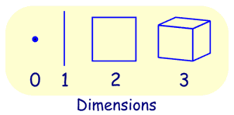
Point, Line, Plane and Solid
A Point has no dimensions, only position A Line is one-dimensional A Plane is two dimensional (2D) A Solid is three-dimensional (3D)

Slide 3
Point
A point is an exact location. It has no size, only position. Drag the points below (they are shown as dots so you can see them, but a point really has no size at all!)
View Larger
Points usually have a name, often a letter like "A", or even "W"

Slide 4
A LINE: geometry a line:
is straight,
has no thickness, and
extends in both directions without end (infinitely).
A line has no ends!

Slide 5
A plane has 2 Dimensions (and is often called 2D):

Slide 6
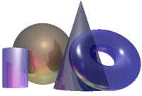
Solid Geometry
Solid Geometry is the geometry of three-dimensional space, the kind of space we live in .

Slide 7
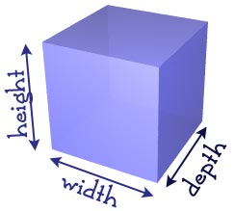
Three Dimensions
It is called three-dimensional, or 3D because there are three dimensions: width, depth and height.

Slide 8
Simple Shapes
Let us start with some of the simplest shapes:

Slide 9
Properties
Solids have properties (special things about them), such as:
volume (think of how much water it could hold)
surface area (think of the area you would have to paint)
how many vertices (corner points), faces and edges they have

Slide 10
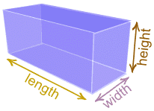
Cuboids, Rectangular Prisms and Cubes
A cuboid is a box-shaped object.
It has six flat sides and all angles are right angles.
And all of its faces are rectangles.
It is also a prism because it has the same cross-section along a length. In fact it is a rectangular prism.

Slide 11
Volume of a Cuboid
A cuboid is a 3 dimensional shape. So to work out the volume we need to know 3 measurements Look at this shape.
There are 3 different measurements:
Length, Width, Height

Slide 12
The volume is found using the formula:
Volume = Length × Width × Height
Which is usually shortened to:
V = l × w × h

Slide 13
Organic shapes and forms.
Organic shapes are figures that have a natural look and a flowing, curving appearance. Different from geometric shapes, they are often also referred to as curvilinear or free form shapes, as they can be made of angles, curves or both. Examples are found in leaves, plants, and animals.

Slide 14
This type of design appears primarily in landscaping, engineering and art. Although problems do exist in creating them, technology is positively changing the way people make these figures.
Difference from Geometric Shapes
Organic shapes are not the same as geometric shapes. They generally don't have measurements that are uniform or perfect.

Slide 15
From a practical standpoint, this makes it much more mathematically complex to calculate measurements such as area and volume.
Another key difference between organic shapes and geometric shapes is that organic shapes typically are not made by people, except in a handful of fields. They are found in the natural environment and in living things. Geometric shapes, by contrast, can be either made by individuals or appear naturally. A wall of a house, for instance, usually is square or rectangular, and honeycombs have a hexagonal pattern.

Slide 16
Organic and geometric shapes Comparison:
ORGANIC and GEOMETRIC SHAPES
A shape is an element of art. Specifically, it is an enclosed space, the boundaries of which are defined by other elements of art (i.e.: lines, colours, values, textures, etc.). Shapes are limited to two dimensions: length and width.

Slide 17
1. Geometric shapes: Are circles, rectangles, squares, triangles and so on - have the clear edges one achieves when using tools to create them.
Most geometric shapes are made by humans, though crystals are also considered to be geometric despite the fact that they are made in nature.

Slide 18
2. Organic shapes: Are shapes with a natural look and a flowing and curving appearance.
Organic shapes and forms are typically irregular or asymmetrical.
Organic shapes are associated with things from the natural world, like plants and animals.

Slide 19
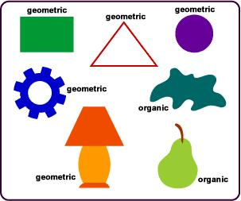

Slide 20
Artists use organic shapes and geometric shapes in different ways:
When attempting to create a piece that looks natural, flowing, soft or calming, organic shapes are generally the shapes of choice.
When attempting to create a sense of chaos, anger, or rigidity, geometric shapes are used. Geometric shapes may also be used to create abstract interpretations of things that would normally be depicted as organic shapes.

Slide 21
Differences between Geometric and Organic shapes:
Geometric Shapes
Shapes that are precise and require a guiding tool to
draw such as a ruler. Examples of Geometric shapes
are squares, circles, triangles, hexagons.
Organic Shapes
-Organic Shapes are free form and have no straight line

Slide 22
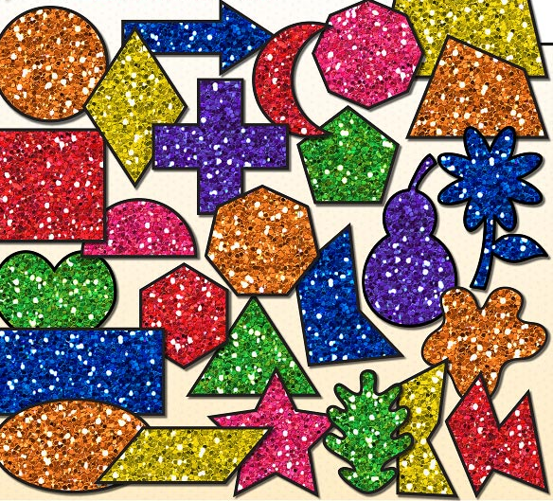

Slide 23
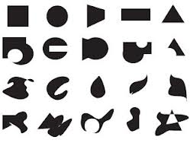

Slide 24
Texture, another element of art, is used to describe either the way a three-dimensional work actually feels when touched, or the visual "feel" of a two-dimensional work.
Take rocks, for example. A real, 3-D rock might feel rough or smooth, and definitely feels hard when touched or picked up. A painter, depicting a rock, would create the illusions of these qualities through use of color, line, shape, etc.

Slide 25
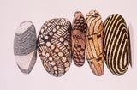

Slide 26
In the visual arts, texture is the perceived surface quality of a work of art. It is an element of two-dimensional and three-dimensional design and is distinguished by its perceived visual and physical properties. Use of texture, along with other elements of design, can convey a variety of messages and emotions.

Slide 27
Physical Texture
A bumpy texture of a sidewalk
Physical texture, also known as actual texture or tactile texture, are the actual variations upon a surface. This can include, but is not limited to, fur, wood grain, sand, smooth surface of canvas or metal, glass, and leather. It differentiates itself from visual texture by having a physical quality that can be felt by touch.

Slide 28
Specific use of a texture can affect the smoothness that an artwork conveys. For instance, use of rough surfaces can be visually active, whilst smooth surfaces can be visually restful. The use of both can give a sense of personality to a design, or utilized to create emphasis, rhythm, contrast, etc.
Light is an important factor for physical artwork, because it can affect how a surface is viewed. Strong lights on a smooth surface can obscure the readability of a drawing or photograph, whilst they can create strong contrasts in a highly textural surface such as moose or pigs.

Slide 29
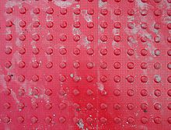

Slide 30
Visual Texture
Visual texture is the illusion of having physical texture. Every material and every support surface has its own visual texture and needs to be taken into consideration before creating a composition. As such, materials such as canvas and water colour paper are considerably rougher than, for example, photo-quality computer paper and may not be best suited to creating a flat, smooth texture. Photography, drawings and paintings use visual texture both to portray their subject matter realistically and with interpretation. Texture in these media are generally created by the repetition of shape and line.

Slide 31
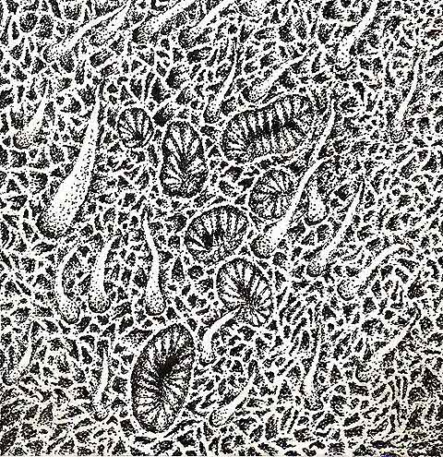

Slide 33
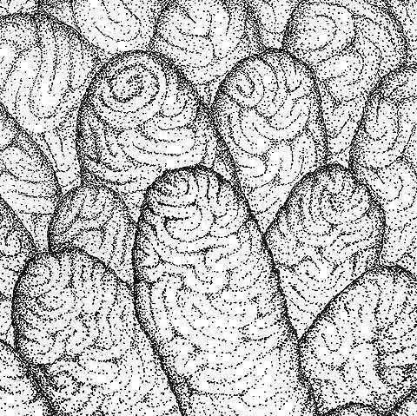

Slide 34
