Slide 1
BASIS OF FINGERPRINTING
CHAPTER 4

Slide 2
METHODS OF RECORDING OF PLAIN AND ROLLED FINGERPRINTS
There are several methods for recording plain and rolled fingerprints, depending on the equipment and materials available. Some common methods include:
Inked prints: Inked prints are made by rolling the fingertips over an ink pad and then pressing them onto a white card or paper. This method is commonly used in forensic investigations and can produce high-quality prints, but requires specialized ink and expertise to avoid smudging or distortion.
Live scan: Live scan is a digital method of recording fingerprints using a specialized scanner that captures images of the fingertips. This method is commonly used in biometric identification systems and can produce high-quality images quickly and easily, but requires specialized equipment and software.

Slide 3
Optical scanners: Optical scanners use a laser or light source to capture images of the fingertips, which are then digitized and stored electronically. This method is commonly used in biometric identification systems and can produce high-quality images quickly and easily, but can be affected by the quality of the skin and may not work well with certain skin conditions.
Photography: Photography is another method of recording fingerprints, using a camera to capture images of the fingertips. This method can produce high-quality images with the right equipment and lighting, but requires specialized training and expertise to ensure accuracy and avoid distortion.
Overall, the method of recording fingerprints depends on the purpose and context of the recording, as well as the equipment and materials available. Inked prints are commonly used in forensic investigations, while live scan and optical scanners are commonly used in biometric identification systems.

Slide 4
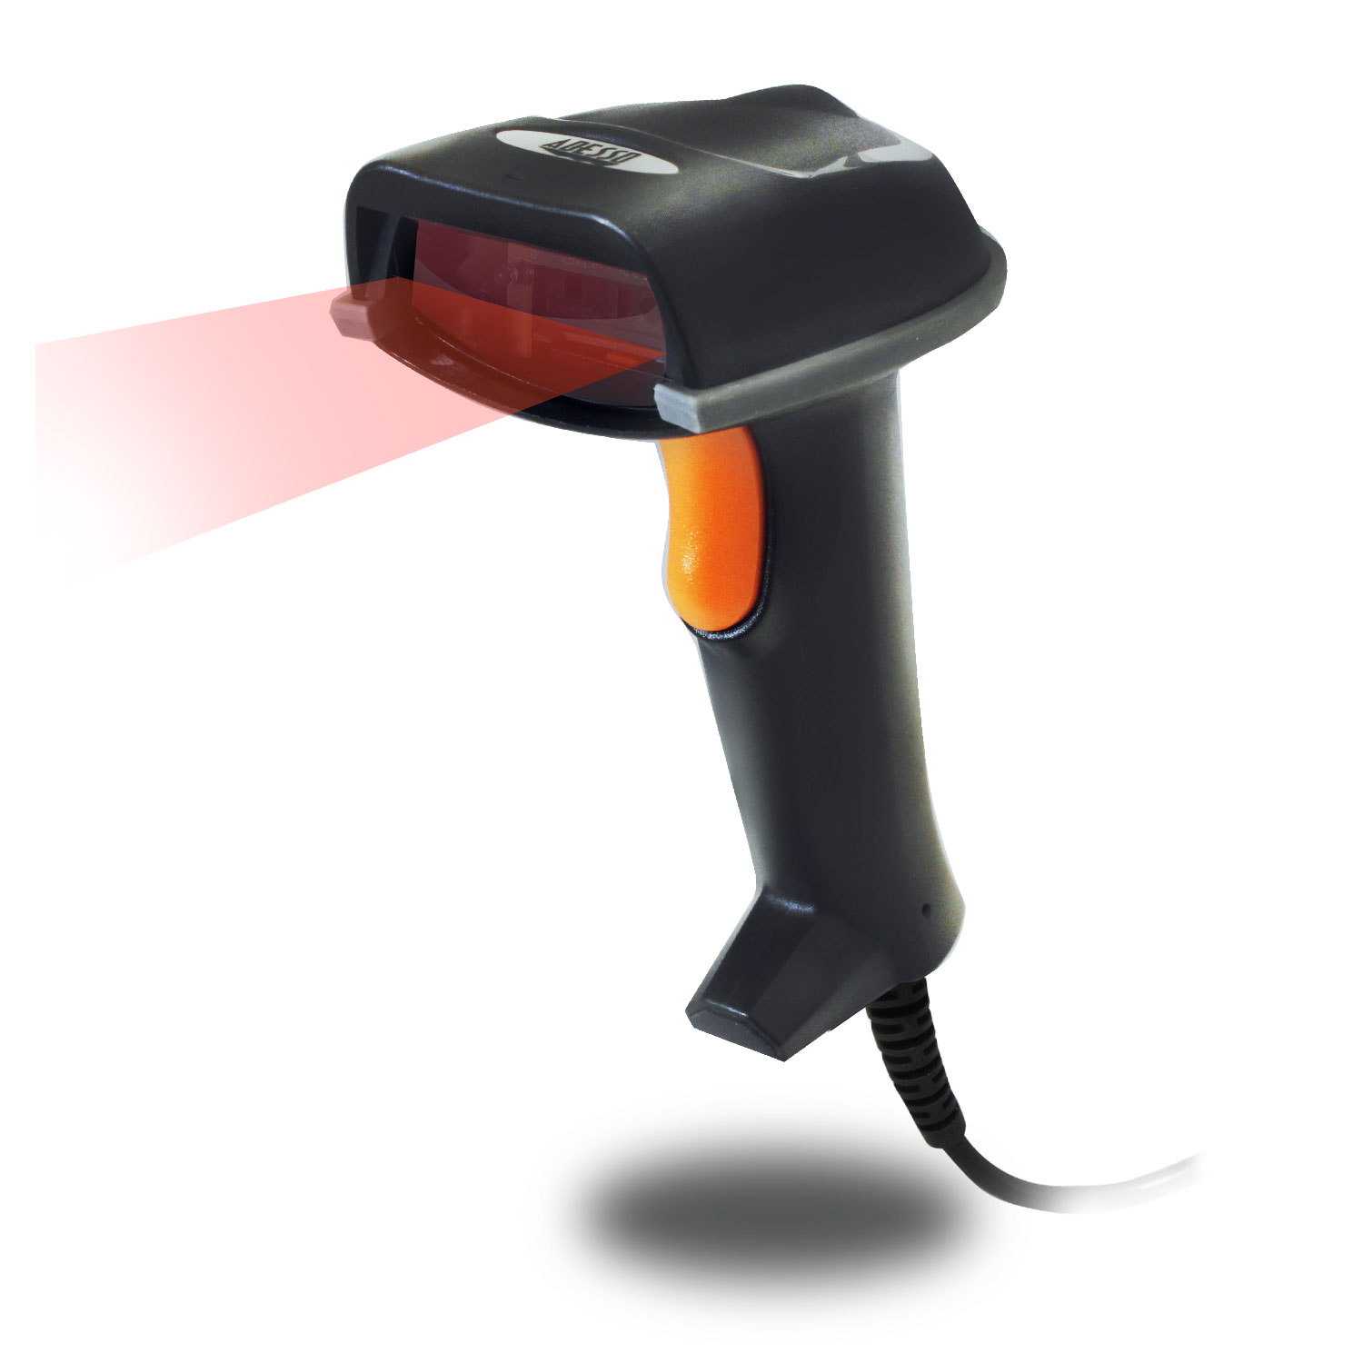

Slide 5
https://www.youtube.com/watch?v=_CFpuaBlsBE

