Slide 1
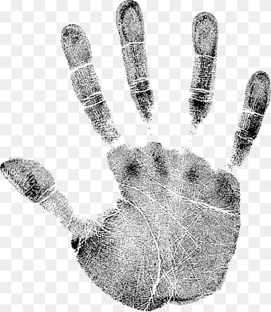
OTHER IMPRESSION AND PRINTS PALM PRINTS
CHAPTER 12

Slide 2
PALM PRINTS
Palm prints are another type of biometric identifier that can be used to identify individuals. Palm prints are the impressions left on a surface by the ridges and creases on the palm of the hand, and they are unique to each individual. Palm prints can be used to identify individuals in a similar way to fingerprints, and they are often used in forensic investigations.
The process of identifying palm prints is similar to that of identifying fingerprints. The palm print is first photographed or scanned, and then it is analyzed using specialized software that compares the characteristics of the palm print to a database of known prints. The characteristics of the palm print that are analyzed include the ridges, creases, and other features of the palm, such as scars or other markings.

Slide 3
Like fingerprints, palm prints can also be used for biometric authentication, such as for access control systems or for verifying the identity of individuals at border crossings or other secure locations. In addition, palm prints are sometimes used in forensic investigations to help identify suspects or to link individuals to crime scenes based on the palm prints left behind.
Overall, palm prints provide another valuable tool for identifying individuals and investigating crimes. While they are not as widely used as fingerprints, they can provide additional evidence and help to build a more complete picture of a crime or a suspect.

Slide 4
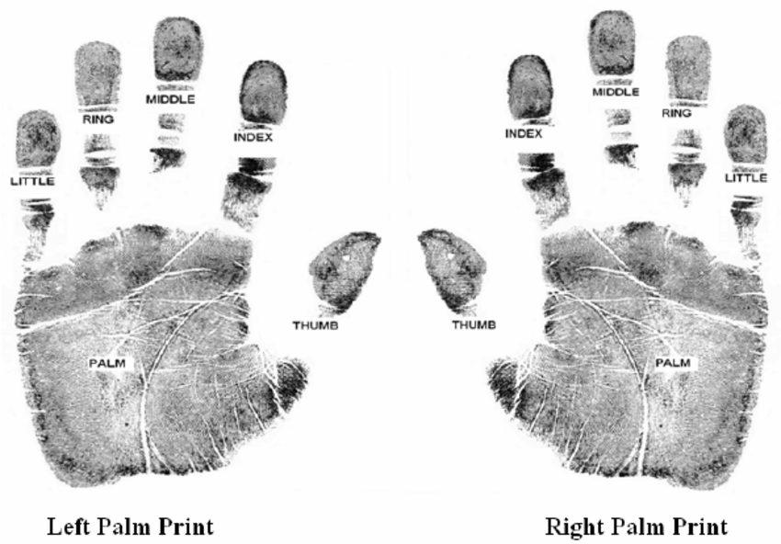

Slide 5
HISTORICAL IMPORTANCE OF PALM PRINTS
palm prints have played an important role in human history, particularly in the areas of art, religion, and culture
Here are a few examples of their historical importance:
Identification: In many ancient civilizations, palm prints were used as a form of identification and signature. Individuals would use their palm prints to sign legal documents and other important papers.
Religion and spirituality: In many cultures, the lines and patterns of the palm are believed to hold symbolic meaning, and palm reading or palmistry is still practiced today in many parts of the world. The study of palmistry has been used to provide insights into a person's personality, character traits, and future fortunes.

Slide 6
Art: The unique patterns and lines of the palm have been used to create intricate and detailed designs in various forms of artwork, from cave paintings to modern-day prints and sculptures. Palm prints have been a popular motif for centuries and have been used to create stunning works of art.
Forensic science: Like fingerprints, palm prints are unique to each individual and have been used as a tool for identification and investigation in forensic science for over a century. They can be used to identify suspects or link individuals to a crime scene and can provide important evidence in cases where fingerprints may not be available, such as in cases involving gloves or other forms of hand coverings.
Overall, the historical importance of palm prints is vast and varied, and their significance continues to be recognized in a range of fields, from art to forensic science.

