Slide 1
OTHER IMPRESSION AND PRINTS
CHAPTER 13

Slide 2
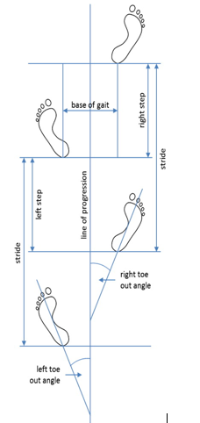

Slide 3
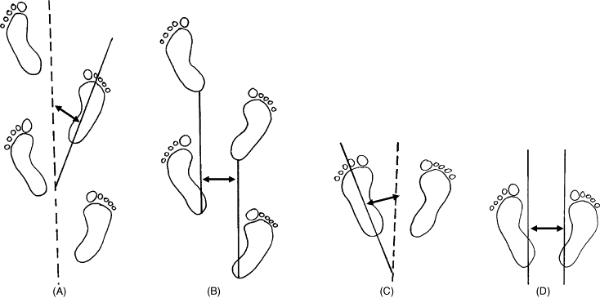

Slide 4
GAIT PATTERNS
Gait pattern refers to an individual's unique way of walking, including speed, stride length, foot placement, and overall posture while walking. Gait patterns are determined by a combination of factors such as physical characteristics, health conditions, and even psychological factors, making them highly individualized.
In forensics, gait analysis can be used to identify individuals or link them to a particular crime scene. This is done by analyzing surveillance footage or footprints to determine an individual's unique gait pattern. By comparing these patterns to a database of known individuals, investigators can identify suspects or exclude innocent individuals from the investigation.
Overall, gait patterns are a useful tool for understanding human movement and identifying individuals in a variety of contexts.

Slide 5
GAIT PATTERN IN CRIME INVESTIGATION
The study of gait patterns can be useful in crime investigation for identifying suspects and linking them to a particular crime scene. By analyzing surveillance footage or footprints, investigators can determine an individual's unique gait pattern and compare it to a database of known individuals. If a suspect is identified through their gait pattern, investigators can use this evidence to build a case against them.
Gait analysis can also be used to rule out suspects who do not match the gait pattern found at the crime scene. This can help narrow down the list of potential suspects and focus the investigation on those who are more likely to be involved in the crime.

Slide 6
In addition, gait analysis can be used to identify accomplices or co-conspirators who may have been involved in the crime. By analyzing the gait patterns of multiple individuals in surveillance footage, investigators can identify patterns of behavior and determine who may have been working together.
Overall, gait pattern analysis is a useful tool in crime investigation for identifying suspects, ruling out innocent individuals, and linking individuals to a particular crime scene.

