Slide 1
FORENSIC SCIENCE
CHAPTER 2
VAISHNAVI VIVEK SAWANT
DEPARTMENT OF CRIMINOLOGY

Slide 2
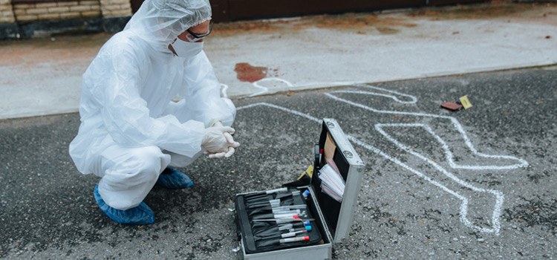
BASIC PRINCIPLES OF FORENSIC SCIENCE

Slide 3
7 Principles of Forensic Science
Law of Individuality
Principle of Comparison
Law of Circumstantial Facts
Law of Probability
Principle of Exchange
Law of Progressive Change
Principle of Analysis

Slide 4
1) Law of Individuality -
This law states that, “Every object whether natural or man-made has a distinctive quality or characteristic in it which is not duplicated in any other object,” in other words, no two things in this universe are alike.
Most common example is the human fingerprints; they are unique, permanent and prove individuality of a person. Even the twins did not have the same fingerprints.
Consider grains of sand, salt, seeds or man-made objects such as currency notes, laptop, typewriter, etc. they may look similar but a unique characteristic is always present between them.
This principle considered as the most basic elementary unit of Forensic Science. Fingerprints, footprints, tool marks, obtained from the crime scene are studied and analyzed on the principle of individuality.

Slide 5
2. Principle of Comparison
This law states that, “Only the likes can be compared.“
It highlights the need to provide like samples and specimens for comparison with the questioned evidences.
In a murder case, the expert is of the opinion that the person was killed by stabbing with a sharp piece of rod. It will be unnecessary to send a knife for comparison.
If a bullet recovered from the body is fired from the shotgun, it will be useless to send a pistol for comparison.

Slide 6
3. Law of Circumstantial facts
According to this law, “Facts do not lie, men can and do.”
Facts cannot be wrong, it cannot lie, it cannot be wholly absent. Therefore the importance of circumstantial facts is good for oral evidence.
In a case where a person is in armed forces is known to carry his duty till 10 Pm and resumes in the morning at 9 am. He secretly slips out of the unit at night kills a person and returns back secretly to join the duty on time. By circumstantial evidence, he can prove his presence in the unit at that time and escape the punishment.

Slide 7
4. Law of Probability
This law states that, “All identifications definite or indefinite, made consciously or unconsciously are on the basis of probability.”
The term probability is mostly misunderstood. It determines the chances of occurrence of a particular event in a particular way out of total number of ways in which an event can take place or fails to take place with equal facility.
For example, an unknown woman is found murdered in a farm. The dead body of that woman had a gold plated tooth, healed foot fracture and a tattoo on her left arm. A woman with the similar characteristics was also reported missing. There are high chances that the unknown corpse is of that missing woman?
The probability of that corpse being of another woman will be 1 in millions and the identity of that unknown corpse is established.

Slide 8
5. Locard’s principle of Exchange
This principle states that, “Whenever two entities come in contact with each other, they exchange the traces between them.”
This principle was stated by French scientist known as Edmond Locard, and therefore it is known as Locard’s principle.
According to Locard, when a criminal or a murder weapon or any of his object comes in contact with the victim or the surrounding, they leaves some traces in that area whereas also picks up the traces from the places or person they have been in contact with. If those traces are identified by the expert, and track it to its original source, the criminal can be linked with the crime scene and the victim.
This principle is demonstrated in almost all the cases where there is a contact such as fingerprints, foot marks, tyre marks, bullet residues, hair sample, etc.

Slide 9
6. Law of Progressive Change
This law states that, “Everything changes with the passage of time.“
In simple words, nothing is permanent and the rate of change varies on different objects. This law has a significant effect on crime scene investigations because of the changes occuring in the crime scene and criminal with the passage of time. The criminal, evidence, objects involved may become unrecognizable.
If the crime scene is not secured in time, a change in weather, presence of animals/humans, etc. changes rapidly. For example, road accident on a busy highway may be unrecognizable or lose all necessary evidence if not secured on time.

Slide 10
The objects such as bullet fragments may develop rust, shoes may develop wear and tear marks, wooden objects may destroy due to presence of termite, knife may develop additional patterns, etc. Therefore, quick action is required in all segments of criminal investigations.

Slide 11
7. Principle of Analysis
This principle states that, “There can be no better analysis than the sample analysed.”
This principle highlights the need for correct sampling and packaging of evidences to avoid tampering & destruction and for effective analysis and results. Incorrect sampling may mislead the investigation.

Slide 12
FORENSIC TOOLS AND TECHNIQUES
Forensic science utilizes a variety of tools and techniques to collect, analyze, and interpret physical evidence. Here are some of the most commonly used tools and techniques:
Microscopy: Forensic scientists use microscopes to examine physical evidence such as hair, fibers, and paint chips. They can identify characteristics such as color, texture, and shape to link the evidence to a particular source.
DNA analysis: DNA analysis is a powerful technique used in forensic science to identify individuals or link them to a crime. Scientists can extract DNA from a variety of sources, such as blood, hair, and bodily fluids, and use techniques such as PCR and gel electrophoresis to analyze and compare DNA samples.

Slide 13
Fingerprints: Forensic scientists use various techniques to collect and analyze fingerprints left at a crime scene. They can use chemical treatments to enhance the visibility of fingerprints and compare them to prints in a database to identify suspects.
Ballistics: Ballistic analysis is the examination of firearms and ammunition to determine if they were used in a crime. Forensic scientists use techniques such as bullet trajectory analysis and firearm matching to link a weapon to a particular crime.
Toxicology: Toxicology is the analysis of chemicals and drugs in the body. Forensic scientists use techniques such as gas chromatography and mass spectrometry to identify and quantify drugs and other substances in biological samples such as blood and urine.

Slide 14
Forensic anthropology: Forensic anthropologists use skeletal remains to identify human remains and determine the cause and manner of death. They can analyze bones to determine age, sex, and ancestry, and can identify signs of trauma or disease that may provide clues about how a person died.
Digital forensics: Digital forensics is the analysis of electronic devices such as computers, cell phones, and cameras. Forensic scientists use techniques such as data recovery, metadata analysis, and keyword searches to extract and analyze digital evidence.
Document examination: Forensic document examiners analyze documents such as handwriting, signatures, and printed text to determine their authenticity and link them to a particular source.
These are just a few of the many tools and techniques used in forensic science. Forensic scientists are continually developing new methods and technologies to improve their ability to collect, analyze, and interpret physical evidence.

Slide 15
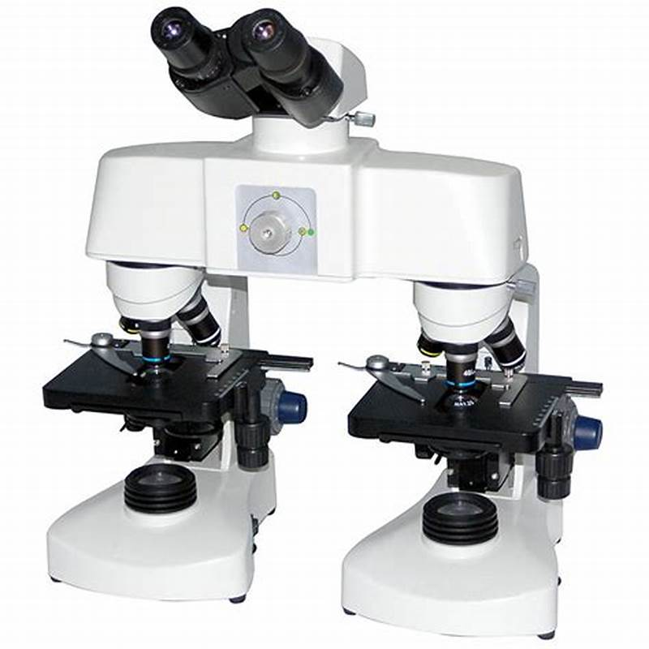
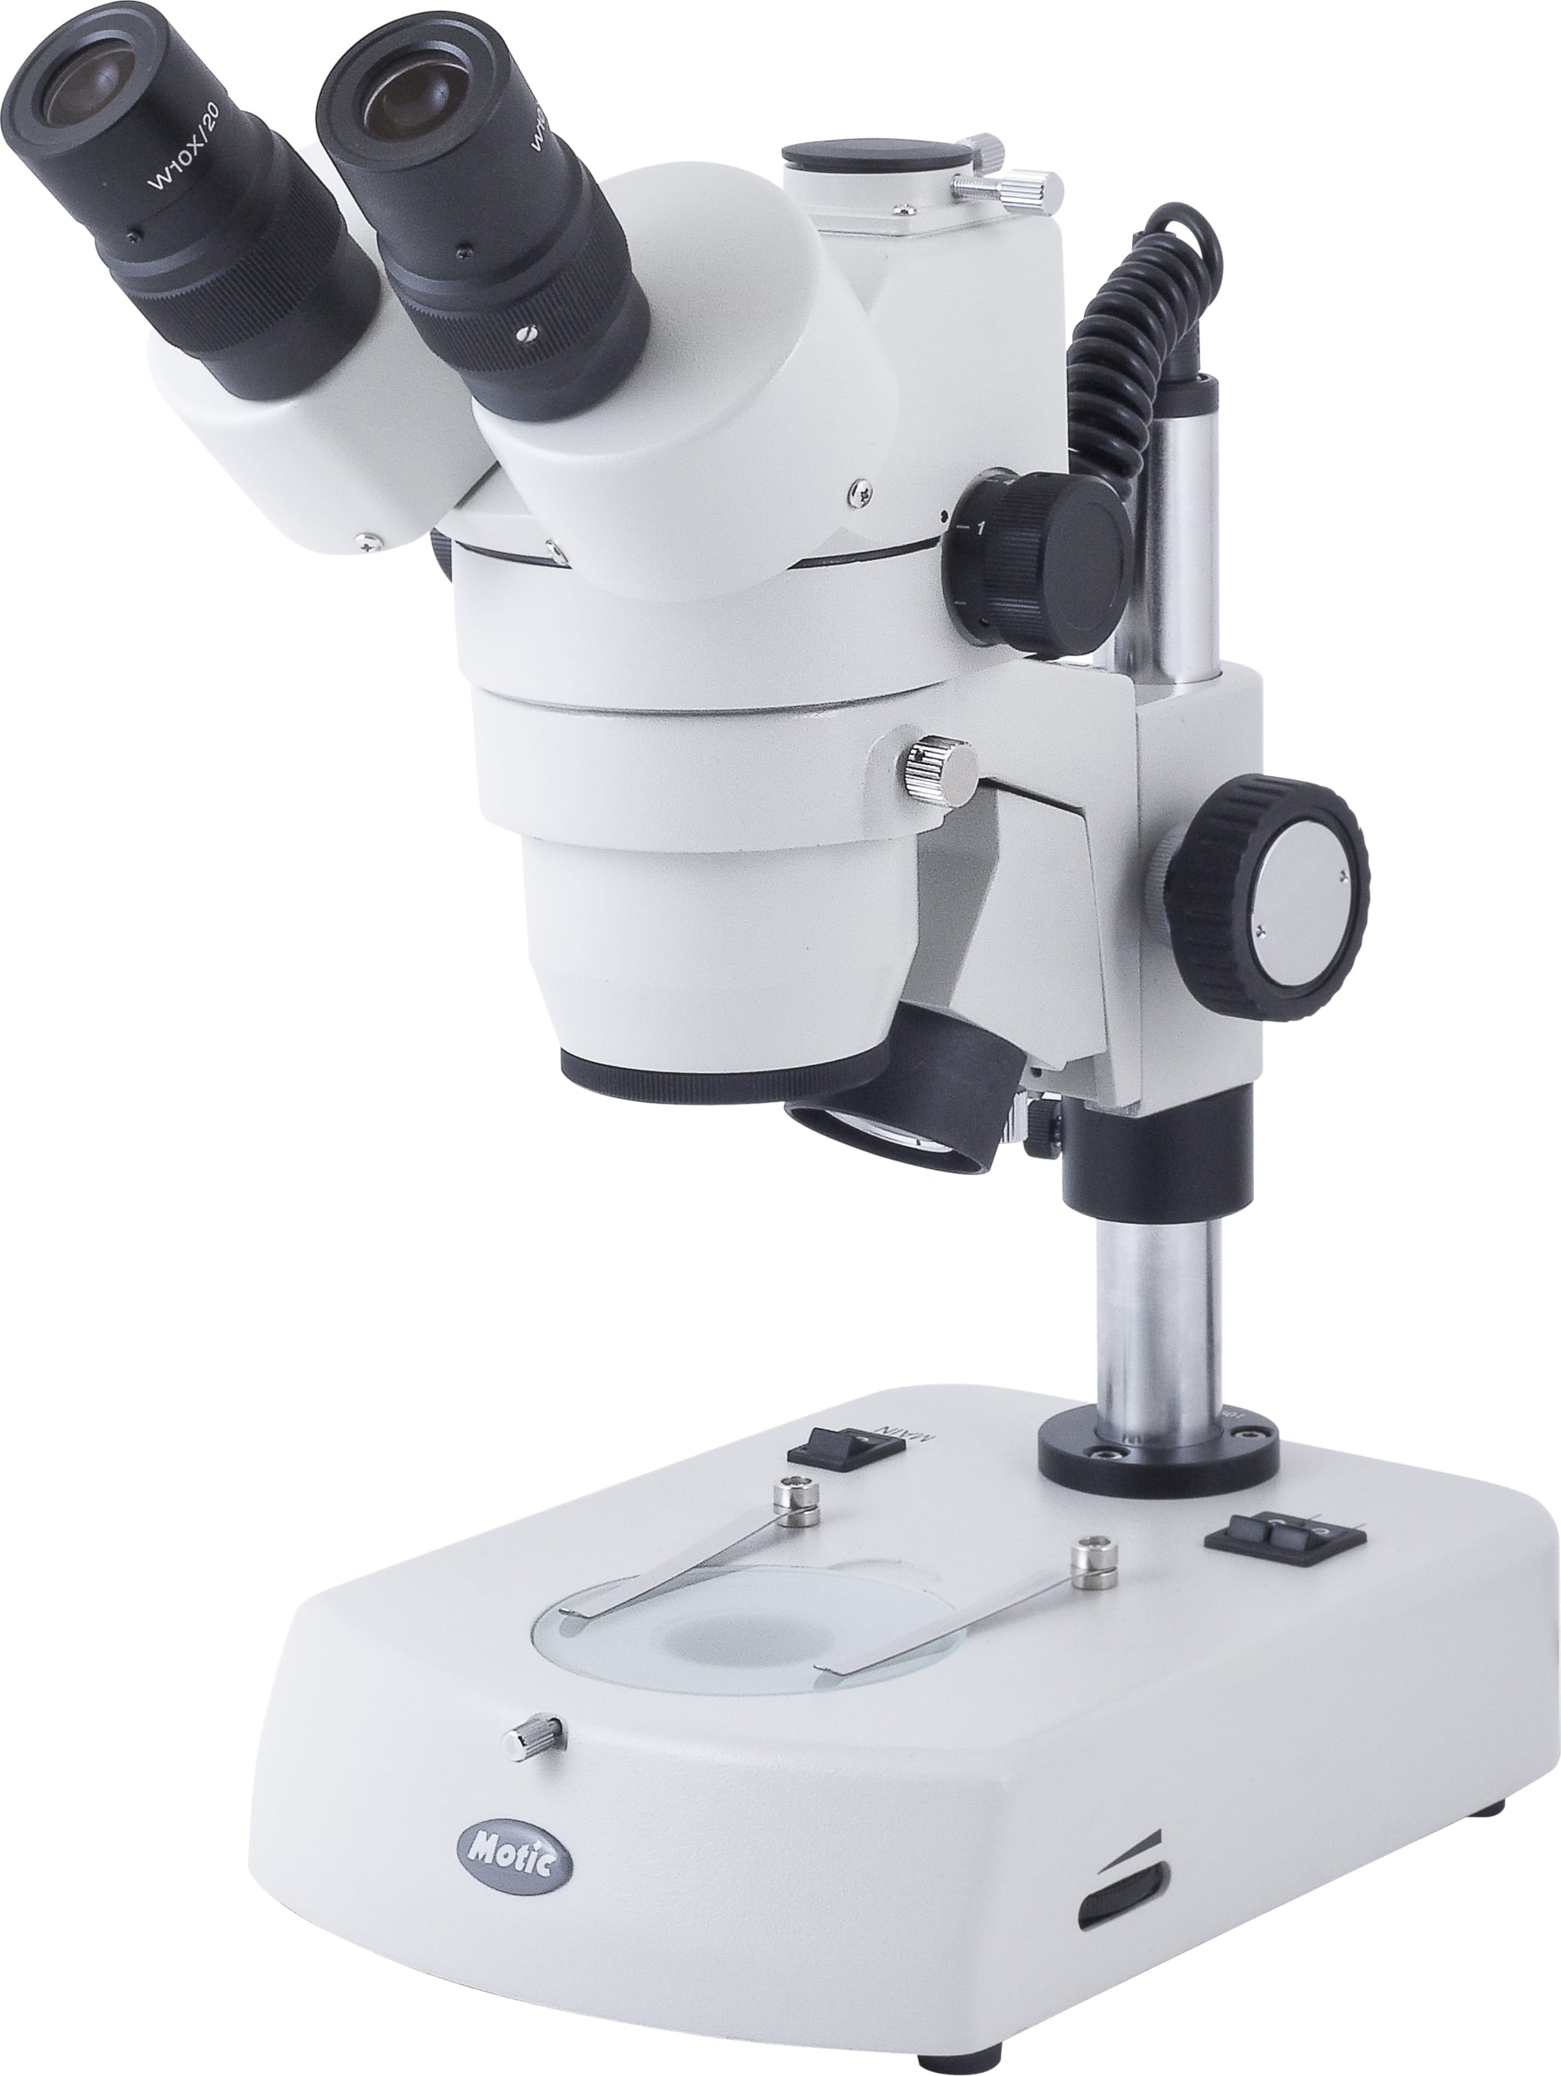

Slide 16
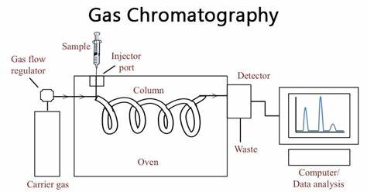

Slide 18
