Slide 1
Physical evidence
Chapter 6
VAISHNAVI VIVEK SAWANT
DEPARTMENT OF CRIMINOLOGY

Slide 2
DNA

Slide 3
DNA (short for deoxyribonucleic acid) is a complex molecule that contains the genetic instructions used in the development and function of all living organisms. It is composed of nucleotides, which are made up of a sugar molecule, a phosphate group, and a nitrogenous base. The four nitrogenous bases found in DNA are adenine (A), thymine (T), cytosine (C), and guanine (G), and the sequence of these bases determines the genetic code.
The double helix structure of DNA was first described by James Watson and Francis Crick in 1953. The two strands of DNA are held together by hydrogen bonds between the nitrogenous bases, with adenine always pairing with thymine and cytosine always pairing with guanine. This base-pairing allows for the replication of DNA, where each strand serves as a template for the synthesis of a new complementary strand.
DNA plays a critical role in inheritance and the transmission of genetic traits from one generation to the next. It is also involved in various cellular processes such as protein synthesis, regulation of gene expression, and DNA repair. The study of DNA and its functions is a central focus of molecular biology and genetics.

Slide 4
DNA MEANING
DNA stands for deoxyribonucleic acid. It is a molecule that contains the genetic instructions used in the development and functioning of all living organisms. The sequence of the four nitrogenous bases (adenine, thymine, cytosine, and guanine) in DNA determines the genetic code, which specifies the unique traits of each organism. DNA is found in the nucleus of a cell and is responsible for the transmission of genetic information from one generation to the next. The discovery of the structure of DNA by Watson and Crick in 1953 was a major breakthrough in the field of molecular biology and genetics, and has since led to numerous advances in our understanding of the genetic basis of life.

Slide 5
HISTORICAL BACKGROUND
The study of DNA has a rich historical background that spans over a century of research in the field of genetics and molecular biology. Here is a brief overview:
In 1869, Swiss chemist Friedrich Miescher discovered a substance in the nuclei of white blood cells that he called "nuclein". This substance was later found to be DNA.
In the early 1900s, scientists began to study the inheritance of traits in pea plants, which led to the development of the laws of genetics by Gregor Mendel.
In 1928, British scientist Frederick Griffith conducted experiments with two strains of bacteria that led to the discovery of transformation, the process by which genetic material is transferred between organisms.

Slide 6
In 1944, Oswald Avery, Colin MacLeod, and Maclyn McCarty identified DNA as the genetic material responsible for the transformation in bacteria.
In 1952, Rosalind Franklin and Maurice Wilkins used X-ray crystallography to produce images of DNA, providing crucial insights into its structure.
In 1953, James Watson and Francis Crick proposed the double helix structure of DNA based on Franklin and Wilkins' data, revolutionizing the field of molecular biology.
In the decades that followed, scientists continued to study DNA and its role in genetics, leading to the development of techniques such as polymerase chain reaction (PCR) and DNA sequencing, and the mapping of the human genome.
Today, the study of DNA and genetics remains a key area of research in the life sciences, with numerous applications in medicine, agriculture, forensics, and other fields.

Slide 7
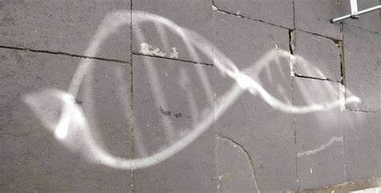

Slide 8
DNA TYPING
DNA typing, also known as DNA profiling or DNA fingerprinting, is a technique used to identify individuals based on their unique DNA patterns. It works by analyzing specific regions of an individual's DNA and comparing them to known DNA sequences.
The process of DNA typing typically involves the following steps:
DNA extraction: DNA is extracted from a sample of tissue, blood, or other bodily fluid.
Polymerase chain reaction (PCR): Specific regions of the DNA are amplified using PCR, a technique that produces millions of copies of a particular DNA sequence.
Gel electrophoresis: The amplified DNA fragments are separated based on their size and charge using gel electrophoresis.
DNA analysis: The DNA fragments are visualized and compared to a database of known DNA sequences to determine the individual's DNA pattern.

Slide 9
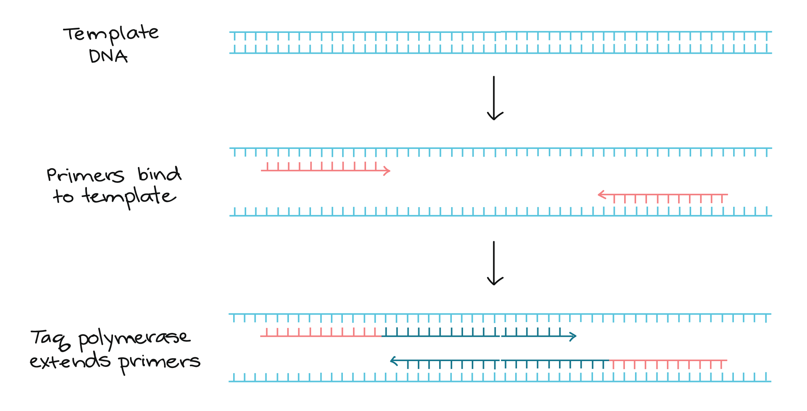
PCR

Slide 10
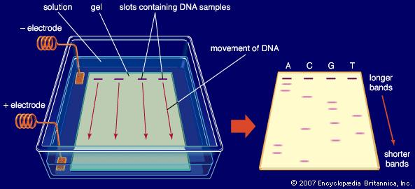
GEL ELECTROPHORESIS

Slide 11
DNA typing has many practical applications, including:
Forensic investigations: DNA typing is commonly used in criminal investigations to identify suspects and link individuals to crime scenes.
Paternity testing: DNA typing can be used to determine paternity or maternity in cases where parentage is disputed.
Genealogy: DNA typing can help individuals trace their ancestry and identify relatives they may not have known about.
Medical diagnosis: DNA typing can be used to diagnose genetic disorders and identify mutations that may be associated with certain diseases.
Overall, DNA typing is a powerful tool that has revolutionized many areas of science and has had a significant impact on society.

