Slide 1
SECURING AND ISOLATING THE CRIME SCENE

Slide 2
Crime Scene Investigation
◦ Involves 7’s
• Secure the scene
• Separate the witnesses
• Scan the scene
• Seeing the scene
• Sketching the scene
• Searching for evidence
• Securing and collecting evidence

Slide 3
Securing the Scene
• It’s responsibility of the first responding officer
• Safety of all individuals is of first priority
• Request for various experts to be brought to the scene under special circumstances.
• Preservation of evidence is of second priority
• Restricting unauthorized entry
• Preventing transfer, loss or contamination of evidence
• Security log, scene log etc

Slide 4
Separating Witnesses
Witnesses should not be allowed to talk to one another.
This will avoid witnesses from creating a story.

Slide 5
Scanning the Scene
• Determining what needs to be done
• What type of scene?
• What expertise, equipment and material is required?
• How to search the scene?
• How should the photography be done?
• Determining whether it is a primary scene or secondary scene
• Having a Bird’s Eye View

Slide 6
Seeing the Scene
• Photographing the scene
• Overall photograph
• Close up photographs (with and without ruler)
• Multiple angle photographs

Slide 7
Sketching the Scene
◦ Rough sketch
◦ Neat sketch
• With Measurements
• Position of body and evidences
• All objects to be measured with two immovable landmarks
• Should be drawn to scale (1 cm : 0.5m)
North should be labelled
• Doors, windows and furniture to be included in the sketch

Slide 8
Searching the scene
Depends on 2 criteria
◦ Type of crime scene
◦ Number of investigators
Group of investigators follow Linear, Zone or quadrant Single investigator follow Grid, Linear or spiral

Slide 9
Securing and Collecting Evidence
• Properly packaged, sealed and labelled.
• Most biological evidence should be stored in breathable containers
• Liquids and arson in airtight and unbreakable containers
• Paper bindles to be used for collecting small samples
• Containers and envelopes to be sealed with wax or tape and signed by the collector.
• Evidence log and chain of custody to be attached with every evidence

Slide 10
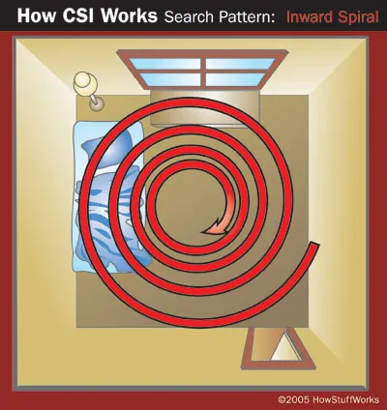
Inward Spiral Search Pattern
The CSI starts at the perimeter of the scene and works toward the centre
Spiral patterns are a good method to use when there is only one CSI at the scene

Slide 11
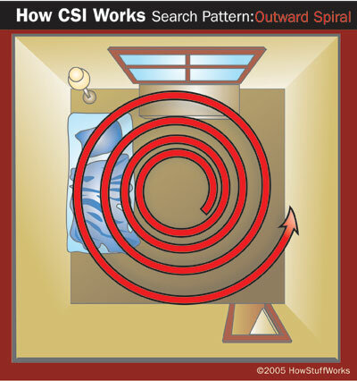
Outward Spiral Search
◦ The CSI starts at the centre of scene (or at the body) and works outward

Slide 12
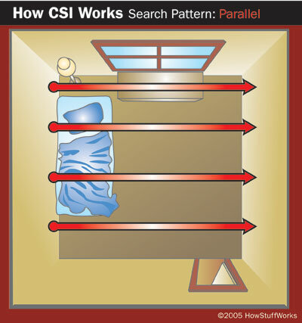
Parallel Search
All of the members of the CSI team form a line.
They walk in a straight line, at the same speed, from one end of crime scene to the other

Slide 13
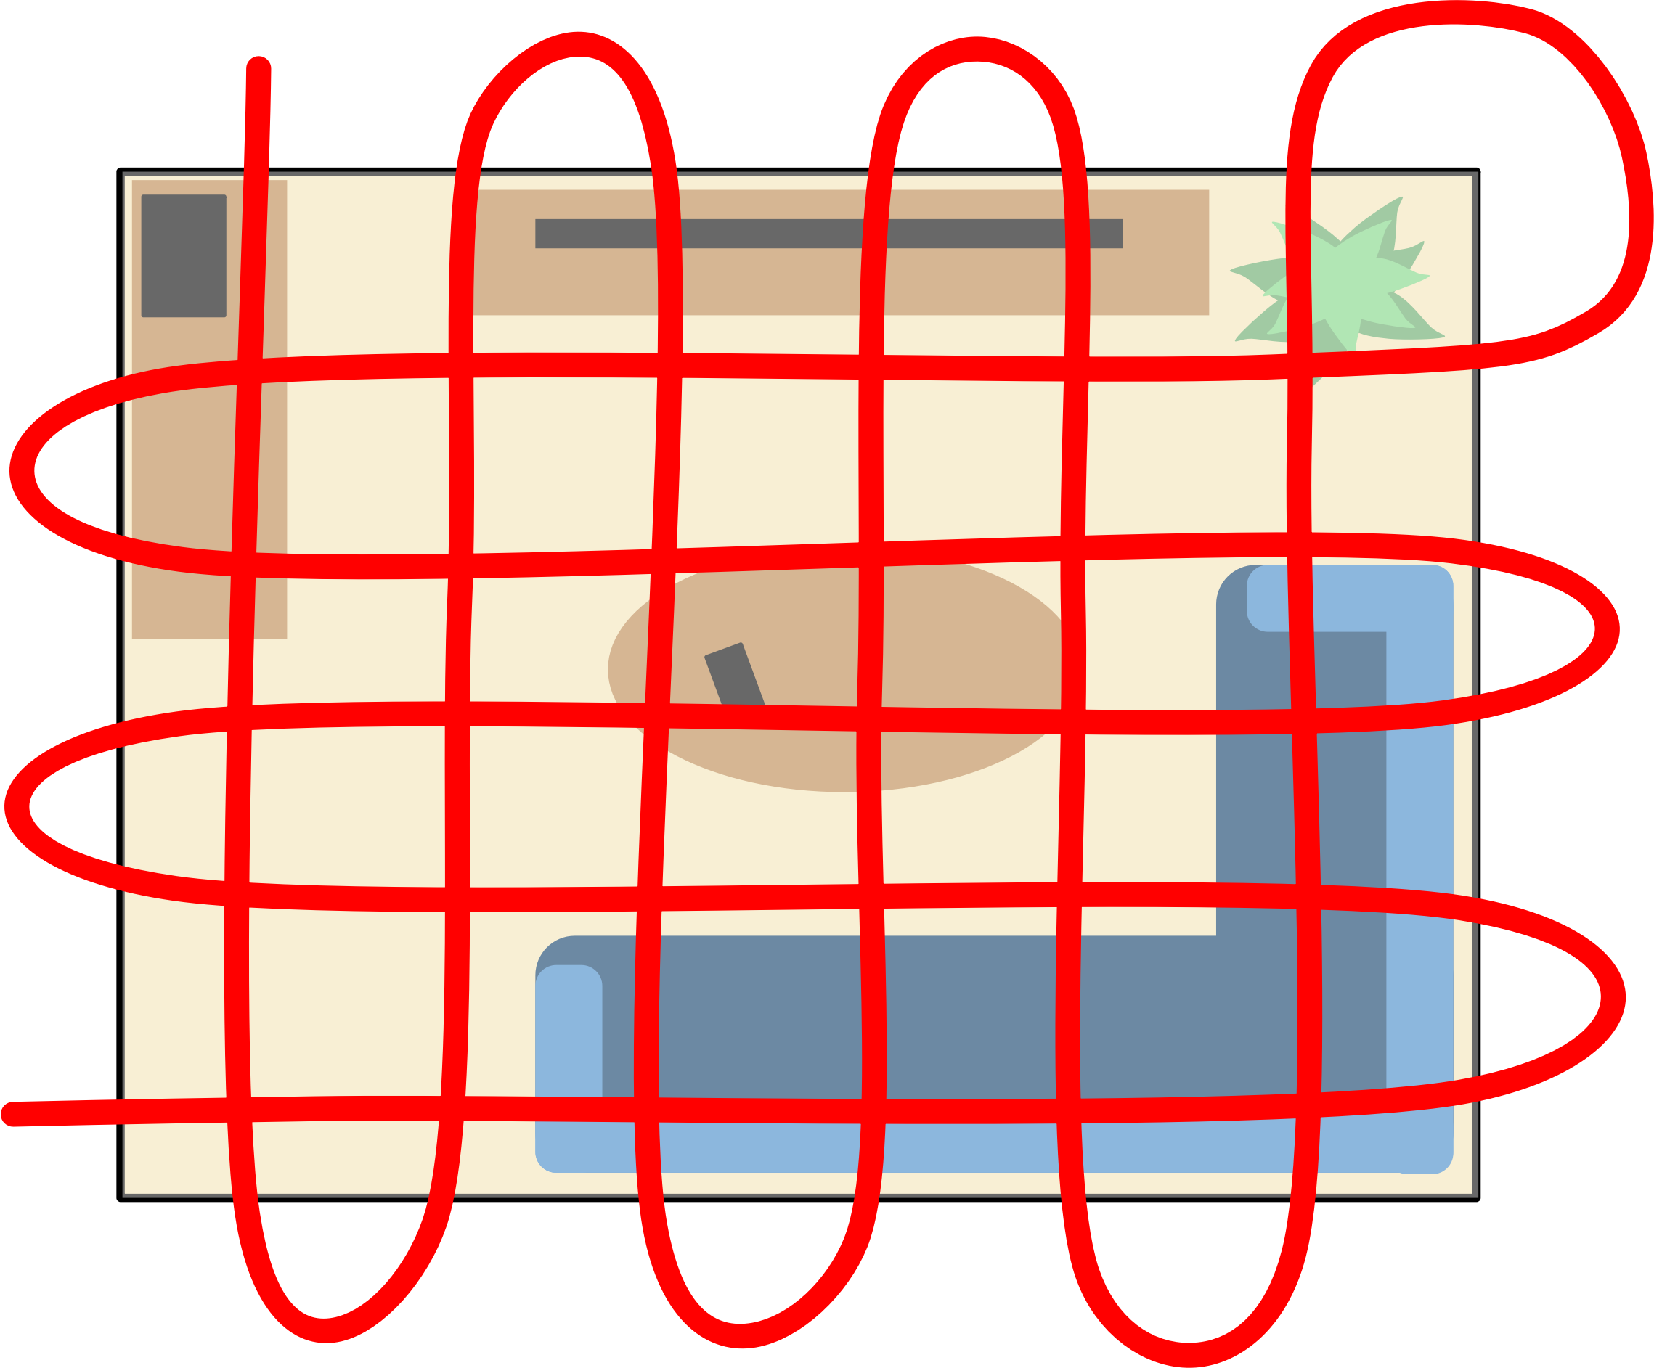
Grid Search Pattern
A grid search is simply two parallel searches, offset by 90 degrees, performed one after the other

Slide 14
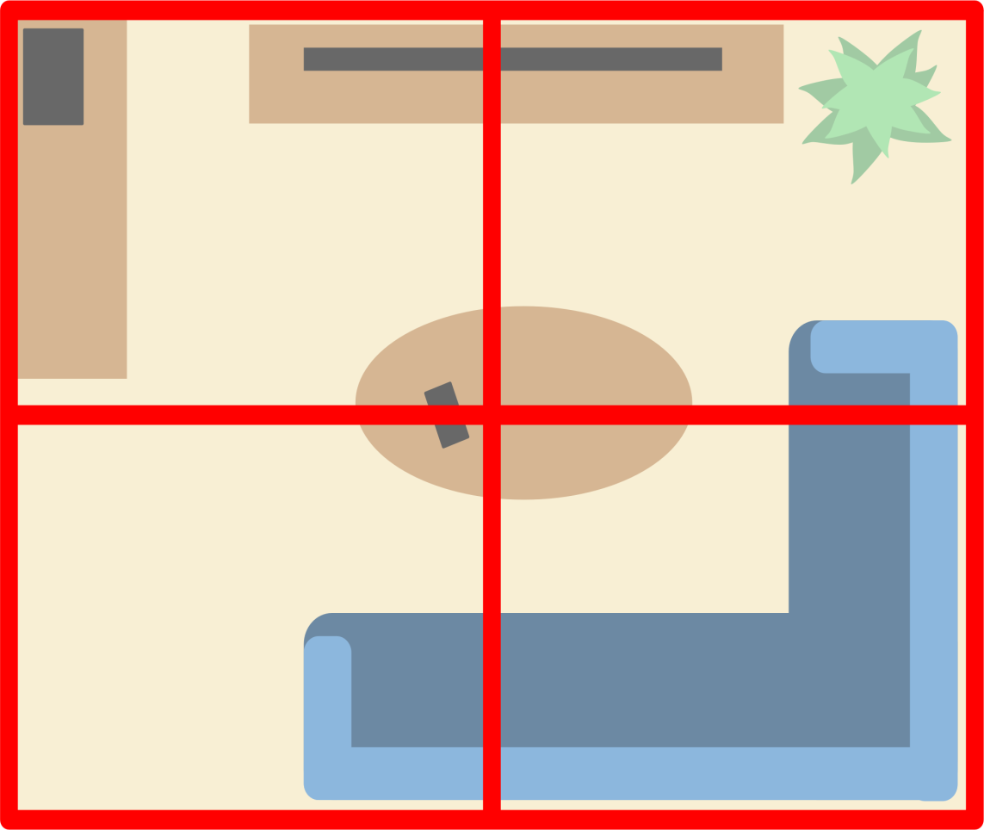
Zone Search Pattern
In a zone search, the CSI in charge divides the crime scene into sectors, and each team member takes one sector.
Team members may then switch sectors and search again to ensure complete coverage

Slide 15
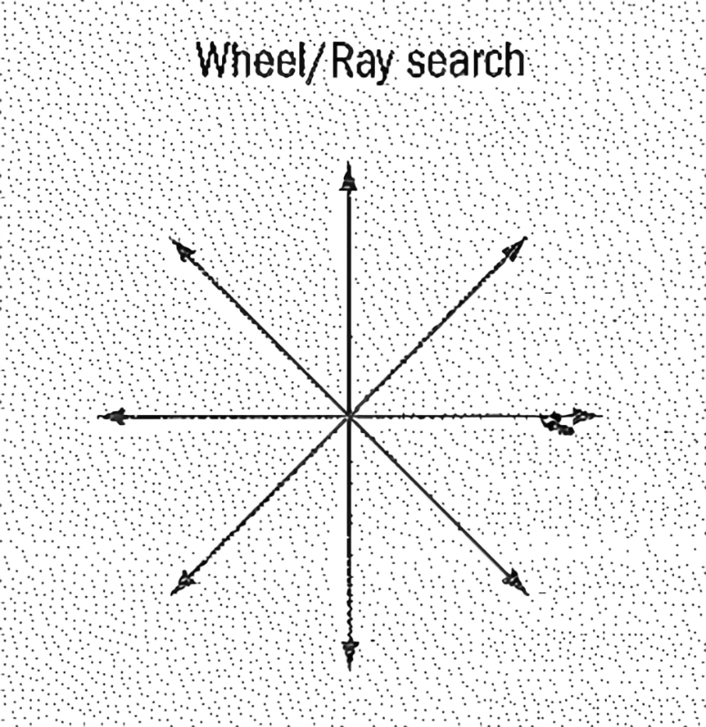
Wheel/ Rey Method
Rarely used anymore, where searchers begin at the centre and move outward.
The number of people searching at the beginning can cause evidence to be ruined.

Slide 16
Safety measures at crime scene
Gloves will be worn at all times when handling blood and biologically stained materials and/or other potentially hazardous chemicals at a crime scene.
Gloves will also be worn while handling bodies.
Additional protective clothing such as disposable lab coats, booties, gloves and caps can also be worn as needed.
No smoking, eating or drinking will be allowed while processing the crime scene. When taking a break away from the immediate crime scene area, protective clothing such as gloves must be removed and where possible hands should be washed before eating or drinking occurs.

Slide 17
Any evidence transported back to the laboratory or transferred to another agency from the crime scene will be packaged in such a manner that protects both its integrity and those that might handle the evidence.
DO NOT place blood-stained materials in plastic bags unless extenuating circumstances warrant the use of plastic.
Non-disposable items such as forceps, scissors, evidence placards, and other tools used at the crime scene will be placed in the appropriate containers for later decontamination at the laboratory.

Slide 18
All disposable protective clothing (gloves, booties, etc.) and other disposable items used while processing the scene will be disposed of at the scene or placed in a receptacle to be transported back to the laboratory for disposal.
Items stained with liquid body fluids will be placed in a container to be disposed of as hazardous waste at the laboratory.
Due to the late and potentially long hours spent processing crime scenes, take frequent breaks and rest when necessary especially when working in extremely hot environments.
Be cautious driving to and from a crime scene. Weather, late nights, and long hours can cause driving hazards.

Slide 19
Legal Considerations
Crime scene investigators and reconstructionists shall conduct themselves with the expectation that their work may be used in every step of the legal process, and therefore shall ensure that they comply with applicable legal standards including those of search and seizure
The search of the crime scene is the most important phase of the investigation conducted at the scene
Decisions of the courts restricting admissibility of testimonial evidence have significantly increased the value of physical evidence in homicide investigations. Therefore, law enforcement personnel involved in the crime scene search must arrange for the proper and effective collection of evidence at the scene.

Slide 20
Practically speaking ANYTHING and EVERYTHING should be considered as evidence until proven
differently. You can never go wrong in over collecting.

Slide 21
circumstance usually occurred after we received additional information from friends and or family, which revealed that some seemingly innocuous item in the crime scene was actually an important piece of evidence. That is why it is imperative to "hold onto" the crime scene as long as possible. Some item, which didn't seem significant on the first day of the investigation, may suddenly take on the intrinsic value of gold.
Once an item is recognized as evidence it must be properly collected and preserved for laboratory examination. However, in order for physical evidence to be admissible, it must have been legally obtained.

