Slide 1
CRIME SCENE DOCUMENTATION AND ITS IMPORTANCE

Slide 2
Documentation is a very vital aspect of crime scene investigation.
Keeping the record of all sorts of data that we gather from the crime scene assists an expert to give better opinions and presumption of the situation by analysing the documentation repetitively.
The documentation itself includes; taking the notes from observers or people around the crime scene, noting down the data of the crime which is specified by the first respondent, drawing sketches of the crime scene, and photographing and video graphing the whole scene through different angles with evidence.
It is always advised to record all these details in brief as it is very crucial for further investigation.

Slide 3
TYPES OF CRIME SCENE DOCUMENTATIONS
Notes
It starts from the beginning when the call arrives in FSLs or any crime scene unit by informant, the first responder, any medical expert, eyewitnesses, testimonies, etc.
demonstrations are written under notes.
The most important part of it starts once the investigator reaches the crime scene.
A full description of the crime scene from each possible angle of how things are kept to their measurements from each other is noted down.
Previously when photography and videography were not much in use compilers use to take notes in such a way that they would visualize to the reader.

Slide 4
This recorded information develops the final report on the case. One more significant action is also sketching the crime scene along with the appropriate position of the evidence present there.
All documented information will be used for testimony in court and to simplify the situation in the scene in case of reconstruction of crime scene.
Photographs of the crime scene investigation is very important to reflect the real image of the scene or any part of evidence which has been inserted into focus photography.
Any mistake in the documentation of the crime scene can lead to inadmissibility to the court of law.

Slide 5
Notes should not include personal opinions just the facts are considered.
Notes must always depict what is seen and not what a person thinks. The final report of notes should always tell a descriptive story. Each department or responsible officer has a method of taking notes that they use at a crime scene.
In the crime scene, the compiler is expected to include the following as must in notes; Data and time the crime is reported, Type of crime, Location of the crime scene and description of the area, Names of personnel who took photographs, drew the crime scene sketch or collected fingerprints, Location of evidence found and name of the person or officer who collected it, Description of interior and exterior of the crime scene (if applicable), weather and light conditions during crime scene investigation.

Slide 6
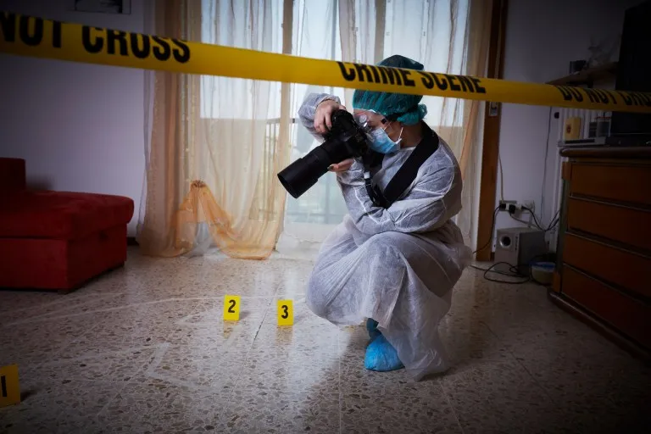
2. PHOTOGRAPHY OF CRIME SCENE

Slide 7
The crime scene should be thoroughly photographed before any contamination or manipulation arises by any natural, artificial, or manpower. Photography is considered to be the first step to do once you reach the crime after securing it.
Photography is used in direct comparison situations. For example, actual-size photographs (also known as one-to-one photos) can be used to compare fingerprints and shoeprints photographed at the crime scene to known fingerprints or shoes from a suspect. Photographs of the evidence are often taken with measure scales or photo scales for better demonstrations.

Slide 8
Photography in crime scenes is divided into three categories; Overall photography includes exterior and interior, Midrange photography compares the measurements or positions of evidence and other substances around each other, and lastly Closeup photography which shows the minute details of every evidence.
Different types of cameras are used in crime scene photography, though the most common is the 35-mm single-lens reflex camera. As it is considered user-friendly, cost-effective, and also gives better clarity. Nowadays, the digital camera is perhaps the most common among both consumers and law enforcement agencies as it’s easily accessible, transferable, and with an abundance of storage.

Slide 9
The forensic photographer clicks the pictures which show himself/herself as a witness of the crime scene, which describes the location of the crime scene, evidence found, and the chronological story of the scene. To be admissible in a court of law, all photograph negatives are retained and preserved in such a way, that the authenticity of the photographs cannot be questioned.

Slide 10
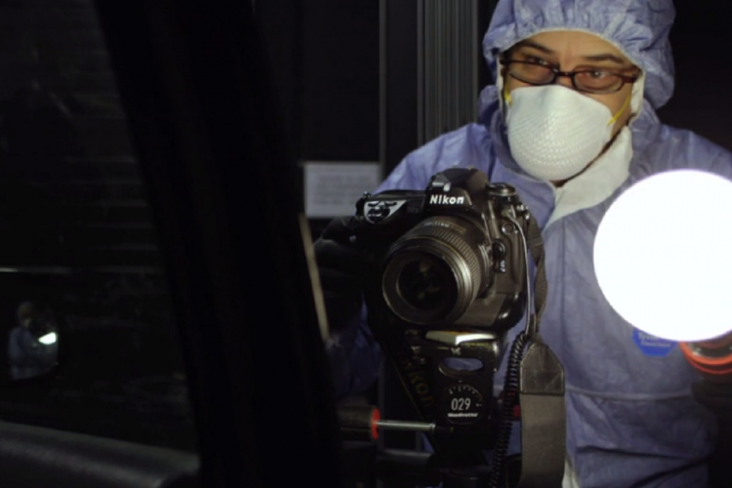
3. VIDEOGRAPHY OF CRIME SCENE

Slide 11
If available then videography should be done. Before video recording starts at the crime scene, it is advised to clear the camera range to avoid any disturbances in between. It is also recommended to aware people around before the recording starts to avoid any comments and try to record it in maximum silence.
The forensic photographer should keeps extra films and chips to avoid any last-minute problems. Once videography starts it cannot be stopped until the coverage of the entire crime scene. The videographer moves slowly to capture the scene as fast movements can skip the important details. This is also a reason that although videotaping is available photography should always be done

Slide 12
The taping begins with a general overview of the scene and surrounding area then it continues throughout the crime scene using wide-angle, close up, and even macro (extreme close up) shots to demonstrate the layout of the evidence and its relevance to the crime scene.
Once the videotaping is done one should transfer the tape to a high-quality master tape which must be kept preserved along with the copies.

Slide 13
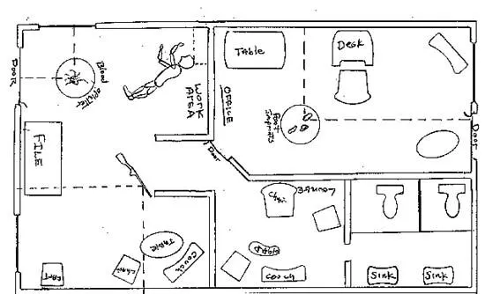
5. Crime scene sketching

Slide 14
Although photographs and notes are considered to be a vital part of any crime scene investigation, sketches, and diagrams are those that show measurements are indispensable tools in crime scene documentation.
A crime scene sketch is also called the final step of documentation. The photographs show the 2D image demonstration of the objects which are 3D in nature and also could not represent the spatial relationship between them.
Sketches are mostly known for showing the spatial relationship or something that needs to have proportional measurements included in its calculations. A sketch is usually drawn as the overhead sketch which means (the view is like the investigator is looking from a drone) or an elevated sketch (straight view).

Slide 15
While constructing a crime scene sketch, several pieces of information need to be included like; Case Number, Name of the victims, Name of the officer who drew the sketch, date and time the sketch was made, Scale (if required, and measurements between items on the sketch), Directional reference points, (i.e., N, S, E, W), A sketch legend or key to identify key items of evidence.
TYPES OF SKETCHES
Rough sketch
Neat sketch

Slide 16
A rough sketch of the scene is usually made first on graph paper in pencil with several squares representing many square feet or inches. The directionality of the overhead view is determined by using a compass. Using a tape measure or other measuring devices, measurements are taken at the crime scene between the distance of objects and/or structures at the crime scene.
A Neat sketch is later drawn using inks, paper, and ruler, or a computer. The rough sketch should be taken and preserved in case it is needed for future references. Once the scene has been methodically documented then the evidence collection can start.

